Slide 1
MGT 461
Lecture # 20
Project Initiation Phase (II OF II)
Ghazala Amin
Notes:
1

Slide 2
Project Management Processes
PM processes are divided into five phases or process groups
Initiating
Processes
Planning
Processes
Controlling
Processes
Executing
Processes
Closing
Processes
Professional Responsibility

Slide 3
Initiation Phase
Process of formally authorizing and recognizing that a new project exists or that an existing project should continue into its next phase

Slide 5
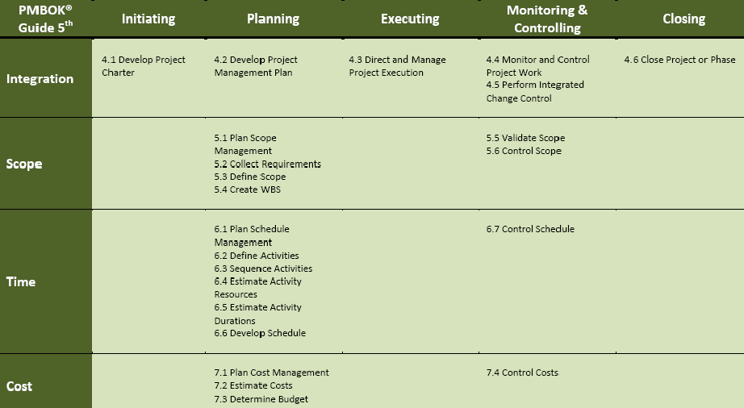
Difference Between PMBOK 4 & 5
5
November 4, 2013

Slide 6
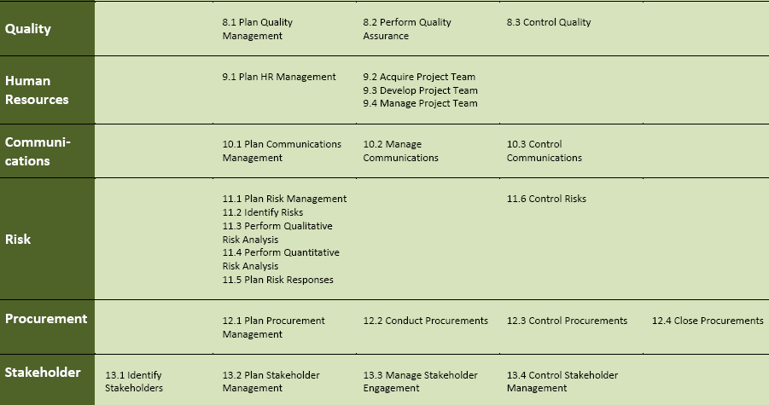
Difference Between PMBOK 4 & 5
6
November 4, 2013

Slide 7
Project Charter
A document that formally authorizes the existence of a project. (PMI).
Provides the project manager with the authority to apply organizational resources to project activities
issued by the Project Sponsor or a senior official outside the level of project organization
It should include
      Reasons for undertaking the project
      Project objectives and constraints
      Identification of main stakeholders
Charter is prepared in the initiation phase of integration management.

Slide 8

Project Charter
Information contained in – or referred to in other project documents – the Project Charter may span the following:
  Project Background
  Purpose for undertaking the project
  Project Justification
  Requirements
  Stakeholder expectations from the project
  Assumptions and Constraints
  Project Organization
  Stakeholder Roles and Responsibilities
  Schedule and milestones
  Indication of budget
  Supporting infrastructure
Notes:
8

Slide 9
Statement of Work Definition
Statement of Work (SOW)
  A description of products and services to be supplied to the customer(s) by the project team or the project delivery organization.
  Narrative description of products or services to be supplied under contract
Notes:
9

Slide 10
Project Proposal
  A project proposal is written, to make an offer and to try to convince a supervisor or a future customer to accept it.
  In a project proposal you state that, in exchange for time and/or money, you will give them something that they want:
    an analysis of an existing process or business procedure,
    make something they desire (a prototype of a new product),
    or do something they wish to have done (redesign an existing structure).
Notes:
10

