Slide 1
MGT 461
Project Management Processes
Lecture # 17
Ghazala Amin
Notes:
1

Slide 2

Global Awareness of Project Management
Over the past half century the subject of project management has evolved into an enormous, diversified and specialized body of knowledge, much of which is derived from decades of continually and carefully observing and studying projects of varying size and complexity undertaken in different fields across the globe.

Slide 3
Global Awareness of Project Management
Project management is now universally acknowledged as constituting an effective and efficient means of handling projects – that is, it offers projects a higher chance of achieving their goals in time and budget.
Project Management is taught at the under-graduate and graduate level at universities, several associations have been established in different countries to advocate its use to government and the private/non-govern-mental sectors, and numerous books have been written on it.

Slide 4
Popularity of Project Management:
Micro-Considerations
Organizations operate in increasingly global, complex, dynamic and uncertain environments.
The pressures on them to change and adapt are immense. Some factors causing them to
pursue projects and apply project management methodologies to enable this change include:
Maturization of Project Mgt. Methodologies
Information and Communication Technology
Effective and Efficient Allocation of Resources
Organization’s Reputation
Management by Projects
Mandatory Requirement
Innovation Challenge
Customer Orientation
Complexity Management
Project Portfolio Management

Slide 5
Major Project Management Standards
(Conventional Types and Customized)
“Off-the-Shelf” Project Management Standards
“In-House” Project Management Standards
Developed in Organizations based on their own specific requirements, policies and environment and may incorporate processes and tools from one or more off-the-shelf standards
PMBOK, Prince 2, IMPA Baseline, APMBOK, P2M, BS 6079, AGILE, Sofware Process Models
Examples:
Notes:
5

Slide 6
Major Project Management Standards
A methodology is a framework of processes and tools tested on diverse projects.
Some of the reputable International organizations for maintaining world wide standards and certifications for project management are;
PMI – Project Management Institute (www.pmi.org)
PRINCE2 – PRojects IN Controlled Environments
IPMA - The International Project Management Association
APM - The Association of Project Management
Notes:
6

Slide 7

Management By Projects
Organizations have undergone a significant structural and process transformation over the past few decades. More and more organizations are adopting „flatter manage-ment hierarchies“. As projects gain in importance for organizations – and con-stitute a sizeable chunk of their overall activities and resources- the interest in managing their projects in a professional and systematic manner has also increased as has interest in the infrastructure needed to support and sustain projects.

Slide 8
Management By Projects
At present, the different project manage-ment methodologies (e.g. PMBOK, PRINCE2, APMBOK) which evolved over time offer the only tested way for organiza-tions to properly manage their projects. Familiarity with one or more of these these project management methodologies (and project portfolio management) has become a necessity.
Notes:
8

Slide 9

Maturization of Project Mgt. Methodologies
Project Management offers several „metho-dologies“ for professionally handling pro-jects. A methodology is an evolving and customizable knowledge framework of processes and tools tested on diverse and usually complex projects over time at diffe-rent places, and which helps the project to achieve its goal in the allocated time and budget (effectiveness and efficiency).
The most popular methodology followed is the Project Management Institute‘s Project Management Body of Knowledge (PMBOK) which is based on ten knowledge areas and over 47 indvidual processes. Other renowned methodologies are PRINCE2, the APM Body of Knowledge and the IPMA Competence Baseline.
A methodology is indispensible for projects but even if it is rigorously applied, it cannot guarantee project success.

Slide 10
About Project Management
Project Management is a formalized and structured method comprising a set of interrelated processes and tools, ranging from simple to complex, and is based on the accepted principles of management used for planning, estimating and controlling work activities with a view to developing specifically defined outputs that are to be delivered by a certain time, to a defined quality standard and with a given level of resources so that the project goal and outcomes/benefits are realized.
Effective project management is essential for the success of any project – whether in the private or public sectors – and irrespective of its category, size and complexity.
Management by projects treats many aspects of ongoing operations as projects in order to apply project management techniques to them.
Notes:
10

Slide 11
Introduction to Project Management
Project
  A temporary endeavor undertaken to create a unique product or service
  Operations (such as manufacturing) and projects differ primarily in that operations are repetitive and ongoing while projects are unique and temporary (PMI)
  A unique process, consisting of coordinated and controlled activities with start and finish dates, to achieve an objective conforming to specific requirements, including constraints of schedule, cost and resources (ISO 10006)

Slide 12
Introduction to Project Management
Program
  A group of projects managed in a coordinated way to obtain benefits not available from managing them individually
  A program is inherently more complex than a constituting project – it has a broader scope and may require extensive coordination between its various constituting projects
  A project results in the creation of an output and is then ended, a program must integrate and maintain the operationality of that output for a specified period of time.
Project A
Programme
X
Project D
Project B
Project E
Project C
Project F

Slide 13
Introduction to Project Management
Project Management
  The application of knowledge, skills, tools and techniques to project activities in order to meet or exceed stakeholder needs and expectations
Project Portfolio
  The project portfolio is the set of projects which an organization is undertaking. Projects usually differ in their type, complexity, cost, time requirement, risk level, priority, etc.
Project Management is primarily about leadership, integrating work occurring in all project areas, steering the project in the right direction and effectively managing stakeholders and complexity.

Slide 14
Introduction to Project Management
Project Management involves;
  Change Management
  Communication Management
  Deliverables Management
  Human Resource Management
  Quality Management
  Risk Management
  Financial/ Cost Management
  Monitoring and Control
  Customer Relationship Management

Slide 15
Project Management Context
Project Stakeholders are;
  Individuals directly involved in project deliverables or
  Part of the project organization responsible for the project or
  Individuals that are positively or negatively affected by the project
Project Stakeholders include;
  Project Manager
  Project Team Members
  Customer
  Performing organization
  Sponsor
  End Users …….
Project manager should create an environment in which project stakeholders,
contribute frequently and appropriately

Slide 16
Project Management Context
Sponsor
  Upper level management that provides guidance and controls effective use of customer’s money on the project
Performing Organization
  Enterprise whose employees are most directly involved in doing the work of the project.

Slide 17

The Project Management Body of Knowledge
The Project Management Institute’s Body of Knowledge – PMBOK – is perhaps the most widely acknowledged and popular project management standard in existence. It is the basis for the PMI’s coveted PMP certification examinations.
Presently in its fifth version (2013), PMBOK offers a comprehensive and sophisticated best practices and process-based standard which can be applied to different categories of projects. At the heart of the PMBOK are the ten areas of knowledge and five process groups which find application over the project life-cycle.
Notes:
17

Slide 18
Introduction to Project Management
Project Management Knowledge Areas – Per PMI (Project Management Institute)
  Describe Project Management knowledge and practice in terms of its component processes
  Mapping of the 10 knowledge areas to the five process groups.

Slide 19
Project Management Context
Representative Project Life Cycle (typical)
  Initiation/Concept/Feasibility
  Planning/Development
  Execution/Implementation
  Control/Monitoring
  Close-out/Termination/Finish

Slide 20
The Five Project Process Groups
Initiation
Defines and authorizes the project (or a phase of the project).
Planning
Refines the project goal, scope, requirements etc. and develops the project master plan.
Implementation/
Execution
Brings together all required resources to undertake the project in accordance with the master plan.
Monitoring, Evaluation & Control
Monitors the project to identify and assess shortfalls and variances and initiate corrective action if needed.
Closure
Formalizes acceptance of the project output by the project customer and brings the project to its end.
Notes:
20

Slide 21
Project Management Processes
PM processes are divided into five phases or process groups
Initiating
Processes
Planning
Processes
Controlling
Processes
Executing
Processes
Closing
Processes
Professional Responsibility

Slide 22
The Project Management Context
Characteristics of Project Phases or Process group
  Each project phase is marked by completion of one or more deliverables (a tangible piece of work)
  Phase End reviews determine if the project should continue to the next phase.
Characteristics of the Project Life Cycle
  Serves to define the beginning and the end of a project
  Project Life cycle is collection of project phases

Slide 23
Project Management Context
Human resource and project cost need is greatest in the execution phase
Project Cost and
Project Staffing
Initiation Planning Execution Closeout
Control

Slide 24
PMBOK Knowledge Areas
Project Integration Management
Project Scope Management
Project Time Management
Project Cost Management
Project Quality Management
Project Human Resource Management
Project Communications Management
Project Risk Management
Project Procurement Management
Project Stakeholder Management

Slide 25
The 10 PMBOK Areas & 5 Process Groups
Integration Management
Initiation
Scope Management
PROCESSES
47
Time Management
Planning
Cost Management
Implementation/
Execution
Quality Management
Project Management Knowledge Areas (PMBOK)
Human Resource Management
Monitoring, Evaluation & Control
Communication Management
Risk Management
Closure
Procurement Management
Stakeholder Management
Notes:
25

Slide 26
Process Interactions
Process – Series of actions bringing about a result.
Individual processes within a process group are linked by their inputs and outputs
Each process is defined by
  Inputs: Documents or documentable items that will be acted upon
  Tools and Techniques: Mechanisms applied to the inputs to create the outputs
  Outputs: Documents or documentable items that are a result of the process

Slide 28
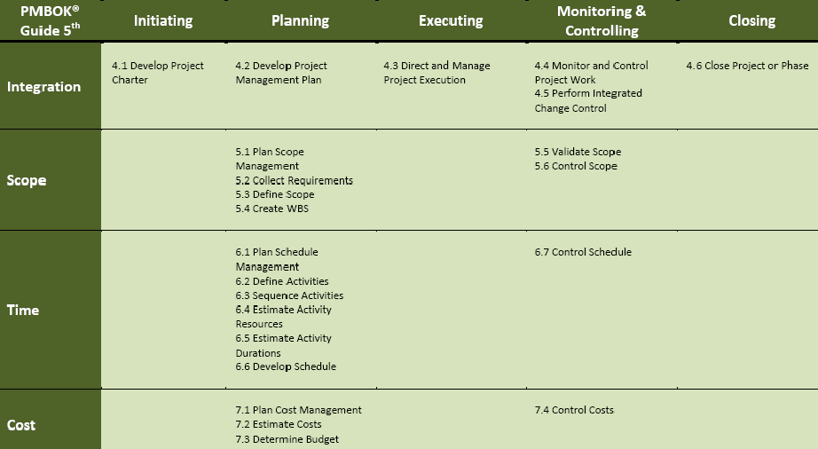
Difference Between PMBOK 4 & 5
28
October 28, 2013

Slide 29
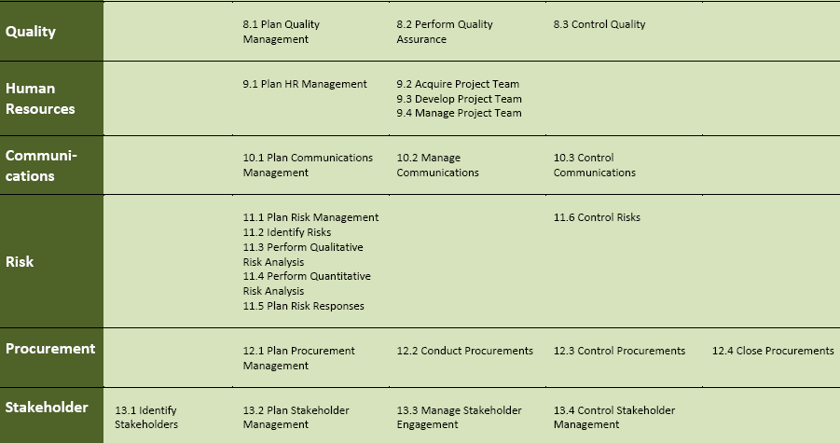
Difference Between PMBOK 4 & 5
29
October 28, 2013

