Slide 1
MGT 461
Applied Project Management
Lecture #12
Project Management Office
Ghazala Amin
Notes:
1

Slide 2

The Project Management Office

Slide 3
The Project Management Office
Many organizations of all sizes across the globe have established „Project Manage-ment Offices (PMOs)“ to serve as an organizational focal point for the effective and efficient management of their pro-grammes and projects. PMOs can perform many important functions and, if con-ceived and managed properly, are a huge asset for project-driven organizations.

Slide 4
Internal Project Management Supporting Institutions in Pakistan
Several public and private-sector organizations which are operating in Pakistan, as well as the federal and provincial governments, have established structures (Project Management Units, Project Monitoring Units) performing PMO functions to support projects which they are undertaking.

Slide 5
Some Typical Functions of a “Mature” PMO
Alignment of Projects with Organization’s Mission, Goals, Objectives
Project Portfolio Management
Resource Planning and Management
Generating Awareness in Organization of Project Management
Standardization of Policies, Processes, Protocols and Documentation
Recruitment and Selection of Project Managers and Team Members
Training in Project Management and Related Competencies, Skills
Monitoring, Evaluation and Auditing of Projects
Maintaining a Project Management Information System
Counseling and Mentoring of Project Staff
Benchmarking Best Practices
Archiving Documentation on Completed Projects
Refining Project Management Methodologies
Software Tools

Slide 6

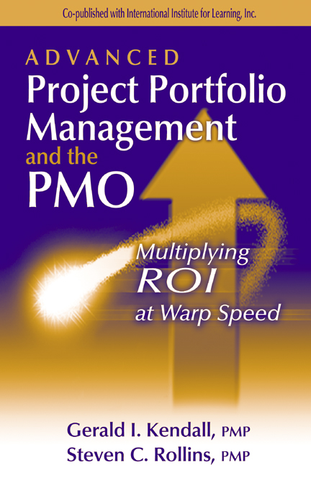

Literature on the Project Management Office

