Slide 1
Advanced Project Management -Review
Ghazala Amin

Slide 2
The 10 PMBOK Areas & 5 Process Groups
Integration Management
Initiation
Scope Management
PROCESSES
47
Time Management
Planning
Cost Management
Execution
Quality Management
Project Management Knowledge Areas (PMBOK)
Human Resource Management
Monitoring, & Control
Communication Management
Risk Management
Closure
Procurement Management
Stakeholder Management
Notes:
2

Slide 3
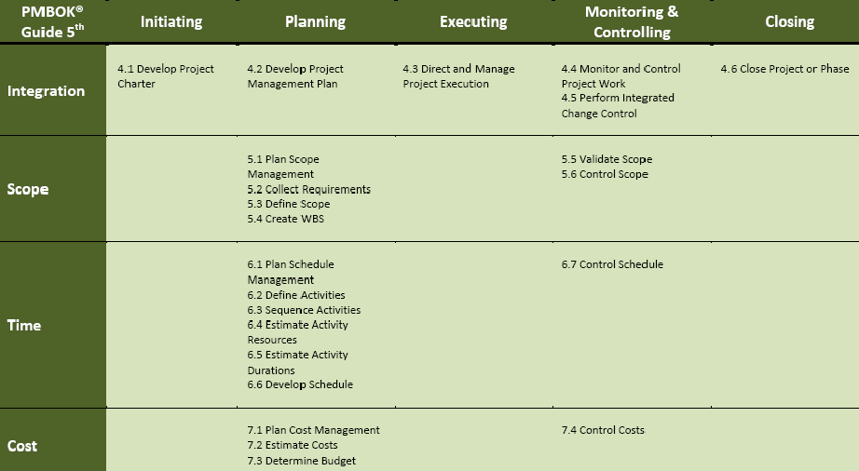
Difference Between PMBOK 4 & 5
3
November 12, 2013

Slide 4
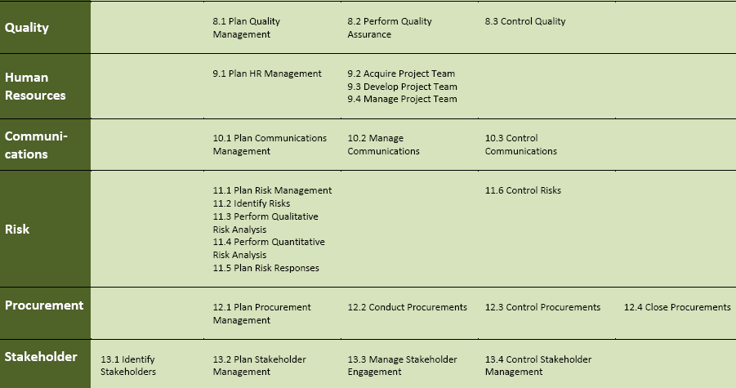
Difference Between PMBOK 4 & 5
4
November 12, 2013

Slide 6
Project Management Processes
PM processes are divided into five phases or process groups
Initiating
Processes
Planning
Processes
Controlling
Processes
Executing
Processes
Closing
Processes
Professional Responsibility

Slide 7
Project Planning
  The purpose of Project Planning is to;
  establish and
  maintain
  plans that define project activities.
  Majority of Project Manager’s time is spent to effectively plan the project activities.

Slide 8
When Project Planning is not done well….
  Poor estimates lead to cost and schedule over runs.
  Inability to discover deviations from undocumented plans
  Resources are not available or applied when needed.
  Inability to meet commitments
  No lessons learned for future projects means making the same mistakes on multiple projects.
  PROJECTS FAIL; “IF YOU FAIL TO PLAN, THEN YOU PLAN TO FAIL”
2004-2005 by Carnegie Mellon University Introduction to CMMI V 1.1

Slide 10
Project Planning Goals
  Establish Estimates
    Estimates of project planning parameters are established and maintained.
  Develop a Project Plan
    A project plan is established and maintained as basis for managing the project.
  Obtain Commitment to the Plan
    Commitments from relevant stakeholders are established and maintained.
2004-2005 by Carnegie Mellon University Introduction tpo CMMI V 1.1

Slide 11
Project Planning Context
Establish Estimates
Develop a Project Plan
Planning Data
Obtain Commitment
to the plan
Project Plan
Relevant Stakeholders
PM&C
2004-2005 by Carnegie Mellon University Introduction tpo CMMI V 1.1

Slide 12
How does an estimate become a budget
  Validate estimate with the project team
    Review assumptions, hours, risks etc.
  Validate estimate with the sponsors, financial executive, quality assurance team ..
    Business rationale, timings and cost estimates, any cost buffers or contingency reserves, profit contribution…
  Baseline the budget
  Report monthly status .
    Plan what the senior management would like to see

Slide 13
Project Management Plan
Uses outputs from other planning processes to create a consistent and coherent document that can be used to guide both project execution and project control.
Formal, approved document used to manage and control project execution.
Project plan must be revised, reviewed, and revisited throughout the project and used as the axis around which all subsequent communications revolve.

Slide 14
Project Plan
The formal Project plan includes but is not limited the following documents.
  Project Charter (Signed and completed in the Initiation phase)
  WBS - Task and resource assignment
  Major milestones and baseline target delivery dates
  Project Communication Plan
  Responsibility Assignment Matrix
  Risk Management document
  Issues Management document
  Change Management document
  Milestone Chart
  Project Status Plan template
  Quality Assurance document
  Lessons Learned
The above documents need to be in place to be ready to execute, manage and track project performance.

Slide 15
Work Breakdown Structure
The WBS serves as the framework on which project is built and as the “map” for project execution.
WBS focuses attention on project objectives and encourages detailed planning and documentation.
It clarifies responsibilities and identifies elements for estimating and work assignment.
WBS is used throughout the project; it needs to be revised in event of any changes or updates.
WBS is the cornerstone of quality project planning!!
  Source/Reference: IBM Learning Centre for development of PM Curriculum

Slide 16
Developing WBS
Gather all project-related materials that define solution, approach and scope.
Review WBS for similar projects
Prepare a hi-level WBS representing “WHAT”
Refine and decompose to manageable and track-able level
Involve responsible project team members in developing WBS
Include project support elements such as PMIS, quality assurance
Avoid developing details before it is needed
Review structure with responsible stakeholders; get buy-in from those responsible for deliverables
Add appropriate elements to manage risk
USE GOOD JUDGEMENT-THERE ARE NO HARD AND FAST RULES
  Source/Reference: IBM Learning Centre for development of PM Curriculum

Slide 17
Set of Templates include
Project Charter Document
Project Communication Plan
Responsibility Assignment Matrix
Risk Management Document
Issues Management Document
Change Management Document
Milestone Chart Template
Project Status Plan template
Lessons Learned Report

Slide 18
Project Charter
A document that formally authorizes a project or phase and documenting initial requirements that satisfy stakeholders’ needs and expectations.
Project Sponsor signs the charter so the project could go in planning phase
We have developed a general project charter template which can be customized

Slide 19
Project Communication Plan
Many experts say that the greatest threat to the success of any project is a failure to communicate.
Project Plan itself is the most meaningful communication vehicle in the entire arsenal.
Communication Plan should be a comprehensive plan.

Slide 20
Responsibility Assignment Matrix (RAM)
A matrix that maps the work of the project as described in the WBS to the people responsible for performing the work as organizational breakdown structure.
RAM is very important document so the project staff is clear about their roles and responsibilities.

Slide 21
Risk Management Document
Risk: An uncertainty that can have a positive or negative effect on meeting project objectives.
Risk Management Plan: A plan that documents the procedures for managing risks throughout a project.
Risk Register is a document that contains results of various risk management processes, often displayed in a table or spreadsheet format.
A tool for documenting potential risk events and related information.

Slide 22
Issues Management Document
Issue: A matter under question or dispute that could impede project success.
When Risk occurs it becomes an issue.
Issue Management Template, documents all issues and how they should be resolved.

Slide 23
Change Management Document
When issues cannot be dealt with, they become changes.
Change management is very important for the project and it should be done through change control board
Change Management Document is supported by Change Request Form(s) to formally make changes in the project.
Change Request Log should be updated whether change request is approved or rejected.

Slide 24
Milestone Template
Milestone is a significant event on a project with zero duration.
We have designed milestone chart as certain activities need to be completed to move on to the next phase.
Milestones serve as a marker to help in identifying necessary activities, setting schedule goals and monitoring progress.

Slide 25
Project Status Plan Template
It describes where the project stands at a specific point in time.
Project Status is generated periodically depending upon the length of the project as per requirement.

Slide 26
Lessons Learned Report
Reflective statements written by project managers and their team members to document important things they have learned from working on the project.
It is a best practice to document the lessons learned on periodic basis.

Slide 27
Project Planning
  The purpose of good Project Planning is to ensure;
  All detailed plans for managing the project are defined
  Formal commitments are established
  Team is ready to execute !!!
  Effective project planning = readiness for performance.

Slide 28
Project Planning Checkpoint
  As a project manager you must;
  Validate financial commitment to the business
  Set expectation with client and project sponsor
  Recognize that this is hard go/no go decision
  Have your project team committed to the plan
  Be ready to be accountable for the project execution
  Project Planning is crucial point in the project life cycle when you decide if the project is ready to commit to future execution tasks

Slide 29
Remember !!
  Project Managers are responsible for;
    Cost
    Project Profit
    Project team efficiency
    Project expenses
    Quality control
    …………….
  At the end of the project planning process, your business executives decide if your project can/should target meeting specific business objectives .

Slide 30
Few Causes of troubled projects (Planning Phase)
    Failure to set and manage customer expectations
    Customer unprepared to take on project responsibilities
    Lack of common understanding of requirements
    Poor quality proposals
    Lack of information in charter
    Unclear organization roles and responsibilities
    Failure to plan and manage project risks
    Lack of defined quality control mechanisms
    Inaccurate and uncommitted project estimates …..

Slide 31
Project Management Processes
PM processes are divided into five phases or process groups
Initiating
Processes
Planning
Processes
Controlling
Processes
Executing
Processes
Closing
Processes
Professional Responsibility

Slide 32
Project Management Processes
PM processes are divided into five phases or process groups
Initiating
Processes
Planning
Processes
Controlling
Processes
Executing
Processes
Closing
Processes
Professional Responsibility

Slide 33
Project Closure
Consists of documenting project results to formalize acceptance of the product of the project by the project sponsor or the customer
Includes;
  Lessons learned
  Historical archives
  Customer or End User Sign Off
  Team appraisals etc…..

Slide 34
Project Closure
Project Closure may result from;
  Project Completion as agreed by the sponsor.
    All project activities and work is complete.
  Mutual agreement to close out the project.
    lack of funds, change in policy etc.
  Either party does not want to proceed further
    Breach of Contract, legal proceedings, law suits etc.

Slide 35
Why we need Project Closure?
  The purpose of Project Closure is to ensure;
    project is formally accepted or terminated
    Contractual obligations are met
    Project records are completed, saved and archived
    Essential documentation is retained
    Resources (3M-Man, machine, material) are released
    Finance books are complete
  Project Close out plan and it’s activities are part of the WBS tasks and resources should be committed to ensure successful closure.
  If you don’t start thinking of closeout from the beginning then you will not be able to close out at the end.

Slide 36
Project Closure Activities
  Project plan updates complete
  Documentation Archived
  Legal Contract Closure
  Administrative Closure for Resources
  Team appraisal with development suggestions
  Positive team closure
  Corrective actions
  Lessons learned
  Sponsor and end user sign off document

Slide 37
Project Manager Closure Responsibilities
  Completion of project documentation
    Completeness of tasks
    All terms of agreement
  Releasing technical environment
    Transfer assets
    Transfer warranty and maintenance support
  Secure intellectual capital
    Include methods and processes developed
    Products developed during the project
  Prepare project evaluation report
    Document and communicate lessons learned to management
    Performance reviews submitted to the functional managers

