Slide 1
Advanced Project Management -Review
Ghazala Amin

Slide 2

Why Project Management
Every organization – whether in the public-sector or the corporate sector, or non-governmental organizations, undertake projects. Projects come in many forms and can range from the very simple to the very complex. Every project is unique and presents unique challenges. Project Management is essential to manage projects.
Notes:
2

Slide 3
Who should study Project Management?
Anyone who is directly or indirectly involved in;
initiating, planning, implementing, monitoring, evaluating and/or controlling a project.
in a position which involves a substantive level of decision-making, responsibility, communication and coordination.
should be familiar with all the subject areas, methodology, processes and tools and techniques of project management.
A good and common project management knowledge platform will increase the likelihood of the project attaining its goal within time and budget.

Slide 4
Project Oriented Industries
NASA and DOD (Department of Defense)
Construction, architecture, new product development
NGOs
Financial/Service Institutions
  Banks, Insurance, Telecommunication
Manufacturing Units and Plants’ operation

Slide 5
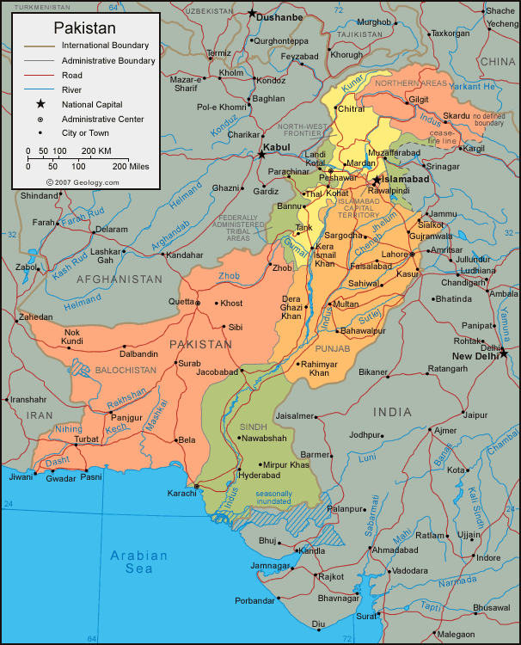
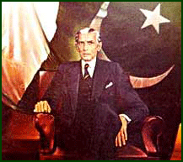
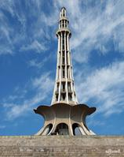
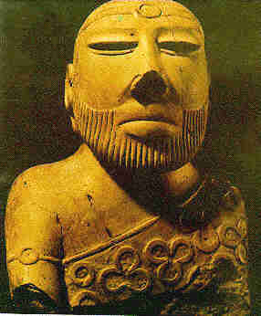
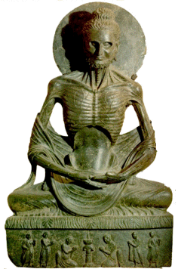




Major Projects in Pakistan (Examples)
Tarbela Dam
Mangla Dam
Ghazi-Barotha
HUBCO
Kot Addu
Chashma Nuclear Power Station
Islamabad-Lahore Motorway
Islamabad-Peshawar Motorway
Karakorum Highway
Jinnah International Airport
Allama Iqbal International Airport
Muslim Commercial Bank
National Stadium Karachi
Shah Faisal Mosque
Shaukat Khanum Memorial Hospital
JF-17 Sino-Pakistan Combat Aircraft
Notes:
5

Slide 6
What is Project Management?
Project Management
  The application of knowledge, skills, tools and techniques to project activities in order to meet or exceed stakeholder needs and expectations
Project Management is primarily about leadership, integrating work occurring in all project areas, steering the project in the right direction and effectively managing stakeholders and complexity.

Slide 7
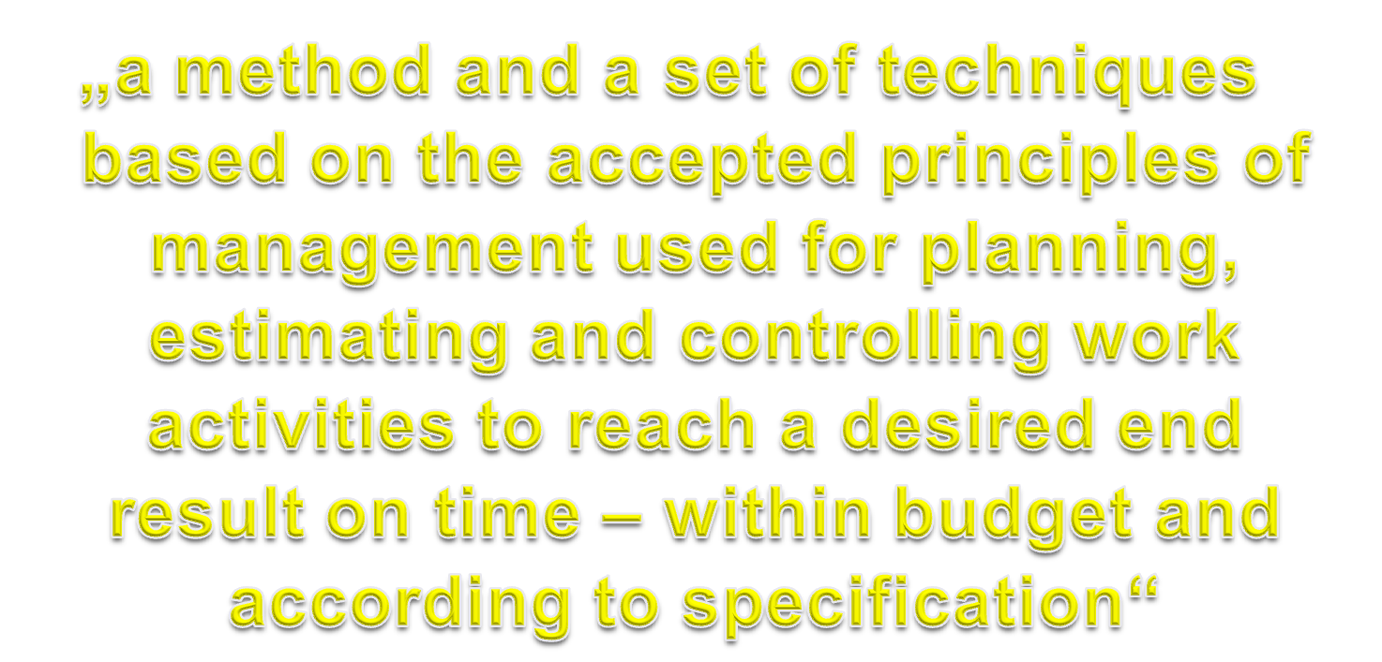
What is Project Management?
(Robert K. Wysocki / Robert Beck Jr. / David B. Crane, Effective Project Management, 2. ed., John Wiley & Sons, 2002, p. 79).

Slide 8
Popularity of Project Management:
Micro-Considerations
Organizations operate in increasingly global, complex, dynamic and uncertain environments.
The pressures on them to change and adapt are immense. Some factors causing them to
pursue projects and apply project management methodologies to enable this change include:
Maturization of Project Mgt. Methodologies
Information and Communication Technology
Effective and Efficient Allocation of Resources
Organization’s Reputation
Management by Projects
Mandatory Requirement
Innovation Challenge
Customer Orientation
Complexity Management
Project Portfolio Management

Slide 9
What is a Project ?
Requirements
Quality
Schedule
Cost

Slide 10
What is a Project ?
Project
  A temporary endeavor undertaken to create a unique product or service
  Operations (such as manufacturing) and projects differ primarily in that operations are repetitive and ongoing while projects are unique and temporary (PMI)
  A unique process, consisting of coordinated and controlled activities with start and finish dates, to achieve an objective conforming to specific requirements, including constraints of schedule, cost and resources (ISO 10006)

Slide 11


Project Output & Outcome: Example
Project Phase
Project Life-Cycle
Initiation, Planning, Implementation and Closure of the Project
Project Output
Operations Phase
Short-term
Economic – Impact on investment, trade, local businesses, tourism, employment, inflation, wealth accumulation and distribution
Selected
Project Outcomes
(+ and -)
Medium-term
Social – Impact on services like health and education, travel, crime, social relations, communities‘ out-look and values
Not Projects: Routine main-tenance & repair
Long-term
Environmental – Impact on fauna and flora, pollution levels, waste accumulation and disposal
Projects: Highway extension, widening, recarpeting, con-struction of bridges, additional exit and entrance ramps, petrol stations and rest stops etc.
Notes:
Slide: „.....“
There may be benefits in other areas (for e.g. political) also which are not reviewed here.
11

Slide 12
What Projects Are Not
Projects must not be confused with an organization‘s on-going and recurring operations. For example:
Customer invoicing and billing
Fabrication or assembly of automobiles
Routine procurement of agricultural inputs for a brewery
Airline flights
Advising a bank client of stock market investment opportunities
Treatment of patients in a hospital emergency ward, and
Counselling of soldiers on a tour of wartime duty
are not projects even though they may exhibit project characteris-tics (goal, time-frame, cost).
Notes:
12

Slide 13
What is a Program?
Program
  A group of projects managed in a coordinated way to obtain benefits not available from managing them individually
  A program is inherently more complex than a constituting project – it has a broader scope and may require extensive coordination between its various constituting projects
  A project results in the creation of an output and is then ended, a program must integrate and maintain the operationality of that output for a specified period of time.
Project A
Program
X
Project D
Project B
Project E
Project C
Project F

Slide 14
Project Stakeholders
Project Stakeholders are;
  Individuals directly involved in project deliverables or
  Part of the project organization responsible for the project or
  Individuals that are positively or negatively affected by the project
Project Stakeholders include;
  Project Manager
  Project Team Members
  Donors
  Government Agencies
  Media
  academia
  Performing organization
  Benefeciories
  End Users and many others

Slide 15
Project Stakeholders
Sponsor/Donors
  Upper level management that provides guidance and controls effective use of customer’s money on the project
Performing Organization
  Enterprise whose employees are most directly involved in doing the work of the project.

Slide 16
Stake Holder Communication
Top
Management
Line Managers
Other Projects
Project
Manager
The
Customer
Project Team
Members
Regulators
Links -TBD
Vendors

Slide 17
Project Management Discipline
Project
A temporary endeavor
undertaken
to create
a unique product or service
Project Management
  The application of knowledge,
  skills, tools and techniques
  to project activities in order to
  meet or exceed stakeholder
  needs and expectations
Program
A group of projects managed
  in a coordinated
  way to obtain benefits
  not available from
  managing them individually
Start and End date, allocated budget and available resources
Dedicated Stakeholders
Informed and Knowledgeable End user
Empowered Project Office personnel
Strict documentation
Change management and risk mitigating process
Estimation process for additional or in-scope deliverables
PLANNING, CONTROLLING AND MANAGING.

Slide 18
The Functions of Project Management
The basic functions of general management equally
apply to project management
CONTROLLING
Who judges results and by what standards?
Project
Resources
DIRECTING
Who decides what and when?
PLANNING
What are we aiming for and why?
MOTIVATION
What brings out the best in people?
ORGANIZING
What‘s involved and why?
David I. Cleland / Lewis R. Ireland, Project Management: Strategic Design and Implementation, 4th ed., p. 42.
Notes:
18

Slide 19
Major Project Management Standards
(Conventional Types and Customized)
“Off-the-Shelf” Project Management Standards
“In-House” Project Management Standards
Developed in Organizations based on their own specific requirements, policies and environment and may incorporate processes and tools from one or more off-the-shelf standards
PMBOK, Prince 2, IMPA Baseline, APMBOK, P2M, BS 6079, AGILE, Software Process Models
Examples:
Notes:
19

Slide 20

Project Parameter: Goal
All projects have one prime goal – for e.g., the development of a new camera, construction of a railway station, regeneration of a derelict neighbourhood, or process re-engineering for a large organization.
The goal must be as specific as possible so that there is no ambiguity about what the project intends to achieve.
In addition to the prime goal, projects may have subgoals and sub-sidiary goals (objectives).
The project goal and project deliverables along with all the requirements and specifications, which must be met by the project for it to be considered complete, determine the project‘s scope.
A project which does not achieve its goal is seen as failed.
Notes:
20

Slide 21
Managing the Project Involves......
Estimating the scope and work that needs to be performed.
Developing mechanisms to acquire identified products
Develop a project plan
Getting commitments to the plan
Working with suppliers to acquire identified products
Monitoring progress against the plan
Identifying and analyzing risks
Taking actions to appropriately mitigate risks and issues
Taking actions to address significant deviations from the plan
2004-2005 by Carnegie Mellon University Introduction to CMMI V 1.1
Notes:
21

Slide 22
Project Life Cycle
Representative Project Life Cycle (typical)
  Initiation/Concept/Feasibility
  Planning/Development
  Execution/Implementation
  Control/Monitoring
  Close-out/Termination/Finish

Slide 23
The Five Project Process Groups
Initiation
Defines and authorizes the project (or a phase of the project).
Planning
Refines the project goal, scope, requirements etc. and develops the project master plan.
Implementation/
Execution
Brings together all required resources to undertake the project in accordance with the master plan.
Monitoring, Evaluation & Control
Monitors the project to identify and assess shortfalls and variances and initiate corrective action if needed.
Closure
Formalizes acceptance of the project output by the project customer and brings the project to its end.
Notes:
23

Slide 24
Project Management Processes
PM processes are divided into five phases or process groups
Initiating
Processes
Planning
Processes
Controlling
Processes
Executing
Processes
Closing
Processes
Professional Responsibility

Slide 25
Project Life Cycle
Project Cost and
Project Staffing
Initiation Planning Execution Closeout
Control

Slide 26
Introduction to Project Management
Project Management Knowledge Areas – Per PMI (Project Management Institute)
  Describe Project Management knowledge and practice in terms of its component processes
  Mapping of the 9 knowledge areas to the five process groups.

Slide 27
The 10 PMBOK Areas & 5 Process Groups
Integration Management
Initiation
Scope Management
PROCESSES
47
Time Management
Planning
Cost Management
Execution
Quality Management
Project Management Knowledge Areas (PMBOK)
Human Resource Management
Monitoring, & Control
Communication Management
Risk Management
Closure
Procurement Management
Stakeholder Management
Notes:
27

Slide 28
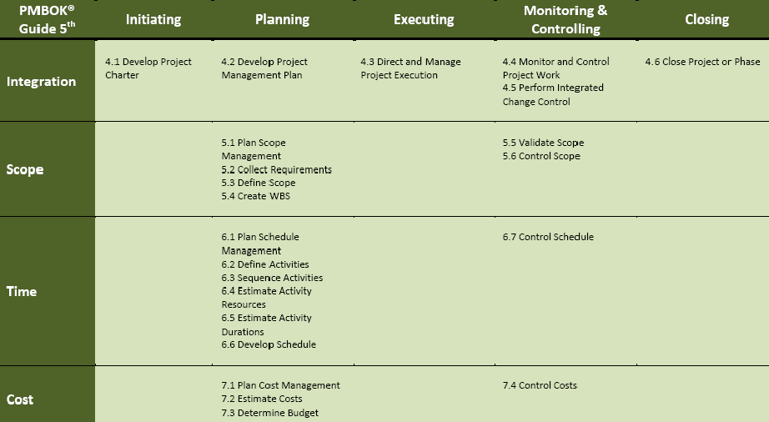
Difference Between PMBOK 4 & 5
28
November 12, 2013

Slide 29
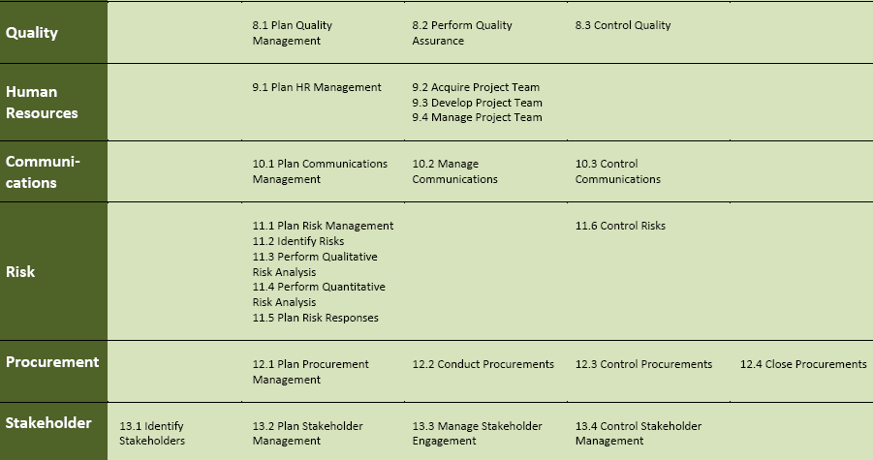
Difference Between PMBOK 4 & 5
29
November 12, 2013

Slide 31
About Project Management
Project Management is a formalized and structured method comprising a set of interrelated processes and tools that ranges from simple to complex.
These processes are based on the accepted principles of management used for planning, estimating and controlling work activities.
This is to produce outputs that are to be delivered by a certain time, to a defined quality standard and with a given level of resources so that the project goal and outcomes/benefits are realized.
Effective project management is essential for the success of any project – whether in the private or public sectors – and irrespective of its category, size and complexity.
Notes:
31

Slide 32
Project Parameters: Important Topics
Project Proposal
Project Contract
Project Charter
Elicitation of Project Requirements and Specifications
Project Statement of Work
Project Scope Statement
Project Work Breakdown Structure
Scope Creep, Control and Verification
Project Change Management
Project Integration Management
Notes:
32

Slide 33
Project Management Processes
PM processes are divided into five phases or process groups
Initiating
Processes
Planning
Processes
Controlling
Processes
Executing
Processes
Closing
Processes
Professional Responsibility

Slide 34
Initiation Phase
Process of formally authorizing and recognizing that a new project exists or that an existing project should continue into its next phase

Slide 35
Project Initiation
The required end product from the project is described at hi-level.
The company makes the decision of whether to go ahead with project.
All or any historical data pertaining to type of project is reviewed.
Expert judgment of staff or SMEs (Subject Matter Experts) are procured.
Results in;
  A project charter.
  Assignment of a project manager
  Identification of project sponsors to support and review/approve the activities of the project.

Slide 36
Project Charter (Business Plan)
A document that formally authorizes the existence of a project. (PMI).
Provides the project manager with the authority to apply organizational resources to project activities
issued by the Project Sponsor or a senior official outside the level of project organization
It should include
      Reasons for undertaking the project
      Project objectives and constraints
      Identification of main stakeholders
Charter is prepared in the initiation phase of integration management.

Slide 37

Project Charter
Information contained in – or referred to in other project documents – the Project Charter may span the following:
  Project Background
  Purpose for undertaking the project
  Project Justification
  Requirements
  Stakeholder expectations from the project
  Assumptions and Constraints
  Project Organization
  Stakeholder Roles and Responsibilities
  Schedule and milestones
  Indication of budget
  Supporting infrastructure
Example: http://www.uc.edu/ucflex/documents/FSRP_Project_Charter_v1.9.pdf
Notes:
37

Slide 38
Statement of Work Definition
Statement of Work (SOW)
  A description of products and services to be supplied to the customer(s) by the project team or the project delivery organization.
  Narrative description of products or services to be supplied under contract
Notes:
38

Slide 39
Project Proposal
  A project proposal is written, to make an offer and to try to convince a supervisor or a future customer to accept it.
  In a project proposal you state that, in exchange for time and/or money, you will give them something that they want:
    an analysis of an existing process or business procedure,
    make something they desire (a prototype of a new product),
    or do something they wish to have done (redesign an existing structure).
Notes:
39

Slide 40
Initial Responsibilities of Project Manager
Plan the project’s
  Technical activities
  Project management activities
Initiate project kickoff meeting
Manage triple constraints to sponsor satisfaction
  Requirements, Schedule and Cost
Organize the project, including
  Forming the project team
  Setting up systems to document the project
  Setting up project plans and processes for controlling
Confirming the project charter

Slide 41
Organizing the Project and Project Team
Project Charter should be issued by the project sponsor. It gives the Project Manager authority to apply resources to the project activities.
Conflict Management - Understand how to effectively manage conflict in project environment.
Scope – Explain clear scope of project with all team members
Team – Plan and actively develop team through entire project.
Risk – Reduce and manage risk continually
Politics – Develop political awareness
Know the project stakeholders and sponsors
Know your strength and weakness
Know who has influence to help your project
Plan globally, think and act locally

Slide 42
Project Management Quotes
Golden Quotes
  If You FAIL to PLAN; You PLAN to FAIL
  Over time and with experience, you will apply Project Management skills at whatever you do.
  Project Managers are professionals; they are not super heroes or firefighters.

