Slide 1
MGT 461
Project Management Institute Knowledge Areas
Lecture # 18
Ghazala Amin
Notes:
1

Slide 2
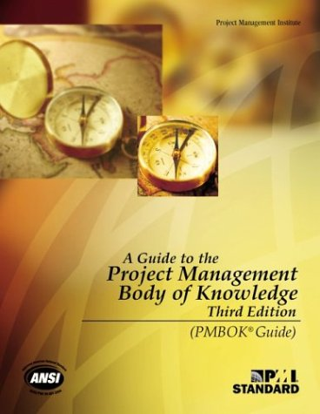
The Project Management Body of Knowledge
The Project Management Institute’s Body of Knowledge – PMBOK – is perhaps the most widely acknowledged and popular project management standard in existence. It is the basis for the PMI’s coveted PMP certification examinations.
Presently in its fifth version (2013), PMBOK offers a comprehensive and sophisticated best practices and process-based standard which can be applied to different categories of projects. At the heart of the PMBOK are the ten areas of knowledge and five process groups which find application over the project life-cycle.
Notes:
2

Slide 3
The 10 PMBOK Areas & 5 Process Groups
Integration Management
Initiation
Scope Management
PROCESSES
47
Time Management
Planning
Cost Management
Implementation/
Execution
Quality Management
Project Management Knowledge Areas (PMBOK)
Human Resource Management
Monitoring, Evaluation & Control
Communication Management
Risk Management
Closure
Procurement Management
Stakeholder Management
Notes:
3

Slide 4
Process Interactions
Process – Series of actions bringing about a result.
Individual processes within a process group are linked by their inputs and outputs
Each process is defined by
  Inputs: Documents or documentable items that will be acted upon
  Tools and Techniques: Mechanisms applied to the inputs to create the outputs
  Outputs: Documents or documentable items that are a result of the process

Slide 6
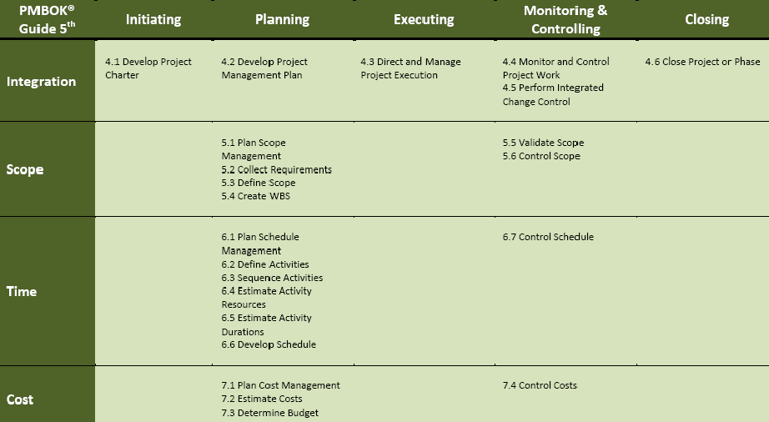
Difference Between PMBOK 4 & 5
6
October 28, 2013

Slide 7
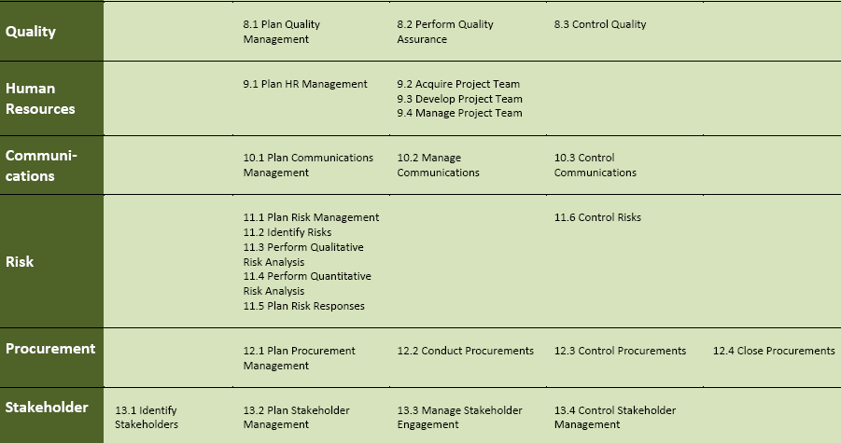
Difference Between PMBOK 4 & 5
7
October 28, 2013

Slide 8

PMBOK Area: Integration Management
Project Integration Management includes the processes which are needed to identify, define, combine, unify and coordinate the various project management processes in the project process groups (e.g. development of the project charter, development of project management plan, directing and managing project execution, monitoring and controlling project work, integrated change control and project closure).
Integration is crucial for project completion, meeting stakeholder expectations and needs, making choices where to concentrate resources over time, dealing with issues and coordinating project activities.

Slide 9
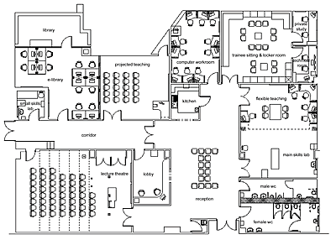
PMBOK Area: Scope Management
Project Scope Management includes the processes required to ensure that the project includes all – and only the – work needed for its successful completion. In other words, scope manage-ment asks what is included in the project.
Completion of the project scope is measured against the project management plan where the requirements and specifications of the project output are given.
Processes covered under Project Scope Management are plan scope management, collect requirements, scope definition, creation of the work breakdown structure, scope verification and scope control.

Slide 10

PMBOK Area: Time Management
Project Time Management includes the processes required to ensure the completion of the project within the time-frame which has been allocated for it.
Processes covered under Project Time Management are planning schedule management, activity definition, sequencing activity, estimating activity resources, activity duration estimating, schedule development, and schedule control.

Slide 11

PMBOK Area: Cost Management
Project Cost Management includes the processes which are required to plan, manage and control costs so that the project can be completed within the budget allocated for it.
Processes covered under project Cost Management are Planning of cost management, cost estimating, determining budget, and cost control.

Slide 12

PMBOK Area: Quality Management
Project Quality Management includes the processes for ensuring that the project satisfies the needs and requirements for which it was undertaken in the first place.
Project Quality Management addresses both the project output (goal-focus) as well as the management of the project (process-focus). It recognizes the importance of customer satisfaction, prevention over inspection, management responsibility and continuous improvement.
Processes covered under Project Quality Management are quality planning, quality assurance performance, and quality control.

Slide 13

PMBOK Area: Human Resource Management
Project Human Resource Management includes the processes needed to organize and manage the project team.
Human resources are considered an organization’s “most important asset” and the same applies to projects.
Processes covered under Project Human Resource Management are human resource planning, project team acquisition, project team development, and project team management.

Slide 14

PMBOK Area: Communications Management
Project Communications Management includes the processes needed to ensure timely and appropriate generation, collection, dissemination, storage, and ultimate disposition of project information.
Considered the “life-blood” of a project, communication is often a challenging undertaking and difficulties in (or a total breakdown of) communication can severely impede a project.
Processes covered under Project Communication Management are communications planning, manage and control communication.

Slide 15

PMBOK Area: Risk Management
Project Risk Management includes the processes needed to manage the risks on the project with a view to reducing the likelihood of a negative impact on attainment of the project goal, the project cost and time, and the project stakeholders.
Processes covered under Project Risk Management are risk management planning, risk identification, qualitative risk analysis, quantitative risk analysis, risk response planning, and risk control.

Slide 16

PMBOK Area: Procurement Management
Project Procurement Management includes the processes for acquiring or purchasing the materials, products, goods and services which are needed to perform the project work.
Project Procurement Management includes the contract management and change control processes required to administer contracts or purchase orders issued by the project team.
Processes covered under Project Procurement Management are planning of procurement management, conduct procurement, control and close procurements.

Slide 17

Managing and Engaging Project Stakeholders
(The Logic Behind Stakeholder Management)
On all projects stakeholders must be carefully and professionally managed and engaged so that they can con-tribute to the project, under-stand the project decisions taken and accept them more readily and they will be project supporters instead of project adversaries.

Slide 18



Managing and Engaging Project Stakeholders
(The Centrality of Stakeholders on Projects)
Stakeholders are central to all projects in every respect because they are the entities which are responsible for conceiving, defining and initiating, planning, executing, closing (or occasionally pre-maturely terminating), and monitoring, evaluating and controlling projects.
Processes include Identification, planning, managing and controlling stakeholders
Stake-holders
Project Goal
Project Duration
Project Cost
A project‘s ‚triple constraint‘ (goal/scope, cost and time) should be modified to depict the central role of its stakeholders.

