Slide 1
Chapter 24
Resolving Disputes

Slide 2
Industrial Relations
IR covers
Collective bargaining
Role of management, unions and government
Mechanism of resolving disputes
Grievances and disciplinary policy and practices
Labour legislation
IR covers
Collective bargaining
Role of management, unions and government
Mechanism of resolving disputes
Grievances and disciplinary policy and practices
Labour legislation

Slide 3
Lecture Overview
Collective Bargaining
Methods of Settling Disputes
Grievance Handling Procedure
Steps in Disciplinary Proceedings

Slide 4
Settlement of Disputes
Collective bargaining
Arbitration
Dispute settlement
Conciliation
Code of discipline
Grievance procedure
Adjudication

Slide 5
Collective Bargaining Process
Preparing for negotiation
Bargaining issues
Negotiating
YES
Overcoming breakdowns
Environment
Negotiation breakdown
Reaching the agreement
NO
Ratifying the agreement
Administration of agreement
Adopted from: Aswathappa. Human Resource Management, Text and Cases, 2008, p. 5783

Slide 6
Collective Bargaining
Collective bargaining a method of settling disputes
Legislative process: in a sense that it establish rules and norms (term and condition) under which both management and labour will work over a period of time
Executive process: Management and union officials share the responsibility to enforce rule
Judicial Process: In every collective agreement there is grievance handling procedure to settle any likely dispute regarding implementation of agreement

Slide 7
Settlement of Disputes
Code of Discipline
Define duties and responsibilities of workers and employer. The objectives of codes are
Employer and employees respect and recognize each other’s rights
Settlement of disputes by negotiation, arbitration and conciliation
Eliminate coercion, intimidation and violation
Avoid work stoppages
Facilitate growth of unions
Maintain discipline

Slide 8
Settlement of Disputes
Grievance Procedure
Grievance is state of dissatisfaction of employees
Method of settling disputes
All agreement contains grievance procedure
Conditions that can create grievance
  Violation of terms and conditions
  Violation of law
  Violation of company rules
  Change in work conditions or terms
  Violation of health and safety standards

Slide 9
Settlement of Disputes
Arbitration
Neutral third party listen to both parties, analyze bargaining situation and then make recommendations that are obligatory/binding on both parties
Conciliation
Mediator persuades and facilitate both parties to discuss the issue and reach to the agreement
Conciliator helps both parties to understand demands of each other, explain position of each party, offer workable solutions or helps in finding solutions
Adjudication
Labour court or tribunal settles the disputes
Conciliator refers to recommend the government to send the case to courts. Once court decides the case it is obligatory on both parties
Collective bargaining
Role of management, unions and government
Mechanism of resolving disputes
Grievances and disciplinary policy and practices
Labour legislation

Slide 10
Industrial Relations
IR covers
Collective bargaining
Role of management, unions and government
Mechanism of resolving disputes
Grievances and disciplinary policy and practices
Labour legislation
IR covers
Collective bargaining
Role of management, unions and government
Mechanism of resolving disputes
Grievances and disciplinary policy and practices
Labour legislation

Slide 11
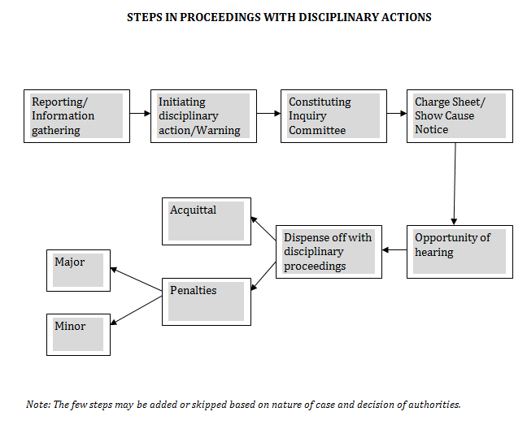

Slide 12
Summary
Nature of Disputes
Causes of Disputes
Collective Bargaining
Methods of Settling Disputes
Grievance Handling Procedure
Steps in Disciplinary Proceedings

