Slide 1
Summary of Previous Lecture
Concept of Time value of money
Simple and Compound interest
Future value of single deposit
Present value of single deposit
Use of interest factor tables while calculating future and present value at a given rate and time period

Slide 2
Chapter 3 (II)
Time Value of Money

Slide 3
Learning outcomes
After this lecture you should be able to
Understand the concept of annuities, uneven cash flows and their future and present values
Compounding periods and effective annual return
Loan amortization

Slide 4
Annuity
An annuity is a series of equal payments or receipts occurring over a specified number of equal periods.
e.g. a deposit or receipt of Rs. 1000 annually for the next 10 years.

Slide 5
Types of Annuities
Ordinary Annuity: Payments or receipts occur at the end of each period. e.g. payment or receipt of Rs. 1000 on December 31, i.e. at the end of financial year.
Annuity Due: Payments or receipts occur at the beginning of each period, i.e. payment or receipt of Rs. 1000 on January 31, i.e. at the begining of financial year.

Slide 6
Examples of Annuities
Student Loan Payments
Car Loan Payments
Insurance Premiums
Mortgage Payments
Retirement Savings

Slide 7
Parts of an Ordinary Annuity
Equal payment at the end of the period at equal distance from each other.
End of
Period 1
End of
Period 2
End of
Period 3
0
$1000 $1000 $1000

Slide 8
Parts of an Annuity Due
Equal payments at the beginning of the equally divided periods.
Beginning of
Period 1
Beginning of
Period 2
Beginning of
Period 3
0 1 2 3
$1000 $1000 $1000

Slide 9
Future value of an Ordinary Annuity -FVA
Cash flows occur at the end of the period
0 1 2 n
i%
. . .
R = Periodic
Cash Flow
R R R
FVA_{n}
FVA_{n} = R(1+i)^{n-1} + R(1+i)^{n-2} + ... + R(1+i)¹ + R(1+i)⁰

Slide 10
Future Value of an Ordinary Annuity - FVA
Cash flows occur at the end of the period
0 1 2 3 4
7%
$1,000 $1,000 $1,000
$1,070
$1,145
FVA₃ = $1,000(1.07)² + $1,000(1.07)¹ + $1,000(1.07)⁰
= $1,145 + $1,070 + $1,000 = $3,215
$3,215 = FVA₃

Slide 11
Annuity Valuation
The future value of an ordinary annuity can be viewed as occurring at the end of the last cash flow period, whereas the future value of an annuity due can be viewed as occurring at the beginning of the last cash flow period.

Slide 12
Valuation Using Table III
FVA_{n} = R (FVIFA_{i%,n}) FVA₃ = $1,000 (FVIFA_{7%,3}) = $1,000 (3.215) = $3,215
Period | 6% | 7% | 8%
1 | 1.000 | 1.000 | 1.000
2 | 2.060 | 2.070 | 2.080
3 | 3.184 | 3.215 | 3.246
4 | 4.375 | 4.440 | 4.506
5 | 5.637 | 5.751 | 5.867

Slide 13
Future value of an Annuity Due - FVAD
Cash flows occur at the beginning of the period
0 1 2 3 n-1 n
i%
. . .
R R R R R
FVAD_{n} = R(1+i)^{n} + R(1+i)^{n-1} + ... + R(1+i)² + R(1+i)¹ = FVA_{n} (1+i)
FVAD_{n}

Slide 14
Example: Annuity Due -- FVAD
Cash flows occur at the beginning of the period
0 1 2 3 4
7%
$1,000 $1,000 $1,000 $1,070
$1,145
$1,225
$3,440 = FVAD₃
FVAD₃= $1,000(1.07)³ + 1,000(1.07)² + $1,000(1.07)¹
= $1,225 + $1,145 + $1,070 = $3,440

Slide 15
Valuation Using Table III
FVAD_{n} = R (FVIFA_{i%,n})(1+i)
FVAD₃ = $1,000 (FVIFA_{7%,3})(1.07) = $1,000 (3.215)(1.07) = $3,440
Period | 6% | 7% | 8%
1 | 1.000 | 1.000 | 1.000
2 | 2.060 | 2.070 | 2.080
3 | 3.184 | 3.215 | 3.246
4 | 4.375 | 4.440 | 4.506
5 | 5.637 | 5.751 | 5.867

Slide 16
Present Value of an Ordinary Annuity -- PVA
Cash flows occur at the end of the period
0 1 2 n n+1
i%
. . . . . . . .
R R R
R = Periodic
Cash Flow
PVA_{n}
PVA_{n} = R/(1+i)¹ + R/(1+i)²
+ ... + R/(1+i)^{n}

Slide 17
Example: Ordinary Annuity - PVA
Cash flows occur at the end of the period
0 1 2 3 4
7%
$1,000 $1,000 $1,000
$934.58
$873.44
$816.30
$2,624.32 = PVA₃
PVA₃ = $1,000/(1.07)¹ + $1,000/(1.07)² + $1,000/(1.07)³
= $934.58 + $873.44 + $816.30 = $2,624.32

Slide 18
Valuation Using Table IV
PVA_{n} = R (PVIFA_{i%,n}) PVA₃ = $1,000 (PVIFA_{7%,3}) = $1,000 (2.624) = $2,624
Period | 6% | 7% | 8%
1 | 0.943 | 0.935 | 0.926
2 | 1.833 | 1.808 | 1.783
3 | 2.673 | 2.624 | 2.577
4 | 3.465 | 3.387 | 3.312
5 | 4.212 | 4.100 | 3.993

Slide 19
Present Value of an Annuity Due - PVAD
Cash flows occur at the beginning of the period
0 1 2 n-1 n
i%
. . . . . . . .
R R R R
R: Periodic
Cash Flow
PVAD_{n}
PVAD_{n} = R/(1+i)⁰ + R/(1+i)¹ + ... + R/(1+i)^{n-1} = PVA_{n} (1+i)

Slide 20
Example of an Annuity Due - PVAD
Cash flows occur at the beginning of the period
0 1 2 3 4
7%
$1,000.00 $1,000 $1,000
$ 934.58
$ 873.44
$2,808.02 = PVAD_{n}
PVAD_{n} = $1,000/(1.07)⁰ + $1,000/(1.07)¹ + $1,000/(1.07)² = $2,808.02

Slide 21
Valuation Using Table IV
PVAD_{n} = R (PVIFA_{i%,n})(1+i)
PVAD₃ = $1,000 (PVIFA_{7%,3})(1.07) = $1,000 (2.624)(1.07) = $2,808
Period | 6% | 7% | 8%
1 | 0.943 | 0.935 | 0.926
2 | 1.833 | 1.808 | 1.783
3 | 2.673 | 2.624 | 2.577
4 | 3.465 | 3.387 | 3.312
5 | 4.212 | 4.100 | 3.993

Slide 22
Steps to Solve Time Value of Money Problems
1. Read problem thoroughly
2. Create a time line
3. Put cash flows and arrows on time line
4. Determine if it is a PV or FV problem
5. Determine if solution involves a single CF, annuity stream(s), or mixed flow
6. Solve the problem using Interest Factor tables I, II, III, and IV or using financial calculator.

Slide 23
Mixed Flows Example
Mr. A will receive the set of cash flows below. What is the Present Value at a discount rate of 10%.
0 1 2 3 4 5
10%
$600 $600 $400 $400 $100
PV₀

Slide 24
Solution
1. Solve a piece-at-a-time by discounting each piece back to t=0.
2. Solve a group-at-a-time by first breaking problem into groups of annuity streams and any single cash flow groups. Then discount each group back to t=0.

Slide 25
Piece-At-A-Time
0 1 2 3 4 5
10%
$600 $600 $400 $400 $100
$545.45
$495.87
$300.53
$273.21
$ 62.09
$1677.15 = PV₀ of the Mixed Flow

Slide 26
Group-At-A-Time
0 1 2 3 4 5
10%
$600 $600 $400 $400 $100
$1,041.60
$ 573.57
$ 62.10
$1,677.27 = PV₀ of Mixed Flow [Using Tables]
$600(PVIFA_{10%,2}) = $600(1.736) = $1,041.60 $400(PVIFA_{10%,2})(PVIF_{10%,2}) = $400(1.736)(0.826) = $573.57
$100 (PVIF_{10%,5}) = $100 (0.621) = $62.10

Slide 27
Group-At-A-Time
0 1 2 3 4
$400 $400 $400 $400
$1,268.00
0 1 2
PV₀ equals
$1677.30
Plus
$200 $200
$347.20
0 1 2 3 4 5
Plus
$100
$62.10

Slide 28
Frequency of Compounding
General Formula:
FV_{n} = PV₀(1 + [Periodic rate])^{mn}
FV_{n} = PV₀(1 + [i/m])^{mn}
n: Number of Years m: Compounding Periods per Year i: Annual Interest Rate FV_{n,m}: FV at the end of Year n
PV₀: PV of the Cash Flow today

Slide 29
Impact of Frequency
Mr. A has Rs.100,000 to invest for 10 Years at an annual interest rate of 10%.
Annual FV₁₀ = 100,000(1+ [.10/1])⁽¹⁾⁽¹⁰⁾ = 259374
Semi FV₁₀ = 100,000(1+ [.10/2])⁽²⁾⁽¹⁰⁾ = 265329

Slide 30
Impact of Frequency
Quarterly FV₁₀ = 100,000(1+ [.10/4])⁽⁴⁾⁽¹⁰⁾ = 268,506
Monthly FV₁₀ = 100,000(1+ [.10/12])⁽¹²⁾⁽¹⁰⁾ = 270,704
Daily FV₁₀ = 100,000(1+[.10/365])⁽³⁶⁵⁾⁽¹⁰⁾ = 271,791

Slide 31
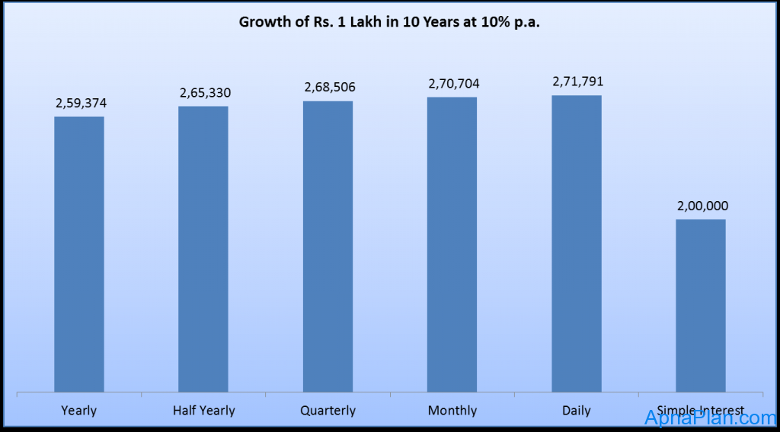
Graph shows increase in investment of Rs 1 Lakh in 10 years at 10% different compounding period

Slide 32
Effective Annual Interest Rate
Effective Annual Interest Rate
The actual rate of interest earned (paid) after adjusting the nominal rate for factors such as the number of compounding periods per year.
EAR = (1 + Periodic rate)^{m} – 1
Periodic rate = annual interest rate/compounding period = i / m
EAR = (1 + [i/m])^{m} – 1

Slide 33
EAR for a deposit of Rs.100,000 at 10% for different periods in 10 years
DEPOSIT | FV | PROFIT | Yield | EAR
100,000 | 259,374 | 159,374 | 0.1 | 10%
100,000 | 265,330 | 165,330 | 0.1025 | 10.25%
100,000 | 268,506 | 168,506 | 0.1038129 | 10.38%
100,000 | 270,704 | 170,704 | 0.1047131 | 10.47%
100,000 | 271,791 | 171,791 | 0.1051558 | 10.52%
100,000 | 200,000 | 100,000 |  | 7.18%
 |  |  | Rule of 72 | 7.2%

Slide 34
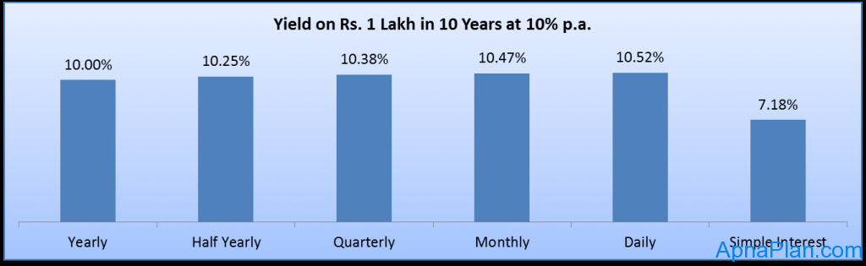
Effective Annual Interest Rate or yield ea

Slide 35
Effective Annual Interest Rate
TT corporation has a $1,000 Cash Deposit at the bank. The interest rate is 6% compounded quarterly for 1 year. What is the Effective Annual Interest Rate (EAR)?
EAR = ( 1 + 6% / 4 )⁴ - 1 = 1.0614 - 1 = .0614 or 6.14%!

Slide 36
Amortizing a Loan Example
Mr. A is borrowing $10,000 at a compound annual interest rate of 12%. Amortize the loan if annual payments are made for 5 years.
PV₀ = R (PVIFA _{i%,n})
$10,000 = R (PVIFA _{12%,5})
$10,000 = R (3.605)
R = $10,000 / 3.605 = $2,774

Slide 37
Amortizing a Loan Example
[Last Payment Slightly Higher Due to Rounding]

Slide 38
Problem
XYZ Corp. plans to borrow $5000 for 10 years. Company’s bank will lend the money at a rate of 8 percent and want the loan to be paid back in 10 equal end of the year payments. What will the payment to fully amortize the loan in 10 years.

Slide 39
Solution
PV₀ = R (PVIFA _{i%,n})
$5,000 = R (PVIFA _{8%,10})
$5,000 = R (6.710)
R = $5,000 / 6.710
= $745

Slide 40
Schedule of Payment
Year | Payment | Interest | Principal | Balance
0 | --- | --- | --- | 5000
1 | 745 | 400 | 345 | 4655
2 | 745 | 372 | 373 | 4282
3 | 745 | 343 | 402 | 3880
4 | 745 | 310 | 435 | 3445
5 | 745 | 276 | 469 | 2976
6 | 745 | 238 | 507 | 2469
7 | 745 | 198 | 547 | 1922
8 | 745 | 154 | 591 | 1330
9 | 745 | 106 | 639 | 692
10 | 747 | 55 | 692 | 0
 | 7452 | 2452 | 5000

Slide 41
Usefulness of Amortization
Determine Interest Expense -- Interest expenses may reduce taxable income of the firm.
Calculate Debt Outstanding -- The quantity of outstanding debt may be used in financing the day-to-day activities of the firm.

Slide 42
Summary
Concept of Annuity, i.e. ordinary annuity and annuity due
Use of interest factor tables for annuities
Compounding periods and effective annual rate
Loan amortization and preparing amortization schedule

