Slide 1
Summary of Previous Lecture
we covered the following topics in previous lecture;
Relationship or trade-off between risk and return.
What is risk and return and how to measure them by calculating expected return, standard deviation, and coefficient of variation.
Different types of investor attitudes toward risk, i.e. risk averse, risk indifferent, and high risk taker.
Risk and return in a portfolio context, and difference between individual security risk and portfolio risk.
Avoidable (unsystematic) risk and unavoidable (systematic) risk and role of diversification in eliminating one of these risks.

Slide 2
Variance - Covariance Matrix
A three asset portfolio:
Col 1 Col 2 Col 3
Row 1 W₁W₁ σ_{1,1} W₁W₂ σ_{1,2} W₁W₃ σ_{1,3}
Row 2 W₂W₁σ_{2,1} W₂W₂ σ_{2,2} W₂W₃ σ_{2,3}
Row 3 W₃W₁σ_{3,1} W₃W₂σ_{3,2} W₃W₃ σ_{3,3}
σ_{j,k} = is the covariance between returns for the j^{th} and k^{th} assets in the portfolio.

Slide 3
Total Risk =
Systematic Risk + Unsystematic Risk
Systematic Risk is the variability of return on stocks or portfolios associated with changes in return on the market as a whole.
Unsystematic Risk is the variability of return on stocks or portfolios not explained by general market movements. Unsystematic risk refers to the risks inherent in each company that you invest. It is avoidable through diversification.

Slide 4
Total Risk =
Systematic Risk + Unsystematic Risk
Systematic Risk
Factors such as changes in nation’s
economy, tax reform by the government,
or a change in the world economic situation
or the exchange rate movements.
STD DEV OF PORTFOLIO RETURN
Unsystematic risk
Total
Risk
Systematic risk
NUMBER OF SECURITIES IN THE PORTFOLIO

Slide 5
Total Risk =
Systematic Risk + Unsystematic Risk
Unsystematic Risk
Factors unique to a particular company
or industry. For example, the death of a
key executive or strike by the employees
of the company.
STD DEV OF PORTFOLIO RETURN
Unsystematic risk
Total
Risk
Systematic risk
NUMBER OF SECURITIES IN THE PORTFOLIO

Slide 6
Chapter 5 (II)
Risk and Return

Slide 7
Learning Outcomes
After studying Chapter 5, you should be able to:
Understand the relationship (or “trade-off”) between risk and return.
Define risk and return and show how to measure them by calculating expected return, standard deviation, and coefficient of variation.
Discuss the different types of investor attitudes toward risk.
Explain risk and return in a portfolio context, and distinguish between individual security and portfolio risk.
Distinguish between avoidable (unsystematic) risk and unavoidable (systematic) risk and explain how proper diversification can eliminate one of these risks.
Define and explain the capital-asset pricing model (CAPM), beta, and the characteristic line.
Calculate a required rate of return using the capital-asset pricing model (CAPM).
Demonstrate how the Security Market Line (SML) can be used to describe this relationship between expected rate of return and systematic risk.
Explain what is meant by an “efficient financial market” and describe the three levels (or forms) to market efficiency.

Slide 8
Capital Asset Pricing Model (CAPM)
CAPM is a model that describes the relationship between risk and expected (required) return; in this model, a security’s expected (required) return is the risk-free rate plus a premium based on the systematic risk of the security.

Slide 9
CAPM Assumptions
1. Capital markets are efficient.
2. Homogeneous investor expectations over a given period.
3. Risk-free asset return is certain (use short to intermediate term Treasuries as a proxy).
4. Market portfolio contains only systematic risk (use S&P 500 Index or similar as a proxy).

Slide 10
Characteristic Line
EXCESS RETURN
ON STOCK
Narrower spread
is higher correlation
Beta =
Rise
Run
EXCESS RETURN
ON MARKET PORTFOLIO
Characteristic Line

Slide 11
Calculating Beta on Your Calculator
Time Pd. | Market | My Stock
1 | 9.6% | 12%
2 | -15.4% | -5%
3 | 26.7% | 19%
4 | -.2% | 3%
5 | 20.9% | 13%
6 | 28.3% | 14%
7 | -5.9% | -9%
8 | 3.3% | -1%
9 | 12.2% | 12%
10 | 10.5% | 10%
The Market and My Stock returns are “excess returns” and have the riskless rate already subtracted.

Slide 12
Calculating Beta on Your Calculator

Slide 13
How to Plot the Characteristic Line using MS Excel
Time Pd. | Market=X | My Stock=Y
1 | 9.60% | 12%
2 | -15.40% | -5%
3 | 26.70% | 19%
4 | -0.20% | 3%
5 | 20.90% | 13%
6 | 28.30% | 14%
7 | -5.90% | -9%
8 | 3.30% | -1%
9 | 12.20% | 12%
10 | 10.50% | 10%
Select the Excess market returns X, and My stock Y
Press Insert and click on scattered graph button in the type of graphs; you will get a graph with scattered points on it.
Then click on any one of those points, they will be selected and right click on it you will get a window; check the buttons “Linear” and add trend line and also check the “Display equation on chart” in this window

Slide 14
How to Plot the Characteristic Line using MS Excel

Slide 15
What is Beta?
An index of systematic risk.
It measures the sensitivity of a stock’s returns to changes in returns on the market portfolio.
The beta for a portfolio is simply a weighted average of the individual stock betas in the portfolio.

Slide 16
Characteristic Lines and Different Betas
EXCESS RETURN
ON STOCK
Beta > 1
(aggressive)
Each characteristic
line has a
different slope.
Beta = 1
Beta < 1
(defensive)
EXCESS RETURN
ON MARKET PORTFOLIO

Slide 17
Security Market Line
R_{j} = R_{f} + (R_{M} - R_{f}) β_{j}
R_{j} is the required rate of return for stock j,
R_{f} is the risk-free rate of return,
β_{j} is the beta of stock j (measures systematic risk of stock j),
R_{M} is the expected return for the market portfolio.

Slide 18
Security Market Line
R_{j} = R_{f} + (R_{M} - R_{f}) β_{j}
Risk
Premium
R_{M}
Required Return
R_{f}
Risk-free
Return
β_{M} = 1.0
Systematic Risk (Beta)

Slide 19
Security Market Line
Obtaining Betas
  Can use historical data if past best represents the expectations of the future
  Can also utilize services like Value Line, Ibbotson Associates, etc.
Adjusted Beta
  Betas have a tendency to revert to the mean of 1.0
  Can utilize combination of recent beta and mean

Slide 20
Determination of the Required Rate of Return
Management at XY Corporations is attempting to determine the rate of return required by their stock investors. XY is using a 6% R_{f} and a long-term market expected rate of return of 10%. A stock analyst following the firm has calculated that the firm beta is 1.2. What is the required rate of return on the stock of XY Corporations?

Slide 21
XYs Required Rate of Return
R_{XY} = R_{f} + (R_{M} - R_{f})β_{j}
R_{XY} = 6% + (10% - 6%)1.2
R_{XY} = 10.8%
The required rate of return exceeds the market rate of return as XY’s beta exceeds the market beta (1.0).

Slide 22
Determination of the Intrinsic Value of XY
XY is also attempting to determine the intrinsic value of the stock and is using the constant growth model. It is estimated that the dividend next period will be $0.50 and that XY will grow at a constant rate of 5.8%. The stock is currently selling for $15.
What is the intrinsic value of the stock? Is the stock over or underpriced?

Slide 23
Determination of the Intrinsic Value of XY
Intrinsic
Value
$0.50
=
10.8% - 5.8%
=
$10
The stock is OVERVALUED as the market price ($15) exceeds the intrinsic value ($10).

Slide 24
Security Market Line
Stock X (Underpriced)
Direction of
Movement
Direction of
Movement
Required Return
R_{f}
Stock Y (Overpriced)
Systematic Risk (Beta)

Slide 25
Determination of the Required Rate of Return
Small-firm Effect
Price / Earnings Effect
January Effect
These anomalies have presented serious challenges to the CAPM theory.

Slide 26
Three Forms of Market Efficiency
Eugene Fama, a pioneer in efficient Markets research has described three levels of market efficiency:
Weak-form efficiency: Current prices fully reflect the historical sequence of prices. The investors can’t improve forecasts for future prices based on the historical information.
Semi strong-form efficiency: Current prices fully reflect all publicly available information, including such things as annual reports and news items.
Strong-form efficiency: Current prices fully reflect all information, both public and private (i.e., information known only to insider)

Slide 27
Problem 1
POSSIBLE PROBABILITY OF
RETURN, Ri OCCURRENCE, Pi (Ri)(Pi) (Ri - R)²(Pi)

Slide 29
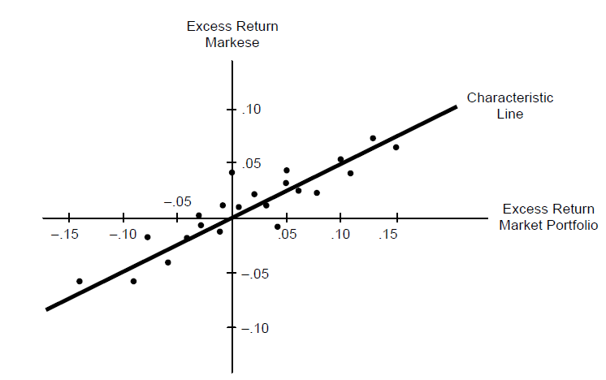
Problem 3

Slide 30
Problem 4
Req. (RA) = .07 + (.13 - .07) (1.5) = .16
Req. (RB) = .07 + (.13 - .07) (1.0) = .13
Req. (RC) = .07 + (.13 - .07) (0.6) = .106
Req. (RD) = .07 + (.13 - .07) (2.0) = .19
Req. (RE) = .07 + (.13 - .07) (1.3) = .148

Slide 31
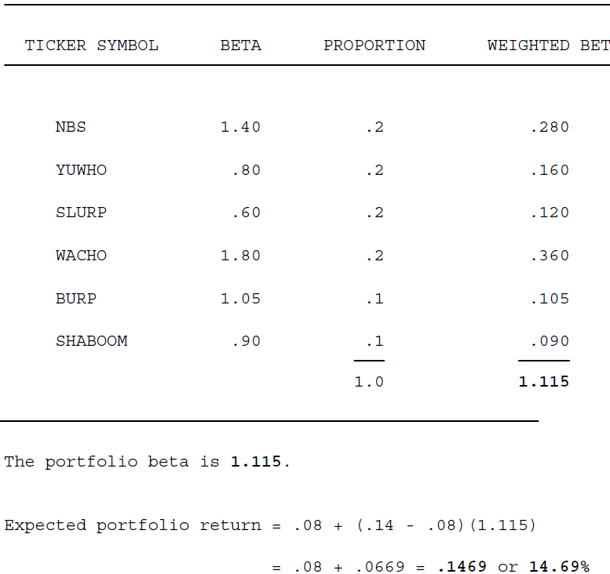
Common stock Symbol Beta Proportion Weighted Beta

Slide 34
Summary
Define and explain the capital-asset pricing model (CAPM), beta, and the characteristic line.
Calculate a required rate of return using the capital-asset pricing model (CAPM).
Demonstrate how the Security Market Line (SML) can be used to describe this relationship between expected rate of return and systematic risk.
Explain what is meant by an “efficient financial market” and describe the three levels (or forms) to market efficiency.

