Slide 1
Summary of Previous Lecture
Corporation's taxable income and corporate tax rate - both average and marginal.
Different methods of depreciation. (Straight line method, DDB and MACRS methods)
Acquisition of assets through the use of debt or equity financing and tax advantages attached with debt financing over both common and preferred stock financing.
Financial markets.
Ratings of the different rating agencies help investors to decide for reliable investments.

Slide 2
Chapter 3
Time Value of Money

Slide 3
Learning outcomes
After this lecture you will be able to
Understand the concept and importance of Time value of money
Simple and Compound interest
Future value of single deposit
Present value of single deposit
How to quickly solve the problems using the Tables given in the appendix of the book

Slide 4
The Interest Rate
What will be your choice:
Rs. 10,000 today or Rs. 10,000 in 5 years?
Obviously, Rs. 10,000 today.
This concept is known as Time Value of Money

Slide 5
Example
Suppose you can purchase a bicycle today for Rs. 10,000, would you be able to purchase the same bicycle 5 years from now.

Slide 6
TIME VALUE OF MONEY
An efficient funds management requires a better funds allocation and arrangement.
e.g. there is always an opportunity to earn an interest rate on deposits instead of exposing them to other investment opportunities.

Slide 7
Types of Interest
Simple Interest
  Interest paid or earned on only the original principal amount borrowed or lent.
Compound Interest
  Interest paid or earned on the principal and any previous interest earned.

Slide 8
Simple Interest Formula
Formula SI = P₀(i)(n)
  SI: Simple Interest
  P₀: Amount Deposited today (t=0)
  i: Interest Rate per Period
  n: Number of Time Periods

Slide 9
Simple Interest Example
Assume that you deposit $100 in an account earning 8% simple interest for 2 years. What is the accumulated interest at the end of the 2nd year?
Simple interest = P₀(i)(n) = $100(.08)(2) = $16

Slide 10
Future Value using Simple Interest
What is the Future Value (FV) of the deposit?
FV = P₀ + SI = $100 + $16 = $116
Future Value is the value at some future time of a present amount of money, or a series of payments, calculated at a given interest rate.

Slide 11
Present Value in Simple Interest
What is the Present Value (PV) of the previous problem?
The Present Value is simply the $100 you originally deposited. That is the value today
Present Value is the current value of a future amount of money, or a series of payments, calculated at a given interest rate.

Slide 12
Compound Interest
An interest rate that applies both on the principal amount and the interest earned on it during the previous year or years.
Most of the deposits in financial institutions earn compound interest.
Deposits grow exponentially in compound interest where as with simple interest they grow linearly.

Slide 13
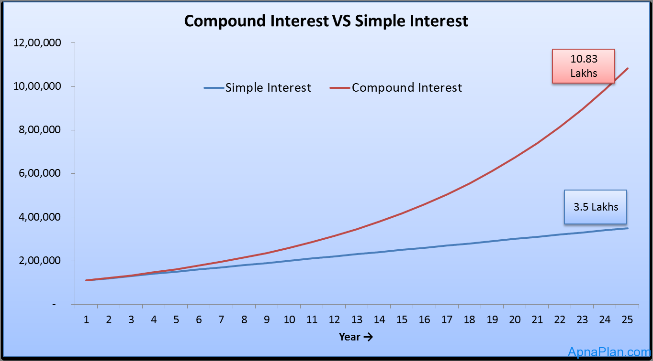
Why Compound Interest?
Growth pattern of Rs. 1 Lakh in 25 years with interest rate of 10% per year simple and compound.

Slide 14
Future Value of a Single Deposit
Assume that you deposit $1,000 at a compound interest rate of 7% for 2 years.
0 1 2
7%
$1,000
FV₂

Slide 15
Future Value of Single Deposit
FV₁ = P₀ (1+i)¹
= $1,000 (1.07) = $1,070
Compound Interest
During the first year of deposit simple and compound interest will remain the same i.e. $70, but from second year the principal amount will become $1070 for compound interest calculations.

Slide 16
Future Value of Single Deposit
FV₁ = P₀ (1+i)¹ = $1,000 (1.07) = $1,070
FV₂ = FV₁ (1+i)¹ = P₀ (1+i)(1+i) = $1,000(1.07)(1.07) = P₀ (1+i)² = $1,000(1.07)² = $1,144.90
You earned an EXTRA $4.90 in Year 2 with compound over simple interest.

Slide 17
General Formula of Future Value
FV₁ = P₀(1+i)¹
FV₂ = P₀(1+i)²
General Future Value Formula:
FV_{n} = P₀ (1+i)^{n}
or
FV_{n} = P₀ (FVIF_{i,n})
(Table 1 in the appendix of the book will help simplify the calculations)

Slide 18
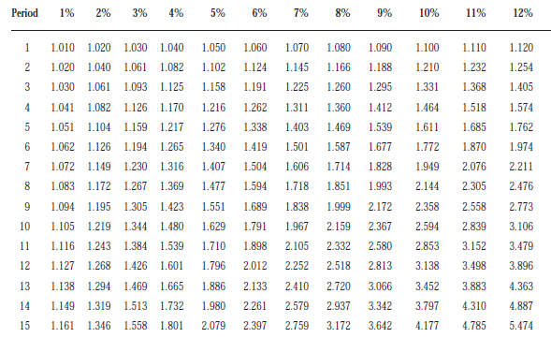
http://wps.aw.com/wps/media/objects/1924/1970895/AppendixA.pdf

Slide 19
Using Future Value Tables
FV₂= $1,000 (FVIF_{7%,2}) = $1,000 (1.145) = $1,145

Slide 20
Problem
Ms. Hamna wants to know how large her deposit of $10,000 today will become at a compound annual interest rate of 10% for 5 years.
0 1 2 3 4 5
10%
$10,000
FV₅

Slide 21
Using Future Value Tables
FV₂= $10,000 (FVIF10_{%,5}) = $10,000 (1.611) = $11,611

Slide 22
Solution
Calculation based on general formula:
FV_{n} = P₀ (1+i)^{n} FV₅ = $10,000 (1+ 0.10) = $16,105.10
5
Calculation using the Table 1 FV₅ = $10,000 (FVIF_{10%, 5}) = $10,000 (1.611) = $16,110

Slide 23
Double Your Money
How long does it take to double $1,000 at a compound rate of 10% per year (approx.)?
A quick answer lies in using the Rule of 72

Slide 24
Rule-of-72
How long does it take to double $1,000 at a compound rate of 10% per year (approx.)?
Approx. Periods to double X i% = 72
Approx. Periods to double = 72/i%
= 72/10%
= 7.2 Years

Slide 25
Rule-of-72
Actual time to double the amount
= $1,000(FVIF10%,n)
(FVIF10%,n) = (1+10%)^{7.2726} =2
= $1,000(2)
= $2,000
n = 7.2726 or 7.3 years; which is greater than the time calculated using rule of 72

Slide 26
Present Value Formula for Single Deposit
Recall the Future value formula we discussed before and rearrange it to get the present value formula for single deposit.
FV₁ = P₀(1+i)¹
FV₂ = P₀(1+i)²
General Future Value Formula:
FV_{n} = P₀ (1+i)^{n}
Rearranging the equation we get
P₀ = FV_{n} / (1+i)^{n}
P₀ = FV_{n} (1+i)^{-n}
P₀ = FV_{n} (FVIF_{i,n})

Slide 27
Present Value of Single Deposit
Suppose you need $10,000 in 2 years given the discount rate of 8%. How much you need to deposit today at a discount rate of 8% compounded annually.
0 1 2
8%
$1,000
PV₀
PV₁

Slide 28
Present Value Formula for Single Deposit
PV₀ = FV₂ / (1+i)²
= $1,000 / (1.08)²
= FV₂ / (1+i)²
= $857.34
0 1 2
8%
$1,000
PV₀

Slide 29
Table II for the General Present Value
PV₀ = FV₁ / (1+i)¹
PV₀ = FV₂ / (1+i)²
PV₀ = FV_{n} / (1+i)^{n}
or PV₀ = FV_{n} (PVIF_{i,n})

Slide 30
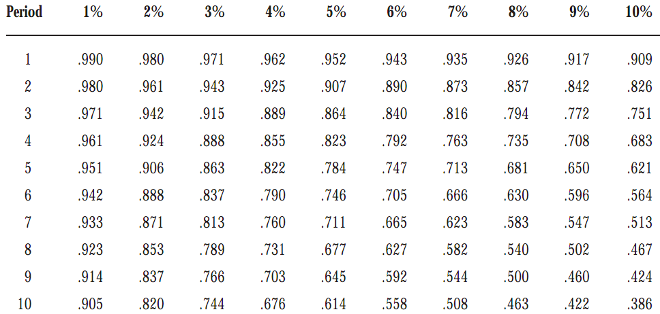
Table II is given at the end of the book PVIFi,n = 1 / (1+i)^{n}

Slide 31

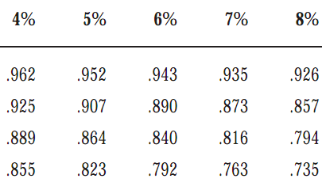
Using Present Value Tables
PV₄ = $1,000 (PVIF_{8%,4}) = $1,000 (.735) = $735

Slide 32
Problem
Ms. Hamna wants to know what amount of a deposit to make so that the money will grow to $10,000 in 7 years at a discount rate of 9%.
0 1 2 3 4 5
9%
$10,000
PV₀

Slide 33
Solution
Calculation based on general formula: PV₀ = FV_{n} / (1+i)^{n} PV₀ = $10,000 / (1+ 0.09)7 = $5470.34
Calculation based on Table I: PV₀ = $10,000 (PVIF_{9%, 7}) = $10,000 (.547) = $5470.00 [Due to Rounding]

Slide 34
Problem
Suppose we need to double an investment of $2000 in 5 years, How much interest rate should be there?

Slide 35
Problem
Suppose we want to double our deposit of $2000 at t=0 at an interest rate of 10%, how long it should take?

Slide 36
Problem
What is going to be the future value of a deposit of $4000 after 5 years at an interest rate of 9%?

Slide 37
Problem
A student requires $500 to pay his/her semester fee at a university after 3 years, how much deposit he/she should have today ?

Slide 38
Summary
Concept of Time value of money
Simple and Compound interest
Future value of single deposit
Present value of single deposit

