Slide 1
Summary
We covered the following topics in today’s lecture;
Firm’s weighted average cost of capital (WACC) and understand its rationale, use, and limitations.
Concept of Economic Value Added (EVA) is related to value creation and the firm’s cost of capital.
Understand the capital-asset pricing model's role in computing project-specific and group-specific required rates of return.

Slide 2
Revision of
Chapter 3
Time Value of Money

Slide 3
The Interest Rate
What will be your choice:
Rs. 10,000 today or Rs. 10,000 in 5 years?
Obviously, Rs. 10,000 today.
This concept is known as Time Value of Money

Slide 4
Types of Interest
Simple Interest
  Interest paid or earned on only the original principal amount borrowed or lent.
Compound Interest
  Interest paid or earned on the principal and any previous interest earned.

Slide 5
Future Value using Simple Interest
What is the Future Value (FV) of the deposit?
FV = P₀ + SI = $100 + $16 = $116
Future Value is the value at some future time of a present amount of money, or a series of payments, calculated at a given interest rate.

Slide 6
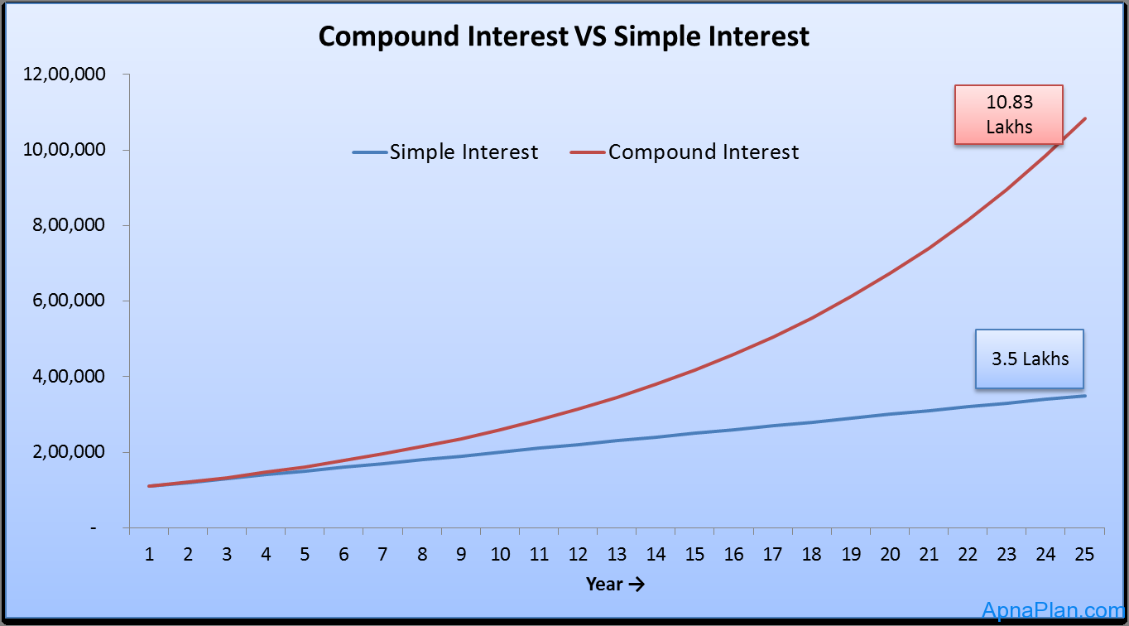
Why Compound Interest?
Growth pattern of Rs. 1 Lakh in 25 years with interest rate of 10% per year simple and compound.

Slide 7
General Formula of Future Value
FV₁ = P₀(1+i)¹
FV₂ = P₀(1+i)²
General Future Value Formula:
FV_{n} = P₀ (1+i)^{n}
or
FV_{n} = P₀ (FVIF_{i,n})
(Table 1 in the appendix of the book will help simplify the calculations)

Slide 8
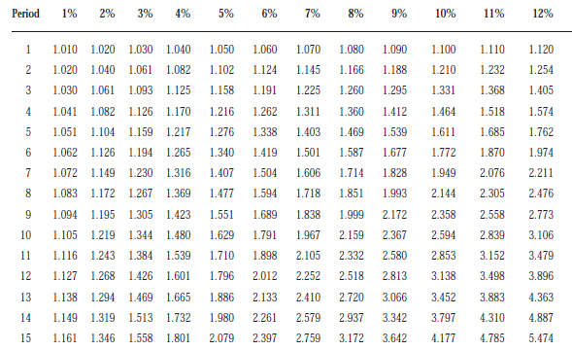
http://wps.aw.com/wps/media/objects/1924/1970895/AppendixA.pdf

Slide 9
Double Your Money
How long does it take to double $1,000 at a compound rate of 10% per year (approx.)?
A quick answer lies in using the Rule of 72

Slide 10
Rule-of-72
How long does it take to double $1,000 at a compound rate of 10% per year (approx.)?
Approx. Periods to double X i% = 72
Approx. Periods to double = 72/i%
= 72/10%
= 7.2 Years

Slide 11
Present Value Formula for Single Deposit
Recall the Future value formula we discussed before and rearrange it to get the present value formula for single deposit.
FV₁ = P₀(1+i)
FV₂ = FV₁(1+i) = P₀ (1+i)(1+i) = P₀(1+i)²
General Future Value Formula:
FV_{n} = P₀ (1+i)^{n}
Rearranging the equation we get
P₀ = FV_{n} / (1+i)^{n}
P₀ = FV_{n} (1+i)^{-n}
P₀ = FV_{n} (FVIF_{i,n})

Slide 12
Table II for the General Present Value
P₀ = FV₁ / (1+i)¹
P₀ = FV₂ / (1+i)²
P₀ = FV_{n} / (1+i)^{n}
or P₀ = FV_{n} (PVIF_{i,n})

Slide 13
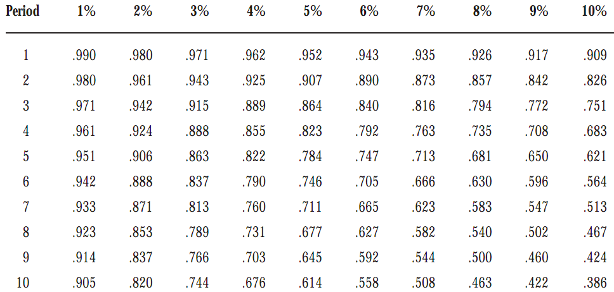
Table II is given at the end of the book PVIF_{i,n} = 1 / (1+i)^{n}

Slide 14
Annuity
An annuity is a series of equal payments or receipts occurring over a specified number of equal periods.
e.g. a deposit or receipt of Rs. 1000 annually for the next 10 years.

Slide 15
Types of Annuities
Ordinary Annuity: Payments or receipts occur at the end of each period. e.g. payment or receipt of Rs. 1000 on December 31, i.e. at the end of financial year.
Annuity Due: Payments or receipts occur at the beginning of each period, i.e. payment or receipt of Rs. 1000 on January 31, i.e. at the begining of financial year.

Slide 16
Examples of Annuities
Student Loan Payments
Car Loan Payments
Insurance Premiums
Mortgage Payments
Retirement Savings

Slide 17
Parts of an Ordinary Annuity
Equal payment at the end of the period at equal distance from each other.
End of
Period 1
End of
Period 2
End of
Period 3
0
$1000 $1000 $1000

Slide 18
Parts of an Annuity Due
Equal payments at the beginning of the equally divided periods.
Beginning of
Period 1
Beginning of
Period 2
Beginning of
Period 3
0 1 2 3
$1000 $1000 $1000

Slide 19
Future value of an Ordinary Annuity -FVA
Cash flows occur at the end of the period
0 1 2 n
i%
. . .
R = Periodic
Cash Flow
R R R
FVA_{n}
FVA_{n} = R(1+i)^{n-1} + R(1+i)^{n-2} + ... + R(1+i)¹ + R(1+i)⁰

Slide 20
Future Value of an Ordinary Annuity - FVA
Cash flows occur at the end of the period
0 1 2 3 4
7%
$1,000 $1,000 $1,000
$1,070
$1,145
FVA₃ = $1,000(1.07)² + $1,000(1.07)¹ + $1,000(1.07)⁰
= $1,145 + $1,070 + $1,000 = $3,215
$3,215 = FVA₃

Slide 21
Valuation Using Table III
FVA_{n} = R (FVIFA_{i%,n}) FVA₃ = $1,000 (FVIFA_{7%,3}) = $1,000 (3.215) = $3,215
Period | 6% | 7% | 8%
1 | 1.000 | 1.000 | 1.000
2 | 2.060 | 2.070 | 2.080
3 | 3.184 | 3.215 | 3.246
4 | 4.375 | 4.440 | 4.506
5 | 5.637 | 5.751 | 5.867

Slide 22
Future value of an Annuity Due - FVAD
Cash flows occur at the beginning of the period
0 1 2 3 n-1 n
i%
. . .
R R R R R
FVAD_{n} = R(1+i)^{n} + R(1+i)^{n-1} + ... + R(1+i)² + R(1+i)¹ = FVA_{n} (1+i)
FVAD_{n}

Slide 23
Example: Annuity Due -- FVAD
Cash flows occur at the beginning of the period
0 1 2 3 4
7%
$1,000 $1,000 $1,000 $1,070
$1,145
$1,225
$3,440 = FVAD₃
FVAD₃= $1,000(1.07)³ + 1,000(1.07)² + $1,000(1.07)¹
= $1,225 + $1,145 + $1,070 = $3,440

Slide 24
Valuation Using Table III
FVAD_{n} = R (FVIFA_{i%,n})(1+i)
FVAD₃ = $1,000 (FVIFA_{7%,3})(1.07) = $1,000 (3.215)(1.07) = $3,440
Period | 6% | 7% | 8%
1 | 1.000 | 1.000 | 1.000
2 | 2.060 | 2.070 | 2.080
3 | 3.184 | 3.215 | 3.246
4 | 4.375 | 4.440 | 4.506
5 | 5.637 | 5.751 | 5.867

Slide 25
Present Value of an Ordinary Annuity -- PVA
Cash flows occur at the end of the period
0 1 2 n n+1
i%
. . . . . . . .
R R R
R = Periodic
Cash Flow
PVA_{n}
PVA_{n} = R/(1+i)¹ + R/(1+i)²
+ ... + R/(1+i)^{n}

Slide 26
Example: Ordinary Annuity - PVA
Cash flows occur at the end of the period
0 1 2 3 4
7%
$1,000 $1,000 $1,000
$934.58
$873.44
$816.30
$2,624.32 = PVA₃
PVA₃ = $1,000/(1.07)¹ + $1,000/(1.07)² + $1,000/(1.07)³
= $934.58 + $873.44 + $816.30 = $2,624.32

Slide 27
Valuation Using Table IV
PVA_{n} = R (PVIFA_{i%,n}) PVA₃ = $1,000 (PVIFA_{7%,3}) = $1,000 (2.624) = $2,624
Period | 6% | 7% | 8%
1 | 0.943 | 0.935 | 0.926
2 | 1.833 | 1.808 | 1.783
3 | 2.673 | 2.624 | 2.577
4 | 3.465 | 3.387 | 3.312
5 | 4.212 | 4.100 | 3.993

Slide 28
Present Value of an Annuity Due - PVAD
Cash flows occur at the beginning of the period
0 1 2 n-1 n
i%
. . . . . . . .
R R R R
R: Periodic
Cash Flow
PVAD_{n}
PVAD_{n} = R/(1+i)⁰ + R/(1+i)¹ + ... + R/(1+i)^{n-1} = PVA_{n} (1+i)

Slide 29
Example of an Annuity Due - PVAD
Cash flows occur at the beginning of the period
0 1 2 3 4
7%
$1,000.00 $1,000 $1,000
$ 934.58
$ 873.44
$2,808.02 = PVAD_{n}
PVAD_{n} = $1,000/(1.07)⁰ + $1,000/(1.07)¹ + $1,000/(1.07)² = $2,808.02

Slide 30
Valuation Using Table IV
PVAD_{n} = R (PVIFA_{i%,n})(1+i)
PVAD₃ = $1,000 (PVIFA_{7%,3})(1.07) = $1,000 (2.624)(1.07) = $2,808
Period | 6% | 7% | 8%
1 | 0.943 | 0.935 | 0.926
2 | 1.833 | 1.808 | 1.783
3 | 2.673 | 2.624 | 2.577
4 | 3.465 | 3.387 | 3.312
5 | 4.212 | 4.100 | 3.993

Slide 31
Steps to Solve Time Value of Money Problems
1. Read problem thoroughly
2. Create a time line
3. Put cash flows and arrows on time line
4. Determine if it is a PV or FV problem
5. Determine if solution involves a single CF, annuity stream(s), or mixed flow
6. Solve the problem using Interest Factor tables I, II, III, and IV or using financial calculator.

Slide 32
Mixed Flows Example
Mr. A will receive the set of cash flows below. What is the Present Value at a discount rate of 10%.
0 1 2 3 4 5
10%
$600 $600 $400 $400 $100
PV₀

Slide 33
Solution
1. Solve a piece-at-a-time by discounting each piece back to t=0.
2. Solve a group-at-a-time by first breaking problem into groups of annuity streams and any single cash flow groups. Then discount each group back to t=0.

Slide 34
Piece-At-A-Time
0 1 2 3 4 5
10%
$600 $600 $400 $400 $100
$545.45
$495.87
$300.53
$273.21
$ 62.09
$1677.15 = PV₀ of the Mixed Flow

Slide 35
Group-At-A-Time
0 1 2 3 4 5
10%
$600 $600 $400 $400 $100
$1,041.60
$ 573.57
$ 62.10
$1,677.27 = PV₀ of Mixed Flow [Using Tables]
$600(PVIFA_{10%,2}) = $600(1.736) = $1,041.60 $400(PVIFA_{10%,2})(PVIF_{10%,2}) = $400(1.736)(0.826) = $573.57
$100 (PVIF_{10%,5}) = $100 (0.621) = $62.10

Slide 36
Group-At-A-Time
0 1 2 3 4
$400 $400 $400 $400
$1,268.00
0 1 2
PV₀ equals
$1677.30
Plus
$200 $200
$347.20
0 1 2 3 4 5
Plus
$100
$62.10

Slide 37
Frequency of Compounding
General Formula:
FV_{n} = PV₀(1 + [Periodic rate])^{mn}
FV_{n} = PV₀(1 + [i/m])^{mn}
n: Number of Years m: Compounding Periods per Year i: Annual Interest Rate FV_{n,m}: FV at the end of Year n
PV₀: PV of the Cash Flow today

Slide 38
Impact of Frequency
Mr. A has Rs.100,000 to invest for 10 Years at an annual interest rate of 10%.
Annual FV₁₀ = 100,000(1+ [.10/1])⁽¹⁾⁽¹⁰⁾ = 259374
Semi FV₁₀ = 100,000(1+ [.10/2])⁽²⁾⁽¹⁰⁾ = 265329

Slide 39
Impact of Frequency
Quarterly FV₁₀ = 100,000(1+ [.10/4])⁽⁴⁾⁽¹⁰⁾ = 268,506
Monthly FV₁₀ = 100,000(1+ [.10/12])⁽¹²⁾⁽¹⁰⁾ = 270,704
Daily FV₁₀ = 100,000(1+[.10/365])⁽³⁶⁵⁾⁽¹⁰⁾ = 271,791

Slide 40
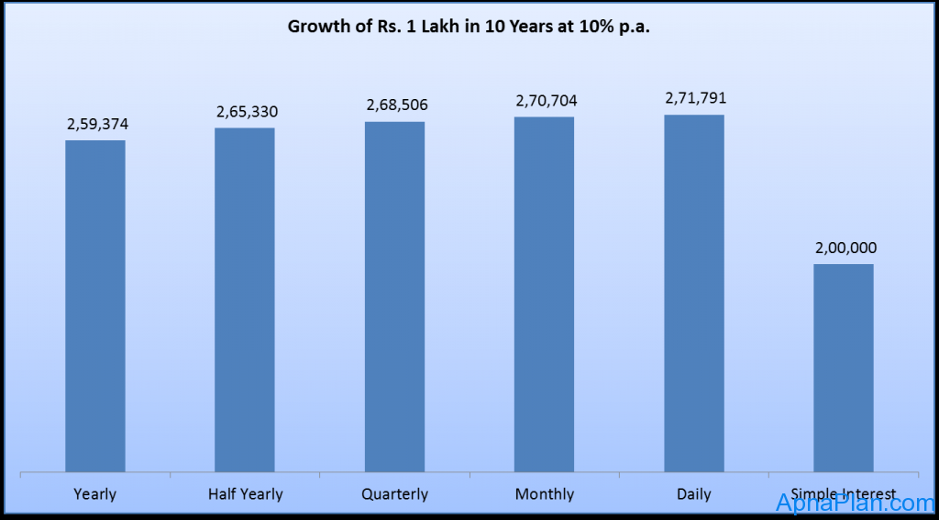
Graph shows increase in investment of Rs 1 Lakh in 10 years at 10% different compounding period

Slide 41
Effective Annual Interest Rate
Effective Annual Interest Rate
The actual rate of interest earned (paid) after adjusting the nominal rate for factors such as the number of compounding periods per year.
EAR = (1 + Periodic rate)^{m} – 1
Periodic rate = annual interest rate/compounding period = i / m
EAR = (1 + [i/m])^{m} – 1

Slide 42
EAR for a deposit of Rs.100,000 at 10% for different periods in 10 years
DEPOSIT | FV | PROFIT | Yield | EAR
100,000 | 259,374 | 159,374 | 0.1 | 10%
100,000 | 265,330 | 165,330 | 0.1025 | 10.25%
100,000 | 268,506 | 168,506 | 0.1038129 | 10.38%
100,000 | 270,704 | 170,704 | 0.1047131 | 10.47%
100,000 | 271,791 | 171,791 | 0.1051558 | 10.52%
100,000 | 200,000 | 100,000 |  | 7.18%
 |  |  | Rule of 72 | 7.2%

Slide 43
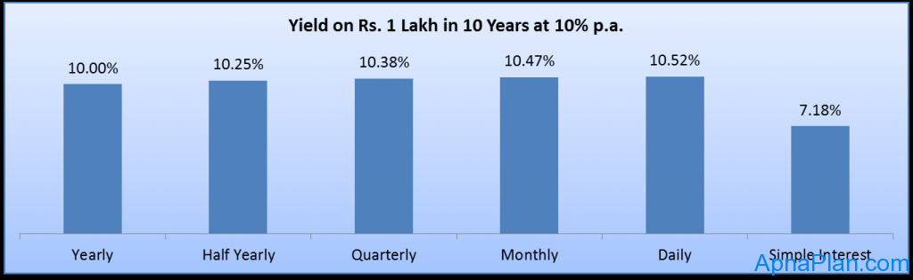
Effective Annual Interest Rate or yield ea

Slide 48
Summary
We revised the chapter 3 and solved few of the problems.

