Slide 1
Summary of Previous Lecture
The difference between the flow of funds statement and the statement of cash flows and understand the benefits of using each.
Create a sources and uses of funds statement, make adjustments, and analyze the final results.
Direct and indirect methods of Statement of Cash Flows
Prepare a cash budget from forecasts of sales, receipts, and disbursements -- and know why such a budget should be flexible.
Develop forecasted balance sheets and income statements.
Understand the importance of using probabilistic information in forecasting financial statements and evaluating a firm's condition.

Slide 2
Chapter 8
Overview of Working Capital Management

Slide 3
After studying Chapter 8, you should be able to:
Explain how the definition of "working capital" differs between financial analysts and accountants.
Understand the two fundamental decision issues in working capital management -- and the trade-offs involved in making these decisions.
Discuss how to determine the optimal level of current assets.
Describe the relationship between profitability, liquidity, and risk in the management of working capital.
Explain how to classify working capital according to its “components” and according to “time” (i.e., either permanent or temporary).
Describe the hedging (maturity matching) approach to financing and the advantages/disadvantages of short- versus long-term financing.
Explain how the financial manager combines the current asset decision with the liability structure decision.

Slide 4
Overview of Working Capital Management
Working Capital Concepts
Working Capital Issues
Financing Current Assets: Short-Term and Long-Term Mix
Combining Liability Structure and Current Asset Decisions

Slide 5
Working Capital Concepts
Net Working Capital
  Current Assets - Current Liabilities.
Gross Working Capital
  The firm’s investment in current assets.
Working Capital Management
  The administration of the firm’s current assets and the financing needed to support current assets.

Slide 6
Management of Working Capital
Cash Management:
Identify the minimum cash balance required for day to day needs
Inventory Management:
A level of inventory that allows interrupted production, it reduces the investment in raw materials and ordering cost.
Debtors management:
Attractive credit terms that not only streamline the cash flows but also attract new customers
Short term financing:
Identify appropriate sources of financing, ideally the supplies are financed by the credits granted by the suppliers

Slide 7
Significance of Working Capital Management
In a typical manufacturing firm, current assets are almost one-half of total assets and for trading firms it can be even more than half of their total assets.
Excessive levels can result in a substandard Return on Investment (ROI).
ROI = Net Profit/Total Assets
Where total assets include current and fixed assets

Slide 8
Significance of Working Capital Management
Current liabilities are the principal source of external financing for small firms.
Requires continuous, day-to-day managerial supervision.
Working capital management affects the company’s risk, return, and share price.

Slide 9
Profitability and Risk
Optimal Amount or (Level) of Current Assets
Assumptions
100,000 maximum units of production
Continuous production
Three different policies for current asset levels are possible
Policy A
Policy B
ASSET LEVEL ($)
Policy C
Current Assets
0 50,000 100,000
OUTPUT (units)

Slide 10
Impact on Liquidity
Optimal Amount or (Level) of Current Assets
Liquidity Analysis
Policy Liquidity
A High
B Average
C Low
Greater current asset levels generate more liquidity; all other factors held constant.
Policy A
Policy B
ASSET LEVEL ($)
Policy C
Current Assets
0 50,000 100,000

Slide 11
Impact on Expected Profitability
Optimal Amount or (Level) of Current Assets
Return on Investment =
Net Profit
Total Assets
Net Current Assets = (Cash + Rec. + Inv.)
Return on Investment =
Net Profit
Current + Fixed Assets
Policy A
Policy B
ASSET LEVEL ($)
Policy C
Current Assets
0 50,000 100,000

Slide 12
Impact on Expected Profitability
Optimal Amount or (Level) of Current Assets
Profitability Analysis
Policy Profitability
A Low
B Average
C High
As current asset levels decline, total assets will decline and the ROI will rise.
Policy A
Policy B
ASSET LEVEL ($)
Policy C
Current Assets
0 50,000 100,000
OUTPUT (units)

Slide 13
Impact on Risk
Optimal Amount or (Level) of Current Assets
Decreasing cash reduces the firm’s ability to meet its financial obligations. More risk!
Stricter credit policies reduce receivables and possibly lose sales and customers. More risk!
Lower inventory levels increase stock outs and lost sales. More risk!
Policy A
Policy B
ASSET LEVEL ($)
Policy C
Current Assets
0 50,000 100,000
OUTPUT (units)

Slide 14
Impact on Risk
Optimal Amount or (Level) of Current Assets
Risk Analysis
Policy Risk
A Low
B Average
C High
Risk increases as the level of current assets are reduced.
Policy A
Policy B
ASSET LEVEL ($)
Policy C
Current Assets
0 50,000 100,000
OUTPUT (units)

Slide 15
Summary of the Optimal Amount of Current Assets
SUMMARY OF OPTIMAL CURRENT ASSET ANALYSIS
Policy Liquidity Profitability Risk
A High Low Low
B Average Average Average
C Low High High
1. Profitability varies inversely with liquidity.
2. Profitability moves together with risk.
(risk and return go hand in hand!)

Slide 16
Classifications of Working Capital
Components
  Cash, marketable securities, receivables, and inventory
Time
  Permanent
  Temporary

Slide 17
Permanent Working Capital
The amount of current assets required to meet a firm’s long-term minimum needs.
DOLLAR AMOUNT
Permanent current assets
TIME

Slide 18
Temporary Working Capital
The amount of current assets that varies with seasonal requirements.
Temporary current assets
DOLLAR AMOUNT
Permanent current assets
TIME

Slide 19
Financing Current Assets:
Short-Term and Long-Term Mix
Spontaneous Financing: Trade credit, and other payables and accruals, that arise spontaneously in the firm’s day-to-day operations.
  Based on policies regarding payment for purchases, labor, taxes, and other expenses.
  We are concerned with managing non-spontaneous financing of assets.

Slide 20
Hedging or Maturity Matching Approach
A method of financing where each asset would be offset with a financing instrument of the same approximate maturity.
Short-term financing**
Current assets*
DOLLAR AMOUNT
Long-term financing
Fixed assets
TIME

Slide 21
Hedging or Maturity Matching Approach
* Less amount financed spontaneously by payables and accruals.
** In addition to spontaneous financing (payables and accruals).
Short-term financing**
Current assets*
DOLLAR AMOUNT
Long-term financing
Fixed assets
TIME

Slide 22
Financing Needs and the Hedging Approach
Fixed assets and the non-seasonal portion of current assets are financed with long-term debt and equity (long-term profitability of assets to cover the long-term financing costs of the firm).
Seasonal needs are financed with short-term loans (under normal operations sufficient cash flow is expected to cover the short-term financing cost).

Slide 23
Self-Liquidating Nature of Short-Term Loans
Seasonal orders require the purchase of inventory beyond current levels.
Increased inventory is used to meet the increased demand for the final product.
Sales become receivables.
Receivables are collected and become cash.
The resulting cash funds can be used to pay off the seasonal short-term loan and cover associated long-term financing costs.

Slide 24
Risks vs. Costs Trade-Off
(Conservative Approach)
Long-Term Financing Benefits
  Less worry in refinancing short-term obligations
  Less uncertainty regarding future interest costs
Long-Term Financing Risks
  Borrowing more than what is necessary
  Borrowing at a higher overall cost (usually)
Result
  Manager accepts less expected profits in exchange for taking less risk.

Slide 25
Risks vs. Costs Trade-Off
(Conservative Approach)
Firm can reduce risks associated with short-term borrowing by using a larger proportion of long-term financing.
Short-term financing
Current assets
DOLLAR AMOUNT
Long-term financing
Fixed assets
TIME

Slide 26
Comparison with an Aggressive Approach
Short-Term Financing Benefits
  Financing long-term needs with a lower interest cost short-term debt
  Borrowing only what is necessary
Short-Term Financing Risks
  Refinancing short-term obligations in the future
  Uncertain future interest costs
Result
  Manager accepts greater expected profits in exchange for taking greater risk.

Slide 27
Risks vs. Costs Trade-Off
(Aggressive Approach)
Firm increases risks associated with short-term borrowing by using a larger proportion of short-term financing.
Short-term financing
Current assets
DOLLAR AMOUNT
Long-term financing
Fixed assets
TIME

Slide 28
Summary of Short- vs. Long-Term Financing
Financing
Maturity
SHORT-TERM
LONG-TERM
Asset
Maturity (or Life)
SHORT-TERM
(Temporary)
Moderate
Risk-Profitability
Low
Risk-Profitability
High
Risk-Profitability
LONG-TERM
(Permanent)
Moderate
Risk-Profitability

Slide 29
Combining Liability Structure and Current Asset Decisions
The level of current assets and the method of financing those assets are interdependent.
A conservative policy of “high” levels of current assets allows a more aggressive method of financing current assets.
A conservative method of financing
(all-equity) allows an aggressive policy of low levels of current assets.

Slide 30
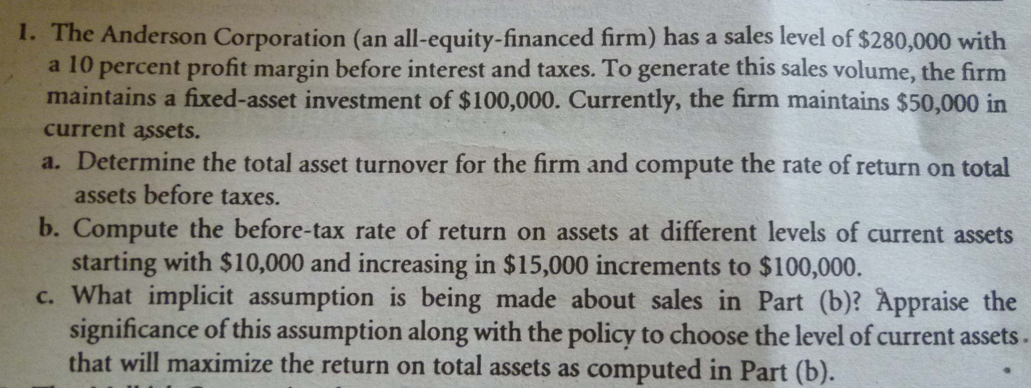
Problem 1

Slide 31
(a)
CA=50,000 FA=100,000 TA=150,000
Sales=280,000 EBIT=10% of sales=28,000
Total Asset turnover = sales / TA
Return on TA = EBIT / TA

Slide 32
(b)
Profit C. Assets F. Assets T. Assets ROA

Slide 33
(c)
Sales & costs are assumed to be constant
The level of working capital has no impact on sales or costs.
One can visualize situations where sales are lost as a result of stock outs and
costs may increase as more lost time in production is caused by shortages of materials

Slide 34
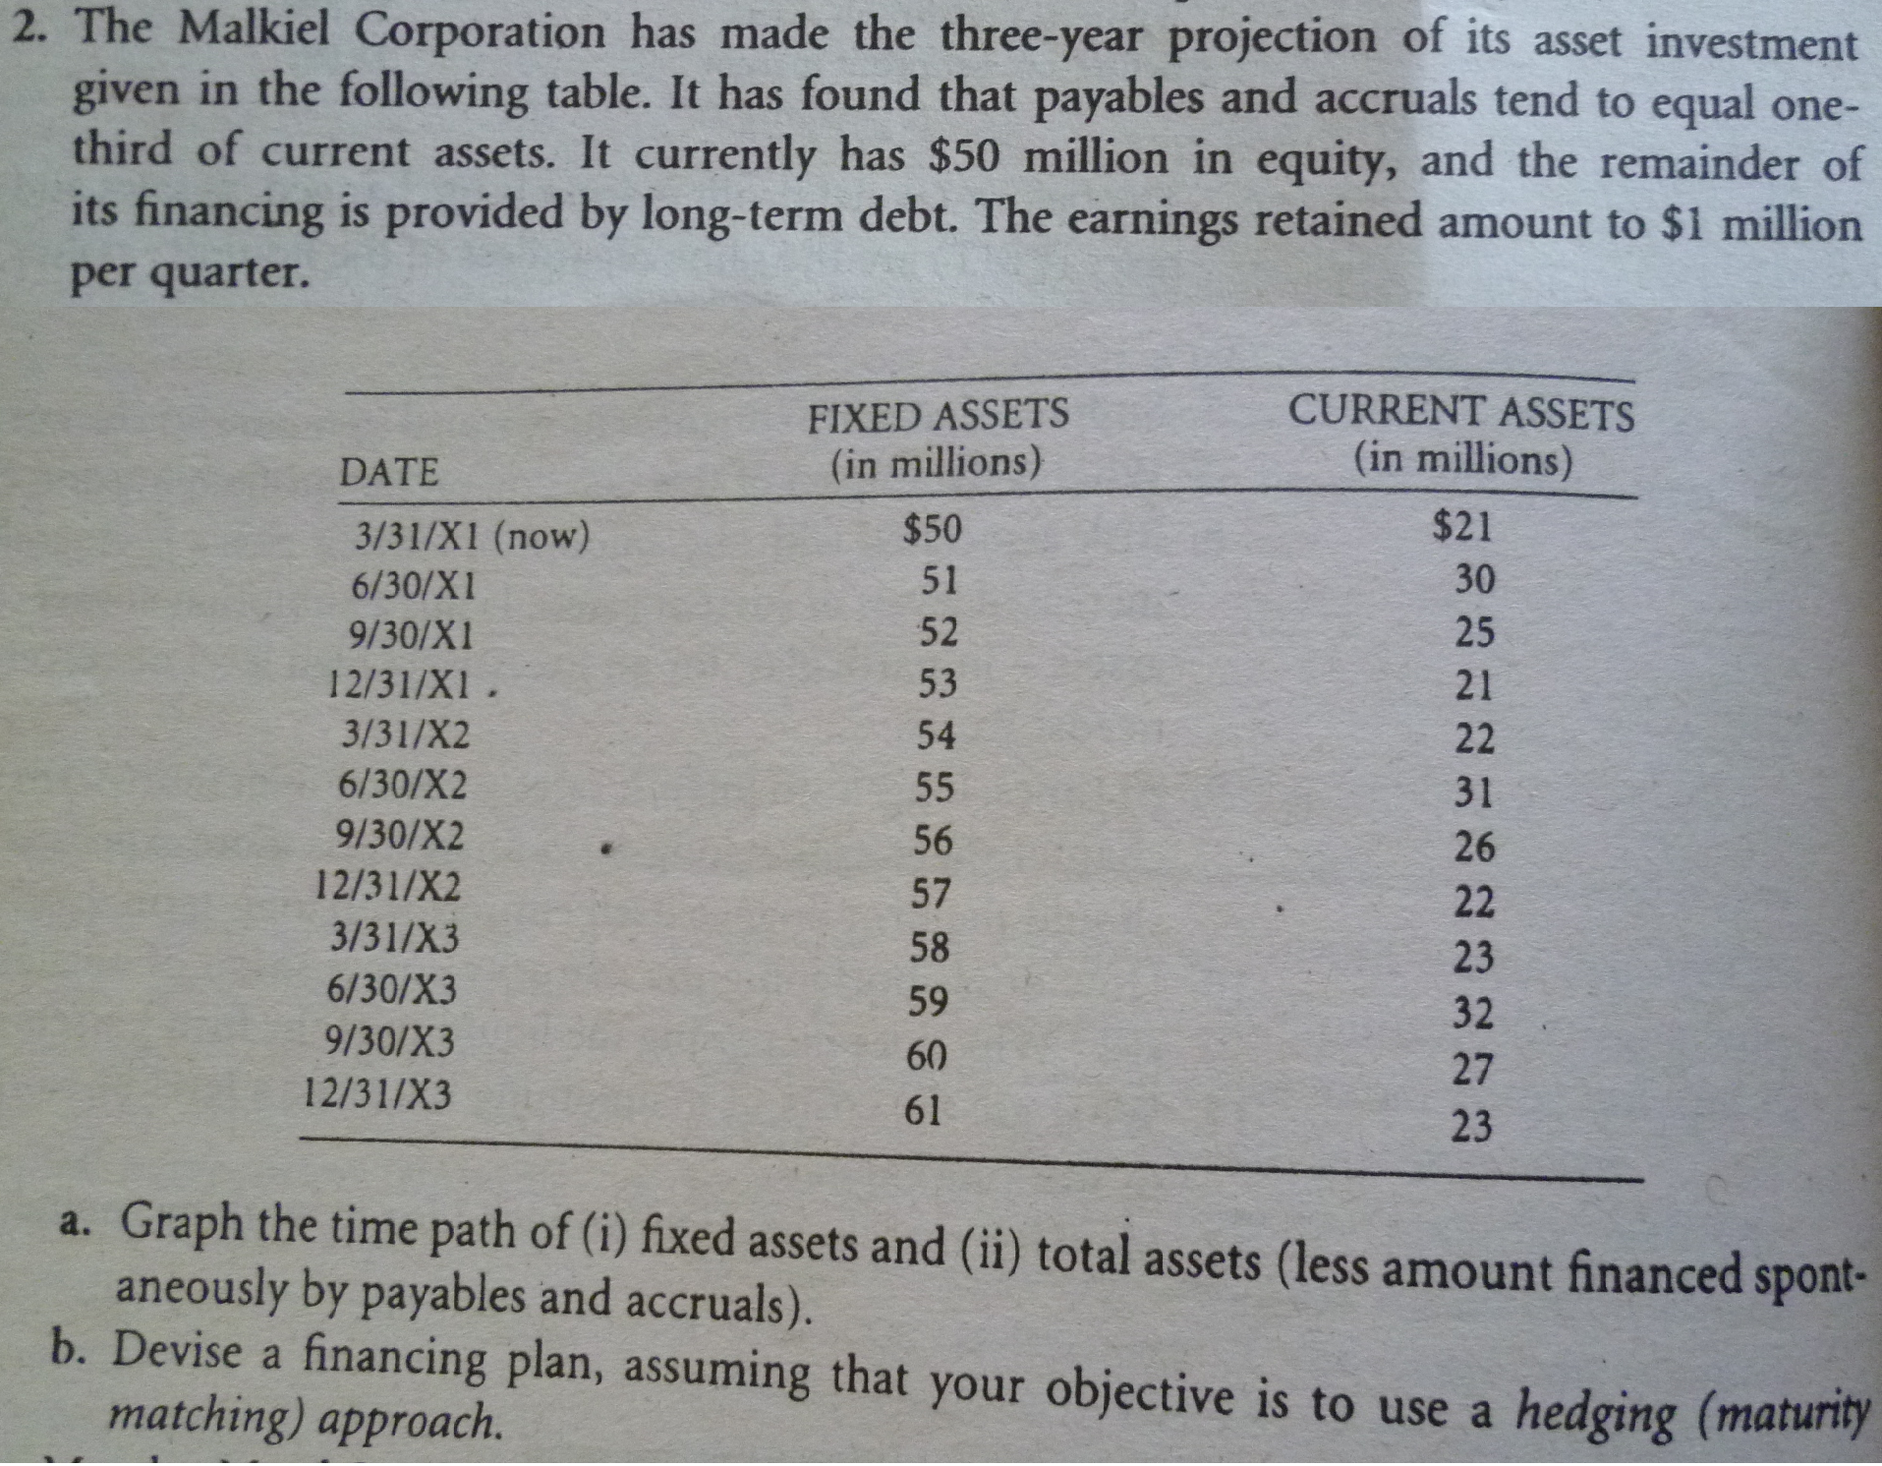

Slide 35
Problem .2
Date | FA | CA | Spont | TA | TA-spont
1-Q1 | 50 | 21 | 7.00 | 71.00 | 64.00
1-Q2 | 51 | 30 | 10.00 | 81.00 | 71.00
1-Q3 | 52 | 25 | 8.33 | 77.00 | 68.67
1-Q4 | 53 | 21 | 7.00 | 74.00 | 67.00
2-Q1 | 54 | 22 | 7.33 | 76.00 | 68.67
2-Q2 | 55 | 31 | 10.33 | 86.00 | 75.67
2-Q3 | 56 | 26 | 8.67 | 82.00 | 73.33
2-Q4 | 57 | 22 | 7.33 | 79.00 | 71.67
3-Q1 | 58 | 23 | 7.67 | 81.00 | 73.33
3-Q2 | 59 | 32 | 10.67 | 91.00 | 80.33
3-Q3 | 60 | 27 | 9.00 | 87.00 | 78.00
3-Q4 | 61 | 23 | 7.67 | 84.00 | 76.33

Slide 36
Date | FA | TA-spont
1-Q1 | 50.00 | 64.00
1-Q2 | 51.00 | 71.00
1-Q3 | 52.00 | 68.67
1-Q4 | 53.00 | 67.00
2-Q1 | 54.00 | 68.67
2-Q2 | 55.00 | 75.67
2-Q3 | 56.00 | 73.33
2-Q4 | 57.00 | 71.67
3-Q1 | 58.00 | 73.33
3-Q2 | 59.00 | 80.33
3-Q3 | 60.00 | 78.00
3-Q4 | 61.00 | 76.33
Finance 14 million of WC with permanent sources of funds.
Finance fixed assets with common stock and retained earnings.
Finance the temporary working capital with short term debt.

Slide 37
Summary
Understand the two fundamental decision issues in working capital management -- and the trade-offs involved in making these decisions.
Discuss how to determine the optimal level of current assets.
Describe the relationship between profitability, liquidity, and risk in the management of working capital.
Explain how to classify working capital according to its “components” and according to “time
Describe the hedging (maturity matching) approach to financing and the advantages/disadvantages of short- versus long-term financing.

