Slide 1
Lecture 05

Slide 2
Lecture 04
Service vs Merchandising Business
Accounts on the Income Statement
Terms used in merchandizing
Sample income statement
Computation of Costs
Balance Sheet Accounts
Closing Entries

Slide 3
Comparing Merchandising and Manufacturing Activities
Merchandisers . . .
  Buy finished goods.
  Sell finished goods.
Manufacturers . . .
  Buy raw materials.
  Produce and sell finished goods.
MegaLoMart

Slide 4
Manufacturing Costs
Direct
Materials
Direct
Labor
Manufacturing
Overhead
The Product

Slide 5
Direct Materials
Those materials that become an integral part of the product and that can be conveniently traced directly to it.
Example: A radio installed in an automobile

Slide 6
Direct Labor
Those labor costs that can be easily traced to individual units of product.
Example: Wages paid to automobile assembly workers

Slide 7
Manufacturing Overhead
Manufacturing costs that cannot be traced directly to specific units produced.
Examples: Indirect labor and indirect materials
Wages paid to employees who are not directly involved in production work.
Examples: maintenance workers, janitors and security guards.
Materials used to support the production process.
Examples: lubricants and cleaning supplies used in the automobile assembly plant.

Slide 8
Classifications of Costs
Manufacturing costs are often
classified as follows:
Direct
Material
Direct
Labor
Manufacturing
Overhead
Prime
Cost
Conversion
Cost

Slide 9
Nonmanufacturing Costs
Marketing and selling costs . . .
  Costs necessary to get the order and deliver the product.
Administrative costs . . .
  All executive, organizational, and clerical costs.

Slide 10
Quick Check ✓
Which of the following costs would be considered manufacturing overhead at Boeing? (More than one answer may be correct.)
  A. Depreciation on factory forklift trucks.
  B. Sales commissions.
  C. The cost of a flight recorder in a Boeing 767.
  D. The wages of a production shift supervisor.

Slide 11
Quick Check ✓
Which of the following costs would be considered manufacturing overhead at Boeing? (More than one answer may be correct.)
  A. Depreciation on factory forklift trucks.
  B. Sales commissions.
  C. The cost of a flight recorder in a Boeing 767.
  D. The wages of a production shift supervisor.

Slide 12
Product Costs Versus Period Costs
Product costs include direct materials, direct labor, and manufacturing overhead.
Period costs are not included in product costs. They are expensed on the income statement.
Inventory
Cost of Good Sold
Expense
Sale
Balance
Sheet
Income
Statement
Income
Statement

Slide 13
Quick Check ✓
Which of the following costs would be considered a period rather than a product cost in a manufacturing company?
  A. Manufacturing equipment depreciation.
  B. Property taxes on corporate headquarters.
  C. Direct materials costs.
  D. Electrical costs to light the production facility.

Slide 14
Quick Check ✓
Which of the following costs would be considered a period rather than a product cost in a manufacturing company?
  A. Manufacturing equipment depreciation.
  B. Property taxes on corporate headquarters.
  C. Direct materials costs.
  D. Electrical costs to light the production facility.

Slide 15
Balance Sheet
Merchandiser
Current assets
  Cash
  Receivables
  Prepaid expenses
  Merchandise inventory
Manufacturer
Current Assets
  Cash
  Receivables
  Prepaid Expenses
  Inventories
    Raw Materials
    Work in Process
    Finished Goods

Slide 16
Balance Sheet
Merchandiser
Current assets
  Cash
  Receivables
  Prepaid expenses
  Merchandise inventory
Manufacturer
Current Assets
  Cash
  Receivables
  Prepaid Expenses
  Inventories
    Raw Materials
    Work in Process
    Finished Goods
Materials waiting to be processed.
Partially complete products – some material, labor, or overhead has been added.
Completed products awaiting sale.

Slide 17
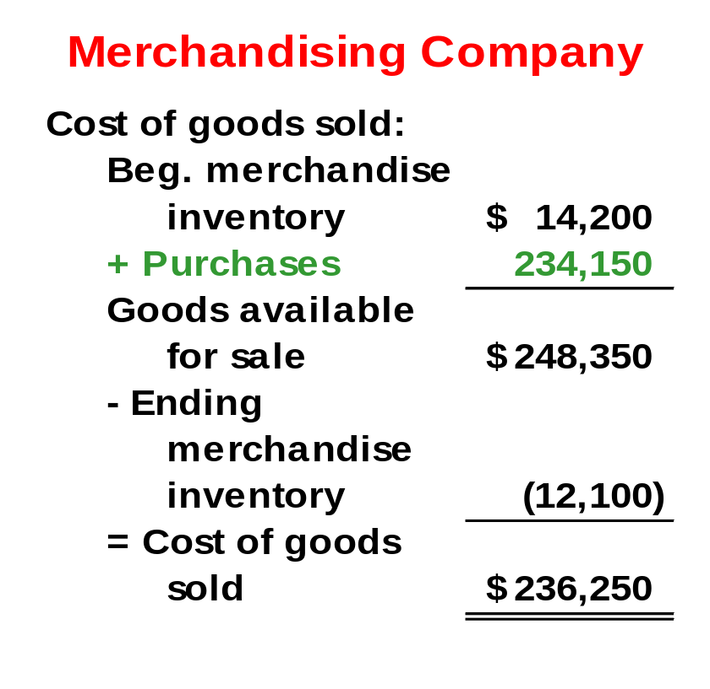
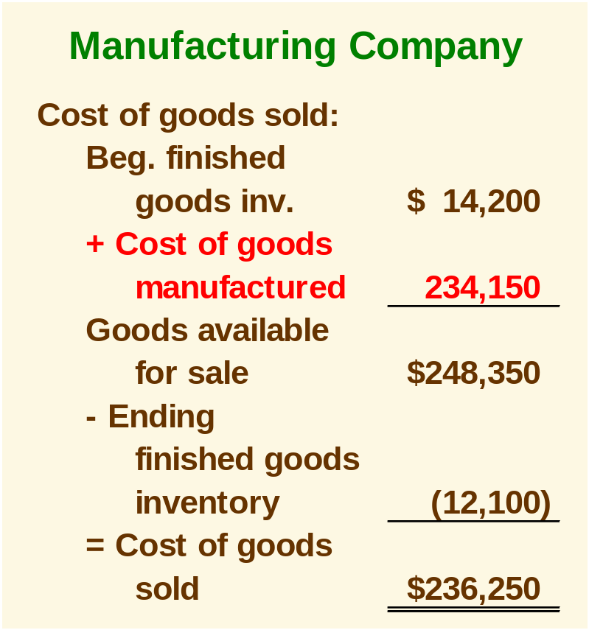
The Income Statement
Cost of goods sold for manufacturers differs only slightly from cost of goods sold for merchandisers.

Slide 18
Manufacturing Cost Flows
Income
Statement
Expenses
Balance Sheet
Costs Inventories
Material Purchases
Raw Materials
Direct Labor
Work in
Process
Manufacturing
Overhead
Cost of
Goods
Sold
Finished
Goods
Selling and
Administrative
Period Costs
Selling and
Administrative

Slide 19
Quick Check ✓
Which of the following transactions would immediately result in an expense? (There may be more than one correct answer.)
  A. Work in process is completed.
  B. Finished goods are sold.
  C. Raw materials are placed into production.
  D. Administrative salaries are accrued and paid.

Slide 20
Quick Check ✓
Which of the following transactions would immediately result in an expense? (There may be more than one correct answer.)
  A. Work in process is completed.
  B. Finished goods are sold.
  C. Raw materials are placed into production.
  D. Administrative salaries are accrued and paid.

Slide 21
Lecture 05
Comparing Merchandising and Manufacturing Activities
Manufacturing Costs
Classifications of Costs
Nonmanufacturing Costs
Product Costs Versus Period Costs
Comparing Merchandising and Manufacturing Activities Financial Statement
Manufacturing Cost Flows

Slide 22
End of Lecture 05

