Slide 1
Lecture 19

Slide 2
Lecture Overview
Systems Design: Activity-Based Costing
Assigning Overhead Costs to Products
Plantwide Overhead Rate
Departmental Overhead Rates
Activity-Based Costing (ABC)
Designing an ABC System
Hierarchy of Activities
Activity-Based Costing at Classic Brass
Using Activity-Based Costing
Direct Labor-Hours as a Base
Computing Activity Rates

Slide 3
Targeting Process Improvements
Activity-Based Management
involves focusing on activities to eliminate waste, decrease processing time, and reduce defects.
Benchmarking
is a systematic approach to identifying the activities with the greatest room for improvement. It is based on comparing the performance in an organization with the performance of other, similar organizations known for their outstanding performance.

Slide 4
Evaluation of Activity-Based Costing
Benefits of ABC
  Improves the accuracy of product costs.
  Activity cost pools are more homogeneous than departmental cost pools.
  Allocates overhead on the basis of activities that cause overhead costs.

Slide 5
Evaluation of Activity-Based Costing
Benefits of ABC
  Improves the accuracy of product costs.
  Activity cost pools are more homogeneous than departmental cost pools.
  Allocates overhead on the basis of activities that cause overhead costs.
Limitations of ABC
  Cost of implementation may exceed benefits.
  Products costs are not always relevant when making decisions.

Slide 6

ABC and Service Industries
Activity-based costing has been implemented in a wide variety of service industries including railroads, hospitals, banks, and data service companies.

Slide 7
Cost Flows in an ABC System
Sarvik Company uses activity-based costing. The company has five cost pools shown below.

Slide 8
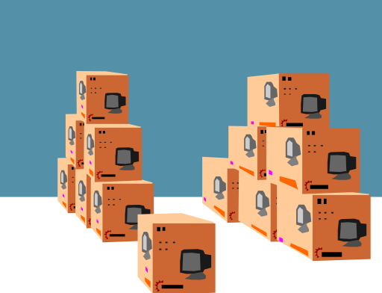
Cost Flows in an ABC System
At the beginning of the year, the company had inventory balance as follows.
Raw materials | $3,000
Work in process | 4,000
Finished goods | - 0 -

Slide 9
Cost Flows in an ABC System
Transaction recorded by the company:
Raw materials purchased on account, $915,000.
Raw materials used in production, $900,000 ($810,000 direct and $90,000 indirect).
Factory labor costs, $370,000 ($95,000 direct and $275,000 indirect).
Depreciation of factory assets, $180,000.
Miscellaneous manufacturing overhead costs, $230,000.
Goods costing $1,650,000 manufactured.

Slide 10
Cost Flows in an ABC System
Manufacturing overhead cost was applied to production. Actual activity during the year was as follows:
Machine related, 4,600 machine-hours.
Purchase orders, 800 orders.
Machine setups, 500 setups.
Product testing, 190 tests.
General factory, 23,000 direct-labor hours.

Slide 11
Cost Flows in an ABC System
The following journal entries would be used to record transactions (a) through (c).

Slide 12
Cost Flows in an ABC System
Predetermined overhead rates are determined as follows:

Slide 13
Cost Flows in an ABC System
Overhead is applied on the basis of actual activities during the year.

Slide 14
Cost Flows in an ABC System
The following journal entry is made to record applied overhead.

Slide 15
Cost Flows in an ABC System
The following journal entries would be used to record transactions (d) through (f).

Slide 16
Raw Materials
Work in Process
Bal. 3,000
(a) 915,000
Bal. 18,000
(b) 900,000
Bal. 4,000
(b) 810,000
(c) 95,000
(f) 761,000
(g) 1, 650,000
Bal. 20,000
Accumulated Depreciation
Wages Payable
(d) 180,000
(c) 370,000
Accounts Payable
Manufacturing Overhead
(a) 915,000
(e) 230,000
(b) 90,000
(c) 275,000
(d) 180,000
(e) 230,000
(g) 761,000
Bal. 14,000
Finished Goods
Underapplied Overhead Costs
Bal. -0-
(g) 1,650,000

Slide 17
Urban cosmetics have used a traditional cost accounting system to apply quality control costs uniformly to all products at a rate of 14.5 percent of direct labor cost. Monthly direct labor cost for sheen makeup is $27500. In an attempt to more equitably distribute quality control cost, management is considering activity based costing. The monthly data is shown in the following chart have been gathered for sheen makeup
Activity Cost Pool | Cost Driver | Pool Rate | Quantity of Driver for Sheen
Material Inspection | Type of Material | $11.5 per type | 12 types
Design Inspection | Number of units | 0.14 per unit | 17500 units
Production certification | Per order | 77 per order | 25 orders
Calculate the monthly quality control cost to be assigned to the Sheen product line under each of the costing method.
Traditional system which assign overhead based upon direct labor
Activity based costing
Does traditional product costing over-cost or under-cost the Sheen product line?

Slide 20
End of Lecture 19

