Slide 1
Chapter 20
Sustainable Marketing:
Social Responsibility and Ethics

Slide 2
Topics to Cover
Consumer Actions to Promote Sustainable Marketing
Business Actions Toward Sustainable Marketing

Slide 3
Consumer Actions to Promote Sustainable Marketing
Consumerism is the organized movement of citizens and government agencies to improve the rights and power of buyers in relation to sellers

Slide 4
Consumer Actions to Promote Sustainable Marketing
Consumerism
Traditional buyers’ rights include:
The right not to buy a product that is offered for sale
The right to expect the product to be safe
The right to expect the product to perform as claimed
Comparing these rights, many believe that the balance of power lies on the seller’s side

Slide 5
Consumer Actions to Promote Sustainable Marketing
Consumerism
Advocates call for:
The right to be well informed about important aspects of the product
The right to be protected against questionable products and marketing practices
The right to influence products and marketing practices in ways that will improve the “quality of life”
The right to consume now in a way that will preserve the world for future generations of consumers

Slide 6
Consumer Actions to Promote Sustainable Marketing
Consumerism
Advocates call for:
The right to be well informed about important aspects of the product
The right to be protected against questionable products and marketing practices
The right to influence products and marketing practices in ways that will improve the “quality of life”
The right to consume now in a way that will preserve the world for future generations of consumers

Slide 7
Consumer Actions to Promote Sustainable Marketing
Environmentalism is an organized movement of concerned citizens, businesses, and government agencies to protect and improve people’s living environment

Slide 8
Consumer Actions to Promote Sustainable Marketing
Environmentalism
Environmental Sustainability
Pollution prevention
Product stewardship
Design for environment (DFE)
New clean technologies
Sustainability vision

Slide 9
Consumer Actions to Promote Sustainable Marketing
Environmentalism
Environmental Sustainability
Pollution prevention involves not just cleaning up waste but also eliminating or minimizing waste before it is created
Product stewardship involves minimizing the pollution from production and all environmental impact throughout the full product life cycle

Slide 10
Consumer Actions to Promote Sustainable Marketing
Environmentalism
Environmental Sustainability
Design for environment (DFE) involves thinking ahead to design products that are easier to recover, reuse, or recycle
New clean technologies involve looking ahead and planning new technologies for competitive advantage

Slide 11
Consumer Actions to Promote Sustainable Marketing
Environmentalism
Environmental Sustainability
Sustainability vision is a guide to the future that shows the company that the company’s products, process, and policies must evolve and what is needed to get there

Slide 12
Business Actions Toward Sustainable Marketing
Sustainable Marketing Principles
Consumer-Oriented Marketing
Customer-Value Marketing
Innovative Marketing
Sense-of-mission Marketing
Societal Marketing

Slide 13
Business Actions Toward Sustainable Marketing
Consumer-Oriented Marketing
View marketing activities from the consumer's point of view
Deliver superior value

Slide 14
Business Actions Toward Sustainable Marketing
Customer-Value Marketing
Invest in customer-value building marketing
Create value FOR customers

Slide 15
Business Actions Toward Sustainable Marketing
Innovative Marketing
Company seeks real product and marketing improvements

Slide 16
Business Actions Toward Sustainable Marketing
Sense-of-Mission Marketing
Define mission in broad social terms rather than narrow product terms

Slide 17
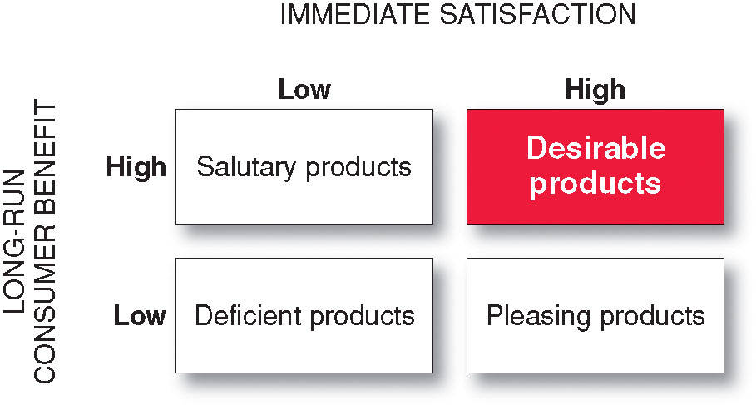
Business Actions Toward Sustainable Marketing
Societal Marketing

Slide 18
Business Actions Toward Sustainable Marketing
Marketing Ethics
Corporate marketing ethics are broad guidelines that everyone in the organization must follow that cover distributor relations, advertising standards, customer service, pricing, product development, and general ethical standards

Slide 19
Business Actions Toward Sustainable Marketing
Marketing Ethics
Who should guide companies?
The free market and the legal system?
Individual companies and managers?

Slide 20
Business Actions Toward Sustainable Marketing
The Sustainable Company
Goes beyond caring for the needs of today’s customers and has concern for tomorrow’s customers and the broader world

Slide 21
MGT-410
Marketing Theory and Practice
COURSE REVIEW

Slide 22
  PART 01 – Defining Marketing the Marketing Process
  Chapter 01 and 02
  PART 02 – Understanding the Marketplace and Consumers
  Chapter 03, 04, 05, and 06
  PART 03 – Designing Customer-Driven Marketing Strategy & Mix
  Chapter 07, 08, 09, 10, 11, 12, 13, 14, 15, 16, and 17
  PART 04 – Extending Marketing
  Chapter 18, 19, and 20

Slide 23
  PART 01 – Defining Marketing and the Marketing Process
  Chapter 01 and 02
Chapter 01
Marketing: Creating & Capturing Customer Value
Chapter 02
Company and Marketing Strategy : Partnering to Build Customer Relationships

Slide 24
  PART 02 – Understanding the Marketplace and Consumers
  Chapter 03, 04, 05, and 06
Chapter 03
Analyzing the Marketing Environment
Chapter 04
Managing Marketing Information to Gain Customer Insights
Chapter 05
Consumer Markets and Consumer Buyer Behavior
Chapter 06
Business Markets and Business Buying Behavior

Slide 25
  PART 03 – Designing Customer-Driven Marketing Strategy & Mix
  Chapter 07, 08, 09, 10, 11, 12, 13, 14, 15, 16, and 17
Chapter 07 - Customer-Driven Marketing Strategy: Creating Value for Target Customers
Chapter 08 - Product, Services, and Brands: Building Customer Value
Chapter 09 - New-Product Development and Product Life- Cycle Strategies
Chapter 10 - Pricing: Understanding and Capturing Customer Value
Chapter 11 - Pricing Strategies
Chapter 12 - Marketing Channels: Delivering Customer Value

Slide 26
  PART 03 – Designing Customer-Driven Marketing Strategy & Mix
  Chapter 07, 08, 09, 10, 11, 12, 13, 14, 15, 16, and 17
Chapter 13 - Retailing and Wholesaling
Chapter 14 - Communicating Customer Value: Integrated Marketing Communications Strategy
Chapter 15 - Advertising and Public Relations
Chapter 16 - Personal Selling and Sales Promotion
Chapter 17 - Direct and Online Marketing: Building Direct Customer Relationships

Slide 27
  PART 04 – Extending Marketing
  Chapter 18, 19, and 20
Chapter 18
Creating Competitive Advantage
Chapter 19
The Global Marketplace
Chapter 20
Sustainable Marketing: Social Responsibility and Ethics

