Slide 1
Chapter 19
The Global Marketplace

Slide 2
Topics to Cover
Deciding on the Global Marketing Program
Deciding on the Global Marketing Organization

Slide 3
Deciding on the Global
Marketing Program
Standardized marketing mix involves selling the same products and using the same marketing approaches worldwide
Adapted marketing mix involves adjusting the marketing mix elements in each target market, bearing more costs but hoping for a larger market share and ROI

Slide 4
Deciding on the Global
Marketing Program
Straight product extension means marketing a product in a foreign market without any change
Product adaptation involves changing the product to meet local conditions or wants
Product invention consists of creating something new for a specific country market
  Maintain or reintroduce earlier products
  Create new products
Product

Slide 5
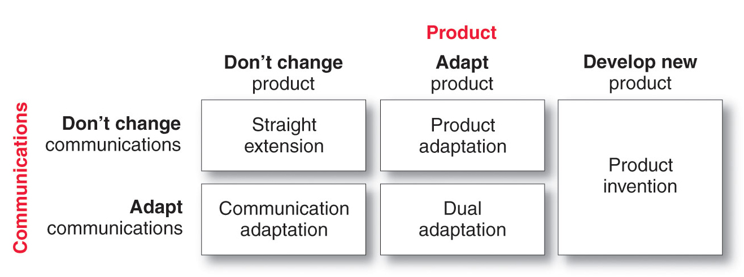
Deciding on the Global
Marketing Program
Product

Slide 6
Deciding on the Global
Marketing Program
Promotion
Companies can either adopt the same communication strategy they use at home or change it for each market

Slide 7
Deciding on the Global
Marketing Program
Price
Uniform pricing is the same price in all markets but does not consider income or wealth where the price may be too high in some or not high enough in other markets
Market-based pricing is the price the market can pay but does not consider actual costs
Standard markup pricing is a price based on a percentage of cost but can cause problems in countries with high costs

Slide 8
Deciding on the Global
Marketing Program
Distribution Channels: Whole-Channel View
Seller’s headquarters organization supervises the channel and is also a part of the channel
Channels between nations move the products to the borders of the foreign nations
Channels within nations move the products from their foreign point of entry to the final customers

Slide 9
Deciding on the Global Marketing Organization
Typical management of international marketing activities include:
Organizing and exporting department with a sales manager and staff
Creating an international division organized by geography, products, or operating units
Becoming a complete global organization

Slide 10
Chapter 20
Sustainable Marketing:
Social Responsibility and Ethics

Slide 11
Topics to Cover
Sustainable Marketing
Social Criticisms of Marketing

Slide 12
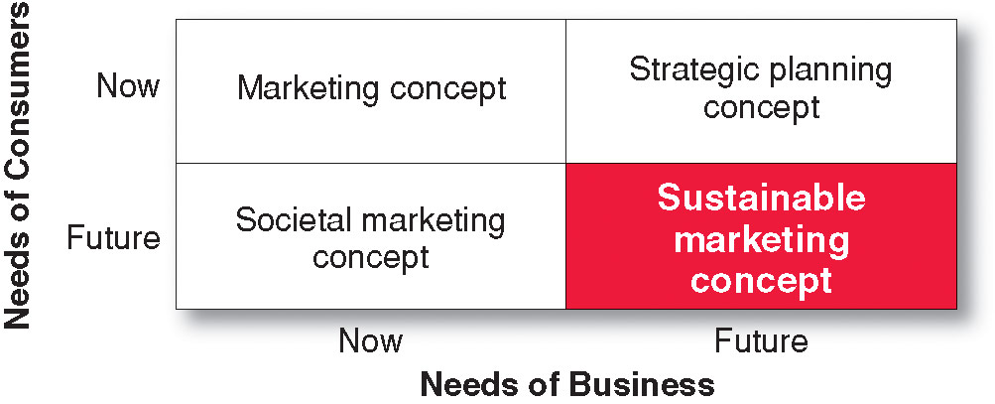
Sustainable Marketing
Meeting needs of consumers while preserving the ability of future generations to meet their needs

Slide 13
Social Criticisms of Marketing
Marketing’s Impact on Individual Consumers
High Prices
Deceptive Practices
High-Pressure Selling
Substandard, Harmful or Unsafe Products
Planned Obsolescence
Poor Service to Disadvantaged Consumers

Slide 14
Social Criticisms of Marketing
Marketing’s Impact on Individual Consumers:
High Cost of Distribution
Complaint:
Prices are too high due to high costs of:
distribution
Advertising and promotion
Excessive mark-ups
Response:
Intermediaries are important and offer value
Advertising informs buyers of availability and merits of a brand
Consumer’s don’t understand the cost of doing business

Slide 15
Social Criticisms of Marketing
Marketing’s Impact on Individual Consumers:
Deceptive Practices
Complaint:
Companies use deceptive practices that lead customers to believe they will get more value than they actually do. These practices fall into three categories:
Deceptive pricing
Deceptive promotion
Deceptive packaging

Slide 16
Social Criticisms of Marketing
Marketing’s Impact on Individual Consumers:
Deceptive Practices
Response:
Support Legislation to protect consumers from deceptive practices
Make lines clear—Is it deception, alluring, or puffery that is just an exaggeration for effect?
Products that are harmful
Products that provide little benefit
Products that are not made well

Slide 17
Social Criticisms of Marketing
Marketing’s Impact on Individual Consumers:
Deceptive Practices
Response:
Support Legislation to protect consumers from deceptive practices
Make lines clear—Is it deception, alluring, or puffery that is just an exaggeration for effect?
Products that are harmful
Products that provide little benefit
Products that are not made well

Slide 18
Social Criticisms of Marketing
Marketing’s Impact on Individual Consumers:
High-Pressure Selling
Complaint:
Salespeople use high-pressure selling that persuade people to buy goods they had no intention of buying.
Response:
Most selling involves building long-term relationships and valued customers. High-pressure or deceptive selling can damage these relationships.

Slide 19
Social Criticisms of Marketing
Marketing’s Impact on Individual Consumers:
Substandard, Harmful, or Unsafe Products
Complaint:
Products have poor quality, provide little benefit, and can be harmful.
Response:
Good marketers realize there is no value in marketing substandard (shoddy), harmful, or unsafe products.

Slide 20
Social Criticisms of Marketing
Marketing’s Impact on Individual Consumers:
Planned Obsolescence
Complaint:
Producers cause their products to become obsolete and change consumers’ concepts of acceptable styles to encourage more and earlier buying.
Response:
Planned obsolescence is really the result of competitive market forces leading to ever-improving goods and services.
Customers like style changes and want the latest innovations

Slide 21
Social Criticisms of Marketing
Marketing’s Impact on Individual Consumers:
Poor Service to Disadvantaged Consumers
Complaint:
Marketers serve disadvantaged customers poorly. Some retail companies “redline” poor neighborhoods and avoid placing stores there.
Response:
Some marketers profitably target these customers

Slide 22
Social Criticisms of Marketing
Marketing’s Impact on Society as a Whole
False wants and too much materialism
Too few social goods
Cultural pollution

Slide 23
Social Criticisms of Marketing
Marketing’s Impact on Society as a Whole
False Wants and Too Much Materialism
Complaint:
The marketing system urges too much interest in material possessions. People are judged by what they own rather than who they are, creating false wants that benefit industry more than they benefit consumers.
Response:
People do have strong defenses against advertising and other marketing tools. Marketers are most effective when they appeal to existing wants rather than creating new ones. The high failure rate of new products shows that companies cannot control demand.

Slide 24
Social Criticisms of Marketing
Marketing’s Impact on Society as a Whole
Too Few Social Goods
Complaint:
Businesses oversell private goods at the expense of public goods and require more public goods to support them
Response:
There needs to be a balance between private and public goods
Producers should bear full social costs of their operations
Consumers should pay the social costs of their purchases

Slide 25
Social Criticisms of Marketing
Marketing’s Impact on Society as a Whole
Cultural Pollution
Complaint:
Marketing and advertising create cultural pollution
Response:
Marketing and advertising are planned to reach only a target audience, and advertising makes radio and television free to users and helps to keep down the costs of newspapers and magazines. Today’s consumers have alternatives to avoid marketing and advertising from technology.

Slide 26
Social Criticisms of Marketing
Marketing’s Impact on Society as a Whole
Cultural Pollution
Complaint:
Marketing and advertising create cultural pollution
Response:
Marketing and advertising are planned to reach only a target audience, and advertising makes radio and television free to users and helps to keep down the costs of newspapers and magazines. Today’s consumers have alternatives to avoid marketing and advertising from technology.

Slide 27
Social Criticisms of Marketing
Marketing’s Impact on Other Businesses
Acquisition of competitors
Unfair competitive marketing practices

