Slide 1
Chapter 18
Creating Competitive Advantage

Slide 2
Topics to Cover
Balancing Customer and Competitor Orientations

Slide 3
Balancing Customer and Competitor Orientations
Companies need to continuously adapt strategies to changes in the competitive environment
  Competitor-centered company
  Customer-centered company
  Market-centered company

Slide 4
Balancing Customer and Competitor Orientations
Competitor-centered company spends most of its time tracking competitor’s moves and market shares and trying to find ways to counter them
Advantage is that the company is a fighter
Disadvantage is that the company is reactive

Slide 5
Balancing Customer and Competitor Orientations
Customer-centered company spends most of its time focusing on customer developments in designing strategies
Provides a better position than competitor-centered company to identify opportunities and build customer relationships

Slide 6
Balancing Customer and Competitor Orientations
Market-centered company spends most of its time focusing on both competitor and customer developments in designing strategies

Slide 7
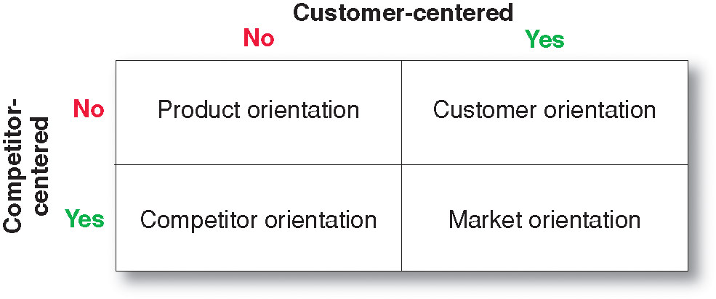
Balancing Customer and Competitor Orientations

Slide 8
Chapter 19
The Global Marketplace

Slide 9
Topics to Cover
Global Marketing Today
Looking at the Global Marketing Environment
Deciding Whether to Go Global
Deciding Which Markets to Enter
Deciding How to Enter the Market

Slide 10
Global Marketing Today
A global firm
Operates in more than one country
Gains marketing, production, R&D, and financial advantages not available to purely domestic competitors
The global firm sees the world as one market

Slide 11
Global Marketing Today
Global firms ask a number of basic questions:
What market position should we try to establish in our own country, in our economic region, and globally?
Who will our global competitors be, and what are their strategies and resources?
Where should we produce or source our product?
What strategic alliances should we form with other firms around the world?

Slide 12
Looking at the Global
Marketing Environment
The International Trade System
Restrictions on trade between nations include:
Tariffs
Quotas
Exchange controls
Nontariff trade barriers

Slide 13
Looking at the Global
Marketing Environment
The International Trade System
Tariffs are taxes on certain imported products designed to raise revenue or to protect domestic firms

Slide 14
Looking at the Global
Marketing Environment
The International Trade System
Quotas are limits on the amount of foreign imports a country will accept in certain product categories to conserve on foreign exchange and protect domestic industry and employment

Slide 15
Looking at the Global
Marketing Environment
The International Trade System
Exchange controls are a limit on the amount of foreign exchange and the exchange rate against other currencies

Slide 16
Looking at the Global
Marketing Environment
The International Trade System
Nontariff trade barriers are biases against bids or restrictive product standards that go against home country’s product features

Slide 17
Looking at the Global
Marketing Environment
The International Trade System
The World Trade Organization and GATT
General Agreement on Tariffs and Trade (GATT):
More than 60 years old treaty
Designed to promote world trade
Reduces tariffs and other international trade barriers

Slide 18
Looking at the Global
Marketing Environment
The International Trade System
The World Trade Organization and GATT
World Trade Organization
Enforces GATT rules
Mediates disputes
Imposes trade sanctions

Slide 19
Looking at the Global
Marketing Environment
The International Trade System
Regional Free Trade Zones
Economic communities are free trade zones
European Union (EU)
North American Free Trade Agreement (NAFTA)
Central American Free Trade Association (CAFTA)

Slide 20
Looking at the Global
Marketing Environment
Economic Environment
Economic factors reflect a country’s attractiveness as a market:
Industrial structure
Income distribution

Slide 21
Looking at the Global
Marketing Environment
Economic Environment
Industrial Structure
Subsistence economies
  The vast majority of people engage in simple agriculture.
Raw material exporting economies
  These economies are rich in one or more natural resources but poor in other ways.

Slide 22
Looking at the Global
Marketing Environment
Economic Environment
Industrial Structure
Industrializing economies
  In an industrializing economy, manufacturing accounts for 10 to 20 percent of the country’s economy.
Industrial economies
  Industrial economies are major exporters of manufactured goods, services, and investment funds. They trade goods among themselves and also export them to other types of economies for raw materials and semi-finished goods.

Slide 23
Looking at the Global
Marketing Environment
Economic Environment
Income Distribution
Low-income households
Middle-income households
High-income households

Slide 24
Looking at the Global
Marketing Environment
Political-Legal Environment
Country’s attitude toward international buying
Government bureaucracy
Political stability
Monetary regulations

Slide 25
Looking at the Global
Marketing Environment
Political-Legal Environment
Countertrade is non-cash payment
Barter is the exchange of goods or services
Compensation or buyback is the sale of a plant or equipment and the payment in resulting products
Counterpurchase is when the seller receives payment and agrees to spend some of the money in the other country

Slide 26
Looking at the Global
Marketing Environment
Cultural Environment
Impact of Culture on Marketing Strategy
Business norms
Cultural preferences, traditions, behaviors
The need to adapt to local cultural values and traditions rather than imposing their own

Slide 27
Deciding Whether to Go Global
Factors to consider
Can the company understand the consumers
Can it offer competitively attractive products
Will it be able to adapt to local culture
Can they deal with foreign nationals
Do the company’s managers have the experience
Has management considered regulation and political environment of other countries

Slide 28
Deciding Which Markets to Enter
Define international marketing objectives and policies
Foreign sales volume
How many countries to market to
Types of countries to market to based on:
  Geography
  Income and population
  Political climate

Slide 29
Deciding Which Markets to Enter
Rank potential global markets based on:
Market size
Market growth
Cost of doing business
Competitive advantage
Risk level

Slide 30
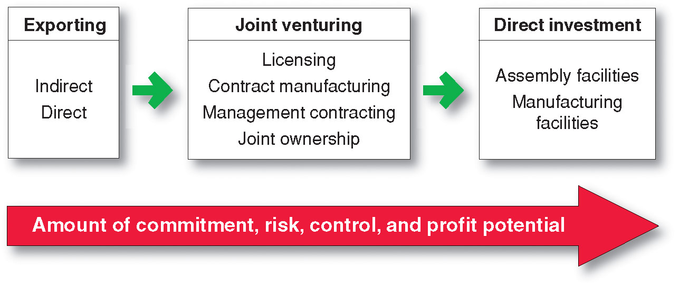
Deciding How to Enter the Market

Slide 31
Deciding How to Enter the Market
Exporting is when the company produces its goods in the home country and sells them in a foreign market. It is the simplest means involving the least change in the company’s product lines, organization, investments, or mission.
Indirect exporting
Direct exporting

Slide 32
Deciding How to Enter the Market
Joint venturing is when a firm joins with foreign companies to produce or market products or services
Licensing
Contract manufacturing
Management contracting
Joint ownership
Joint venturing differs from exporting in that the company joins with a host country partner to sell or market abroad

Slide 33
Deciding How to Enter the Market
Joint Venturing
Licensing is when a firm enters into an agreement with a licensee in a foreign market. For a fee or royalty, the licensee buys the right to use the company’s process, trademark, patent, trade secret, or other item of value.

Slide 34
Deciding How to Enter the Market
Joint Venturing
Contract manufacturing is when a firm contracts with manufacturers in the foreign market to produce its product or provide its service. Benefits include faster startup, less risk, and the opportunity to form a partnership or to buy out the local manufacturer.

Slide 35
Deciding How to Enter the Market
Joint Venturing
Management contracting is when the domestic firm supplies management skill to a foreign company that supplies capital. The domestic firm is exporting management services rather than products.

Slide 36
Deciding How to Enter the Market
Joint Venturing
Joint ownership is when one company joins forces with foreign investors to create a local business in which they share joint ownership and control. Joint ownership is sometimes required for economic or political reasons.

Slide 37
Deciding How to Enter the Market
Direct investment is the development of foreign-based assembly or manufacturing facilities and offers a number of advantages including
Labor
Logistics
Control
Government incentives
Lower costs
Raw material

