Slide 1
Chapter 17
Direct and Online Marketing:
Building Direct Customer Relationships

Slide 2
Topics to Cover
Online Marketing
Public Policy Issues in Direct Marketing

Slide 3
Online Marketing
Internet is a vast public Web of computer networks that connects users of all types around the world to each other and to a large information repository

Slide 4
Online Marketing Domains
Business to consumer
(B2C)
Business to business
(B2B)
Consumer to consumer
(C2C)
Consumer to business
(C2B)

Slide 5
Online Marketing Domains
Business to consumer (B2C) involves selling goods and services online to final consumers
Business to business (B2B) involves selling goods and services, providing information online to businesses, and building customer relationships

Slide 6
Online Marketing Domains
Consumer to consumer (C2C) occurs on the Web between interested parties over a wide range of products and subjects
Blogs
  Offer fresh, original, and inexpensive ways to reach fragmented audiences
  Difficult to control

Slide 7
Online Marketing Domains
Consumer to business (C2B) involves consumers communicating with companies to send suggestions and questions via company Web sites

Slide 8
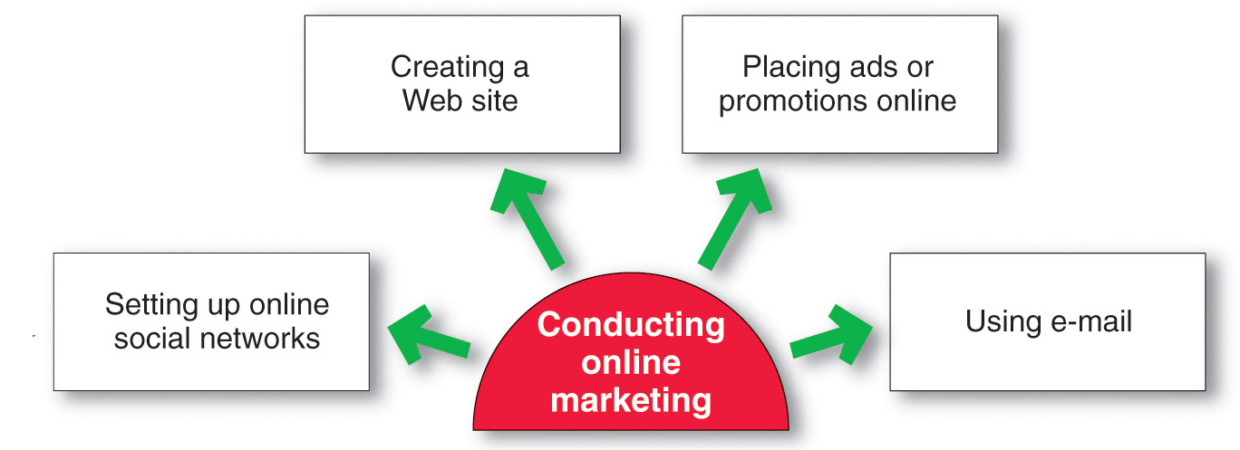
Online Marketing
Setting Up an Online Presence
Creating a Web site requires designing an attractive site and developing ways to get consumers to visit the site, remain on the site, and return to the site

Slide 9
Online Marketing
Setting Up an Online Presence
Types of sites
Corporate Web site
Marketing Web site

Slide 10
Online Marketing
Setting Up an Online Presence
Corporate Web site is designed to build customer goodwill and to supplement other channels, rather than to sell the company’s products directly to:
Provide information
Create excitement
Build relationships

Slide 11
Online Marketing
Setting Up an Online Presence
Marketing Web site is designed to engage consumers in interaction that will move them closer to a direct purchase or other marketing outcome

Slide 12
Online Marketing
Designing Effective Websites
To attract visitors, companies must:
Promote an offline promotion and online links
Create value and excitement
Constantly update the site
Make the site useful

Slide 13
Online Marketing
Designing Effective Websites: The Seven C’s
Context
Content
Community
Customization
Communication
Connection
Commerce

Slide 14
Online Marketing
Placing Ads and Promotions Online
Forms of online advertising
  Display ads
  Search-related ads
  Online classifieds

Slide 15
Online Marketing
Placing Ads and Promotions Online
Banners are banner-shaped ads found on a Web site
Interstitials are ads that appear between screen changes
Pop-ups are ads that suddenly appear in a new window in front of the window being viewed
Rich media ads incorporate animation, video, sound, and interactivity

Slide 16
Online Marketing
Placing Ads and Promotions Online
Search-related ads are ads in which text-based ads and links appear alongside search engine results on sites such as Google and Yahoo! and are effective in linking consumers to other forms of online promotion

Slide 17
Online Marketing
Other forms of online promotion include:
Content sponsorships
Alliances
Affiliate programs
Viral advertising

Slide 18
Online Marketing
Content sponsorships provide companies with name exposure through the sponsorship of special content such as news or financial information
Alliances and affiliate programs are relationships where online companies promote each other

Slide 19
Online Marketing
Viral marketing is the Internet version of word-of-mouth marketing and involves the creation of a Web site, e-mail message, or other marketing event that customers pass along to friends

Slide 20
Online Marketing
Creating or Participating in Social Networks (Web Communities)
Social Networks (Web communities) allow members to congregate online and exchange views on issues of common interest
iVillage.com
Facebook

Slide 21
Online Marketing
Using E-mail
Marketers are developing enriched messages that include animation, interactivity, and personal messages with streaming audio and video to compete with the cluttered e-mail environment

Slide 22
Online Marketing
Using E-mail
Spam is unsolicited, unwanted commercial e-mail messages
Permission-based marketing allows users to opt in or opt out of e-mail marketing

Slide 23
Online Marketing
The Promise and Challenges of Online Marketing
Online marketing will remain an important approach in the marketing mix to:
Build customer relationships
Improve sales
Communicate company and product information
Deliver products and services more effectively and efficiently

Slide 24
Public Policy Issues in Direct Marketing
Customer irritation, unfairness, deception, and fraud
Privacy
Security

Slide 25
Public Policy Issues in Direct Marketing
Irritation, Unfairness, Deception, and Fraud
Irritation includes annoying and offending customers
Unfairness includes taking unfair advantage of impulsive or less-sophisticated buyers
Deception includes “heat merchants” who design mailers and write copy designed to mislead consumers
Internet fraud includes identity theft and financial scams

Slide 26
Public Policy Issues in Direct Marketing
Invasion of Privacy
The concern is that marketers may know too much about consumers and use this information to take unfair advantage
Sale of databases

