Slide 1
Chapter 16
Personal Selling and Sales Promotion

Slide 2
Topics to Cover
Managing the Sales Force
The Personal Selling Process
Sales Promotion

Slide 3
Managing the Sales Force
Other Sales Force Strategy and Structure Issues
Outside salespeople call on customers in the field
Inside salespeople conduct business from their offices and often provide support for the outside salespeople
  Technical sales support people
  Sales assistants
  Team selling is used to service large, complex accounts
Notes:
Note to Instructor
Challenges of team selling include:
Confusing and overwhelming customers used to working with one salesperson.
Salespeople used to working alone can have difficulties working with and trusting teams.
Evaluating individual contributions can lead to compensation issues.

Slide 4
Managing the Sales Force
Recruiting and Selecting Salespeople
Issues in Recruiting and Selecting
Careful selection and training increases sales performance
Poor selection
Increases recruiting and training costs
  Lost sales
  Disrupts customer relationships
Notes:
Note to Instructor
Challenges of team selling include:
Confusing and overwhelming customers used to working with one salesperson.
Salespeople used to working alone can have difficulties working with and trusting teams.
Evaluating individual contributions can lead to compensation issues.

Slide 5
Managing the Sales Force
Salesperson compensation based on:
Fixed amounts
Variable amounts
Expenses
Fringe benefits
Notes:
Note to Instructor
Challenges of team selling include:
Confusing and overwhelming customers used to working with one salesperson.
Salespeople used to working alone can have difficulties working with and trusting teams.
Evaluating individual contributions can lead to compensation issues.

Slide 6
Managing the Sales Force
Supervising and Motivating Salespeople
The goal of supervision is to help salespeople work smart by doing the right things in the right ways
The goal of motivation is to encourage salespeople to work hard and energetically toward sales force goals
Notes:
Note to Instructor
Challenges of team selling include:
Confusing and overwhelming customers used to working with one salesperson.
Salespeople used to working alone can have difficulties working with and trusting teams.
Evaluating individual contributions can lead to compensation issues.

Slide 7
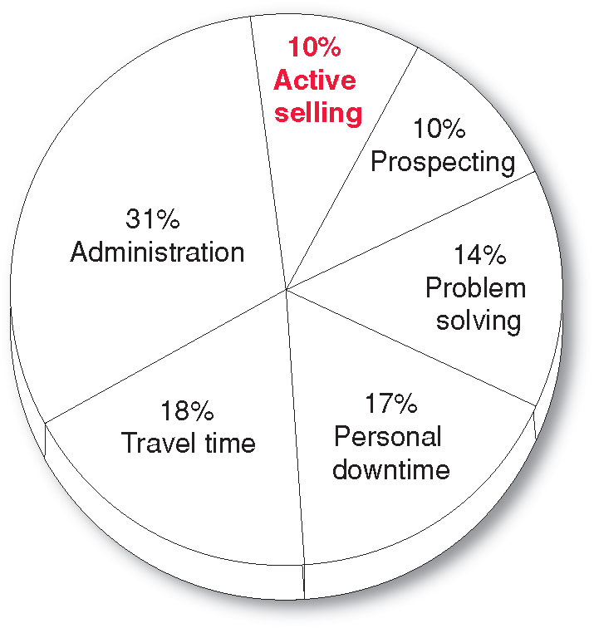
Managing the Sales Force
How Salespeople Spend Their Time
Notes:
Note to Instructor
Challenges of team selling include:
Confusing and overwhelming customers used to working with one salesperson.
Salespeople used to working alone can have difficulties working with and trusting teams.
Evaluating individual contributions can lead to compensation issues.

Slide 8
Managing the Sales Force
Selling and the Internet
Major tool to support salespeople
Training
Sales meetings
Live sales presentations
Servicing accounts
Notes:
Note to Instructor
Challenges of team selling include:
Confusing and overwhelming customers used to working with one salesperson.
Salespeople used to working alone can have difficulties working with and trusting teams.
Evaluating individual contributions can lead to compensation issues.

Slide 9
Managing the Sales Force
Supervising and Motivating Salespeople
Sales morale and performance can be increased through:
  Organizational climate
  Sales quotas
  Positive incentives
Notes:
Note to Instructor
Challenges of team selling include:
Confusing and overwhelming customers used to working with one salesperson.
Salespeople used to working alone can have difficulties working with and trusting teams.
Evaluating individual contributions can lead to compensation issues.

Slide 10
Managing the Sales Force
Evaluating Salespeople and Sales Force Performance
Sales reports
Call reports
Expense reports
Notes:
Note to Instructor
Challenges of team selling include:
Confusing and overwhelming customers used to working with one salesperson.
Salespeople used to working alone can have difficulties working with and trusting teams.
Evaluating individual contributions can lead to compensation issues.

Slide 11
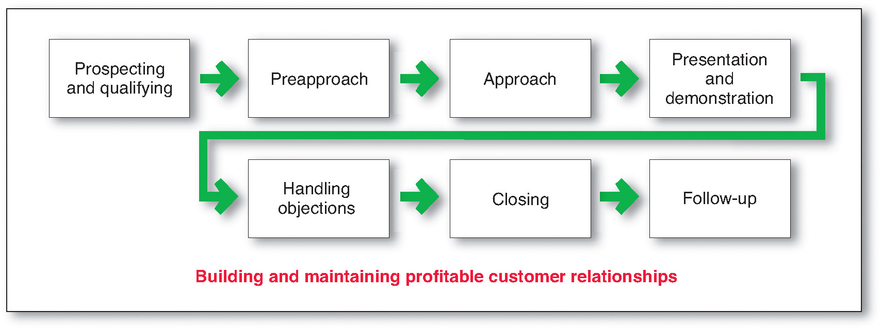
The Personal Selling Process
The goal of the personal selling process is to get new customers and obtain orders from them
Notes:
Note to Instructor
Challenges of team selling include:
Confusing and overwhelming customers used to working with one salesperson.
Salespeople used to working alone can have difficulties working with and trusting teams.
Evaluating individual contributions can lead to compensation issues.

Slide 12
The Personal Selling Process
Steps in the Personal Selling Process
Prospecting identifies qualified potential customers through referrals from:
Customers
Suppliers
Dealers
Internet
Notes:
Note to Instructor
Challenges of team selling include:
Confusing and overwhelming customers used to working with one salesperson.
Salespeople used to working alone can have difficulties working with and trusting teams.
Evaluating individual contributions can lead to compensation issues.

Slide 13
The Personal Selling Process
Steps in the Personal Selling Process
Qualifying is identifying good customers and screening out poor ones by looking at:
Financial ability
Volume of business
Needs
Location
Growth potential
Notes:
Note to Instructor
Challenges of team selling include:
Confusing and overwhelming customers used to working with one salesperson.
Salespeople used to working alone can have difficulties working with and trusting teams.
Evaluating individual contributions can lead to compensation issues.

Slide 14
The Personal Selling Process
Steps in the Personal Selling Process
Pre-approach is the process of learning as much as possible about a prospect, including needs, who is involved in the buying, and the characteristics and styles of the buyers
Objectives
Qualify the prospect
Gather information
Make an immediate sale
Approaches
Personal visit
Phone call
Letter
Notes:
Note to Instructor
Challenges of team selling include:
Confusing and overwhelming customers used to working with one salesperson.
Salespeople used to working alone can have difficulties working with and trusting teams.
Evaluating individual contributions can lead to compensation issues.

Slide 15
The Personal Selling Process
Steps in the Personal Selling Process
Approach is the process where the salesperson meets and greets the buyer and gets the relationship off to a good start and involves the salesperson’s:
Appearance
Opening lines
Follow-up remarks
Notes:
Note to Instructor
Challenges of team selling include:
Confusing and overwhelming customers used to working with one salesperson.
Salespeople used to working alone can have difficulties working with and trusting teams.
Evaluating individual contributions can lead to compensation issues.

Slide 16
The Personal Selling Process
Steps in the Personal Selling Process
Opening lines should be positive, build goodwill, and be followed by key questions to learn about the customer’s needs or showing a display or sample to attract the buyer’s attention and curiosity
The most important attribute is for the salesperson to: listen
Notes:
Note to Instructor
Challenges of team selling include:
Confusing and overwhelming customers used to working with one salesperson.
Salespeople used to working alone can have difficulties working with and trusting teams.
Evaluating individual contributions can lead to compensation issues.

Slide 17
The Personal Selling Process
Steps in the Personal Selling Process
Presentation is when the salesperson tells the product story to the buyer, presenting customer benefits and showing how the product solves the customer’s problems
Need-satisfaction approach: Buyers want solutions and salespeople should listen and respond with the right products and services to solve customer problems
Notes:
Note to Instructor
Challenges of team selling include:
Confusing and overwhelming customers used to working with one salesperson.
Salespeople used to working alone can have difficulties working with and trusting teams.
Evaluating individual contributions can lead to compensation issues.

Slide 18
The Personal Selling Process
Steps in the Personal Selling Process
Bad Traits
Pushy
Late
Deceitful
Disorganized
Unprepared
Notes:
Note to Instructor
Challenges of team selling include:
Confusing and overwhelming customers used to working with one salesperson.
Salespeople used to working alone can have difficulties working with and trusting teams.
Evaluating individual contributions can lead to compensation issues.

Slide 19
The Personal Selling Process
Steps in the Personal Selling Process
Good Traits
Good listeners
Empathetic
Honest
Dependable
Thorough
Follow-up types
Notes:
Note to Instructor
Challenges of team selling include:
Confusing and overwhelming customers used to working with one salesperson.
Salespeople used to working alone can have difficulties working with and trusting teams.
Evaluating individual contributions can lead to compensation issues.

Slide 20
The Personal Selling Process
Steps in the Personal Selling Process
Handling objections is the process where salespeople resolve problems that are logical, psychological, or unspoken
Notes:
Note to Instructor
Challenges of team selling include:
Confusing and overwhelming customers used to working with one salesperson.
Salespeople used to working alone can have difficulties working with and trusting teams.
Evaluating individual contributions can lead to compensation issues.

Slide 21
The Personal Selling Process
Steps in the Personal Selling Process
Closing is the process where salespeople should recognize signals from the buyer—including physical actions, comments, and questions—to close the sale
Notes:
Note to Instructor
Challenges of team selling include:
Confusing and overwhelming customers used to working with one salesperson.
Salespeople used to working alone can have difficulties working with and trusting teams.
Evaluating individual contributions can lead to compensation issues.

Slide 22
The Personal Selling Process
Steps in the Personal Selling Process
Follow-up is the last step in which the salesperson follows up after the sale to ensure customer satisfaction and repeat business
Notes:
Note to Instructor
Challenges of team selling include:
Confusing and overwhelming customers used to working with one salesperson.
Salespeople used to working alone can have difficulties working with and trusting teams.
Evaluating individual contributions can lead to compensation issues.

Slide 23
The Personal Selling Process
Personal Selling and Managing Customer Relationships
Personal selling is transaction-oriented to close a specific sale with a specific customer
The long-term goal is to develop a mutually profitable relationship
Notes:
Note to Instructor
Challenges of team selling include:
Confusing and overwhelming customers used to working with one salesperson.
Salespeople used to working alone can have difficulties working with and trusting teams.
Evaluating individual contributions can lead to compensation issues.

Slide 24
Sales Promotion
Sales promotion refers to the short-term incentives to encourage purchases or sales of a product or service:
  Consumer promotions
  Trade promotions
  Sales force promotions
Notes:
Note to Instructor
Challenges of team selling include:
Confusing and overwhelming customers used to working with one salesperson.
Salespeople used to working alone can have difficulties working with and trusting teams.
Evaluating individual contributions can lead to compensation issues.

Slide 25
Sales Promotion
Factors in the Growth of Sales Promotions
Product managers are under pressure to increase current sales
Companies face more competition
Competing brands offer less differentiation
Advertising efficiency has declined due to rising costs, clutter, and legal constraints
Consumers have become more deal-oriented
Notes:
Note to Instructor
Challenges of team selling include:
Confusing and overwhelming customers used to working with one salesperson.
Salespeople used to working alone can have difficulties working with and trusting teams.
Evaluating individual contributions can lead to compensation issues.

Slide 26
Sales Promotion
Sales Promotion Objectives
Setting sales promotion objectives includes using:
  Consumer promotions
  Trade promotions
  Sales force promotions
Notes:
Note to Instructor
Challenges of team selling include:
Confusing and overwhelming customers used to working with one salesperson.
Salespeople used to working alone can have difficulties working with and trusting teams.
Evaluating individual contributions can lead to compensation issues.

Slide 27
Sales Promotion
Major Sales Promotion Tools
Samples
Coupons
Cash refunds
Price packs
Premiums
Advertising specialties
Patronage rewards
Point-of-purchase displays
Demonstrations
Contests
Sweepstakes
Games
Notes:
Note to Instructor
Challenges of team selling include:
Confusing and overwhelming customers used to working with one salesperson.
Salespeople used to working alone can have difficulties working with and trusting teams.
Evaluating individual contributions can lead to compensation issues.

Slide 28
Sales Promotion
Major Sales Promotion Tools
Consumer Promotion Tools
Samples offer a trial amount of a product
Coupons are certificates that give buyers a saving when they purchase specified products
Cash refunds are similar to coupons except that the price reduction occurs after the purchase
Price packs offer consumers savings off the regular price of a product
Notes:
Note to Instructor
Challenges of team selling include:
Confusing and overwhelming customers used to working with one salesperson.
Salespeople used to working alone can have difficulties working with and trusting teams.
Evaluating individual contributions can lead to compensation issues.

Slide 29
Sales Promotion
Major Sales Promotion Tools
Consumer Promotion Tools
Premiums are goods offered either for free or at low price
Advertising specialties are useful articles imprinted with the advertiser’s name, logo, or message that are given as gifts to consumers
Point-of-purchase promotions include displays and demonstrations that take place at the point of sales
Notes:
Note to Instructor
Challenges of team selling include:
Confusing and overwhelming customers used to working with one salesperson.
Salespeople used to working alone can have difficulties working with and trusting teams.
Evaluating individual contributions can lead to compensation issues.

Slide 30
Sales Promotion
Major Sales Promotion Tools
Consumer Promotion Tools
Contests, sweepstakes, and games give consumers the chance to win something—such as cash, trips, or goods—by luck or through extra effort
Contests require an entry by a consumer
Sweepstakes require consumers to submit their names for a drawing
Games present consumers with something that may or may not help them win a prize
Event marketing
Notes:
Note to Instructor
Challenges of team selling include:
Confusing and overwhelming customers used to working with one salesperson.
Salespeople used to working alone can have difficulties working with and trusting teams.
Evaluating individual contributions can lead to compensation issues.

Slide 31
Sales Promotion
Major Sales Promotion Tools
Trade Promotion Tools
Discount
Allowance
Free goods
Specialty advertising
Notes:
Note to Instructor
Challenges of team selling include:
Confusing and overwhelming customers used to working with one salesperson.
Salespeople used to working alone can have difficulties working with and trusting teams.
Evaluating individual contributions can lead to compensation issues.

Slide 32
Sales Promotion
Major Sales Promotion Tools
Business Promotion Tools
Conventions and trade shows are effective to reach many customers not reached with the regular sales force
Sales contests are effective in motivating salespeople or dealers to increase performance over a given period
Notes:
Note to Instructor
Challenges of team selling include:
Confusing and overwhelming customers used to working with one salesperson.
Salespeople used to working alone can have difficulties working with and trusting teams.
Evaluating individual contributions can lead to compensation issues.

Slide 33
Sales Promotion
Developing the Sales Promotion Program
Size of the incentive
Conditions for participation
Promote and distribute the program
Length of the program
Evaluation of the program
Notes:
Note to Instructor
Challenges of team selling include:
Confusing and overwhelming customers used to working with one salesperson.
Salespeople used to working alone can have difficulties working with and trusting teams.
Evaluating individual contributions can lead to compensation issues.

