Slide 1
Chapter 14
Communicating Customer Value: Integrated Marketing Communications Strategy

Slide 2
Topics to Cover
Setting the Total Promotion Budget and Mix
Socially Responsible Marketing Communication

Slide 3
Setting the Total Promotion
Budget and Mix
Setting the Total Promotion Budget
Affordable budget method sets the budget at an affordable level
Ignores the effects of promotion on sales
Small businesses often use this method
Usually business start with total revenues, deduct operating expenses and capital outlays and then devote some portion of the remaining funds to advertising
Notes:
Note to Instructor
Although television, magazines, and other mass media remain very important, their dominance is declining. Advertisers are now adding a broad selection of more-specialized and highly targeted media to reach smaller customer segments with more-personalized, interactive messages. The new media range from specialty magazines, cable television channels, and video on demand (VOD) to Internet catalogs, e-mail, podcasts, cell phones, and online social networks. In all, companies are doing less broadcasting and more narrowcasting. Ask students how they have changed as consumers in the past year and how that might affect marketer’s.

Slide 4
Setting the Total Promotion
Budget and Mix
Setting the Total Promotion Budget
Percentage of sales method sets the budget at a certain percentage of current or forecasted sales or unit sales price
Easy to use and helps management think about the relationship between promotion, selling price, and profit per unit
Wrongly views sales as the cause rather than the result of promotion
Notes:
Note to Instructor
Although television, magazines, and other mass media remain very important, their dominance is declining. Advertisers are now adding a broad selection of more-specialized and highly targeted media to reach smaller customer segments with more-personalized, interactive messages. The new media range from specialty magazines, cable television channels, and video on demand (VOD) to Internet catalogs, e-mail, podcasts, cell phones, and online social networks. In all, companies are doing less broadcasting and more narrowcasting. Ask students how they have changed as consumers in the past year and how that might affect marketer’s.

Slide 5
Setting the Total Promotion
Budget and Mix
Setting the Total Promotion Budget
Competitive-parity method sets the budget to match competitor outlays
Represents industry standards
Avoids promotion wars
Notes:
Note to Instructor
Although television, magazines, and other mass media remain very important, their dominance is declining. Advertisers are now adding a broad selection of more-specialized and highly targeted media to reach smaller customer segments with more-personalized, interactive messages. The new media range from specialty magazines, cable television channels, and video on demand (VOD) to Internet catalogs, e-mail, podcasts, cell phones, and online social networks. In all, companies are doing less broadcasting and more narrowcasting. Ask students how they have changed as consumers in the past year and how that might affect marketer’s.

Slide 6
Setting the Total Promotion
Budget and Mix
Setting the Total Promotion Budget
Objective-and-task method sets the budget based on what the firm wants to accomplish with promotion and includes:
Defining promotion objectives
Determining tasks to achieve the objectives
Estimating costs
Notes:
Note to Instructor
Although television, magazines, and other mass media remain very important, their dominance is declining. Advertisers are now adding a broad selection of more-specialized and highly targeted media to reach smaller customer segments with more-personalized, interactive messages. The new media range from specialty magazines, cable television channels, and video on demand (VOD) to Internet catalogs, e-mail, podcasts, cell phones, and online social networks. In all, companies are doing less broadcasting and more narrowcasting. Ask students how they have changed as consumers in the past year and how that might affect marketer’s.

Slide 7
Setting the Total Promotion
Budget and Mix
Shaping the Overall Promotion Mix
The Nature of Each Promotion Tool
Personal selling is the most effective method at certain stages of the buying process, particularly in building buyers’ preferences, convictions, actions, and developing customer relationships
Notes:
Note to Instructor
Although television, magazines, and other mass media remain very important, their dominance is declining. Advertisers are now adding a broad selection of more-specialized and highly targeted media to reach smaller customer segments with more-personalized, interactive messages. The new media range from specialty magazines, cable television channels, and video on demand (VOD) to Internet catalogs, e-mail, podcasts, cell phones, and online social networks. In all, companies are doing less broadcasting and more narrowcasting. Ask students how they have changed as consumers in the past year and how that might affect marketer’s.

Slide 8
Setting the Total Promotion
Budget and Mix
Shaping the Overall Promotion Mix
The Nature of Each Promotion Tool
Advertising reaches masses of geographically dispersed buyers at a low cost per exposure, and it enables the seller to repeat a message many times
Notes:
Note to Instructor
Although television, magazines, and other mass media remain very important, their dominance is declining. Advertisers are now adding a broad selection of more-specialized and highly targeted media to reach smaller customer segments with more-personalized, interactive messages. The new media range from specialty magazines, cable television channels, and video on demand (VOD) to Internet catalogs, e-mail, podcasts, cell phones, and online social networks. In all, companies are doing less broadcasting and more narrowcasting. Ask students how they have changed as consumers in the past year and how that might affect marketer’s.

Slide 9
Setting the Total Promotion
Budget and Mix
Shaping the Overall Promotion Mix
The Nature of Each Promotion Tool
Sales promotion includes coupons, contests, and premiums that attract consumer attention and offer strong incentives to purchase, and can be used to dramatize product offers and to boost sagging sales
Notes:
Note to Instructor
Although television, magazines, and other mass media remain very important, their dominance is declining. Advertisers are now adding a broad selection of more-specialized and highly targeted media to reach smaller customer segments with more-personalized, interactive messages. The new media range from specialty magazines, cable television channels, and video on demand (VOD) to Internet catalogs, e-mail, podcasts, cell phones, and online social networks. In all, companies are doing less broadcasting and more narrowcasting. Ask students how they have changed as consumers in the past year and how that might affect marketer’s.

Slide 10
Setting the Total Promotion
Budget and Mix
Shaping the Overall Promotion Mix
The Nature of Each Promotion Tool
Public relations is a very believable form of promotion that includes news stories, features, sponsorships, and events
Notes:
Note to Instructor
Although television, magazines, and other mass media remain very important, their dominance is declining. Advertisers are now adding a broad selection of more-specialized and highly targeted media to reach smaller customer segments with more-personalized, interactive messages. The new media range from specialty magazines, cable television channels, and video on demand (VOD) to Internet catalogs, e-mail, podcasts, cell phones, and online social networks. In all, companies are doing less broadcasting and more narrowcasting. Ask students how they have changed as consumers in the past year and how that might affect marketer’s.

Slide 11
Setting the Total Promotion
Budget and Mix
Shaping the Overall Promotion Mix
The Nature of Each Promotion Tool
Direct marketing is a non-public, immediate, customized, and interactive promotional tool that includes direct mail, catalogs, telemarketing, and online marketing
Notes:
Note to Instructor
Although television, magazines, and other mass media remain very important, their dominance is declining. Advertisers are now adding a broad selection of more-specialized and highly targeted media to reach smaller customer segments with more-personalized, interactive messages. The new media range from specialty magazines, cable television channels, and video on demand (VOD) to Internet catalogs, e-mail, podcasts, cell phones, and online social networks. In all, companies are doing less broadcasting and more narrowcasting. Ask students how they have changed as consumers in the past year and how that might affect marketer’s.

Slide 12
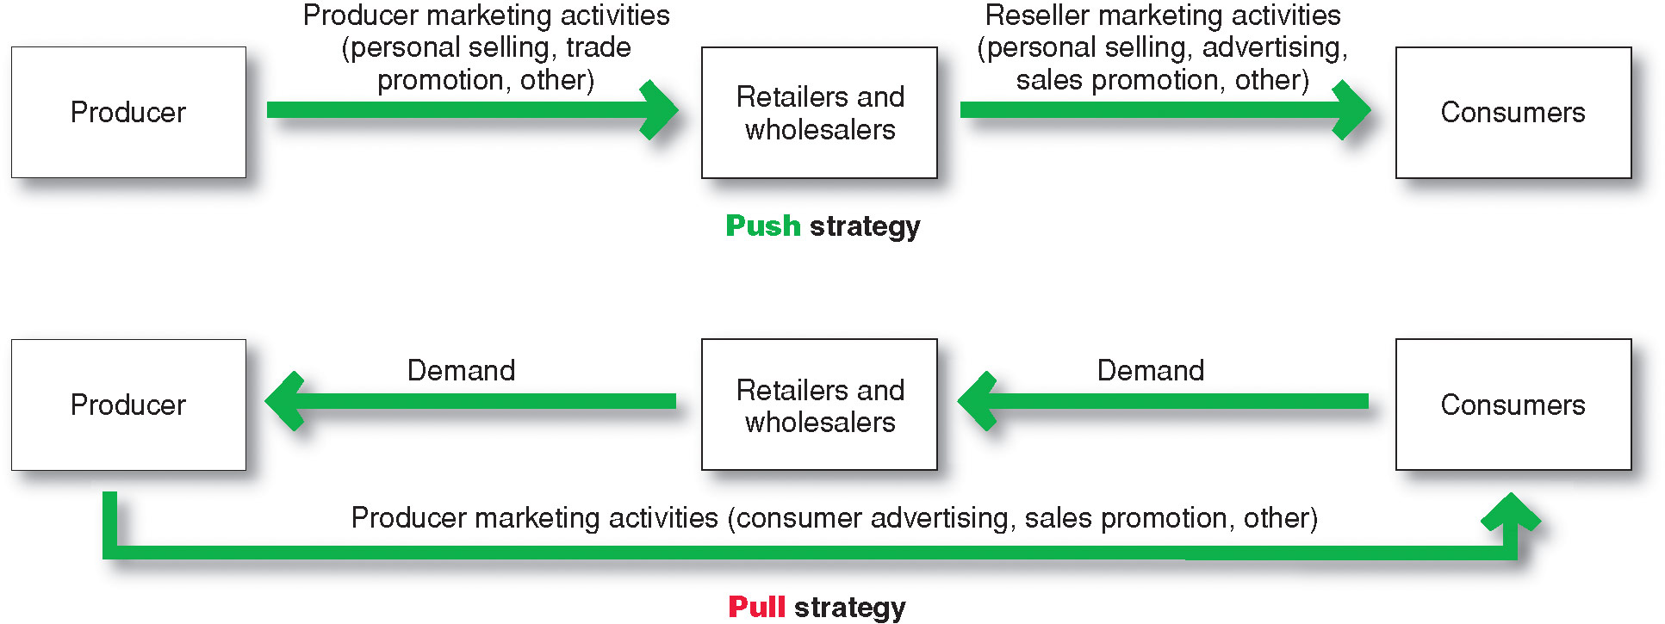
Setting the Total Promotion
Budget and Mix
Promotion Mix Strategies
Notes:
Note to Instructor
Although television, magazines, and other mass media remain very important, their dominance is declining. Advertisers are now adding a broad selection of more-specialized and highly targeted media to reach smaller customer segments with more-personalized, interactive messages. The new media range from specialty magazines, cable television channels, and video on demand (VOD) to Internet catalogs, e-mail, podcasts, cell phones, and online social networks. In all, companies are doing less broadcasting and more narrowcasting. Ask students how they have changed as consumers in the past year and how that might affect marketer’s.

Slide 13
Setting the Total Promotion
Budget and Mix
Integrating the Promotion Mix: Checklist
1. Identify customer touch points
2. Analyze trends—internal and external
3. Audit the pockets of communication spending throughout the organization
4. Team up in communications planning
Notes:
Note to Instructor
Although television, magazines, and other mass media remain very important, their dominance is declining. Advertisers are now adding a broad selection of more-specialized and highly targeted media to reach smaller customer segments with more-personalized, interactive messages. The new media range from specialty magazines, cable television channels, and video on demand (VOD) to Internet catalogs, e-mail, podcasts, cell phones, and online social networks. In all, companies are doing less broadcasting and more narrowcasting. Ask students how they have changed as consumers in the past year and how that might affect marketer’s.

Slide 14
Setting the Total Promotion
Budget and Mix
Integrating the Promotion Mix: Checklist
5. Create compatible themes, tones, and quality across all communications media
6. Create performance measures that are shared by all communications elements
7. Appoint a director responsible for the company’s persuasive communications efforts
Notes:
Note to Instructor
Although television, magazines, and other mass media remain very important, their dominance is declining. Advertisers are now adding a broad selection of more-specialized and highly targeted media to reach smaller customer segments with more-personalized, interactive messages. The new media range from specialty magazines, cable television channels, and video on demand (VOD) to Internet catalogs, e-mail, podcasts, cell phones, and online social networks. In all, companies are doing less broadcasting and more narrowcasting. Ask students how they have changed as consumers in the past year and how that might affect marketer’s.

Slide 15
Socially Responsible Marketing Communication
Communicate openly and honestly with consumers and resellers
Avoid deceptive or false advertising
Avoid bait-and-switch advertising
Conform to all federal, state, and local regulations
Notes:
Note to Instructor
Although television, magazines, and other mass media remain very important, their dominance is declining. Advertisers are now adding a broad selection of more-specialized and highly targeted media to reach smaller customer segments with more-personalized, interactive messages. The new media range from specialty magazines, cable television channels, and video on demand (VOD) to Internet catalogs, e-mail, podcasts, cell phones, and online social networks. In all, companies are doing less broadcasting and more narrowcasting. Ask students how they have changed as consumers in the past year and how that might affect marketer’s.

Slide 16
Socially Responsible Marketing Communication
Follow rules of “fair competition”
Do not offer bribes
Do not attempt to obtain competitors’ trade secrets
Do not disparage competitors or their products
Notes:
Note to Instructor
Although television, magazines, and other mass media remain very important, their dominance is declining. Advertisers are now adding a broad selection of more-specialized and highly targeted media to reach smaller customer segments with more-personalized, interactive messages. The new media range from specialty magazines, cable television channels, and video on demand (VOD) to Internet catalogs, e-mail, podcasts, cell phones, and online social networks. In all, companies are doing less broadcasting and more narrowcasting. Ask students how they have changed as consumers in the past year and how that might affect marketer’s.

Slide 17
Chapter 15
Advertising and Public Relations

Slide 18
Topics to Cover
Advertising
  Objectives
  Budget

Slide 19
Advertising
Advertising is any paid form of non-personal presentation and promotion of ideas, goods, or services by an identified sponsor

Slide 20
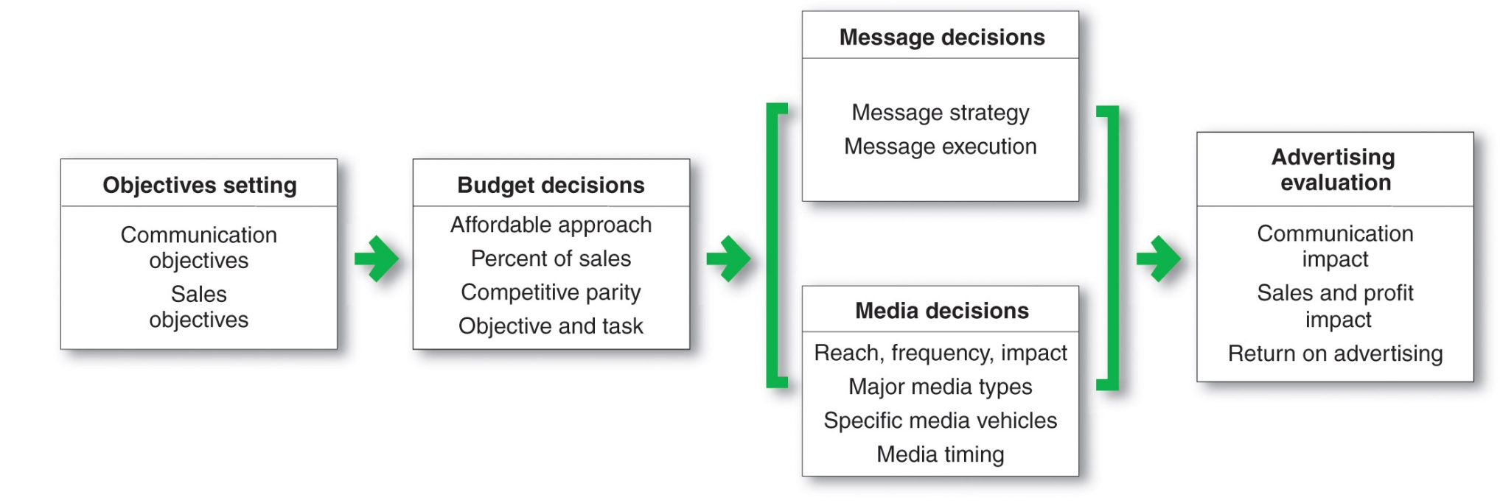
Advertising
Developing an Advertising Programs

Slide 21
Advertising
Setting Advertising Objectives
An advertising objective is a specific communication task to be accomplished with a specific target audience during a specific time
Objectives are classified by primary purpose
Inform
Persuade
Remind

Slide 22
Advertising
Setting Advertising Objectives
Informative advertising is used when introducing a new product category; the objective is to build primary demand
Comparative advertising directly or indirectly compares the brand with one or more other brands

Slide 23
Advertising
Setting Advertising Objectives
Persuasive advertising is important with increased competition to build selective demand
Reminder advertising is important with mature products to help maintain customer relationships and keep customers thinking about the product

Slide 24
Advertising
Setting the Advertising Budget
Factors to consider when setting the budget
Product life-cycle stage
Market share

Slide 25
Advertising
Setting the Advertising Budget
Product life-cycle stage
New products require larger budgets
Mature brands require lower budgets

Slide 26
Advertising
Setting the Advertising Budget
Market share
Building or taking market share requires larger budgets
Markets with heavy competition or high advertising clutter require larger budgets
Undifferentiated brands require larger budgets

