Slide 1
Chapter 13
Retailing and Wholesaling

Slide 2
Topics to Cover
Wholesaling

Slide 3
Wholesaling
Wholesaling includes all activities involved in selling goods and services to those buying for resale or business use

Slide 4
Wholesaling
Selling and promoting
Buying assortment building
Bulk breaking
Warehousing
Transportation
Financing
Risk bearing
Market information
Management services and advice

Slide 5
Wholesaling
Selling and promoting involves the wholesaler’s sales force helping the manufacturer reach many smaller customers at lower cost
Buying assortment building involves the selection of items and building of assortments needed by their customers, saving the customers work

Slide 6
Wholesaling
Bulk breaking involves the wholesaler buying in larger quantity and breaking into smaller lots for its customers
Warehousing involves the wholesaler holding inventory, reducing its customers’ inventory cost and risk

Slide 7
Wholesaling
Transportation involves the wholesaler providing quick delivery due to its proximity to the buyer
Financing involves the wholesaler providing credit and financing suppliers by ordering earlier and paying on time

Slide 8
Wholesaling
Risk bearing involves the wholesaler absorbing risk by taking title and bearing the cost of theft, damage, spoilage, and obsolescence
Market information involves the wholesaler providing information to suppliers and customers about competitors, new products, and price developments

Slide 9
Wholesaling
Management services and advice involves wholesalers helping retailers train their sales clerks, improve store layouts, and set up accounting and inventory control systems

Slide 10
Wholesaling
Types of Wholesalers
Merchant wholesalers
Agents and brokers
Manufacturers’ sales branches and offices

Slide 11
Wholesaling
Types of Wholesalers
Merchant wholesalers is the largest group of wholesalers and include:
Full-service wholesalers who provide a full set of services
Limited service wholesalers who provide few services and specialized functions

Slide 12
Wholesaling
Types of Wholesalers
Brokers and agents do not take title, perform a few functions, and specialize by product line or customer type
Brokers bring buyers and sellers together and assist in negotiations
Agents represent buyers or sellers

Slide 13
Wholesaling
Types of Wholesalers
Manufacturers’ sales branches and offices is a form of wholesaling by sellers or buyers themselves rather than through independent wholesalers

Slide 14
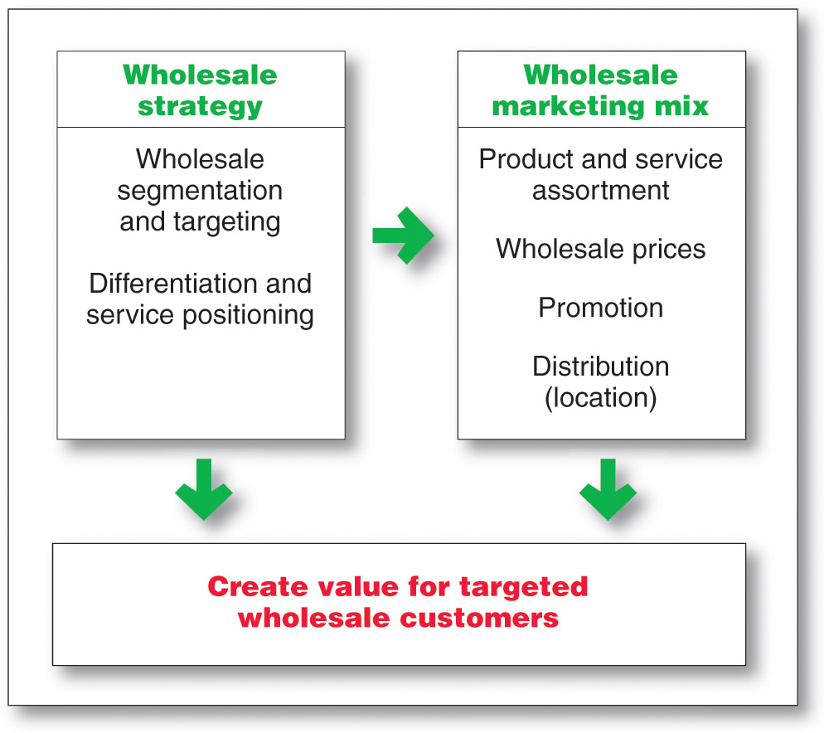
Wholesaling
Wholesaler Marketing Decisions

Slide 15
Wholesaling
Wholesaler Marketing Decisions
Target market and positioning decisions
Size of customer
Type of customer
Need for service

Slide 16
Wholesaling
Wholesaler Marketing Decisions
Target market and positioning decisions
Size of customer
Type of customer
Need for service

Slide 17
Wholesaling
Wholesaler Marketing Decisions
Marketing mix decisions
Product
Price
Promotion
Place

Slide 18
Wholesaling
Trends in Wholesaling
Challenges
Resistance to price increases
Lack of suppliers
Changing customer needs
Adding value by increasing efficiency and effectiveness

Slide 19
Chapter 14
Communicating Customer Value: Integrated Marketing Communications Strategy

Slide 20
Topics to Cover
The Promotion Mix

Slide 21
The Promotion Mix
The promotion mix is the specific blend of advertising, public relations, personal selling, and direct-marketing tools that the company uses to persuasively communicate customer value and build customer relationships

Slide 22
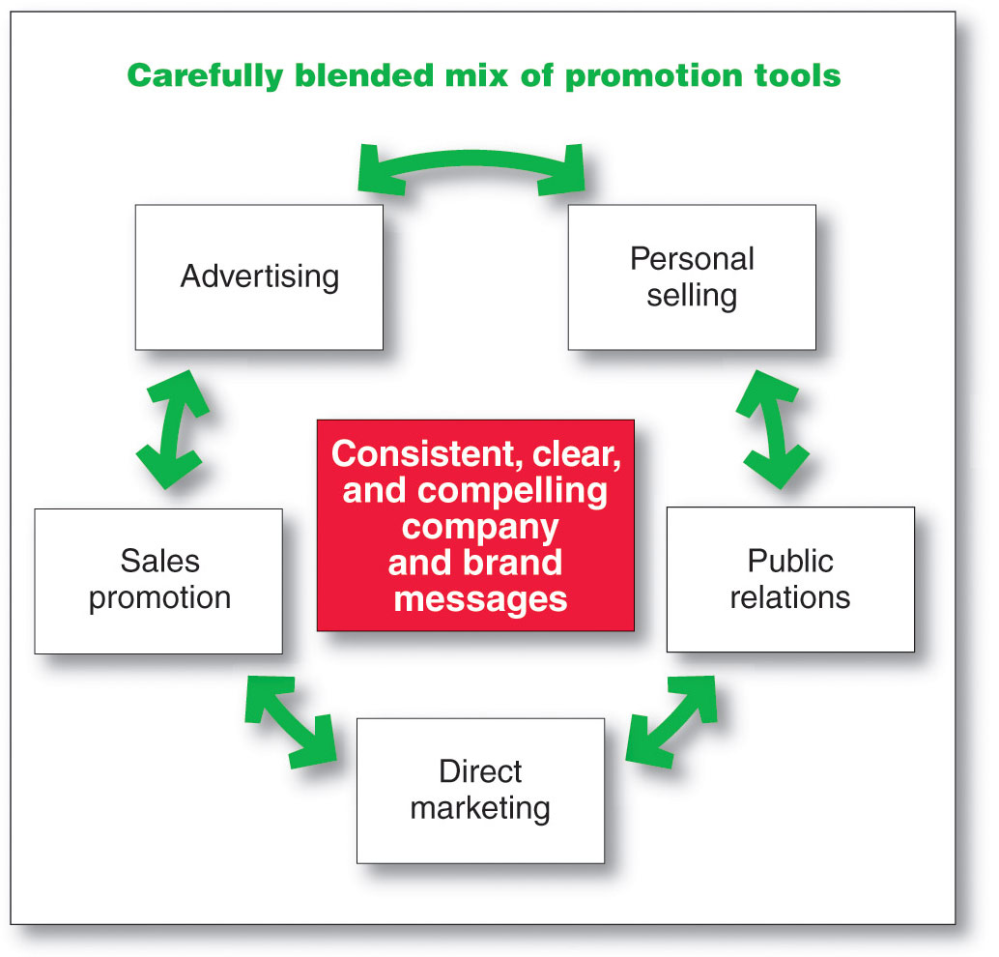
The Promotion Mix
Major Promotion Tools

Slide 23
The Promotion Mix
Major Promotion Tools
Advertising is any paid form of non-personal presentation and promotion of ideas, goods, or services by an identified sponsor
Broadcast
Print
Internet
Outdoor

Slide 24
The Promotion Mix
Major Promotion Tools
Sales promotion is the short-term incentives to encourage the purchase or sale of a product or service
Discounts
Coupons
Displays
Demonstrations

Slide 25
The Promotion Mix
Major Promotion Tools
Public relations involves building good relations with the company’s various publics by obtaining favorable publicity, building up a good corporate image, and handling or heading off unfavorable rumors, stories, and events
Press releases
Sponsorships
Special events
Web pages

Slide 26
The Promotion Mix
Major Promotion Tools
Personal selling is the personal presentation by the firm’s sales force for the purpose of making sales and building customer relationships
Sales presentations
Trade shows
Incentive programs

Slide 27
The Promotion Mix
Major Promotion Tools
Direct marketing involves making direct connections with carefully targeted individual consumers to both obtain an immediate response and cultivate lasting customer relationships—through the use of direct mail, telephone, direct-response television, e-mail, and the Internet to communicate directly with specific consumers
Catalog
Telemarketing
Kiosks

Slide 28
This Powerpoint Presentation was adopted from Pearson Education Inc. (Prentice Hall) for the Text Book of this course: Principles of Marketing 13th Edition by Phillip Kotler and Gary Armstrong.
Necessary changes are being made as per the recording needs of this lecture and VCOMSATS

