Slide 1
Chapter 13
Retailing and Wholesaling

Slide 2
Topics to Cover
Retailing
Retailer Marketing Decisions
The Future of Retailing

Slide 3
Retailing
Retailing includes all the activities in selling products or services directly to final consumers for their personal, non-business use
Retailers are businesses whose sales come primarily from retailing

Slide 4
Retailing
Types of Retailers: Amount of Service
Amount of service
  Self-service
  Limited service
  Full service

Slide 5
Retailing
Types of Retailers: Amount of Service
Self-service retailers serve customers who are willing to perform their own locate-compare-select process to save money.
They include: Wal-Mart and Supermarkets.
Limited service retailers provide more sales assistance because they carry more shopping goods about which customers need more information.
Examples include Sears and JC Penney.

Slide 6
Retailing
Types of Retailers: Amount of Service
Full-service retailers assist customers in every phase of the shopping process, resulting in higher costs that are passed on to the customer as higher prices.
Includes department stores and specialty stores

Slide 7
Retailing
Types of Retailers: Product Line
Specialty stores
Narrow product line with deep assortment
Department stores
Wide variety of product lines
Convenience stores
Limited line of high-turnover goods
Superstores
Non-food goods
Category killers
Deep in category with sales staff

Slide 8
Retailing
Types of Retailers: Relative Prices
Discount stores
Off-price retailers
Factory outlets
Warehouse clubs

Slide 9
Retailing
Types of Retailers: Relative Prices
Discount stores sell standard merchandise at lower prices by accepting lower margins and selling higher volume.
Independent off-price retailers either are owned and run by entrepreneurs or are divisions of larger retail corporations.
Off-price retailers buy at less-than-regular wholesale prices and charge customers less than retail.

Slide 10
Retailing
Types of Retailers: Relative Prices
Factory outlets are producer-operated stores.
Warehouse clubs are large warehouse-like facilities with few frills and offer ultra-low prices.

Slide 11
Retailing
Types of Retailers: Organizational Approach
Corporate chains
Voluntary chains
Retailer cooperatives
Franchise organizations
Merchandising conglomerates

Slide 12
Retailing
Types of Retailers: Organizational Approach
Corporate chains are two or more outlets that are commonly owned and controlled
Size allows them to buy in large quantities at lower prices and gain promotional economies
  Sears
  CVS

Slide 13
Retailing
Types of Retailers: Organizational Approach
Voluntary chains are wholesale-sponsored groups of independent retailers that engage in group buying and common merchandising
IGA
Western Auto

Slide 14
Retailing
Types of Retailers: Organizational Approach
Retailer cooperatives is a group of independent retailers that band together to set up a joint-owned, central wholesale operation and conduct joint merchandising and promotion effort
Ace Hardware
Associated Grocers

Slide 15
Retailing
Types of Retailers: Organizational Approach
Franchise organizations are based on some unique product or service; on a method of doing business; or on the trade name, good will, or patent that the franchisor has developed

Slide 16
Retailing
Types of Retailers: Organizational Approach
Merchandising conglomerates are corporations that combine several retailing forms under central ownership
Limited Brands

Slide 17
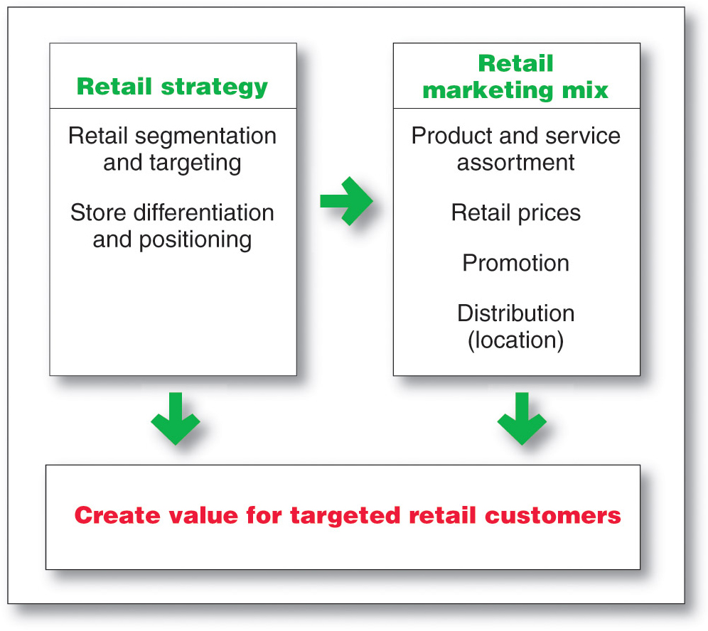
Retailing
Retailer Marketing Decisions

Slide 18
Retailing
Retailer Marketing Decisions
Segmentation targeting, differentiation, and positioning involves the definition and profile of the market so the other retail marketing decisions can be made

Slide 19
Retailing
Retailer Marketing Decisions
Product Assortment and Service
Product assortment and service decisions include:
Product assortment
Services mix
Store atmosphere

Slide 20
Retailing
Retailer Marketing Decisions
Product Assortment and Service
Product assortment should differentiate the retailer while matching target shoppers’ expectations. Offers merchandise that no other competitor carries:
  Private or national brands
  Merchandising events
  Highly targeted product assortment

Slide 21
Retailing
Retailer Marketing Decisions
Product Assortment and Service
Services mix should also serve to differentiate the retailer from the competition with customer support.
Store atmosphere is the physical layout that makes moving around the store hard or easy.

Slide 22
Retailing
Retailer Marketing Decisions
Price Decision
Price policy must fit the target market and positioning, product and service assortment, and competition
High markup on lower volume
Low markup on higher volume

Slide 23
Retailing
Retailer Marketing Decisions
Price Decision
High-low pricing involves charging higher prices on an everyday basis, coupled with frequent sales and other price promotions
Everyday low price (EDLP) involves charging constant, everyday low prices with few sales or discounts

Slide 24
Retailing
Retailer Marketing Decisions
Promotion Decision
Advertising
Personal selling
Sales promotion
Public relations
Direct marketing

Slide 25
Retailing
Retailer Marketing Decisions
Place Decision
Central business districts are located in cities and include department and specialty stores, banks, and movie theaters
Shopping center is a group of retail businesses planned, developed, owned, and managed as a unit

Slide 26
Retailing
The Future of Retailing
Retailers have to consider:
  Non-store retailing
  Retail convergence
  Mega-retailers
  Retail technology
  Global expansion
  Retail stores as communities

Slide 27
Retailing
The Future of Retailing
New Retail Forms and Shortening Retail Life Cycles
Wheel-of-retailing concept states that many new types of retailing forms begin as low-margin, low-price, low-status operations, and challenge established retailers. As they succeed they upgrade their facilities and offer more services, increasing their costs and forcing them to increase prices, eventually becoming the retailers they replaced.

Slide 28
Retailing
The Future of Retailing
New Retail Forms and Shortening Retail Life Cycles
Growth of non-store retailing includes:
Mail order
Television
Phone
Online

Slide 29
Retailing
The Future of Retailing
New Retail Forms and Shortening Retail Life Cycles
Retail convergence involves the merging of consumers, producers, prices, and retailers, creating greater competition for retailers and greater difficulty differentiating offerings

Slide 30
Retailing
The Future of Retailing
New Retail Forms and Shortening Retail Life Cycles
The rise of megaretailers involves the rise of mass merchandisers and specialty superstores, the formation of vertical marketing systems, and a rash of retail mergers and acquisitions
Superior information systems
Buying power
Large selection

Slide 31
Retailing
The Future of Retailing
New Retail Forms and Shortening Retail Life Cycles
Growing importance of retail technology provides better forecasts, inventory control, electronic ordering, transfer of information, scanning, online transaction processing, improved merchandise handling systems, and the ability to connect with customers

Slide 32
This Powerpoint Presentation was adopted from Pearson Education Inc. (Prentice Hall) for the Text Book of this course: Principles of Marketing 13th Edition by Phillip Kotler and Gary Armstrong.
Necessary changes are being made as per the recording needs of this lecture and VCOMSATS

