Slide 1
Chapter 12
Marketing Channels:
Delivering Customer Value

Slide 2
Topics to Cover
Supply Chains and the Value Delivery Network
The Nature and Importance of Marketing Channels
Channel Behavior and Organization

Slide 3
Supply Chains & Value Delivery Network
Supply Chain Partners
Upstream partners include raw material suppliers, components, parts, information, finances, and expertise to create a product or service
Downstream partners include the marketing channels or distribution channels that look toward the customer

Slide 4
Supply Chains & Value Delivery Network
Supply Chain Views
Supply chain “make and sell” view includes the firm’s raw materials, productive inputs, and factory capacity

Slide 5
Supply Chains & Value Delivery Network
Supply Chain Views
Demand chain “sense and respond” view suggests that planning starts with the needs of the target customer, and the firm responds to these needs by organizing a chain of resources and activities with the goal of creating customer value

Slide 6
Supply Chains & Value Delivery Network
Value Delivery Network
Value delivery network is the firm’s suppliers, distributors, and ultimately customers who partner with each other to improve the performance of the entire system

Slide 7
Nature & Importance of
Marketing Channels
How Channel Members Add Value
Intermediaries offer producers greater efficiency in making goods available to target markets. Through their contacts, experience, specialization, and scale of operations, intermediaries usually offer the firm more than it can achieve on its own.

Slide 8
Nature & Importance of
Marketing Channels
How Channel Members Add Value
From an economic view, intermediaries transform the assortment of products into assortments wanted by consumers
Channel members add value by bridging the major time, place, and possession gaps that separate goods and services from those who would use them

Slide 9
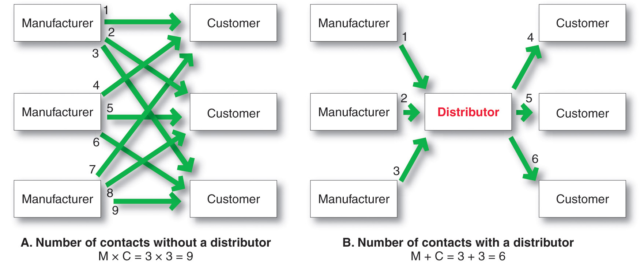
Nature & Importance of
Marketing Channels
How Channel Members Add Value

Slide 10
Nature & Importance of
Marketing Channels
How Channel Members Add Value
Information
Promotion
Contact
Matching
Negotiation
Physical distribution
Financing
Risk taking

Slide 11
Nature & Importance of
Marketing Channels
How Channel Members Add Value
Information: Gathering and distributing marketing research and intelligence information.
Promotion: Developing and spreading persuasive communications about an offer.
Contact: Finding and communicating with prospective buyers.

Slide 12
Nature & Importance of
Marketing Channels
How Channel Members Add Value
Matching: Shaping and fitting the offer to the buyer’s needs
Negotiation: Reaching an agreement on price and other terms of the offer.
Physical Distribution: Transporting and storing goods.

Slide 13
Nature & Importance of
Marketing Channels
How Channel Members Add Value
Financing: Acquiring and using funds to cover the costs of the channel work.
Risk Taking: Assuming the risks of carrying out the channel work.

Slide 14
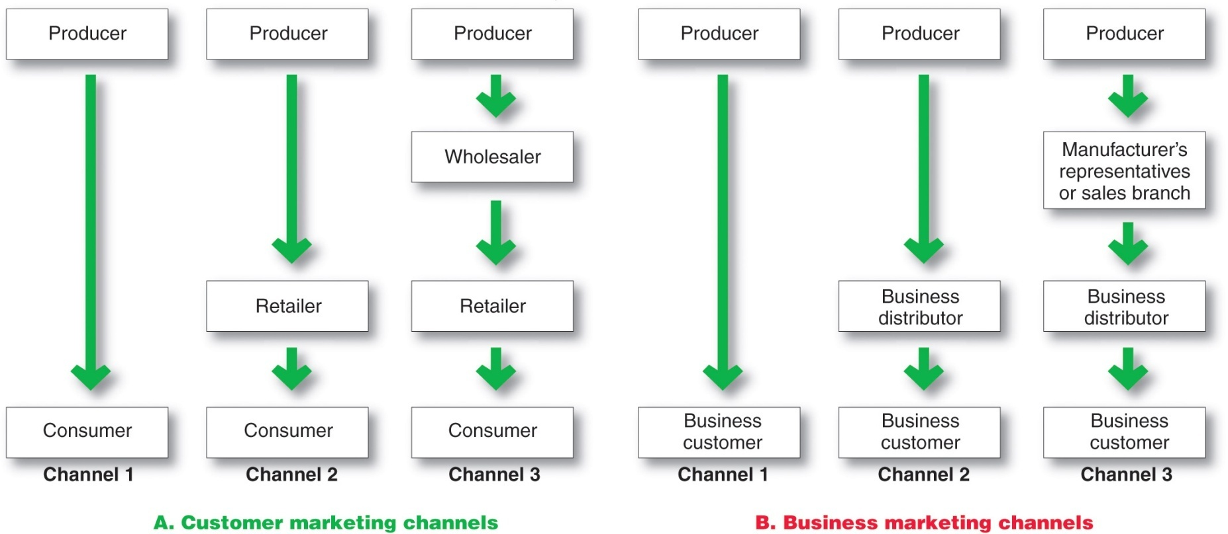
Nature & Importance of
Marketing Channels
Number of Channel Levels

Slide 15
Nature & Importance of
Marketing Channels
Number of Channel Levels
Connected by types of flows:
Physical flow of products
Flow of ownership
Payment flow
Information flow
Promotion flow

Slide 16
Channel Behavior and Organization
Number of Channel Levels
Marketing channel consists of firms that have partnered for their common good with each member playing a specialized role.

Slide 17
Channel Behavior and Organization
Number of Channel Levels
Channel conflict refers to disagreement over goals, roles, and rewards by channel members
Horizontal conflict
Vertical conflict

Slide 18
Channel Behavior and Organization
Number of Channel Levels
Horizontal conflict
  Among firms at the same level of the channel.
Vertical conflict
  Between different levels of the same channel which is even more common.
  Some conflict in channels takes the form of healthy competition, which is good for the channel.

Slide 19
Channel Behavior and Organization
Conventional Distributions Systems
Conventional distribution systems consist of one or more independent producers, wholesalers, and retailers. Each seeks to maximize its own profits, and there is little control over the other members and no formal means for assigning roles and resolving conflict.

Slide 20
Channel Behavior and Organization
Vertical Marketing Systems
Vertical marketing systems (VMSs) provide channel leadership and consist of producers, wholesalers, and retailers acting as a unified system and consist of:
Corporate marketing systems
Contractual marketing systems
Administered marketing systems

Slide 21
Channel Behavior and Organization
Vertical Marketing Systems
Corporate vertical marketing system integrates successive stages of production and distribution under single ownership

Slide 22
Channel Behavior and Organization
Vertical Marketing Systems
Contractual vertical marketing system consists of independent firms at different levels of production and distribution who join together through contracts to obtain more economies or sales impact than each could achieve alone. The most common form is the franchise organization.

Slide 23
Channel Behavior and Organization
Vertical Marketing Systems
Franchise organization links several stages in the production distribution process
  Manufacturer-sponsored retailer franchise system
  Manufacturer-sponsored wholesaler franchise system
  Service firm-sponsored retailer franchise system

Slide 24
Channel Behavior and Organization
Vertical Marketing Systems
  Administered vertical marketing system has a few dominant channel members without common ownership. Leadership comes from size and power.

Slide 25
Channel Behavior and Organization
Horizontal Marketing Systems
  Horizontal marketing systems are when two or more companies at one level join together to follow a new marketing opportunity. Companies combine financial, production, or marketing resources to accomplish more than any one company could alone.

Slide 26
Channel Behavior and Organization
Multichannel Distribution Systems
Hybrid Marketing Channels
  Multichannel Distribution systems (Hybrid marketing channels) are when a single firm sets up two or more marketing channels to reach one or more customer segments

Slide 27
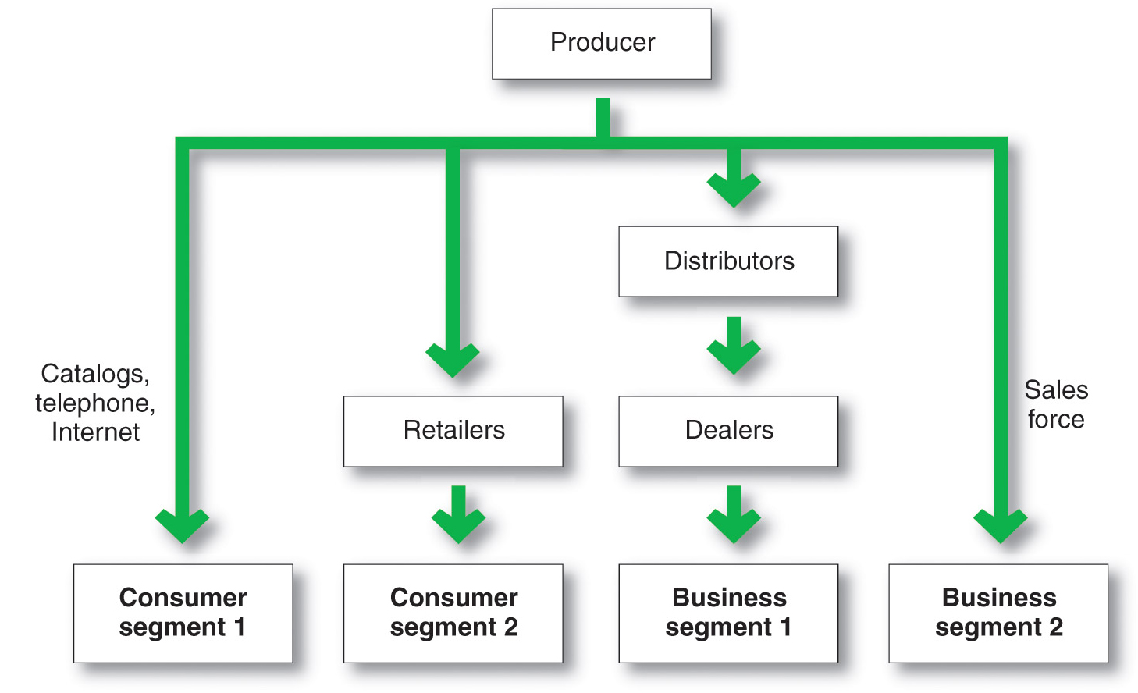
Channel Behavior and Organization
Multichannel Distribution Systems

Slide 28
Channel Behavior and Organization
Changing Channel Organization
Disintermediation occurs when product or service producers cut out intermediaries and go directly to final buyers, or when radically new types of channel intermediaries displace traditional ones

Slide 29
This Powerpoint Presentation was adopted from Pearson Education Inc. (Prentic Hall) for the Text Book of this course: Principles of Marketing 13th Edition by Phillip Kotler and Gary Armstrong.
Necessary changes are being made as per the recording needs of this lecture and VCOMSATS.

