Slide 1
Chapter 11
Pricing Strategies

Slide 2
Topics to Cover
Price Adjustment Strategies
Price Changes
Public Policy and Pricing

Slide 3
Price-Adjustment Strategies
Discount and allowance pricing
Segmented pricing
Psychological pricing
Promotional pricing
Geographic pricing
Dynamic pricing
International pricing
Notes:
Note to Instructor
In slideshow view, click on movie icon to launch General Electric video snippet. See accompanying DVD for full video segment.

Slide 4
Price-Adjustment Strategies
Discount and allowance pricing
Discount and allowance pricing reduces prices to reward customer responses such as paying early or promoting the product
Discounts
Allowances
Notes:
Note to Instructor
In slideshow view, click on movie icon to launch General Electric video snippet. See accompanying DVD for full video segment.

Slide 5
Price-Adjustment Strategies
Discount and allowance pricing
Discounts
A straight reduction in price on purchases during a stated period of time
Allowances
Promotional money paid by manufacturers to retailers in return for an agreement to feature the manufacturer’s products in some way.
Notes:
Note to Instructor
In slideshow view, click on movie icon to launch General Electric video snippet. See accompanying DVD for full video segment.

Slide 6
Price-Adjustment Strategies
Segmented pricing
Segmented pricing is used when a company sells a product at two or more prices even though the difference is not based on cost
Notes:
Note to Instructor
In slideshow view, click on movie icon to launch General Electric video snippet. See accompanying DVD for full video segment.

Slide 7
Price-Adjustment Strategies
Segmented pricing
To be effective:
Market must be segmentable
Segments must show different degrees of demand
Watching the market cannot exceed the extra revenue obtained from the price difference
Must be legal
Notes:
Note to Instructor
In slideshow view, click on movie icon to launch General Electric video snippet. See accompanying DVD for full video segment.

Slide 8
Price-Adjustment Strategies
Psychological pricing
Psychological pricing occurs when sellers consider the psychology of prices and not simply the economics; the price is used to say something about the product.
Notes:
Note to Instructor
In slideshow view, click on movie icon to launch General Electric video snippet. See accompanying DVD for full video segment.

Slide 9
Price-Adjustment Strategies
Psychological pricing
Reference prices (an important aspect of psychological pricing) are prices that buyers carry in their minds and refer to when looking at a given product
  Noting current prices
  Remembering past prices
  Assessing the buying situations
Notes:
Note to Instructor
In slideshow view, click on movie icon to launch General Electric video snippet. See accompanying DVD for full video segment.

Slide 10
Price-Adjustment Strategies
Promotional pricing
Promotional pricing is when prices are temporarily priced below list price or cost to increase demand
Loss leaders
Special event pricing
Cash rebates
Low-interest financing
Longer warrantees
Free maintenance
Notes:
Note to Instructor
In slideshow view, click on movie icon to launch General Electric video snippet. See accompanying DVD for full video segment.

Slide 11
Price-Adjustment Strategies
Promotional pricing
Risks of promotional pricing include
Used too frequently, and copies by competitors can create “deal-prone” customers who will wait for promotions and avoid buying at regular price
Creates price wars
Notes:
Note to Instructor
In slideshow view, click on movie icon to launch General Electric video snippet. See accompanying DVD for full video segment.

Slide 12
Price-Adjustment Strategies
Geographical pricing
Geographical pricing is used for customers in different parts of the country or the world.
Types of geographical pricing strategies
FOB-origin pricing
Uniformed-delivered pricing
Zone pricing
Basing-point pricing
Freight-absorption pricing
Notes:
Note to Instructor
In slideshow view, click on movie icon to launch General Electric video snippet. See accompanying DVD for full video segment.

Slide 13
Price-Adjustment Strategies
Geographical pricing
FOB-origin (free on board) pricing means that the goods are delivered to the carrier and the title and responsibility passes to the customer
Notes:
Note to Instructor
In slideshow view, click on movie icon to launch General Electric video snippet. See accompanying DVD for full video segment.

Slide 14
Price-Adjustment Strategies
Geographical pricing
Uniformed-delivered pricing means the company charges the same price plus freight to all customers, regardless of location
Notes:
Note to Instructor
In slideshow view, click on movie icon to launch General Electric video snippet. See accompanying DVD for full video segment.

Slide 15
Price-Adjustment Strategies
Geographical pricing
Zone pricing means that the company sets up two or more zones where customers within a given zone pay a single total price
Notes:
Note to Instructor
In slideshow view, click on movie icon to launch General Electric video snippet. See accompanying DVD for full video segment.

Slide 16
Price-Adjustment Strategies
Geographical pricing
Basing-point pricing means that a seller selects a given city as a “basing point” and charges all customers the freight cost associated from that city to the customer location, regardless of the city from which the goods are actually shipped
Notes:
Note to Instructor
In slideshow view, click on movie icon to launch General Electric video snippet. See accompanying DVD for full video segment.

Slide 17
Price-Adjustment Strategies
Geographical pricing
Freight-absorption pricing means the seller absorbs all or part of the actual freight charge as an incentive to attract business in competitive markets
Notes:
Note to Instructor
In slideshow view, click on movie icon to launch General Electric video snippet. See accompanying DVD for full video segment.

Slide 18
Price-Adjustment Strategies
Dynamic pricing
Dynamic pricing is when prices are adjusted continually to meet the characteristics and needs of the individual customer and situations
Notes:
Note to Instructor
In slideshow view, click on movie icon to launch General Electric video snippet. See accompanying DVD for full video segment.

Slide 19
Price-Adjustment Strategies
International pricing
International pricing is when prices are set in a specific country based on country-specific factors
Economic conditions
Competitive conditions
Laws and regulations
Infrastructure
Company marketing objective
Notes:
Note to Instructor
In slideshow view, click on movie icon to launch General Electric video snippet. See accompanying DVD for full video segment.

Slide 20
Price Changes
Initiating Pricing Changes
Price cuts
Price increases
Notes:
Note to Instructor
In slideshow view, click on movie icon to launch General Electric video snippet. See accompanying DVD for full video segment.

Slide 21
Price Changes
Initiating Pricing Changes
Price cuts occur due to:
Excess capacity
Price increase from:
Cost inflation
Increased market share
Increased demand
Lack of supply
Notes:
Note to Instructor
In slideshow view, click on movie icon to launch General Electric video snippet. See accompanying DVD for full video segment.

Slide 22
Price Changes
Buyer Reactions to Pricing Changes
Price increases
Product is “hot”
Company greed
Price cuts
New models will be available
Models are not selling well
Quality issues
Notes:
Note to Instructor
In slideshow view, click on movie icon to launch General Electric video snippet. See accompanying DVD for full video segment.

Slide 23
Price Changes
Competitor Reactions to Pricing Changes
Price increases
All the competitors may or may not behave alike because of differences in size, market share or policies.
Price cuts
Company is trying to grab a larger market share
Doing poorly and trying to boost its sales
Company wants the whole industry to cut prices
Notes:
Note to Instructor
In slideshow view, click on movie icon to launch General Electric video snippet. See accompanying DVD for full video segment.

Slide 24
Price Changes
Responding to Pricing Changes
Questions
  Why did the competitor change the price?
  Is the price cut permanent or temporary?
  What is the effect on market share and profits?
  Will competitors respond?
Notes:
Note to Instructor
In slideshow view, click on movie icon to launch General Electric video snippet. See accompanying DVD for full video segment.

Slide 25
Price Changes
Responding to Pricing Changes
Solutions
  Reduce price to match competition
  Maintain price but raise the perceived value through communications
  Improve quality and increase price
  Launch a lower-price “fighting” brand
Notes:
Note to Instructor
In slideshow view, click on movie icon to launch General Electric video snippet. See accompanying DVD for full video segment.

Slide 26
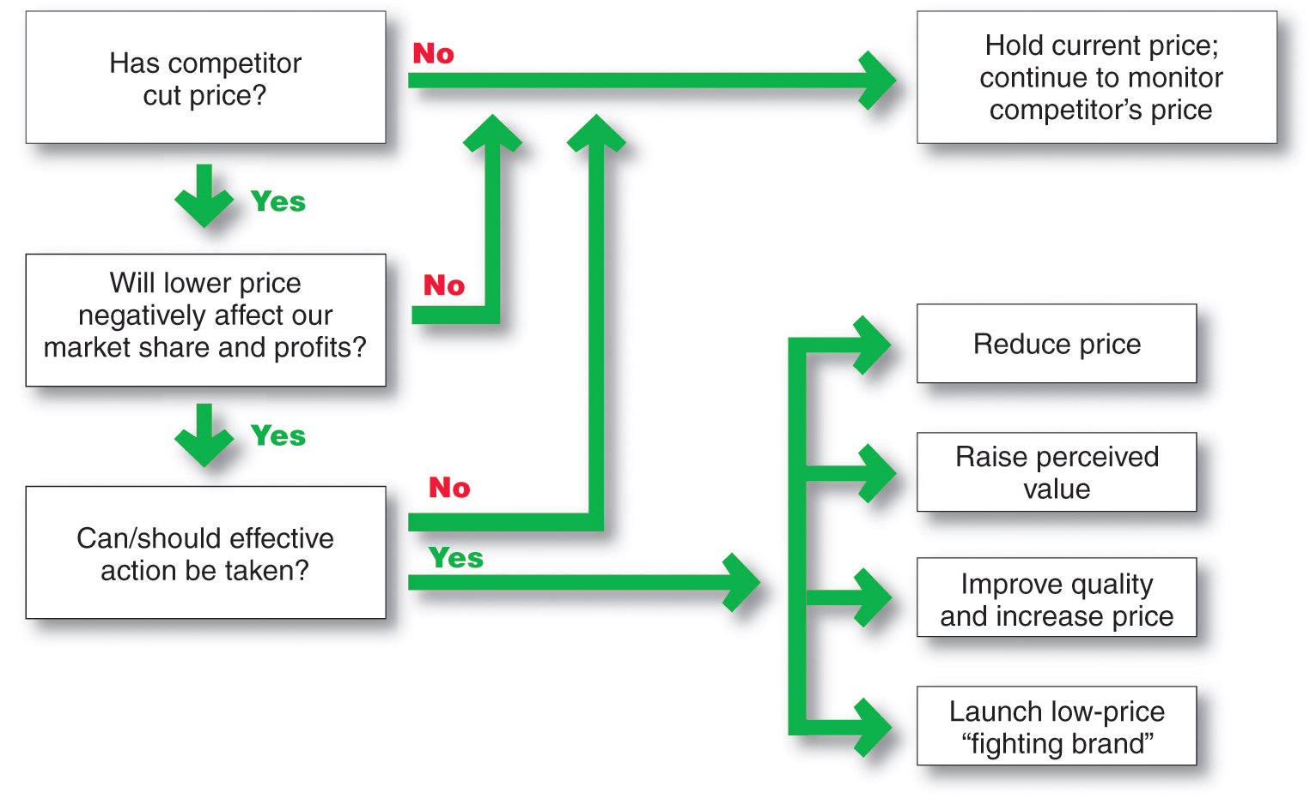
Price Changes
Responding to Pricing Changes
Notes:
Note to Instructor
In slideshow view, click on movie icon to launch General Electric video snippet. See accompanying DVD for full video segment.

Slide 27
Public Policy and Pricing
Pricing Within Channel Levels
Price fixing: Sellers must set prices without talking to competitors
Predatory pricing: Selling below cost with the intention of punishing a competitor or gaining higher long-term profits by putting competitors out of business
Notes:
Note to Instructor
In slideshow view, click on movie icon to launch General Electric video snippet. See accompanying DVD for full video segment.

Slide 28
Public Policy and Pricing
Pricing Across Channel Levels
Retail (or resale) price maintenance is when a manufacturer requires a dealer to charge a specific retail price for its products
Notes:
Note to Instructor
In slideshow view, click on movie icon to launch General Electric video snippet. See accompanying DVD for full video segment.

Slide 29
Public Policy and Pricing
Pricing Across Channel Levels
Deceptive pricing occurs when a seller states prices or price savings that mislead consumers or are not actually available to consumers
Scanner fraud failure of the seller to enter current or sale prices into the computer system
Price confusion results when firms employ pricing methods that make it difficult for consumers to understand what price they are really paying
Notes:
Note to Instructor
In slideshow view, click on movie icon to launch General Electric video snippet. See accompanying DVD for full video segment.

Slide 30
This Powerpoint Presentation was adopted from Pearson Education Inc. (Prentice Hall) for the Text Book of this course: Principles of Marketing 13th Edition by Phillip Kotler and Gary Armstrong.
Necessary changes are being made as per the recording needs of this lecture and VCOMSATS.

