Slide 1
Chapter 10
Pricing:
Understanding and Capturing
Customer Value

Slide 2
Topics to Cover
Other Internal and External Considerations Affecting Price Decisions

Slide 3
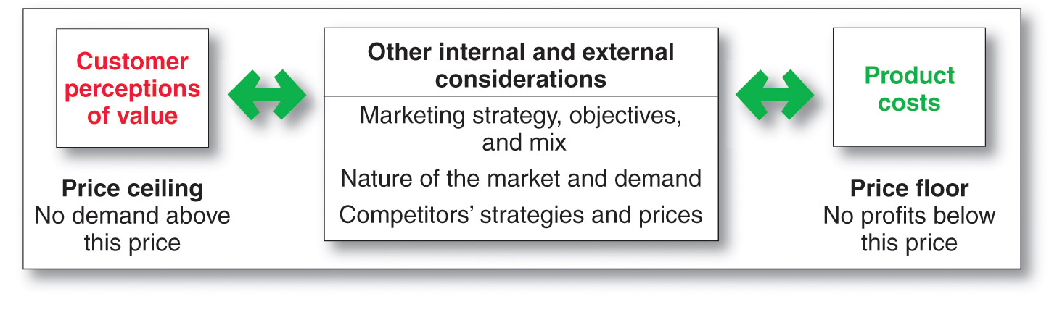
Considerations in Setting Price

Slide 4
Factors to Consider When Setting Prices
Other Internal and External Considerations Affecting Price Decisions
Customer perceptions of value set the upper limit for prices, and costs set the lower limit
Companies must consider internal and external factors when setting prices
Notes:
Note to Instructor
Discussion Question
How does a company like Starbuck’s price their products?
This will lead to a good overview of the chapter as students will most likely focus on customers, costs and competitors.

Slide 5
Factors to Consider When Setting Prices
Other Internal and External Considerations Affecting Price Decisions
Target costing starts with an ideal selling price based on consumer value considerations and then targets costs that will ensure that the price is met
Notes:
Note to Instructor
Discussion Question
How does a company like Starbuck’s price their products?
This will lead to a good overview of the chapter as students will most likely focus on customers, costs and competitors.

Slide 6
Factors to Consider When Setting Prices
Other Internal and External Considerations Affecting Price Decisions
The Market and Demand
Before setting prices, the marketer must understand the relationship between price and demand for its products
Notes:
Note to Instructor
Discussion Question
How does a company like Starbuck’s price their products?
This will lead to a good overview of the chapter as students will most likely focus on customers, costs and competitors.

Slide 7
Factors to Consider When Setting Prices
Other Internal and External Considerations Affecting Price Decisions
Competition
Pure competition
Monopolistic competition
Oligopolistic competition
Pure monopoly
Notes:
Note to Instructor
Discussion Question
How does a company like Starbuck’s price their products?
This will lead to a good overview of the chapter as students will most likely focus on customers, costs and competitors.

Slide 8
Factors to Consider When Setting Prices
Other Internal and External Considerations Affecting Price Decisions
Competition
Under pure competition, the market consists of many buyers and sellers trading in a uniform commodity such as wheat, copper, financial services etc.
No single buyer or seller has much effect on the going market price.
Notes:
Note to Instructor
Discussion Question
How does a company like Starbuck’s price their products?
This will lead to a good overview of the chapter as students will most likely focus on customers, costs and competitors.

Slide 9
Factors to Consider When Setting Prices
Other Internal and External Considerations Affecting Price Decisions
Competition
Under monopolistic competition, the market consists of many buyers and sellers who trade over a range of prices rather than a single market price.
A range of prices occurs because sellers can differentiate their offers to buyers.
Notes:
Note to Instructor
Discussion Question
How does a company like Starbuck’s price their products?
This will lead to a good overview of the chapter as students will most likely focus on customers, costs and competitors.

Slide 10
Factors to Consider When Setting Prices
Other Internal and External Considerations Affecting Price Decisions
Competition
Under oligopolistic competition, the market consists of a few sellers who are highly sensitive to each other’s pricing and marketing strategies.
The product can be uniform or non-uniform.
There are few sellers because it is difficult for new sellers to enter the market.
Notes:
Note to Instructor
Discussion Question
How does a company like Starbuck’s price their products?
This will lead to a good overview of the chapter as students will most likely focus on customers, costs and competitors.

Slide 11
Factors to Consider When Setting Prices
Other Internal and External Considerations Affecting Price Decisions
Competition
Under pure monopoly, the market consists of one seller.
The seller may be a government monopoly, a private regulated monopoly, or a private non-regulated monopoly.
Notes:
Note to Instructor
Discussion Question
How does a company like Starbuck’s price their products?
This will lead to a good overview of the chapter as students will most likely focus on customers, costs and competitors.

Slide 12
Factors to Consider When Setting Prices
Other Internal and External Considerations Affecting Price Decisions
Demand Curve
The demand curve shows the number of units the market will buy in a given period at different prices
Normally, demand and price are inversely related
Higher price = lower demand
For prestige (luxury) goods, higher price can equal higher demand when consumers perceive higher prices as higher quality
Notes:
Note to Instructor
Discussion Question
How does a company like Starbuck’s price their products?
This will lead to a good overview of the chapter as students will most likely focus on customers, costs and competitors.

Slide 13
Factors to Consider When Setting Prices
Other Internal and External Considerations Affecting Price Decisions
Demand Curve
Price elasticity of demand illustrates the response of demand to a change in price
  Inelastic demand occurs when demand hardly changes when there is a small change in price
  Elastic demand occurs when demand changes greatly for a small change in price
Price elasticity of demand = % change in quantity demand
% change in price
Notes:
Note to Instructor
Discussion Question
How does a company like Starbuck’s price their products?
This will lead to a good overview of the chapter as students will most likely focus on customers, costs and competitors.

Slide 14
Factors to Consider When Setting Prices
Other Internal and External Considerations Affecting Price Decisions
Competitor’s Strategies
Comparison of offering in terms of customer value
Strength of competitors
Competition pricing strategies
Customer price sensitivity
Notes:
Note to Instructor
Discussion Question
How does a company like Starbuck’s price their products?
This will lead to a good overview of the chapter as students will most likely focus on customers, costs and competitors.

Slide 15
Factors to Consider When Setting Prices
Other Internal and External Considerations Affecting Price Decisions
Economic conditions
Reseller’s response to price
Government
Social concerns
Notes:
Note to Instructor
Discussion Question
How does a company like Starbuck’s price their products?
This will lead to a good overview of the chapter as students will most likely focus on customers, costs and competitors.

Slide 16
Factors to Consider When Setting Prices
Other Internal and External Considerations Affecting Price Decisions
Economic conditions such as boom or recession, inflation, and interest rates affect pricing decisions because they affect both consumer perceptions of the product’s price and value and the costs of producing a product
Notes:
Note to Instructor
Discussion Question
How does a company like Starbuck’s price their products?
This will lead to a good overview of the chapter as students will most likely focus on customers, costs and competitors.

Slide 17
Factors to Consider When Setting Prices
Other Internal and External Considerations Affecting Price Decisions
The company should set prices that give resellers a fair profit, encourage their support, and help them to sell the product effectively.
Government is also an important external influence on pricing decisions.
Social-concerns need to be taken into consideration when setting prices.
Notes:
Note to Instructor
Discussion Question
How does a company like Starbuck’s price their products?
This will lead to a good overview of the chapter as students will most likely focus on customers, costs and competitors.

Slide 18
Chapter 11
Pricing Strategies

Slide 19
Topics to Cover
New-Product Pricing Strategies
Product Mix Pricing Strategies
Price Adjustment Strategies
Price Changes

Slide 20
New-Product Pricing Strategies
Market-skimming pricing
Market- penetration pricing

Slide 21
New-Product Pricing Strategies
Market-skimming pricing
Market-skimming pricing is a strategy with high initial prices to “skim” revenue layers from the market
Product quality and image must support the price
Buyers must want the product at the price
Costs of producing the product in small volume should not cancel the advantage of higher prices
Competitors should not be able to enter the market easily

Slide 22
New-Product Pricing Strategies
Market-penetration pricing
Market-penetration pricing sets a low initial price in order to penetrate the market quickly and deeply to attract a large number of buyers quickly to gain market share
Price sensitive market
Inverse relationship of production and distribution cost to sales growth
Low prices must keep competition out of the market

Slide 23
Product Mix Pricing Strategies
Product line pricing
Optional- product pricing
Captive- product pricing
By-product pricing
Product bundle pricing

Slide 24
Product Mix Pricing Strategies
In the product line pricing, management must decide on the price steps to set between the various products in a line e.g.
the cost differences between products in the line,
customer evaluation of their features, and
competitors’ prices.

Slide 25
Product Mix Pricing Strategies
Optional-product pricing takes into account optional or accessory products along with the main product e.g.
A car buyer may choose a navigation system
Refrigerator with optional ice makers etc.

Slide 26
Product Mix Pricing Strategies
Captive-product pricing involves products that must be used along with the main product.
Examples of captive products are razor blades, video games and printer cartridges.
Producers of the main products often price them low and set high markups on the supplies.

Slide 27
Product Mix Pricing Strategies
In the case of services, captive-product pricing is called as Two-part pricing.
It involves breaking the price into:
  Fixed fee
  Variable usage fee

Slide 28
Product Mix Pricing Strategies
By-product pricing refers to products with little or no value produced as a result of the main product. Producers will seek little or no profit other than the cost to cover storage and delivery.

Slide 29
Product Mix Pricing Strategies
Product bundle pricing combines several products at a reduced price
For example fast food restaurants bundle a burger, fries and a soft-drink at a certain price.

