Slide 1
Chapter 10
Pricing:
Understanding and Capturing
Customer Value

Slide 2
Topics to Cover
What Is a Price?
Customer Perceptions of Value
Company and Product Costs

Slide 3
What Is a Price?
Price is the amount of money charged for a product or service. It is the sum of all the values that consumers give up in order to gain the benefits of having or using a product or service.
Notes:
Note to Instructor
Discussion Question
How does a company like Starbuck’s price their products?
This will lead to a good overview of the chapter as students will most likely focus on customers, costs and competitors.

Slide 4
What Is a Price?
Price is the only element in the marketing mix that produces revenue; all other elements represent costs
Notes:
Note to Instructor
Discussion Question
How does a company like Starbuck’s price their products?
This will lead to a good overview of the chapter as students will most likely focus on customers, costs and competitors.

Slide 5
What Is a Price?
Some managers view pricing as a big headache, preferring instead to focus on the other marketing mix elements.
While smart managers treat pricing as a key strategic tool for creating and capturing customer value.
Notes:
Note to Instructor
Discussion Question
How does a company like Starbuck’s price their products?
This will lead to a good overview of the chapter as students will most likely focus on customers, costs and competitors.

Slide 6
Factors to Consider When Setting Prices
Customer Perceptions of Value
Understanding how much value consumers place on the benefits they receive from the product and setting a price that captures that value
Notes:
Note to Instructor
Discussion Question
How does a company like Starbuck’s price their products?
This will lead to a good overview of the chapter as students will most likely focus on customers, costs and competitors.

Slide 7
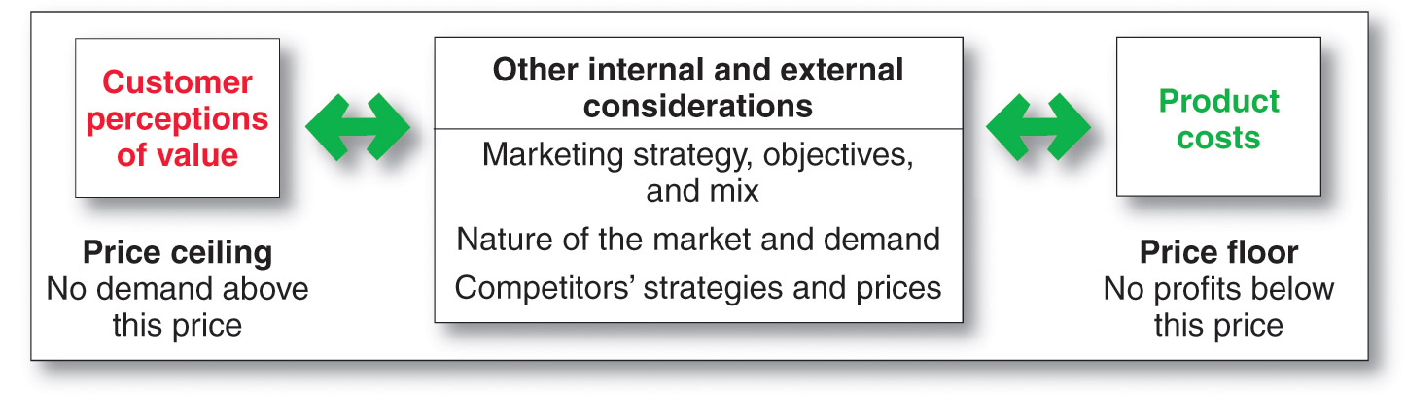
Factors to Consider When Setting Prices
Customer Perceptions of Value
Notes:
Note to Instructor
Discussion Question
How does a company like Starbuck’s price their products?
This will lead to a good overview of the chapter as students will most likely focus on customers, costs and competitors.

Slide 8
Factors to Consider When Setting Prices
Customer Perceptions of Value
Value-based pricing uses the buyers’ perceptions of value, not the sellers cost, as the key to pricing. Price is considered before the marketing program is set.
Value-based pricing is customer driven
Cost-based pricing is product driven
Notes:
Note to Instructor
Discussion Question
How does a company like Starbuck’s price their products?
This will lead to a good overview of the chapter as students will most likely focus on customers, costs and competitors.

Slide 9
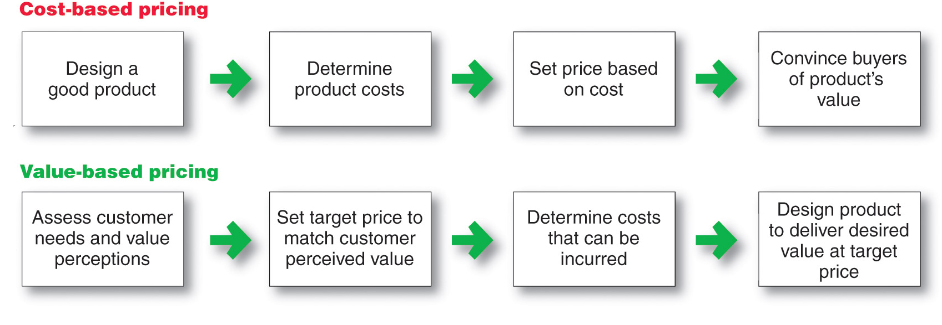
Factors to Consider When Setting Prices
Customer Perceptions of Value
Notes:
Note to Instructor
Discussion Question
How does a company like Starbuck’s price their products?
This will lead to a good overview of the chapter as students will most likely focus on customers, costs and competitors.

Slide 10
Factors to Consider When Setting Prices
Customer Perceptions of Value
Value-based pricing
Good-value pricing
Value-added pricing
Notes:
Note to Instructor
Discussion Question
How does a company like Starbuck’s price their products?
This will lead to a good overview of the chapter as students will most likely focus on customers, costs and competitors.

Slide 11
Factors to Consider When Setting Prices
Customer Perceptions of Value
Good-value pricing offers the right combination of quality and good service to fair price
Existing brands are being redesigned to offer more quality for a given price or the same quality for less price
Notes:
Note to Instructor
Discussion Question
How does a company like Starbuck’s price their products?
This will lead to a good overview of the chapter as students will most likely focus on customers, costs and competitors.

Slide 12
Factors to Consider When Setting Prices
Customer Perceptions of Value
Everyday low pricing (EDLP) involves charging a constant everyday low price with few or no temporary price discounts
High-low pricing involves charging higher prices on an everyday basis but running frequent promotions to lower prices temporarily on selected items
Notes:
Note to Instructor
Discussion Question
How does a company like Starbuck’s price their products?
This will lead to a good overview of the chapter as students will most likely focus on customers, costs and competitors.

Slide 13
Factors to Consider When Setting Prices
Customer Perceptions of Value
Value-added pricing attaches value-added features and services to differentiate offers, support higher prices, and build pricing power
Pricing power is the ability to escape price competition and to justify higher prices and margins without losing market share
Notes:
Note to Instructor
Discussion Question
How does a company like Starbuck’s price their products?
This will lead to a good overview of the chapter as students will most likely focus on customers, costs and competitors.

Slide 14
Factors to Consider When Setting Prices
Company and Product Costs
Cost-based pricing involves setting prices based on the costs for producing, distributing, and selling the product plus a fair rate of return for its effort and risk
Cost-based pricing adds a standard markup to the cost of the product
Notes:
Note to Instructor
Discussion Question
How does a company like Starbuck’s price their products?
This will lead to a good overview of the chapter as students will most likely focus on customers, costs and competitors.

Slide 15
Factors to Consider When Setting Prices
Company and Product Costs
Types of Costs
Fixed costs
Variable costs
Total costs
Notes:
Note to Instructor
Discussion Question
How does a company like Starbuck’s price their products?
This will lead to a good overview of the chapter as students will most likely focus on customers, costs and competitors.

Slide 16
Factors to Consider When Setting Prices
Company and Product Costs
Fixed costs are the costs that do not vary with production or sales level
Rent
Heat
Interest
Executive salaries
Notes:
Note to Instructor
Discussion Question
How does a company like Starbuck’s price their products?
This will lead to a good overview of the chapter as students will most likely focus on customers, costs and competitors.

Slide 17
Factors to Consider When Setting Prices
Company and Product Costs
Variable costs are the costs that vary with the level of production
Packaging
Raw materials
Notes:
Note to Instructor
Discussion Question
How does a company like Starbuck’s price their products?
This will lead to a good overview of the chapter as students will most likely focus on customers, costs and competitors.

Slide 18
Factors to Consider When Setting Prices
Company and Product Costs
Total costs are the sum of the fixed and variable costs for any given level of production
Average cost is the cost associated with a given level of output
Notes:
Note to Instructor
Discussion Question
How does a company like Starbuck’s price their products?
This will lead to a good overview of the chapter as students will most likely focus on customers, costs and competitors.

Slide 19
Factors to Consider When Setting Prices
Cost – Plus Pricing
Cost-plus pricing adds a standard markup to the cost of the product
Notes:
Note to Instructor
Discussion Question
How does a company like Starbuck’s price their products?
This will lead to a good overview of the chapter as students will most likely focus on customers, costs and competitors.

Slide 20
Factors to Consider When Setting Prices
Cost – Plus Pricing
Benefits
  Sellers are certain about costs
  Prices are similar in industry and price competition is minimized
  Consumers feel it is fair
Disadvantages
  Ignores demand and competitor prices
Notes:
Note to Instructor
Discussion Question
How does a company like Starbuck’s price their products?
This will lead to a good overview of the chapter as students will most likely focus on customers, costs and competitors.

Slide 21
Factors to Consider When Setting Prices
Cost – Plus Pricing
The simplest pricing method
Example of toaster in the book (Page 297, Ch. 10)
      Variable cost = $ 10
      Fixed costs = $ 300,000
      Expected unit sales = 50,000
Notes:
Note to Instructor
Discussion Question
How does a company like Starbuck’s price their products?
This will lead to a good overview of the chapter as students will most likely focus on customers, costs and competitors.

Slide 22
Factors to Consider When Setting Prices
Cost – Plus Pricing
Finding the manufacturer’s cost per toaster
Unit cost = variable cost + fixed costs / unit sales
Unit Cost = $ 10 + $300,000/50,000
= $ 16
Notes:
Note to Instructor
Discussion Question
How does a company like Starbuck’s price their products?
This will lead to a good overview of the chapter as students will most likely focus on customers, costs and competitors.

Slide 23
Factors to Consider When Setting Prices
Cost – Plus Pricing
Suppose the manufacturer’s wants to earn a 20 percent markup on sales.
Hence,
Markup Price = Unit cost / (1 – Desired Return on Sales)
= $ 16 / (1 – 0.2)
= $ 20
Manufacturer will charge dealers $ 20 per toaster
and make a profit of $ 4 per toaster.
Notes:
Note to Instructor
Discussion Question
How does a company like Starbuck’s price their products?
This will lead to a good overview of the chapter as students will most likely focus on customers, costs and competitors.

Slide 24
Factors to Consider When Setting Prices
Break-Even Analysis and Target Profit Pricing
Break-even pricing is the price at which total costs are equal to total revenue and there is no profit
Target profit pricing is the price at which the firm will break even or make the profit it’s seeking
Notes:
Note to Instructor
Discussion Question
How does a company like Starbuck’s price their products?
This will lead to a good overview of the chapter as students will most likely focus on customers, costs and competitors.

Slide 25
Factors to Consider When Setting Prices
Break-Even Analysis and Target Profit Pricing
Example of Toaster continued
Break-Even Volume = Fixed Cost / Price – Variable Cost
= $ 300,000 / $ 20 - $ 10
= 30,000
If the company wants to make a target profit, it must sell more than 30,000 units at $ 20 each.
Notes:
Note to Instructor
Discussion Question
How does a company like Starbuck’s price their products?
This will lead to a good overview of the chapter as students will most likely focus on customers, costs and competitors.

Slide 26
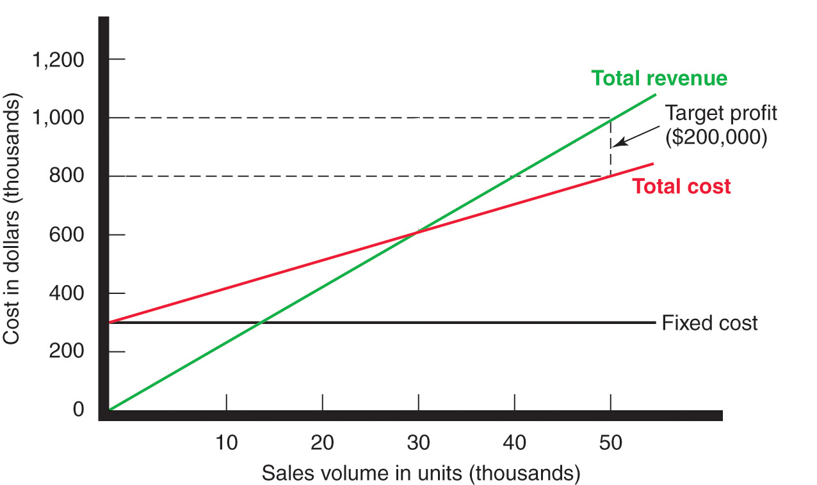
Factors to Consider When Setting Prices
Break-Even Analysis and Target Profit Pricing
Notes:
Note to Instructor
Discussion Question
How does a company like Starbuck’s price their products?
This will lead to a good overview of the chapter as students will most likely focus on customers, costs and competitors.

