Slide 1
Chapter 09
New-Product Development and Product Life-Cycle Strategies

Slide 2
Topics to Cover
Managing New-Product Development
Product Life-Cycle Strategies
Additional Product and Service Considerations

Slide 3
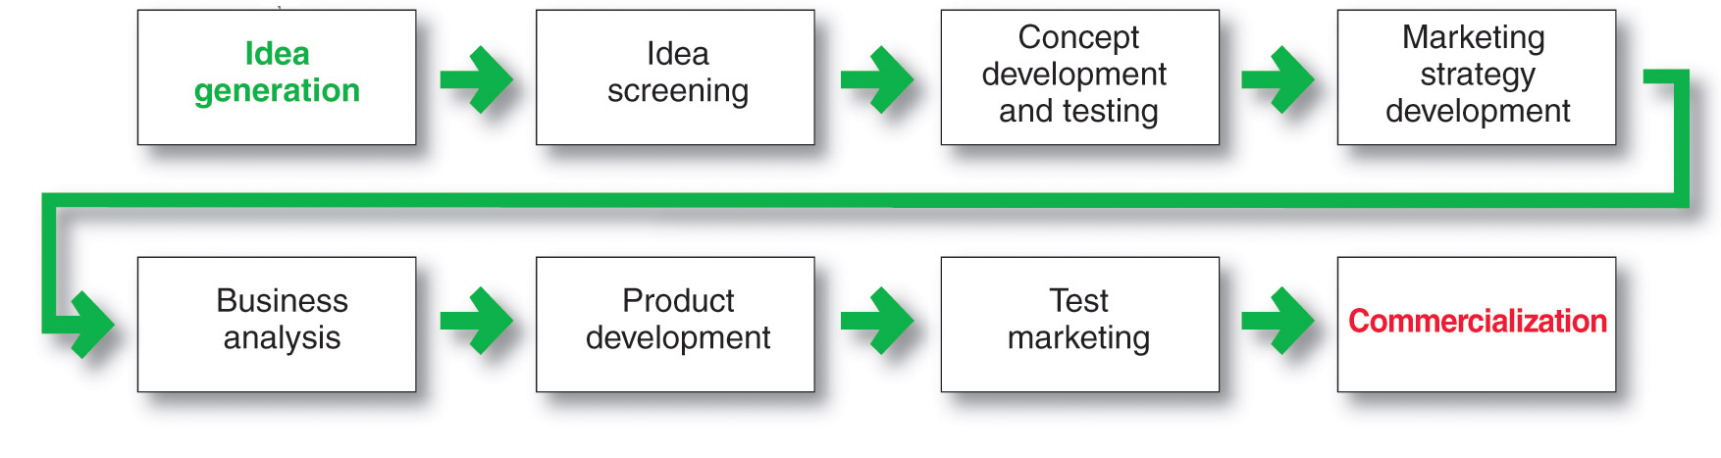
New-Product Development Process
Major Stages in New-Product Development

Slide 4
Managing New-Product Development
Successful new-product development should be:
Customer centered
Team centered
Systematic

Slide 5
Managing New-Product Development
Customer-centered new product development focuses on finding new ways to solve customer problems and create more customer satisfying experiences
Begins and ends with solving customer problems

Slide 6
Managing New-Product Development
Sequential new-product development is a development approach where company departments work closely together individually to complete each stage of the process before passing it along to the next department or stage
Increased control in risky or complex projects
Slow

Slide 7
Managing New-Product Development
Team-based new-product development is a development approach where company departments work closely together in cross-functional teams, overlapping in the product-development process to save time and increase effectiveness

Slide 8
Managing New-Product Development
Systematic new-product development is an innovative development approach that collects, reviews, evaluates, and manages new-product ideas
  Creates an innovation-oriented culture
  Yields a large number of new-product ideas

Slide 9
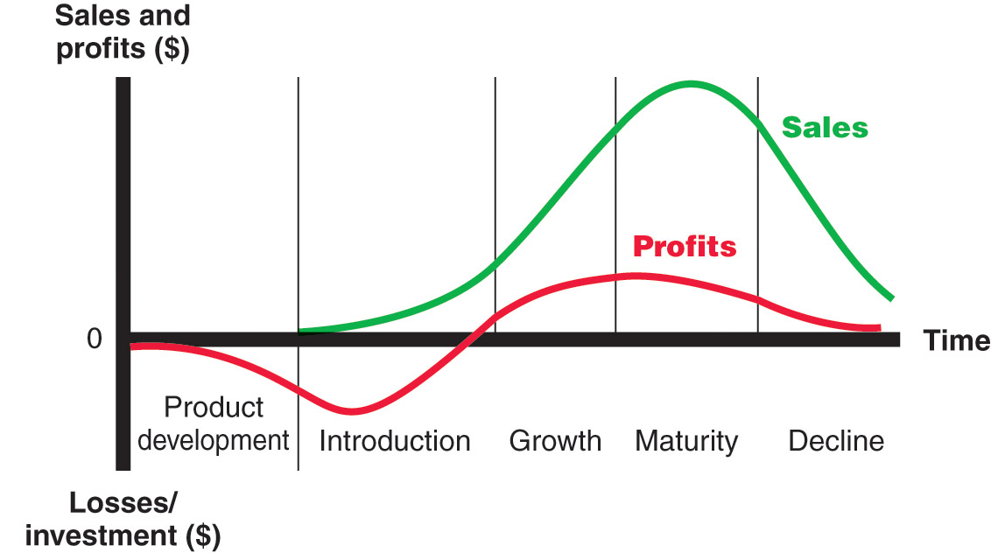
Product Life-Cycle Strategies
Product Life Cycle
Notes:
Note to Instructor
Discussion Question
Name a product at each stage of the PLC.
This concept is very new to students. See if they can identify products or product categories that are in each stage of the model. Introduction might include online movie viewing software, growth might include MP3 players, maturity might include bottled water, and decline could include soda (actually in a decline) or videotape players.

Slide 10
Product Life-Cycle Strategies
Product Life Cycle
Product development
  Sales are zero and investment costs mount
Introduction
  Slow sales growth and profits are nonexistent
Growth
  Rapid market acceptance and increasing profits.
Maturity
  Slowdown in sales growth and profits level off or decline
Decline
  Sales fall off and profits drop
Notes:
Note to Instructor
Discussion Question
Name a product at each stage of the PLC.
This concept is very new to students. See if they can identify products or product categories that are in each stage of the model. Introduction might include online movie viewing software, growth might include MP3 players, maturity might include bottled water, and decline could include soda (actually in a decline) or videotape players.

Slide 11
Product Life-Cycle Strategies
Product Life Cycle
Introduction Stage
Slow sales growth
Little or no profit
High distribution and promotion expense
Notes:
Note to Instructor
Discussion Question
Name a product at each stage of the PLC.
This concept is very new to students. See if they can identify products or product categories that are in each stage of the model. Introduction might include online movie viewing software, growth might include MP3 players, maturity might include bottled water, and decline could include soda (actually in a decline) or videotape players.

Slide 12
Product Life-Cycle Strategies
Product Life Cycle
Growth Stage
Sales increase
New competitors enter the market
Price stability or decline to increase volume
Consumer education
Profits increase
Promotion and manufacturing costs gain economies of scale
Notes:
Note to Instructor
Discussion Question
Name a product at each stage of the PLC.
This concept is very new to students. See if they can identify products or product categories that are in each stage of the model. Introduction might include online movie viewing software, growth might include MP3 players, maturity might include bottled water, and decline could include soda (actually in a decline) or videotape players.

Slide 13
Product Life-Cycle Strategies
Product Life Cycle
Maturity Stage
Sales slows or levels off
Competitors begin marking down prices, increasing their advertising and sales promotions, and upping their product development budgets to find better versions of the product.
Notes:
Note to Instructor
Discussion Question
Name a product at each stage of the PLC.
This concept is very new to students. See if they can identify products or product categories that are in each stage of the model. Introduction might include online movie viewing software, growth might include MP3 players, maturity might include bottled water, and decline could include soda (actually in a decline) or videotape players.

Slide 14
Product Life-Cycle Strategies
Product Life Cycle
Maturity Stage Modifying Strategies
Market modifying
Product modifying
Marketing mix modifying
Notes:
Note to Instructor
Discussion Question
Name a product at each stage of the PLC.
This concept is very new to students. See if they can identify products or product categories that are in each stage of the model. Introduction might include online movie viewing software, growth might include MP3 players, maturity might include bottled water, and decline could include soda (actually in a decline) or videotape players.

Slide 15
Product Life-Cycle Strategies
Product Life Cycle
Maturity Stage – Modifying Strategies
Market modifying
  The company tries to increase the consumption of the current product.
  May look for new users or new market segments
  The manager may also look for ways to increase usage among present customers
Notes:
Note to Instructor
Discussion Question
Name a product at each stage of the PLC.
This concept is very new to students. See if they can identify products or product categories that are in each stage of the model. Introduction might include online movie viewing software, growth might include MP3 players, maturity might include bottled water, and decline could include soda (actually in a decline) or videotape players.

Slide 16
Product Life-Cycle Strategies
Product Life Cycle
Maturity Stage – Modifying Strategies
Product modifying
  Changing characteristics such as quality, features, style, or packaging to attract new customers and to inspire more usage.
  Might improve the durability, reliability, speed and taste
Notes:
Note to Instructor
Discussion Question
Name a product at each stage of the PLC.
This concept is very new to students. See if they can identify products or product categories that are in each stage of the model. Introduction might include online movie viewing software, growth might include MP3 players, maturity might include bottled water, and decline could include soda (actually in a decline) or videotape players.

Slide 17
Product Life-Cycle Strategies
Product Life Cycle
Maturity Stage – Modifying Strategies
Modifying the Marketing Mix
  Improve sales by changing one or more marketing mix elements
  Can also move into new marketing channels to help serve new users
Notes:
Note to Instructor
Discussion Question
Name a product at each stage of the PLC.
This concept is very new to students. See if they can identify products or product categories that are in each stage of the model. Introduction might include online movie viewing software, growth might include MP3 players, maturity might include bottled water, and decline could include soda (actually in a decline) or videotape players.

Slide 18
Product Life-Cycle Strategies
Product Life Cycle
Decline Stage
Maintain the product
Harvest the product
Drop the product
Notes:
Note to Instructor
Discussion Question
Name a product at each stage of the PLC.
This concept is very new to students. See if they can identify products or product categories that are in each stage of the model. Introduction might include online movie viewing software, growth might include MP3 players, maturity might include bottled water, and decline could include soda (actually in a decline) or videotape players.

Slide 19
Product Life-Cycle Strategies
Product Life Cycle
Decline Stage
Maintain the product
Harvest the product
Drop the product
Notes:
Note to Instructor
Discussion Question
Name a product at each stage of the PLC.
This concept is very new to students. See if they can identify products or product categories that are in each stage of the model. Introduction might include online movie viewing software, growth might include MP3 players, maturity might include bottled water, and decline could include soda (actually in a decline) or videotape players.

Slide 20
Product Life-Cycle Strategies
Product Life Cycle
PLC concept can be applied to styles, fashions, and fads
Notes:
Note to Instructor
Discussion Question
Name a product at each stage of the PLC.
This concept is very new to students. See if they can identify products or product categories that are in each stage of the model. Introduction might include online movie viewing software, growth might include MP3 players, maturity might include bottled water, and decline could include soda (actually in a decline) or videotape players.

Slide 21
Product Life-Cycle Strategies
Product Life Cycle
  Style
    A basic and distinction mode of expression
    Once a style is invented, it may last for generations.
  Fashion
    A currently accepted or popular style in a given filed.
    Fashions tend to grow slowly, remain popular for a while, and then decline slowly.
Notes:
Note to Instructor
Discussion Question
Name a product at each stage of the PLC.
This concept is very new to students. See if they can identify products or product categories that are in each stage of the model. Introduction might include online movie viewing software, growth might include MP3 players, maturity might include bottled water, and decline could include soda (actually in a decline) or videotape players.

Slide 22
Product Life-Cycle Strategies
Product Life Cycle
  Fads
    A temporary period of unusually high sales driven by consumer enthusiasm and immediate product or brand popularity.
    A fad may be part of an otherwise normal life cycle or may comprise of a brand’s or product’s entire life cycle.
Notes:
Note to Instructor
Discussion Question
Name a product at each stage of the PLC.
This concept is very new to students. See if they can identify products or product categories that are in each stage of the model. Introduction might include online movie viewing software, growth might include MP3 players, maturity might include bottled water, and decline could include soda (actually in a decline) or videotape players.

Slide 23
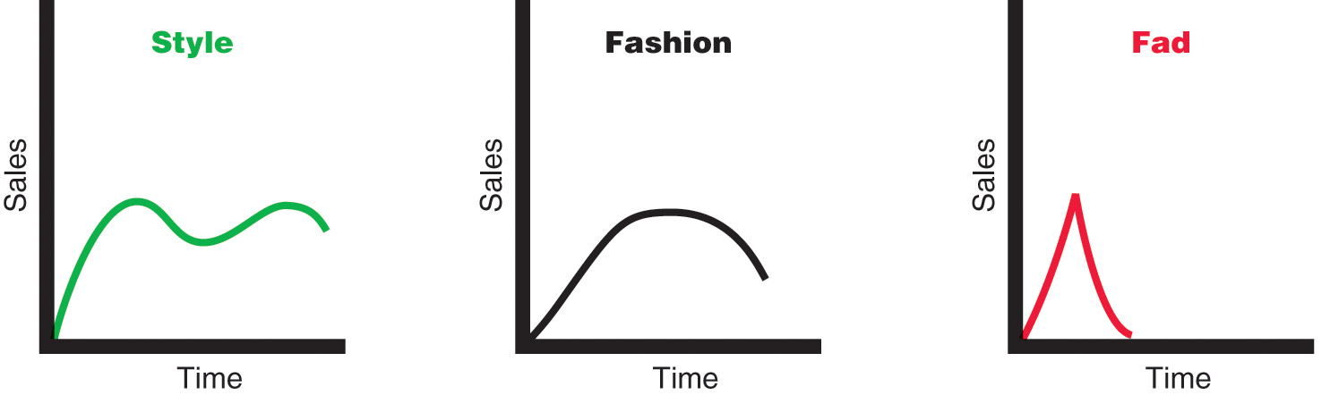
Product Life-Cycle Strategies
Product Life Cycle
Notes:
Note to Instructor
Discussion Question
Name a product at each stage of the PLC.
This concept is very new to students. See if they can identify products or product categories that are in each stage of the model. Introduction might include online movie viewing software, growth might include MP3 players, maturity might include bottled water, and decline could include soda (actually in a decline) or videotape players.

Slide 24
Product Life-Cycle Strategies
Summary of Product Life Cycle
Notes:
Note to Instructor
Discussion Question
Name a product at each stage of the PLC.
This concept is very new to students. See if they can identify products or product categories that are in each stage of the model. Introduction might include online movie viewing software, growth might include MP3 players, maturity might include bottled water, and decline could include soda (actually in a decline) or videotape players.

Slide 25
Additional Product and Service Considerations
Product Decisions and Social Responsibility
Marketers should carefully consider Public policy and regulations regarding developing and dropping products, patents, quality, and safety
For example many manufacturers often written warranties to convince customers of their product quality.
Notes:
Note to Instructor
Discussion Question
Name a product at each stage of the PLC.
This concept is very new to students. See if they can identify products or product categories that are in each stage of the model. Introduction might include online movie viewing software, growth might include MP3 players, maturity might include bottled water, and decline could include soda (actually in a decline) or videotape players.

Slide 26
Additional Product and Service Considerations
International Product and Service Marketing
Challenges
Determining what products and services to introduce in which countries
Standardization versus customization
Packaging and labeling
Customs, values, laws
Notes:
Note to Instructor
Discussion Question
Name a product at each stage of the PLC.
This concept is very new to students. See if they can identify products or product categories that are in each stage of the model. Introduction might include online movie viewing software, growth might include MP3 players, maturity might include bottled water, and decline could include soda (actually in a decline) or videotape players.

