Slide 1
Chapter 09
New-Product Development and Product Life-Cycle Strategies

Slide 2
Topics to Cover
New-Product Development Strategy
New-Product Development Process

Slide 3
New-Product Development Strategy
Ways to obtain new products
Two ways to obtain new products
Acquisition
New product development
Notes:
Note to Instructor
New products are important—to both customers and the marketers who serve them. For companies, new products are a key source of growth. For customers, they bring new solutions and variety to their lives. Yet, innovation can be very expensive and very risky. New products face tough odds. According to one estimate, 90 percent of all new products in America fail. Each year, companies lose an estimated $20 billion to $30 billion on failed food products alone.

Slide 4
New-Product Development Strategy
Ways to obtain new products
Acquisition refers to the buying of a whole company, a patent, or a license to produce someone else’s product
Notes:
Note to Instructor
New products are important—to both customers and the marketers who serve them. For companies, new products are a key source of growth. For customers, they bring new solutions and variety to their lives. Yet, innovation can be very expensive and very risky. New products face tough odds. According to one estimate, 90 percent of all new products in America fail. Each year, companies lose an estimated $20 billion to $30 billion on failed food products alone.

Slide 5
New-Product Development Strategy
Ways to obtain new products
New product development refers to original products, product improvements, product modifications, and new brands developed from the firm’s own research and development
Notes:
Note to Instructor
New products are important—to both customers and the marketers who serve them. For companies, new products are a key source of growth. For customers, they bring new solutions and variety to their lives. Yet, innovation can be very expensive and very risky. New products face tough odds. According to one estimate, 90 percent of all new products in America fail. Each year, companies lose an estimated $20 billion to $30 billion on failed food products alone.

Slide 6
New-Product Development
Reasons for new product failure
Overestimation of market size
Poor design
Incorrect positioning
Wrong timing
Priced too high
Ineffective promotion
Management influence
High development costs
Competition
Notes:
Note to Instructor
If you are running a marketing plan project in your class, this is a good time to ask why their project ideas might fail in the real market. You can then ask what they plan to do to prevent failure.

Slide 7
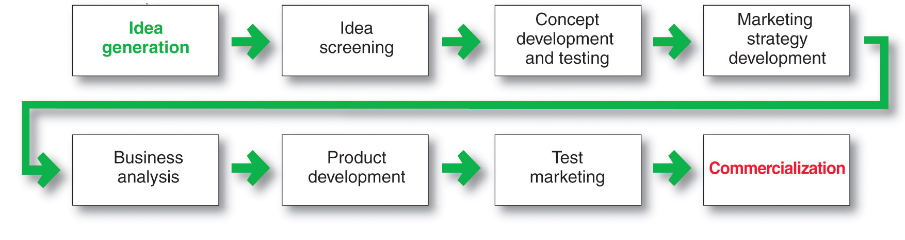
New-Product Development Process
Major Stages in New-Product Development

Slide 8
New-Product Development Process
Idea Generation
Idea generation is the systematic search for new-product ideas
Sources of new-product ideas
Internal
External

Slide 9
New-Product Development Process
Idea Generation
Internal sources refer to the company’s own formal research and development, management and staff, and intrapreneurial programs

Slide 10
New-Product Development Process
Idea Generation
External sources refer to sources outside the company such as customers, competitors, distributors, suppliers, and outside design firms

Slide 11
New-Product Development Process
Idea Screening
Screening new-product ideas in order to spot good ideas and drop poor one as soon as possible

Slide 12
New-Product Development Process
Idea Screening
Identify good ideas and drop poor ideas
R-W-W Screening Framework:
  Is it real?
  Can we win?
  Is it worth doing?

Slide 13
New-Product Development Process
Concept Development and Testing
Product idea is an idea for a possible product that the company can see itself offering to the market
Product concept is a detailed version of the idea stated in meaningful consumer terms
Product image is the way consumers perceive an actual or potential product

Slide 14
New-Product Development Process
Concept Development and Testing
Concept testing refers to testing new-product concepts with groups of target consumers
Many firms routinely test the new products with consumers before attempting to turn them into actual new products.

Slide 15
New-Product Development Process
Marketing Strategy Development
Designing an initial marketing strategy for a new product based on the product concept
Marketing strategy development refers to the initial marketing strategy for introducing the product to the market

Slide 16
New-Product Development Process
Marketing Strategy Development
    Marketing Strategy Statement includes: -
      Description of the target market, the planned value propositions, and the sales, market share, and profit goals for the first few years.
      The product’s planned price, distribution, and marketing budget for the first year.
      Describes the planned long-run sales, profit goals, and marketing mix strategy

Slide 17
New-Product Development Process
Business Analysis
Business analysis involves a review of the sales, costs, and profit projections to find out whether they satisfy the company’s objectives

Slide 18
New-Product Development Process
Business Analysis
To estimate sales, the company might look at the history of similar products and conduct market surveys.
It can then estimate minimum and maximum sales to assess the range of risk.
The company then uses the sales and costs figures to analyze the new product’s financial attractiveness.

Slide 19
New-Product Development Process
Product Development
Product development involves the creation and testing of one or more physical versions by the R&D or engineering departments
Requires an increase in investment

Slide 20
New-Product Development Process
Product Development
Often products undergo a rigorous tests to make sure that they perform safely and effectively, or that consumers will find value in them.
Companies can do their own product testing or outsource testing to other firms that specialize in testing.

Slide 21
New-Product Development Process
Test Marketing
Test marketing is the stage at which the product and marketing program are introduced into more realistic marketing settings
Provides the marketer with experience in testing the product and entire marketing program before full introduction

Slide 22
New-Product Development Process
Test Marketing
When firms test market
New product with large investment
Uncertainty about product or marketing program
When firms may not test market
Simple line extension
Copy of competitor product
Low costs
Management confidence

Slide 23
New-Product Development Process
Types of Test Markets
Simulated test markets
Standard test markets
Controlled test markets

Slide 24
New-Product Development Process
Types of Test Markets
Standardized Test Markets
Using standard test markets, the company finds a small number of representative test cities, conducts a full marketing campaign in these cities, and use audits, consumer and distributor surveys, and other measures to gauge product performance.
Most widely used but there are some disadvantages

Slide 25
New-Product Development Process
Types of Test Markets
Drawbacks of Standardized Test Markets
Costly
May take a long time
Competitors can monitor test market results
Give competitors a look well ahead of product launch

Slide 26
New-Product Development Process
Types of Test Markets
Controlled Test Markets
Several firms keep controlled panels of stores that have agreed to carry new products for a fee.
Costs less than the standard test markets.

Slide 27
New-Product Development Process
Types of Test Markets
Simulated Test Markets
Test the product in a simulated shopping environment.
Simulation provides a measure of trial and the commercial effectiveness.
Usually costs less and complete in eight weeks time and keep the competitors out of reach.

Slide 28
New-Product Development Process
Types of Test Markets
Simulated Test Markets
Advantages
  Faster
  Less expensive than other test methods
  Restricts access by competitors
Disadvantages
  Not considered as reliable and accurate due to the controlled setting

Slide 29
New-Product Development Process
Commercialization
Introducing the new product into the market.
  When to launch
  Where to launch
  Planned market rollout

