Slide 1
Chapter 08
Product, Services, and Brands:
Building Customer Value

Slide 2
Topics to Cover
Branding Strategy: Building Strong Brands
Services Marketing

Slide 3
Branding Strategy: Building Strong Brands
Brand Sponsorship
Manufacturer has four sponsorship options.
Manufacturer’s brand (National brand).
Private brand (Store brand or Distributor brand).
Licensed brand
Co-brand

Slide 4
Branding Strategy: Building Strong Brands
Brand Sponsorship
National Brands Vs Store Brands
Sony – SonyBravia (National Brand)
Wall-Mart (Store Brand)

Slide 5
Branding Strategy: Building Strong Brands
Brand Sponsorship
Licensing (Licensed brand)
  Some companies spend millions to create their own brand while some take the license (by paying a fee) of an established brand which is proven.
  Name and character licensing has grown rapidly in the recent years.

Slide 6
Branding Strategy: Building Strong Brands
Brand Sponsorship
Co-brand
  Occurs when two established brand names of different companies are used on the same product.
  In most co-branding situations, one company licenses another company’s well known brand to use in combination with its own.

Slide 7
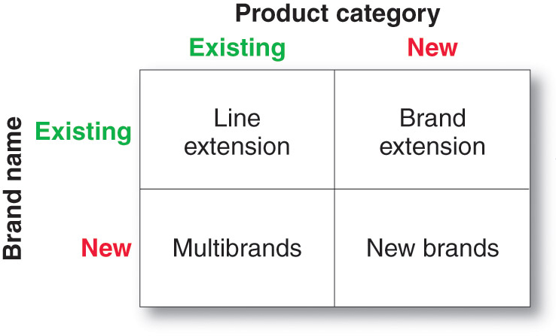
Branding Strategy: Building Strong Brands
Brand Development Strategies

Slide 8
Branding Strategy: Building Strong Brands
Brand Development Strategies
Line Extension
Occurs when a company extends existing brand names to new forms, colors, sizes, ingredients or flavors of the existing product category.

Slide 9
Branding Strategy: Building Strong Brands
Brand Development Strategies
Line Extension
A company might introduce line extensions as a low-cost, low-risk way to introduce new products or it might want to meet consumer desires for variety, to use excess capacity, or simply to command more shelf space from resellers.

Slide 10
Branding Strategy: Building Strong Brands
Brand Development Strategies
Line Extension
Involves risks like
  An overextended brand name might lose its specific meaning.
  Sales of an extension may come at the expense of other items in the line.

Slide 11
Branding Strategy: Building Strong Brands
Brand Development Strategies
Brand Extension
Brand Extension extends the current brand name to new or modified products in a new category.

Slide 12
Branding Strategy: Building Strong Brands
Brand Development Strategies
Brand Extension
A brand extension gives a new product instant recognition and faster acceptance.
Also saves the high advertising costs usually required to build a new brand name

Slide 13
Branding Strategy: Building Strong Brands
Brand Development Strategies
Brand Extension
Risks Involved are
  The extension may confuse the image of the brand.
  If brand extension fails, it may harm consumer attitudes towards the other products of same brand
  A brand name may not be appropriate for a particular new brand.

Slide 14
Branding Strategy: Building Strong Brands
Brand Development Strategies
Multibrands
Multibranding offers a way to establish different features and appeal to different buying motives. It also allows a company to lock more reseller shelf space.
Companies are often seen introducing additional brands in the same category.

Slide 15
Branding Strategy: Building Strong Brands
Brand Development Strategies
Multibrands
A major disadvantage of multibrands is that each brand obtain a small market share and none of them may be profitable.

Slide 16
Branding Strategy: Building Strong Brands
Brand Development Strategies
New Brands
A company might believe that the power of its existing brand name is waning (declining) and a new brand name is needed.

Slide 17
Services Marketing
Types of Service Industries
Government
Private not-for-profit organizations
Business services

Slide 18
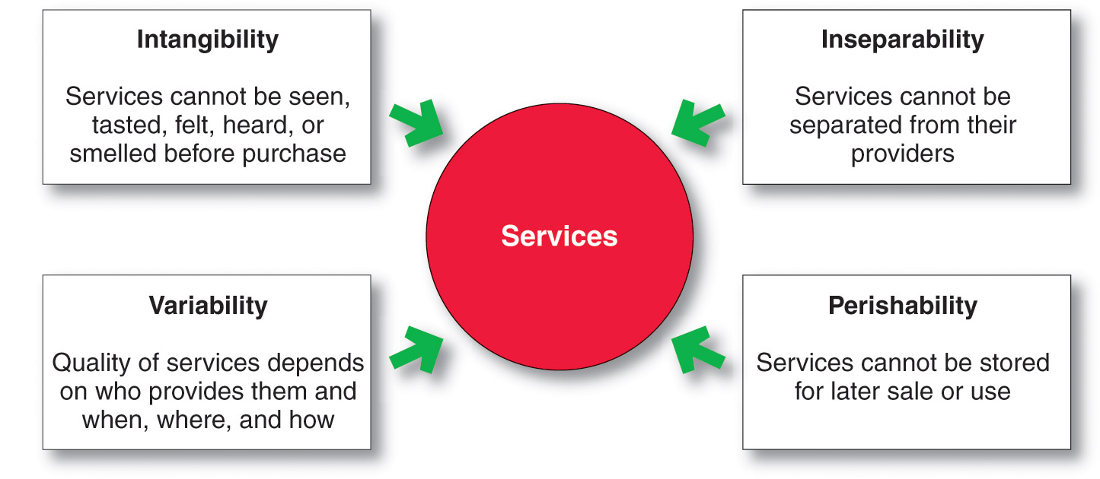
Services Marketing
Nature and Characteristics of a Service

Slide 19
Services Marketing
Nature and Characteristics of a Service
Intangibility
Means services cannot be seen, tasted, felt, heard, or smelled before they are bought.
The service provider’s task is to make the service tangible in one or more ways and to send the right signals about quality.

Slide 20
Services Marketing
Nature and Characteristics of a Service
Inseparability
Services are produced and consumed at the same time and cannot be separated from their providers.
If a service employee provides the service, then the employee becomes part of the service.

Slide 21
Services Marketing
Nature and Characteristics of a Service
Variability
The quality of the service may vary greatly, depending on who provides the service and when, where, and how the service is provided.

Slide 22
Services Marketing
Nature and Characteristics of a Service
Perishability
The services cannot be stored for later use or sale.
Perishability of services is not a problem when the demand is steady, but when the demand fluctuates, service firms often have to face different problems.

Slide 23
Services Marketing
Marketing Strategies for Service Firms
In addition to traditional marketing strategies, service firms often require additional strategies
Service-profit chain
Internal marketing
Interactive marketing

Slide 24
Services Marketing
Marketing Strategies for Service Firms
Service-profit chain links service firm profits with employee and customer satisfaction
Internal service quality
Satisfied and productive service employees
Greater service value
Satisfied and loyal customers
Healthy service profits and growth

Slide 25
Services Marketing
Marketing Strategies for Service Firms
Internal marketing means that the service firm must orient and motivate its customer contact employees and supporting service people to work as a team to provide customer satisfaction
Internal marketing must precede external marketing

Slide 26
Services Marketing
Marketing Strategies for Service Firms
Interactive marketing means that service quality depends heavily on the quality of the buyer-seller interaction during the service encounter
Service differentiation
Service quality
Service productivity

Slide 27
Services Marketing
Marketing Strategies for Service Firms
Managing service differentiation creates a competitive advantage from the offer, delivery, and image of the service
Offer can include distinctive features
Delivery can include more able and reliable customer contact people, environment, or process
Image can include symbols and branding

Slide 28
Services Marketing
Marketing Strategies for Service Firms
Managing service quality provides a competitive advantage by delivering consistently higher quality than its competitors
Service quality always varies depending on interactions between employees and customers

Slide 29
Services Marketing
Marketing Strategies for Service Firms
Managing service productivity refers to the cost side of marketing strategies for service firms
Employee recruiting, hiring, and training strategies
Service quantity and quality strategies

