Slide 1
Chapter 07
Customer-Driven Marketing Strategy: Creating Value for Target Customers

Slide 2
Topics to Cover
Differentiation and Positioning

Slide 3
Differentiation and Positioning
Product position is the way the product is defined by consumers on important attributes—the place the product occupies in consumers’ minds relative to competing products
  Perceptions
  Impressions
  Feelings
Notes:
Note to Instructor
Tide is positioned as a powerful, all-purpose family detergent; Ivory is positioned as the gentle detergent for fine washables and baby clothes.
At Subway restaurants, you “Eat Fresh;” at Olive Garden, “When You’re Here, You’re Family;” and at Applebee’s you’re “Eatin’ Good in the Neighborhood.”
In the automobile market, the Nissan Versa and Honda Fit are positioned on economy, Mercedes and Cadillac on luxury, and Porsche and BMW on performance. Volvo positions powerfully on safety. And Toyota positions its fuel efficient, hybrid Prius as a high-tech solution to the energy shortage. “How far will you go to save the planet?” it asks.

Slide 4
Differentiation and Positioning
Choosing a Differentiation and Positioning Strategy
Identifying a set of possible competitive advantages to build a position
Choosing the right competitive advantages
Selecting an overall positioning strategy
Developing a positioning statement
Notes:
Note to Instructor
Tide is positioned as a powerful, all-purpose family detergent; Ivory is positioned as the gentle detergent for fine washables and baby clothes.
At Subway restaurants, you “Eat Fresh;” at Olive Garden, “When You’re Here, You’re Family;” and at Applebee’s you’re “Eatin’ Good in the Neighborhood.”
In the automobile market, the Nissan Versa and Honda Fit are positioned on economy, Mercedes and Cadillac on luxury, and Porsche and BMW on performance. Volvo positions powerfully on safety. And Toyota positions its fuel efficient, hybrid Prius as a high-tech solution to the energy shortage. “How far will you go to save the planet?” it asks.

Slide 5
Differentiation and Positioning
Identifying Possible Value Differences and
Competitive Advantages
Competitive advantage is an advantage over competitors gained by offering consumers greater value, either through lower prices or by providing more benefits that justify higher prices
Notes:
Note to Instructor
Tide is positioned as a powerful, all-purpose family detergent; Ivory is positioned as the gentle detergent for fine washables and baby clothes.
At Subway restaurants, you “Eat Fresh;” at Olive Garden, “When You’re Here, You’re Family;” and at Applebee’s you’re “Eatin’ Good in the Neighborhood.”
In the automobile market, the Nissan Versa and Honda Fit are positioned on economy, Mercedes and Cadillac on luxury, and Porsche and BMW on performance. Volvo positions powerfully on safety. And Toyota positions its fuel efficient, hybrid Prius as a high-tech solution to the energy shortage. “How far will you go to save the planet?” it asks.

Slide 6
Differentiation and Positioning
Choosing a Differentiation and Positioning Strategy
Identifying a set of possible competitive advantages to build a position by providing superior value from:
Product differentiation
Service differentiation
Channel differentiation
People differentiation
Image differentiation
Notes:
Note to Instructor
Tide is positioned as a powerful, all-purpose family detergent; Ivory is positioned as the gentle detergent for fine washables and baby clothes.
At Subway restaurants, you “Eat Fresh;” at Olive Garden, “When You’re Here, You’re Family;” and at Applebee’s you’re “Eatin’ Good in the Neighborhood.”
In the automobile market, the Nissan Versa and Honda Fit are positioned on economy, Mercedes and Cadillac on luxury, and Porsche and BMW on performance. Volvo positions powerfully on safety. And Toyota positions its fuel efficient, hybrid Prius as a high-tech solution to the energy shortage. “How far will you go to save the planet?” it asks.

Slide 7
Differentiation and Positioning
Choosing the Right Competitive Advantage
Difference to promote should be:
Important
Distinctive
Superior
Communicable
Preemptive
Affordable
Profitable
Notes:
Note to Instructor
Tide is positioned as a powerful, all-purpose family detergent; Ivory is positioned as the gentle detergent for fine washables and baby clothes.
At Subway restaurants, you “Eat Fresh;” at Olive Garden, “When You’re Here, You’re Family;” and at Applebee’s you’re “Eatin’ Good in the Neighborhood.”
In the automobile market, the Nissan Versa and Honda Fit are positioned on economy, Mercedes and Cadillac on luxury, and Porsche and BMW on performance. Volvo positions powerfully on safety. And Toyota positions its fuel efficient, hybrid Prius as a high-tech solution to the energy shortage. “How far will you go to save the planet?” it asks.

Slide 8
Differentiation and Positioning
Developing a Positioning Statement
To (target segment and need) our (brand) is (concept) that (point of difference)
Notes:
Note to Instructor
Tide is positioned as a powerful, all-purpose family detergent; Ivory is positioned as the gentle detergent for fine washables and baby clothes.
At Subway restaurants, you “Eat Fresh;” at Olive Garden, “When You’re Here, You’re Family;” and at Applebee’s you’re “Eatin’ Good in the Neighborhood.”
In the automobile market, the Nissan Versa and Honda Fit are positioned on economy, Mercedes and Cadillac on luxury, and Porsche and BMW on performance. Volvo positions powerfully on safety. And Toyota positions its fuel efficient, hybrid Prius as a high-tech solution to the energy shortage. “How far will you go to save the planet?” it asks.

Slide 9
Communication and
Delivering the Chosen Position
Choosing the positioning is often easier than implementing the position.

Slide 10
Chapter 08
Product, Services, and Brands:
Building Customer Value

Slide 11
Topics to Cover
What Is a Product?
Product and Services Decisions

Slide 12
What Is a Product?
Products, Services, and Experiences
Product is anything that can be offered in a market for attention, acquisition, use, or consumption that might satisfy a need or want
Experiences represent what buying the product or service will do for the customer
Notes:
Note to Instructor
This Web link is a great example of a store that creates experiences is Jordan’s Furniture in the Boston. These furniture stores include an Imax theater, an amusement park quality motion ride, a trapeze school, and Mardi Gras parades. You can visit their stores through their Web sites.

Slide 13
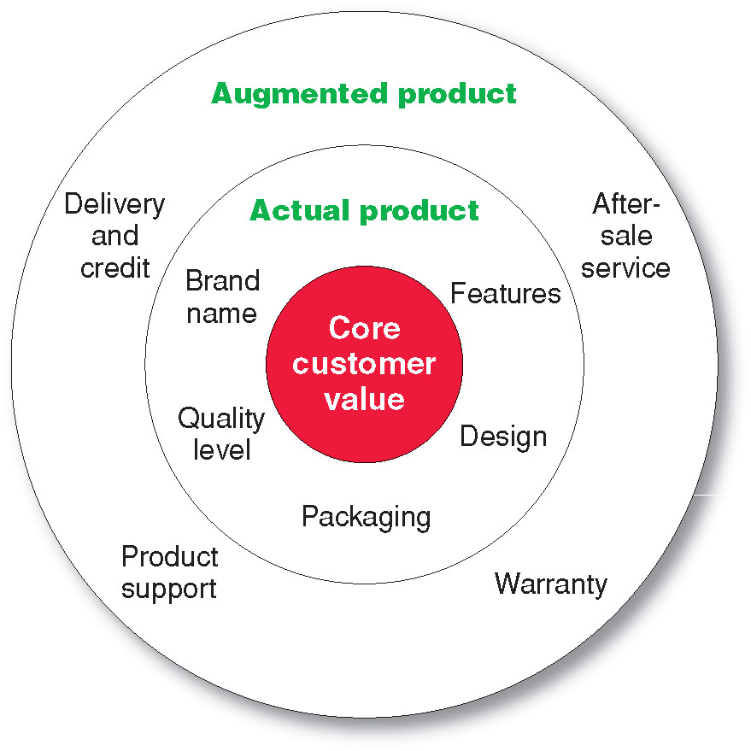
What Is a Product?
Levels of Product and Services
Notes:
Note to Instructor
Core benefits represent what the buyer is really buying.
Actual product represents the design, brand name, and packaging that delivers the core benefit to the customer.
Augmented product represents additional services or benefits of the actual product.
It is a good idea for the students to bring in some products so the class can discuss the levels of product and services. Products including Gatorade, toothpaste, facial moisturizer or cosmetics work well in this discussion. You can often find augmented product features on the product’s Web sites including games, features and support.

Slide 14
What Is a Product?
Product and Service Classifications
Consumer products
Industrial products

Slide 15
What Is a Product?
Product and Service Classifications
Consumer products are products and services for personal consumption
Classified by how consumers buy them
  Convenience products
  Shopping products
  Specialty products
  Unsought products

Slide 16
What Is a Product?
Product and Service Classifications
Convenience products are consumer products and services that the customer usually buys frequently, immediately, and with a minimum comparison and buying effort
Newspapers
Candy
Fast food

Slide 17
What Is a Product?
Product and Service Classifications
Shopping products are consumer products and services that the customer compares carefully on suitability, quality, price, and style
Furniture
Cars
Appliances

Slide 18
What Is a Product?
Product and Service Classifications
Specialty products are consumer products and services with unique characteristics or brand identification for which a significant group of buyers is willing to make a special purchase effort
Medical services
Designer clothes
High-end electronics

Slide 19
What Is a Product?
Product and Service Classifications
Unsought products are consumer products that the consumer does not know about or knows about but does not normally think of buying
Life insurance
Funeral services
Blood donations
Notes:
Note to Instructor
Discussion Question
What is a product that could be convenience, shopping, and specialty?
This is a bit of a puzzle. They might realize that a camera could fall into several categories depending on the buyer and the situation. Certainly, if you are on vacation and you forgot your camera, you would pick one up at a convenience store, pharmacy, or maybe the hotel store. If you were a professional photographer, a camera purchase could easily be specialty if you were buying a $5,000 camera. Other examples might include mats for the floor of a automobile, tires, or a fan.

Slide 20
What Is a Product?
Product and Service Classifications
Industrial products are products purchased for further processing or for use in conducting a business
Classified by the purpose for which the product is purchased
  Materials and parts
  Capital
  Raw materials

Slide 21
What Is a Product?
Product and Service Classifications
Capital items are industrial products that aid in the buyer’s production or operations
Materials and parts include raw materials and manufactured materials and parts usually sold directly to industrial users
Supplies and services include operating supplies, repair and maintenance items, and business services
Notes:
Note to Instructor
This Web link brings you to CBIZ—a consulting firm for businesses. It is interesting to look at their drop-down menus for an overview of the services they offer.

Slide 22
What Is a Product?
Organizations, Persons, Places, and Ideas
Organization marketing consists of activities undertaken to create, maintain, or change attitudes and behavior of target consumers toward an organization

Slide 23
What Is a Product?
Organizations, Persons, Places, and Ideas
Person marketing consists of activities undertaken to create, maintain, or change attitudes and behavior of target consumers toward particular people
Notes:
Note to Instructor
The text highlights Rachael Ray who has become a one-woman marketing phenomenon.
In less than a decade, she’s zipped from nobody to pop-culture icon. Beginning with her 30-Minute Meals cookbooks, followed later by a Food Network TV show.
Bearing her name are more than a dozen best-selling cookbooks (the latest is Yum-o! The Family Cookbook), a monthly lifestyle magazine, three Food Network shows, a syndicated daytime talk show, and assorted licensing deals that have stamped her name on kitchen essentials from knives to her own “E.V.O.O.” (extra virgin olive oil for those not familiar with Rayisms).
There are even Ray-branded music CDs and ring tones.
Her brands “begin with food and move briskly on to the emotional, social, and cultural benefits that food gives us.” Ray’s persona—and hence her brand—is a “celebration of why food matters.”

Slide 24
What Is a Product
Organizations, Persons, Places, and Ideas
Place marketing consists of activities undertaken to create, maintain, or change attitudes and behavior of target consumers toward particular places
Social marketing is the use of commercial marketing concepts and tools in programs designed to influence individuals’ behavior to improve their well-being and that of society
Notes:
Note to Instructor
Las Vegas has worked hard to bring themselves into the forefront as a major destination for business and leisure. This YouTube ad is from their famous “What happens in Vegas, stays in Vegas” campaign.

Slide 25
Product and Service Decisions
Individual Product and Service Decisions
Product attributes are the benefits of the product or service
Quality
Features
Style and design

Slide 26
Product and Service Decisions
Individual Product and Service Decisions
Product quality includes level and consistency:
Quality level is the level of quality that supports the product’s positioning
Conformance quality is the product’s freedom from defects and consistency in delivering a targeted level of performance

Slide 27
Product and Service Decisions
Individual Product and Service Decisions
Product features are a competitive tool for differentiating a product from competitors’ products
Product features are assessed based on the value to the customer versus the cost to the company

Slide 28
Product and Service Decisions
Individual Product and Service Decisions
Style describes the appearance of the product
Design contributes to a product’s usefulness as well as to its looks

Slide 29
Product and Service Decisions
Individual Product and Service Decisions
Brand is the name, term, sign, or design—or a combination of these—that identifies the maker or seller of a product or service
Brand equity is the differential effect that the brand name has on customer response to the product and its marketing

Slide 30
Product and Service Decisions
Individual Product and Service Decisions
Packaging involves designing and producing the container or wrapper for a product
Labels identify the product or brand, describe attributes, and provide promotion

Slide 31
Product and Service Decisions
Individual Product and Service Decisions
Product support services augment actual products

Slide 32
Product and Service Decisions
Product Line Decisions
Product line is a group of products that are closely related because they function in a similar manner, are sold to the same customer groups, are marketed through the same types of outlets, or fall within given price ranges

Slide 33
Product and Service Decisions
Product Line Decisions
Product line length is the number of items in the product line
Line stretching
Line filling

Slide 34
Product and Service Decisions
Product Mix Decisions
Product mix consists of all the products and items that a particular seller offers for sale
Width
Length
Depth
Consistency

