Slide 1
Chapter Six
Business Markets and Business Buying Behavior

Slide 2
Topics to Cover
Business Buyer Behavior
The Business Buying Process
E-Procurement: Buying on the Internet
Institutional and Government Markets

Slide 3
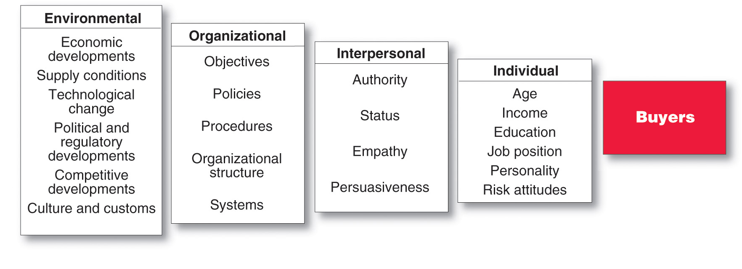
Business Buyer Behavior
The Model of Business Buyer Behavior
Notes:
Note to Instructor
Discussion Question
How would the purchase of a chair like the one you are sitting in be different for the University versus an end consumer like yourself buying a chair for your desk?
It may be difficult for students with no business buying experience to grasp the difference between business and consumer buying. Students will note how the university needs to buy more, that they need to ask users about the chairs, that they will organize more intricately for the buying effort, that they will work with the vendors for reduced prices for bulk purchases. In addition, this can tie directly to the major types of buying situations.
Discussion Questions
How could the chair be a straight rebuy versus a modified rebuy. What implications would the different situation make on the process?

Slide 4
Business Buyer Behavior
Major Types of Buying Situations
Straight rebuy is a routine purchase decision such as reorder without any modification
Modified rebuy is a purchase decision that requires some research where the buyer wants to modify the product specification, price, terms, or suppliers
Notes:
Note to Instructor
Discussion Question
How would the purchase of a chair like the one you are sitting in be different for the University versus an end consumer like yourself buying a chair for your desk?
It may be difficult for students with no business buying experience to grasp the difference between business and consumer buying. Students will note how the university needs to buy more, that they need to ask users about the chairs, that they will organize more intricately for the buying effort, that they will work with the vendors for reduced prices for bulk purchases. In addition, this can tie directly to the major types of buying situations.
Discussion Questions
How could the chair be a straight rebuy versus a modified rebuy. What implications would the different situation make on the process?

Slide 5
Business Buyer Behavior
Major Types of Buying Situations
New task is a purchase decision that requires thorough research such as a new product
Systems selling (or Solutions Selling) involves the purchase of a packaged solution from a single seller
Notes:
Note to Instructor
Discussion Question
How would the purchase of a chair like the one you are sitting in be different for the University versus an end consumer like yourself buying a chair for your desk?
It may be difficult for students with no business buying experience to grasp the difference between business and consumer buying. Students will note how the university needs to buy more, that they need to ask users about the chairs, that they will organize more intricately for the buying effort, that they will work with the vendors for reduced prices for bulk purchases. In addition, this can tie directly to the major types of buying situations.
Discussion Questions
How could the chair be a straight rebuy versus a modified rebuy. What implications would the different situation make on the process?

Slide 6
Business Buyer Behavior
Major Types of Buying Situations
Systems Selling is a two-step process of selling:
  Interlocking products
  System of production, inventory control, distribution, and other services to meet the buyer’s need for a smooth-running operation
Notes:
Note to Instructor
Discussion Question
How would the purchase of a chair like the one you are sitting in be different for the University versus an end consumer like yourself buying a chair for your desk?
It may be difficult for students with no business buying experience to grasp the difference between business and consumer buying. Students will note how the university needs to buy more, that they need to ask users about the chairs, that they will organize more intricately for the buying effort, that they will work with the vendors for reduced prices for bulk purchases. In addition, this can tie directly to the major types of buying situations.
Discussion Questions
How could the chair be a straight rebuy versus a modified rebuy. What implications would the different situation make on the process?

Slide 7
Business Buyer Behavior
Participants in the Business Buying Process
Buying center is all of the individuals and units that participate in the business decision-making process
  Users
  Influencers
  Buyers
  Deciders
  Gatekeepers

Slide 8
Business Buyer Behavior
Participants in the Business Buying Process
Buying center provides a major challenge
Who participates in the process
  Their relative authority
  What evaluation criteria each participant uses
  Informal participants

Slide 9
Business Buyer Behavior
Participants in the Business Buying Process
Users are those that will use the product or service
Influencers help define specifications and provide information for evaluating alternatives
Buyers have formal authority to select the supplier and arrange terms of purchase

Slide 10
Business Buyer Behavior
Participants in the Business Buying Process
Deciders have formal or informal power to select and approve final suppliers
Gatekeepers control the flow of information

Slide 11
Business Buyer Behavior
Major Influences on Business Buyers
Economic Factors
Price
Service
Personal Factors
Emotion

Slide 12
Business Buyer Behavior
Major Influences on Business Buyers
Environmental Factors
Demand for product
Economic outlook
Cost of money
Resource availability
Technology
Culture
Politics
Competition

Slide 13
Business Buyer Behavior
Major Influences on Business Buyers
Organizational Factors
Objectives
Policies
Procedures
Structure
Systems

Slide 14
Business Buyer Behavior
Major Influences on Business Buyers
Interpersonal Factors
Authority
Status
Empathy
Persuasiveness

Slide 15
Business Buyer Behavior
Major Influences on Business Buyers
Interpersonal Factors
Age
Income
Education
Job Position
Personality
Attitude toward risk

Slide 16
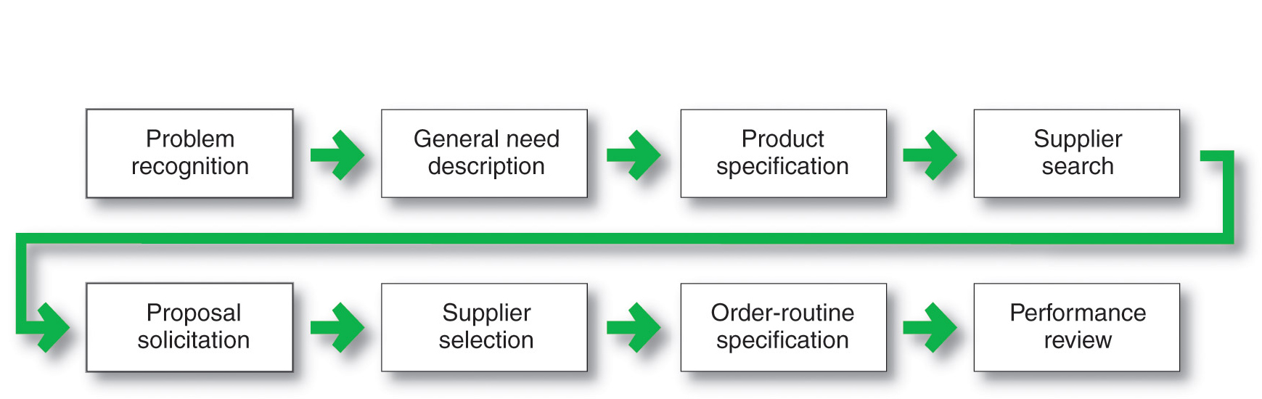
Business Buyer Behavior
The Buying Process

Slide 17
Business Buyer Behavior
The Buying Process
Problem recognition occurs when someone in the company recognizes a problem or need
Internal stimuli
  Need for new product or production equipment
External stimuli
  Idea from a trade show or advertising

Slide 18
Business Buyer Behavior
The Buying Process
General need description describes the characteristics and quantity of the needed item
Product specification describes the technical criteria

Slide 19
Business Buyer Behavior
The Buying Process
Value analysis is an approach to cost reduction where components are studied to determine if they can be redesigned, standardized, or made with less costly methods of production

Slide 20
Business Buyer Behavior
The Buying Process
Supplier search involves compiling a list of qualified suppliers
Proposal solicitation is the process of requesting proposals from qualified suppliers

Slide 21
Business Buyer Behavior
The Buying Process
Supplier selection is the process when the buying center creates a list of desired supplier attributes and negotiates with preferred suppliers for favorable terms and conditions

Slide 22
Business Buyer Behavior
The Buying Process
Order-routine specifications is the final order with the chosen supplier and lists all of the specifications and terms of the purchase

Slide 23
Business Buyer Behavior
The Buying Process
Performance review involves a critique of supplier performance to the purchase terms

Slide 24
Business Buyer Behavior
E-Procurement
Online purchasing
Company-buying sites
Extranets

Slide 25
Business Buyer Behavior
E-Procurement Advantages
  Access to new suppliers
  Lowers costs
  Speeds order processing and delivery
  Shares information
  Sales
  Service and support

Slide 26
Business Buyer Behavior
E-Procurement Disadvantages
  Can erode relationships as buyers search for new suppliers
  Security

Slide 27
Institutional and Government Markets
Institutional markets consist of hospitals, nursing homes, and prisons that provide goods and services to people in their care
Characteristics
  Low budgets
  “Captive” audience

Slide 28
Institutional and Government Markets
Government markets tend to favor domestic suppliers and require suppliers to submit bids and normally award to the lowest bidder

Slide 29
Institutional and Government Markets
Government Markets are: -
  Carefully monitored
  Affected by similar environmental factors
  Good credit
  Non-economic factors
  Minority suppliers
  Depressed suppliers
  Small businesses

