Slide 1
Chapter Five
Consumer Markets and Consumer Buyer Behavior

Slide 2
Topics to Cover
Characteristics Affecting Consumer Behavior
Types of Buying Decision Behavior
The Buyer Decision Process
The Buyer Decision Process for New Products

Slide 3
What Influences Consumer Behavior?
Cultural factors
  Buyer’s culture
  Buyer’s subculture
  Buyer’s social class
Social factors
  Groups and Social Networks
  Family
  Roles and status
Personal factors
  Age and life-cycle stage
  Occupation
  Economic situation
  Lifestyle
  Personality and self-concept
Psychological Factors
  Motivation
  Perception
  Learning
  Beliefs and attitudes

Slide 4
Psychological Factors
(Beliefs)
Belief is a descriptive thought that a person has about something based on:
Knowledge
Opinion
Faith

Slide 5
Psychological Factors
(Attitudes)
Attitudes describe a person’s relatively consistent evaluations, feelings, and tendencies toward an object or idea

Slide 6
Types of Buying Decision Behavior
Complex buying behavior
Dissonance-reducing buying behavior
Habitual buying behavior
Variety-seeking buying behavior

Slide 7
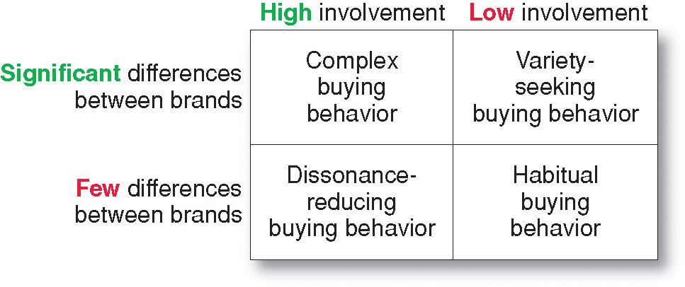
Types of Buying Decision Behavior

Slide 8
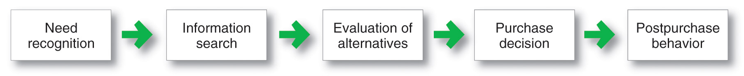
The Buyer Decision Process
Buyer Decision Making Process

Slide 9
The Buyer Decision Process
Need Recognition
Occurs when the buyer recognizes a problem or need triggered by:
  Internal stimuli
  External stimuli

Slide 10
The Buyer Decision Process
Information Search
Sources of Information
Personal sources—family and friends
Commercial sources—advertising, Internet
Public sources—mass media, consumer organizations
Experiential sources—handling, examining, using the product

Slide 11
The Buyer Decision Process
Evaluation of Alternatives
How the consumer processes information to arrive at brand choices

Slide 12
The Buyer Decision Process
Purchase Decision
The act by the consumer to buy the most preferred brand
The purchase decision can be affected by:
  Attitudes of others
  Unexpected situational factors

Slide 13
The Buyer Decision Process
Post-Purchase Decision
The satisfaction or dissatisfaction that the consumer feels about the purchase
Relationship between:
  Consumer’s expectations
  Product’s perceived performance

Slide 14
The Buyer Decision Process
Post-Purchase Decision
The larger the gap between expectation and performance, the greater the consumer’s dissatisfaction
Cognitive dissonance is the discomfort caused by a post-purchase conflict

Slide 15
The Buyer Decision Process
Post-Purchase Decision
Customer satisfaction is a key to building profitable relationships with consumers—to keeping and growing consumers and reaping their customer lifetime value

Slide 16
The Buyer Decision Process for New Products
Adoption process is the mental process an individual goes through from first learning about an innovation to final regular use.

Slide 17
The Buyer Decision Process for New Products
Awareness
Interest
Evaluation
Trial
Adoption
Stages in the process include:

Slide 18
The Buyer Decision Process for New Products
Awareness: The consumer becomes aware of new product but lacks information about it.
Interest: The consumer seeks information about the new product.
Evaluation: The consumer considers whether trying the new product makes sense.

Slide 19
The Buyer Decision Process for New Products
Trial: The consumer tries the new product on a small scale to improve his or her estimate of its value.
Adoption: The consumer decides to make full and regular use of the new product.

Slide 20
The Buyer Decision Process for New Products
Influence of Product Characteristics on Rate of Adoption
Relative Advantage
Compatibility
Complexity
Divisibility
Communicability

Slide 21
The Buyer Decision Process for New Products
Influence of Product Characteristics on Rate of Adoption
Relative Advantage: the degree to which the innovation appears superior to existing products.
Compatibility: the degree to which the innovation fits the values and experiences of potential customers.

Slide 22
The Buyer Decision Process for New Products
Influence of Product Characteristics on Rate of Adoption
Complexity: the degree to which the innovation is difficult to understand or use.
Divisibility: the degree to which the innovation may be tried on a limited basis.
Communicability: the degree to which the results of using the innovation can be observed or described to others.

Slide 23
Chapter Six
Business Markets and Business Buying Behavior

Slide 24
Topics to Cover
Business Markets

Slide 25
Business Markets
Business buyer behavior refers to the buying behavior of the organizations that buy goods and services for use in production of other products and services that are sold, rented, or supplied to others.

Slide 26
Business Markets
Business buying process is the process where business buyers determine which products and services are needed to purchase, and then find, evaluate, and choose among alternative brands

Slide 27
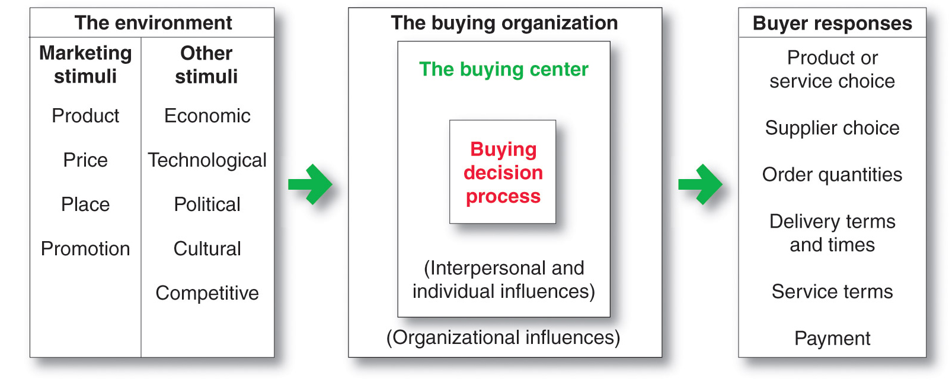
Business Markets

Slide 28
Business Markets
Market Structure and Demand
Fewer and larger buyers
Geographic concentration
Derived demand
Inelastic demand
Fluctuating demand
Buyer and seller dependency

Slide 29
Business Markets
Nature of Buying Unit
More decision participants
More professional purchasing effort

Slide 30
Business Markets
Types of Decisions and the Decision Process
Business buyers usually face more complex buying decisions
The business buying process is more formalized
In business buying, buyers and sellers work more closely together and build close long-term relationships

Slide 31
Business Markets
Types of Decisions and the Decision Process
Supplier development is the systematic development of networks of supplier-partners to ensure an appropriate and dependable supply of products and materials that they will use in making their own products or resell

