Slide 1
Chapter Five
Consumer Markets and Consumer Buyer Behavior

Slide 2
Topics to Cover
Model of Consumer Behavior
Consumer Behavior as a process
Characteristics Affecting Consumer Behavior

Slide 3
Model of Consumer Behavior
Consumer buyer behavior refers to the buying behavior of final consumers—individuals and households who buy goods and services for personal consumption
Consumer market refers to all of the personal consumption of final consumers
Notes:
Note to Instructor
Discussion Question
What have you recently purchased that cost over $100? Write down all the reasons you purchased this particular item.
Because students are all consumers—it is interesting to start the class with a discussion of products they have recently purchased. When you ask them why they purchased a particular item or product, you can bring them through many topics in this chapter including the characteristics that affect consumer behavior (cultural, social, personal, and psychological). You can also try to determine the process they went through including how and where they searched for information and how they evaluated their alternatives. Finally, ask them how they feel about their purchase (postpurchase behavior). This discussion will lead nicely to the next slide which is the Model of Buyer Behavior.

Slide 4
What is Consumer Behavior / Consumer Buyer Behavior?
The study of the processes involved when individuals or groups select, purchase, use, or dispose of products, services, ideas, or experiences to satisfy needs and desires

Slide 5
Consumer Behavior is a “Process”
 | CONSUMER’S PERSPECTIVE |  | MARKETER’S PERSPECTIVE
PREPURCHASE ISSUES | How does a consumer decide about needing a product? |  | How are consumer attitudes formed/changed?
PURCHASE ISSUES | Is product acquisition a stressful or pleasant experience? |  | How do situational factors affect purchase decision?
POSTPURCHASE ISSUES | Does product provide pleasure or perform function? How is product disposed of? |  | What determines customer satisfaction and repurchase?

Slide 6
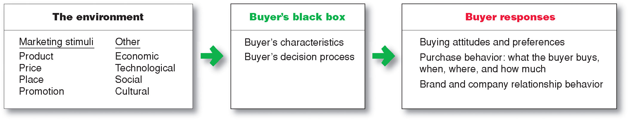

Model of Consumer Behavior
Notes:
Note to Instructor
It is interesting to talk about the buyer’s black box and one of the largest challenges in marketing is to understand what happens in this black box. Students will enjoy this video by Derren Brown. It is unclear how he obtains his results and how scientific this is, but it will certainly have students realize the mystery of the consumer’s brain.

Slide 7
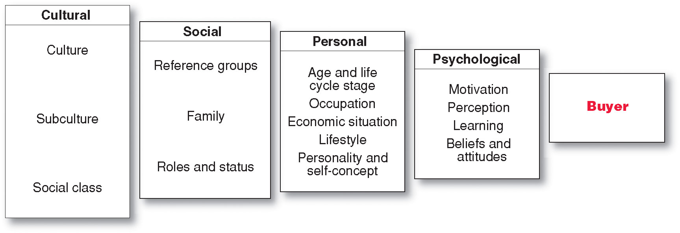
Characteristics Affecting Consumer Behavior
Factors Influencing Consumer Behavior

Slide 8
What Influences Consumer Behavior?
Cultural factors
  Buyer’s culture
  Buyer’s subculture
  Buyer’s social class
Social factors
  Groups and Social Networks
  Family
  Roles and status
Personal factors
  Age and life-cycle stage
  Occupation
  Economic situation
  Lifestyle
  Personality and self-concept
Psychological Factors
  Motivation
  Perception
  Learning
  Beliefs and attitudes

Slide 9
Cultural Factors
(Culture and Subculture)
Culture is the learned values, perceptions, wants, and behavior from family and other important institutions

Slide 10
Cultural Factors
(Culture and Subculture)
Subculture are groups of people within a culture with shared value systems based on common life experiences
and situations
Hispanic
African American
Asian
Mature consumers

Slide 11
Cultural Factors
(Social Classes)
Social classes are society’s relatively permanent and ordered divisions whose members share similar values, interests, and behaviors
Social class is measured by a combination of occupation, income, education, wealth, and other variables

Slide 12
Cultural Factors
(Social Classes)
Upper Class
  Upper Uppers
  Lower Uppers
Middle Class
  Upper Middles
  Middle Class
Working Class
Lower Class
  Upper Lowers
  Lower Lowers

Slide 13
Social Factors
(Groups and Social Networks)
Membership Groups
Groups with direct influence and to which a person belongs
Aspirational Groups
Groups an individual wishes to belong to
Reference Groups
Groups that form a comparison or reference in forming attitudes or behavior

Slide 14
Social Factors
(Groups and Social Networks)
Word-of-mouth influence and buzz marketing
  Opinion leaders are people within a reference group who exert social influence on others
  Also called influentials or leading adopters
  Marketers identify them to use as brand ambassadors

Slide 15
Social Factors
(Groups and Social Networks)
Online Social Networks are online communities where people socialize or exchange information and opinions
Include blogs, social networking sites (facebook), virtual worlds (second life)

Slide 16
Social Factors
(Family, Roles and Status)
  Family is the most important consumer-buying organization in society
  Social roles and status are the groups, family, clubs, and organizations to which a person belongs that can define role and social status

Slide 17
Personal Factors
(Age and life-cycle)
Age and life-cycle stage
According to RBC Royal Band Stages
  Youth—younger than 18
  Getting started—18-35
  Builders—35-50
  Accumulators—50-60
  Preservers—over 60

Slide 18
Personal Factors
(Occupation and Economic Situation)
Occupation affects the goods and services bought by consumers
Economic situation includes trends in:
Personal income
Savings
Interest rates

Slide 19
Personal Factors
(Life Style)
Lifestyle is a person’s pattern of living as expressed in his or her psychographics
Measures a consumer’s AIOs (activities, interests, opinions) to capture information about a person’s pattern of acting and interacting in the environment

Slide 20
Personal Factors
(Life Style)
SRI Consulting’s Values and Lifestyle (VALS) typology
Classifies people according to how they spend money and time
  Primary motivations
  Resources

Slide 21
Personal Factors
(Personality and Self Concept)
Personality and self-concept
  Personality refers to the unique psychological characteristics that lead to consistent and lasting responses to the consumer’s environment

Slide 22
Personal Factors
(Personality and Self Concept)
Personality and self-concept
  Personality refers to the unique psychological characteristics that lead to consistent and lasting responses to the consumer’s environment

Slide 23
Personal Factors
(Personality and Self-concept)
  Brand personality refers to the specific mix of human traits that may be attributed to a particular brand
    Sincerity (Genuineness)
    Excitement (Pleasure)
    Competence (Ability)
    Sophistication (Superiority)
    Ruggedness (Roughness)
  Self-concept refers to people’s possessions that contribute to and reflect their identities

Slide 24
Psychological Factors
Motivation
Perception
Learning
Beliefs and attitudes

Slide 25
Psychological Factors
(Motivation)
Freud’s
Theory
Behavior
is guided by
subconscious
motivations
Maslow’s
Hierarchy
of Needs
Behavior
is driven by
lowest,
unmet need
Herzberg’s
Two-Factor
Theory
Behavior is
guided by
motivating
and hygiene
factors

Slide 26
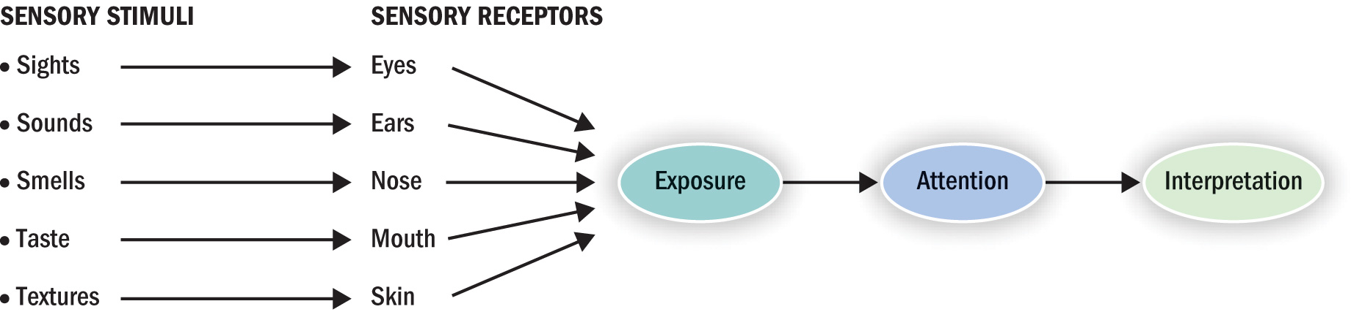
Psychological Factors
(Perception)
  Process by which sensations are selected, organized, and interpreted
    Adding meaning to raw sensations

Slide 27
Psychological Factors
(Perception)
Perception is the process by which people select, organize, and interpret information to form a meaningful picture of the world from three perceptual processes
  Selective attention
  Selective distortion
  Selective retention

Slide 28
Psychological Factors
(Perception)
Selective attention is the tendency for people to screen out most of the information to which they are exposed
Selective distortion is the tendency for people to interpret information in a way that will support what they already believe
Selective retention is the tendency to remember good points made about a brand they favor and forget good points about competing brands

Slide 29
Psychological Factors
(Learning)
Learning is the change in an individual’s behavior arising from experience and occurs through interplay of:
Drives
Stimuli
Cues
Responses
Reinforcement

Slide 30

Psychological Factors
(Learning)
Products as reminders of life experiences
Products + memory = brand equity/loyalty
Learning: a relatively permanent change in behavior caused by experience
  Incidental learning
  Ongoing process

Slide 31

Psychological Factors
(Role of Memory in Learning)
Memory: acquiring information and storing it over time so that it will be available when needed
Information-processing approach
  Mind = computer & data = input/output
EXTERNAL
INPUTS
ENCODING
STORAGE
RETRIEVAL

