Slide 1
Responding to the Marketing Environment
Views on Responding
Uncontrollable
React and adapt to forces in the environment
Proactive
Aggressive actions to affect forces in the environment
Reactive
Watching and reacting to forces in the environment

Slide 2
Chapter 04
Managing Marketing Information to Gain Customer Insights

Slide 3
Topics to Cover
Marketing Information and Customer Insights
Assessing Marketing Information Needs
Developing Marketing Information

Slide 4
Marketing Information & Customer Insights
Customer Insights are:
Fresh and deep insights into customers needs and wants
Difficult to obtain
  Not obvious
  Customer’s unsure of their behavior
Not derived from more information but better information and more effective use of existing information

Slide 5
Marketing Information & Customer Insights
Marketing Information Systems (MIS)
Marketing information system (MIS) consists of people and procedures for:
  Assessing the information needs
  Developing needed information
  Helping decision makers use the information for customer

Slide 6
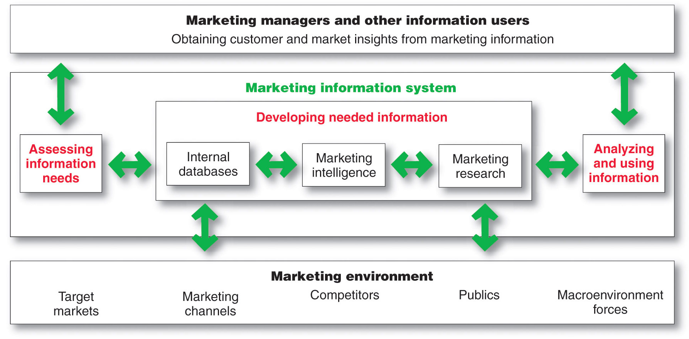
Marketing Information System

Slide 7
Assessing Marketing Information Needs
MIS provides information to the company’s marketing and other managers and external partners such as suppliers, resellers, and marketing service agencies

Slide 8
Assessing Marketing Information Needs
Characteristics of a Good MIS
Balancing what the information users would like to have against what they need and what is feasible to offer
User’s Needs
MIS Offerings

Slide 9
Developing Marketing Information
Marketers obtain information from
Internal data
Marketing intelligence
Marketing research

Slide 10
Developing Marketing Information
Internal Data and Marketing Intelligence
Internal databases are electronic collections of consumer and market information obtained from data sources within the company network
Marketing intelligence is the systematic collection and analysis of publicly available information about consumers, competitors and developments in the marketplace
Notes:
Note to Instructor
Pizza Hut’s database is highlighted in the text. They have:
Detailed customer data on 40 million U.S. households, gleaned from phone orders, online orders, and point-of-sale transactions at its more than 7,500 restaurants.
The company can organize the data by order details to enhance customer relationships such as the Pizza Hut designed VIP (Very Into Pizza) program to retain its best customers. It invites these customers to join the VIP program for $14.95 and receive a free large pizza. Then, for every two pizzas ordered each month, VIP customers automatically earn a coupon for another free large pizza.

Slide 11
Developing Marketing Information
Marketing Research
Marketing research is the systematic design, collection, analysis, and reporting of data relevant to a specific marketing situation facing an organization

Slide 12

Developing Marketing Information
Steps in the Marketing Research Process

Slide 13
Developing Marketing Information
Marketing Research
Defining the Problem and Research Objectives
Exploratory research
Descriptive research
Causal research
Notes:
Note to Instructor
These can be explained in more depth:
Exploratory research—objective is to gather preliminary information that will help define the problem and suggest hypotheses.
Descriptive research—describes things.
Causal research—tests hypothesis about cause and effect relationships.
Discussion Question
Consider a local business near campus. . .
How would they conduct exploratory research?
What might they want to find out in descriptive research?
What relationships might they explore in causal research?
Students will have the following responses for the above questions: exploratory research (focus groups, interviews); descriptive research (who, when, how, why);causal research (price/demand, environment/purchase rate).

Slide 14
Developing Marketing Information
Marketing Research
Developing the Research Plan
Outlines sources of existing data
Spells out the specific research approaches, contact methods, sampling plans, and instruments to gather data

Slide 15
Developing Marketing Information
Marketing Research
Writing Research Plan includes:
Management problem
Research objectives
Information needed
How the results will help management decisions
Budget

Slide 16
Developing Marketing Information
Marketing Research
Developing the Research Plan
Secondary data consists of information that already exists somewhere, having been collected for another purpose
Primary data consists of information gathered for the special research plan

Slide 17
Developing Marketing Information
Advantages
Disadvantages
Current
Relevant
Speed
Cost
Could not get data otherwise
Accuracy
Impartial

Slide 18
Developing Marketing Information
Marketing Research
Developing the Research Plan
Planning Primary Data Collection
Research approaches
Contact methods
Sampling plan
Research instruments

Slide 19
Developing Marketing Information
Marketing Research
Research Approaches
Observational research involves gathering primary data by observing relevant people, actions, and situations
Ethnographic research involves sending trained observers to watch and interact with consumers in their natural environment

Slide 20
Developing Marketing Information
Marketing Research
Research Approaches
Survey research is the most widely used method and is best for descriptive information—knowledge, attitudes, preferences, and buying behavior
Flexible
People can be unable or unwilling to answer
Gives misleading or pleasing answers
Privacy concerns

Slide 21
Developing Marketing Information
Marketing Research
Research Approaches
Experimental research is best for gathering causal information—cause-and-effect relationships

Slide 22
Developing Marketing Information
Marketing Research
Strengths and Weaknesses of Contact Methods
 | Mail | Telephone | Personal | Online
Flexibility | Poor | Good | Excellent | Good
Quantity of data collected | Good | Fair | Excellent | Good
Control of interviewer effects | Excellent | Fair | Poor | Fair
Control of sample | Fair | Excellent | Good | Excellent
Speed of data collection | Poor | Excellent | Good | Excellent
Response rate | Poor | Poor | Good | Good
Cost | Good | Fair | Poor | Excellent

Slide 23
Developing Marketing Information
Marketing Research
Contact Methods
Focus Groups
  Six to 10 people with a trained moderator
  Challenges
    Expensive
    Difficult to generalize from small group
    Consumers not always open and honest

Slide 24
Developing Marketing Information
Marketing Research
Contact Methods
Online marketing research
Internet surveys
Online panels
Online experiments
Click-stream data
Online focus groups

Slide 25
Developing Marketing Information
Marketing Research
Online Research
Advantages
Low cost
Speed
Higher response rates
Good for hard to reach groups
Disadvantages
Restricted internet access
Not sure who is answering

Slide 26
Developing Marketing Information
Marketing Research
Sampling Plan
Sample is a segment of the population selected for marketing research to represent the population as a whole
  Who is to be surveyed?
  How many people should be surveyed?
  How should the people be chosen?

Slide 27
Developing Marketing Information
Marketing Research
Sampling Plan – Type of Samples
Probability Sample
Simple random sample | Every member of the population has a known and equal chance of selection
Stratified random sample | The population is divided into mutually exclusive groups and random samples are drawn from each group
Cluster (area) sample | The population is divided into mutually exclusive groups and the researcher draws a sample
Nonprobability Sample
Convenience sample | The research selects the easiest population members
Judgment sample | The researcher uses their judgment to select population members
Quota sample | The researcher finds and interviews a prescribed number of people in each of several categories

