Slide 1
  PART 02
  UNDERSTANDING THE MARKETPLACE AND CONSUMERS

Slide 2
Chapter 03
Analyzing the Marketing Environment

Slide 3
Topics to Cover
The Company’s Microenvironment
The Company’s Macroenvironment
Responding to the Marketing Environment

Slide 4
The Marketing Environment
The marketing environment includes the actors and forces outside marketing that affect marketing management’s ability to build and maintain successful relationships with customers

Slide 5
The Marketing Environment
Microenvironment consists of the actors close to the company that affect its ability to serve its customers, the company, suppliers, marketing intermediaries, customer markets, competitors, and publics

Slide 6
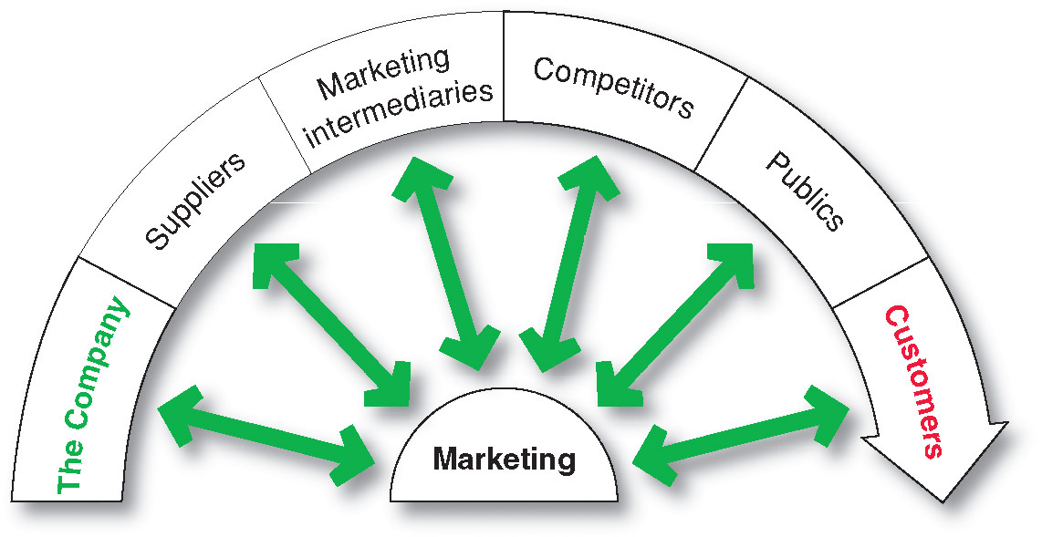
The Company’s Microenvironment
Actors in the Microenvironment

Slide 7
The Company’s Microenvironment
The Company
Top management
Finance
R&D
Purchasing
Operations
Accounting

Slide 8
The Company’s Microenvironment
Suppliers
Provide the resources to produce goods and services
Treated as partners to provide customer value

Slide 9
The Company’s Microenvironment
Marketing Intermediaries
Help the company to promote, sell and distribute its products to final buyers

Slide 10
The Company’s Microenvironment
Marketing Intermediaries
Resellers
Physical distribution firms
Marketing services agencies
Financial intermediaries
Help the company to promote, sell and distribute its products to final buyers

Slide 11
The Company’s Microenvironment
Competitors
Firms must gain strategic advantage by positioning their offerings against competitors’ offerings

Slide 12
The Company’s Microenvironment
Publics
Any group that has an actual or potential interest in or impact on an organization’s ability to achieve its objectives
  Financial publics
  Media publics
  Government publics
  Citizen-action publics
  Local publics
  General public
  Internal publics

Slide 13
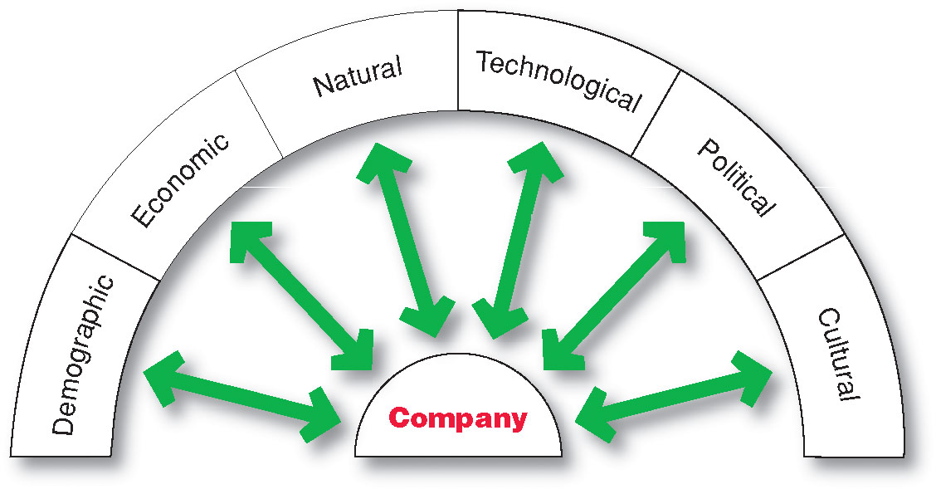
The Company’s Macroenvironment

Slide 14
The Company’s Macroenvironment
Demographic Environment
Demography is the study of human populations in terms of size, density, location, age, gender, race, occupation, and other statistics
Demographic environment is important because it involves people, and people make up markets
Demographic trends include age, family structure, geographic population shifts, educational characteristics, and population diversity

Slide 15
The Company’s Macroenvironment
Demographic Environment
Changes in the Workforce
  More educated
  More white collar
Markets are becoming more diverse
  International
  National

Slide 16
The Company’s Macroenvironment
Economic Environment
Economic environment consists of factors that affect consumer purchasing power and spending patterns
Industrial economies are richer markets
Subsistence economies consume most of their own agriculture and industrial output

Slide 17
The Company’s Macroenvironment
Economic Environment
Changes in income
Value marketing involves ways to offer financially cautious buyers greater value—the right combination of quality and service at a fair price

Slide 18
The Company’s Macroenvironment
Natural Environment
Natural environment involves the natural resources that are needed as inputs by marketers or that are affected by marketing activities
Trends
  Shortages of raw materials
  Increased pollution
  Increase government intervention
  Environmentally sustainable strategies

Slide 19
The Company’s Macroenvironment
Technological Environment
Most dramatic force in changing the marketplace
Creates new products and opportunities
Safety of new product always a concern

Slide 20
The Company’s Macroenvironment
Political Environment
Political environment consists of laws, government agencies, and pressure groups that influence or limit various organizations and individuals in a given society

Slide 21
The Company’s Macroenvironment
Political Environment
Legislation regulating business
  Increased legislation
  Changing government agency enforcement
Increased emphasis on ethics
  Socially responsible behavior
  Cause-related marketing

Slide 22
The Company’s Macroenvironment
Cultural Environment
Cultural environment consists of institutions and other forces that affect a society’s basic values, perceptions, and behaviors

Slide 23
The Company’s Macroenvironment
Cultural Environment
Persistence of Cultural Values
Core beliefs and values are persistent and are passed on from parents to children and are reinforced by schools, mosques, businesses, and government
Secondary beliefs and values are more open to change and include people’s views of themselves, others, organization, society, nature, and the universe

Slide 24
The Company’s Macroenvironment
Cultural Environment
Shifts in Secondary Cultural Values
People’s view of themselves
  Yankelovich Monitor’s consumer segments:
    Do-it-yourselfers—recent movers
    Adventurers
People’s view of others
  More “cocooning”
  People’s view of organizations

Slide 25
The Company’s Macroenvironment
Cultural Environment
Shifts in Secondary Cultural Values
People’s view of society
  Patriots defend it
  Reformers want to change it
  Malcontents want to leave it
People’s view of nature
  Some feel ruled by it
  Some feel in harmony with it
  Some seek to master it
People’s view of the universe
  Renewed interest in spirituality

Slide 26
Responding to the Marketing Environment
Views on Responding
Uncontrollable
React and adapt to forces in the environment
Proactive
Aggressive actions to affect forces in the environment
Reactive
Watching and reacting to forces in the environment

