Slide 1
Chapter 02
Company and Marketing Strategy
Partnering to Build Customer Relationships

Slide 2
Topics to Cover
Companywide Strategic Planning: Defining Marketing’s Role
Designing the Business Portfolio
Planning Marketing: Partnering to Build Customer Relationships
Marketing Strategy and the Marketing Mix
Managing the Marketing Effort
Measuring and Managing Return on Marketing Investment

Slide 3
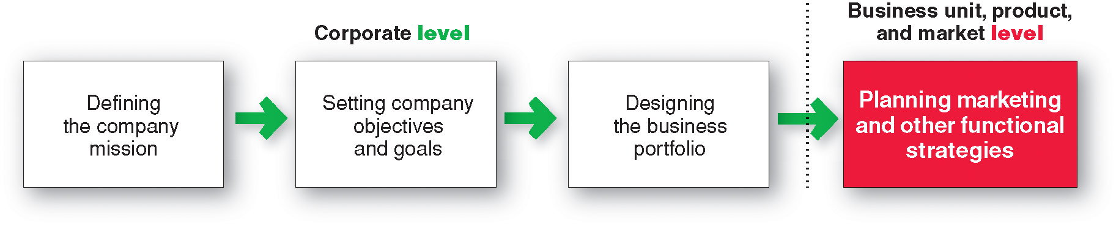
Companywide Strategic Planning
Strategic Planning
Strategic planning is the process of developing and maintaining a strategic fit between the organization’s goals and capabilities and its changing marketing opportunities

Slide 4

Companywide Strategic Planning
Strategic Planning
The mission statement is the organization’s purpose, what it wants to accomplish in the larger environment
Market-oriented mission statement defines the business in terms of satisfying basic customer needs
We help you organize the world’s information and make it universally accessible and useful.

Slide 5
Companywide Strategic Planning
Setting Company Objectives and Goals
Business objectives
Build profitable customer relationships
Invest in research
Improve profits
Marketing objectives
Increase market share
Create local partnerships
Increase promotion

Slide 6
Companywide Strategic Planning
Designing the Business Portfolio
The business portfolio is the collection of businesses and products that make up the company
Portfolio analysis is a major activity in strategic planning whereby management evaluates the products and businesses that make up the company

Slide 7
Companywide Strategic Planning
Analyzing the Current Business Portfolio
Strategic business unit (SBU) is a unit of the company that has a separate mission and objectives that can be planned separately from other company businesses
  Company division
  Product line within a division
  Single product or brand

Slide 8
Companywide Strategic Planning
Analyzing the Current Business Portfolio
Identify key businesses (strategic business units, or SBUs) that make up the company
Assess the attractiveness of its various SBUs
Decide how much support each SBU deserves

Slide 9
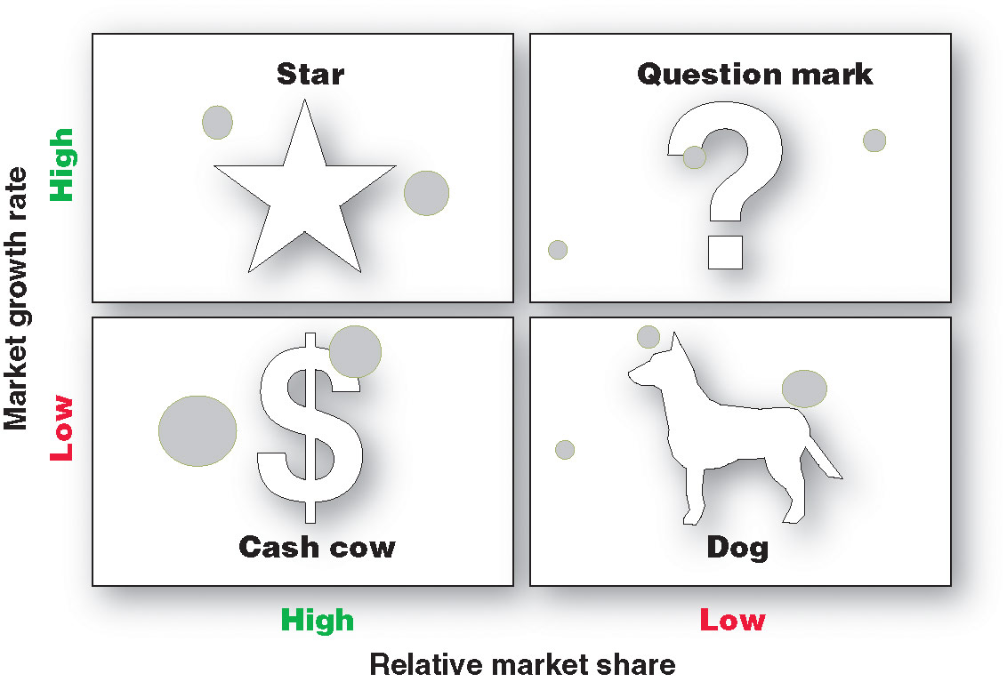
Companywide Strategic Planning

Slide 10
Companywide Strategic Planning
Problems with Matrix Approaches
Difficulty in defining SBUs and measuring market share and growth
Time consuming
Expensive
Focus on current businesses, not future planning

Slide 11
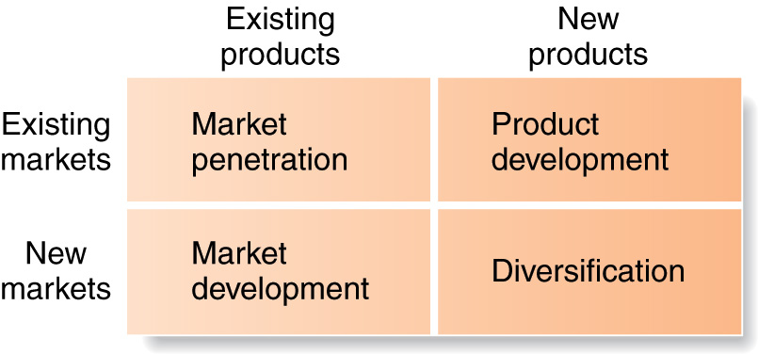
Companywide Strategic Planning
Developing Strategies for Growth and Downsizing
Product/market expansion grid is a tool for identifying company growth opportunities through market penetration, market development, product development, or diversification

Slide 12
Companywide Strategic Planning
Developing Strategies for Growth and Downsizing
Market penetration is a growth strategy increasing sales to current market segments without changing the product
Market development is a growth strategy that identifies and develops new market segments for current products

Slide 13
Companywide Strategic Planning
Developing Strategies for Growth and Downsizing
Product development is a growth strategy that offers new or modified products to existing market segments
Diversification is a growth strategy through starting up or acquiring businesses outside the company’s current products and markets

Slide 14
Planning Marketing
Partnering to Build Customer Relationships
Value chain is a series of departments that carry out value-creating activities to design, produce, market, deliver, and support a firm’s products
Value delivery network is made up of the company, suppliers, distributors, and ultimately customers who partner with each other to improve performance of the entire system

Slide 15
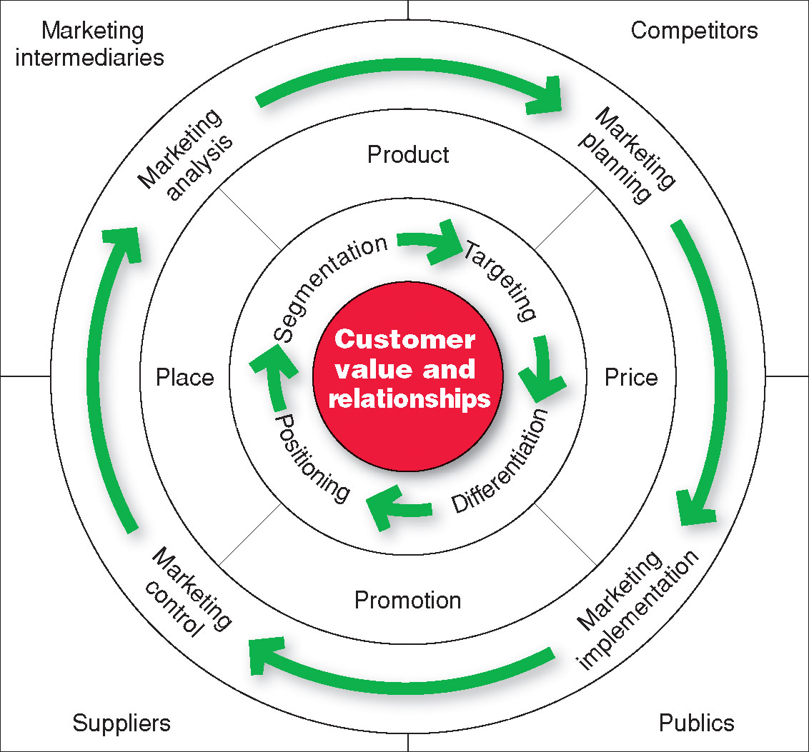
Marketing Strategy & Marketing Mix

Slide 16
Marketing Strategy & Marketing Mix
Customer Driven Marketing Strategy
Market segmentation is the division of a market into distinct groups of buyers who have distinct needs, characteristics, or behavior and who might require separate products or marketing mixes
Market segment is a group of consumers who respond in a similar way to a given set of marketing efforts

Slide 17
Marketing Strategy & Marketing Mix
Customer Centered Marketing Strategy
Market targeting is the process of evaluating each market segment’s attractiveness and selecting one or more segments to enter
Market positioning is the arranging for a product to occupy a clear, distinctive, and desirable place relative to competing products in the minds of the target consumer

Slide 18
Marketing Strategy & Marketing Mix
Developing an Integrated Marketing Mix
Marketing mix is the set of controllable tactical marketing tools—product, price, place, and promotion—that the firm blends to produce the response it wants in the target market

Slide 19
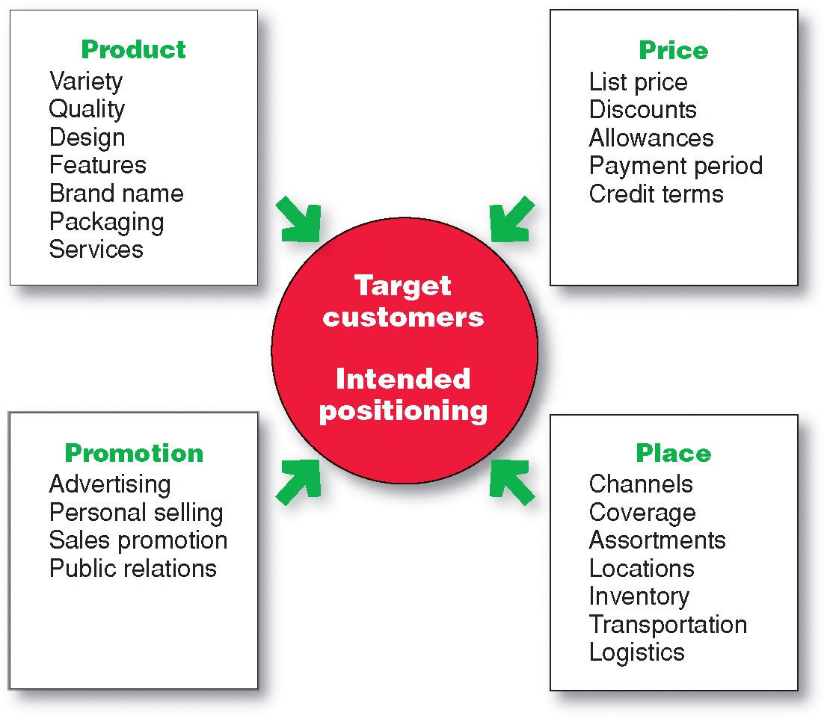
Marketing Strategy & Marketing Mix
Developing an Integrated Marketing Mix

Slide 20
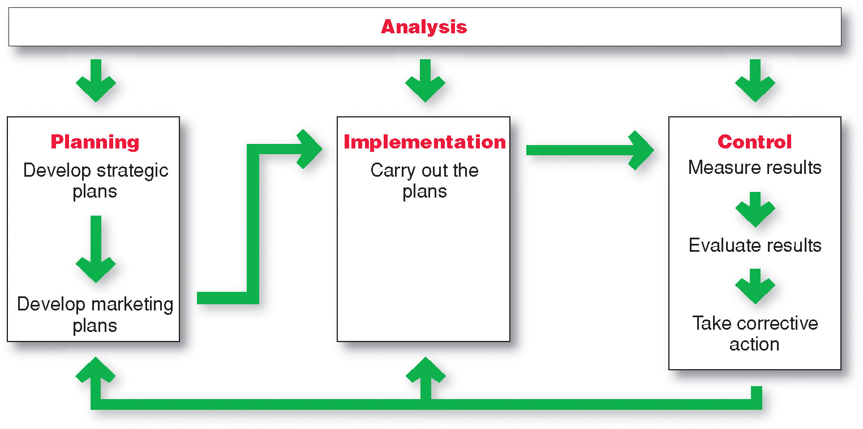
Managing the Marketing Effort

Slide 21
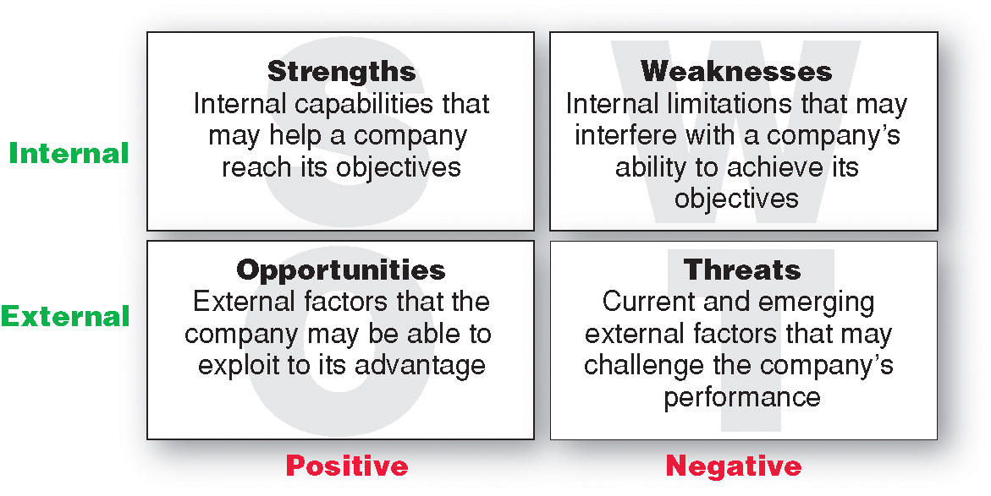
Managing the Marketing Effort

Slide 22
Managing the Marketing Effort Marketing Planning – Parts of a Marketing Plan
Executive summary
Marketing situation
Threats and opportunities
Objective and issues
Action programs
Budgets
Controls
Marketing strategy

Slide 23
Managing the Marketing Effort Marketing Planning – Parts of a Marketing Plan
Implementing is the process that turns marketing plans into marketing actions to accomplish strategic marketing objectives
Successful implementation depends on how well the company blends its people, organizational structure, decision and reward system, and company culture into a cohesive action plan that supports its strategies

Slide 24
Managing the Marketing Effort Marketing Department Organization
Functional organization
Geographic organization
Product management organization
Market or customer management

Slide 25
Managing the Marketing Effort Marketing Control
Controlling is the measurement and evaluation of results and the taking of corrective action as needed
Operating control
Strategic control

Slide 26
Measuring and Managing
Return on Marketing Investment
Return on marketing investment (Marketing ROI) is the net return from a marketing investment divided by the costs of the marketing investment. Marketing ROI provides a measurement of the profits generated by investments in marketing activities.

