Slide 1
ENTREPRENEURSHIP
Lecture No: 7
Resource Person:
Malik Jawad Saboor
Assistant Professor
Department of Management Sciences
COMSATS Institute of Information Technology
Islamabad.

Slide 2

Previous Lecture Review
How to Enhance Organizational
Creativity
How to enhance individual’s Creativity

Slide 3

Objectives
To learn creativity techniques
Brainstorming
Mind Mapping
Rapid Prototyping
Mix n Match (Thomas Edison Challenge)
Attribute Listing Chart

Slide 4
Brainstorming
A group problem-solving technique that involves the spontaneous contribution of large quantity of novel and imaginative ideas from all members of the group;
the mulling over of ideas by one or more individuals in an attempt to devise or find a solution to a problem

Slide 5

Brainstorming Guidelines
Keep the group small – “Two pizza rule.”
Make the group as diverse as possible.
Company rank is irrelevant.
Have a well-defined problem, but don’t reveal it ahead of time.
Limit the session to 40 to 60 minutes.
Take a field trip.
Appoint a recorder.

Slide 6
Brainstorming Guidelines
Use a seating pattern that encourages interaction.
Throw logic out the window.
Encourage all ideas from the team.
Shoot for quantity of ideas over quality of ideas.
Forbid criticism.
Encourage idea “hitch-hiking.”
Dare to imagine the unreasonable.

Slide 7

Techniques for Improving the Creative Process
Mind-mapping
  A graphical technique that encourages thinking on both sides of the brain, visually displays relationships among ideas, and improves the ability to see a problem from many sides.

Slide 8
Mind Mapping- How to Draw?
Take a large sheet of paper and place it horizontally in front of you.
Write the text or Draw a reasonably sized (colored) memorable central image that represents the topic you are going to be mapping.
Draw thick organic looking branches radiating outwards from the central image. Make sure to use a different color to represent each branch.
Write key-topic words along these branches that represent the central image and the topic you are mapping.

Slide 9
Mind Mapping – How to Draw?
Draw additional branches that extend from your main branches.
The words on these branches are sub-topics of the words you wrote on your main branches.
Keep expanding the mind map outwards with additional sub sub-topics/keywords and branches.

Slide 10
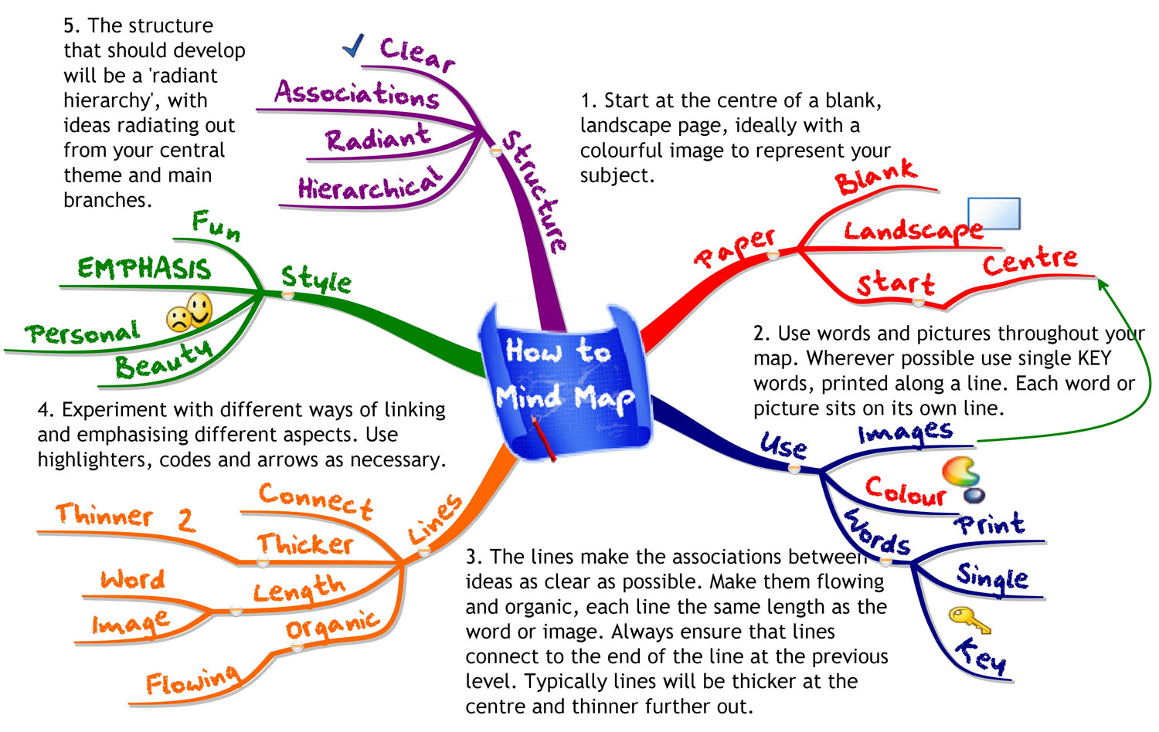
EXAMPLES OF MIND MAP

Slide 11
Mix n Match ( Thomas Edison)
LIST A | LIST B
PERFUME | CIGARETTE
SCOTCH TAPE | INSECT KILLER SPRAY
CHOCOLATE | SOAP
PEN | OLIVES
RUBBER | SHIRT
GLASS (Water wala) | KASHMIRI TEA
PAPER | ASH TRAY
BISCUITS | NAIL POLISH REMOVER
MOUTH FRESHNER | PIZZA
PAD LOCK | ALARM

Slide 12
Mix n Match ( Thomas Edison)
Glass + Ashtray
Paper + Kashmiri Tea
Biscuits + Olives
Padlock + Alarm
Paper + Soap
Pizza + Chocolate
Perfume + Insect Killer Spray
Pen + Insect Killer Spray

Slide 13
Techniques for Improving the Creative Process
Rapid prototyping
Transforming an idea into an actual model that will point out flaws and lead to design improvements.

Slide 14
Attribute Listing Chart
List the attributes of the product, service or strategy you are examining.
Attributes are parts, properties, qualities or design elements of the thing being looked at.
Draw up a table using these attributes as column headings.
Write down as many variations of the attribute as possible within these columns
Now select one entry from each column. Either do this randomly or select interesting combinations

Slide 15
Attribute Listing Chart to
Attributes for a Lamp
Power Supply
Bulb Type
Light Intensity
Size
Style
Finish
Material

Slide 16
Attribute Listing Chart to Create a new Lamp
POWER SUPPLY | BULB Type | Light Intensity | Size | Style | Finish | Material
Main | Halogen | Low | Very Large | Modern | Black | Wood
Solar | Bulb | Medium | Large | Antique | White | Stone
Generator | LED | High | Medium | Roman | Metallic | Plastic
Oil | Colored |  | Small | Industrial | Fabric
LPG |  |  | Hand Held

Slide 17
Entrepreneurs in Action
Brett Wilson
Kevin O’ Larry

Slide 18

Lecture Review
Brainstorming
Mind Mapping
Rapid Prototyping
Mix n Match (Thomas Edison Challenge)
Attribute Listing Chart

