Slide 1
ENTREPRENEURSHIP
Lecture No: 4
Resource Person:
Malik Jawad Saboor
Assistant Professor
Department of Management Sciences
COMSATS Institute of Information Technology
Islamabad.

Slide 2

Previous Lecture Review
Explain the forces that are driving
the growth of entrepreneurship.
Explain the cultural diversity of entrepreneurship.
Put failure into proper perspective.
Avoiding the Pitfalls of Small Business Failure.

Slide 3

Objectives
Role of Entrepreneurs in Economic Development
The Entrepreneurial Process
Carol Moore’s Model of Entrepreneurial Process
The Timmon’s Model of Entrepreneurial Process
10 D’s of Entrepreneurship
9 F’s of a successful Firm

Slide 4

Role of Entrepreneurship in Economic Development
Promotion of Capital Formation
Creates Large-Scale Employment opportunities
Promotes Balanced Regional Development
Reduces Concentration of Economic Power

Slide 5

Role of Entrepreneurship in Economic Development
Increasing Gross National Product and Per Capita Income
Improvement in the Standard of Living
Promotes Country's Export Trade

Slide 6

Role of Entrepreneurship in Economic Development
Induces Backward and Forward Linkages
Facilitates Overall Development

Slide 7

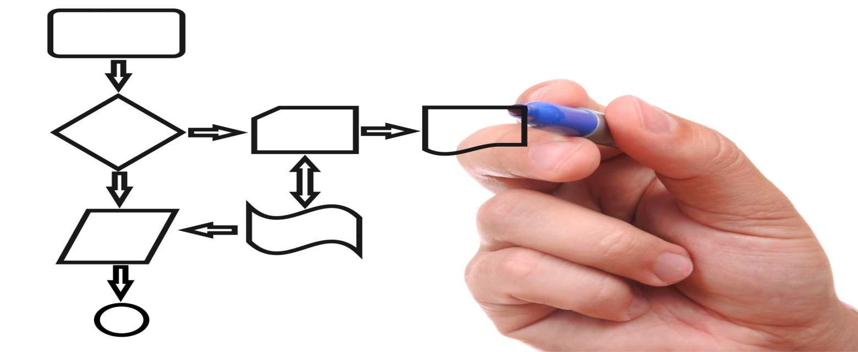
Models of Entrepreneur Process
Carol Moore’s Model
Timmon’s Model

Slide 8
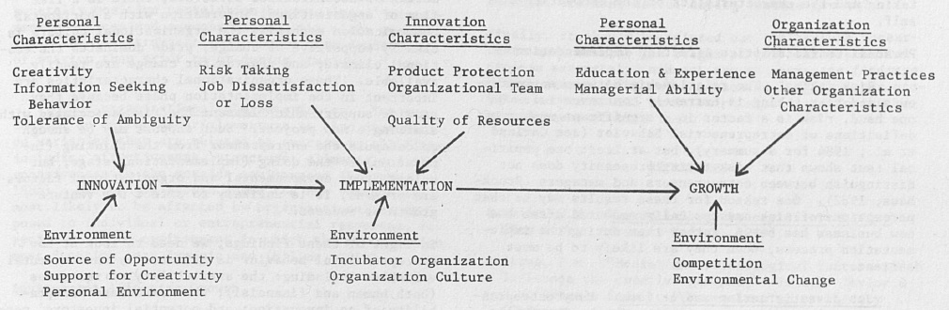
Models of Entrepreneur Process
Source: Carol Moore Model

Slide 9

Innovation Stage
PERSONAL CHARACTERISTICS
CREATIVITY
TOLERANCE FOR AMBIGUITY
INFORMATION SEEKING BEHAVIOR
ENVIORNMENT
Source of Opportunity
Support for Creativity
Personal Environment

Slide 10


Implementation Stage
PERSONAL CHARACTERISTICS
Risk Taking
Job Dissatisfaction/ Loss
INNOVATION CHARACTERISTICS
PRODUCT PROTECTION
ORGANIZATIONAL TEAM
QUALITY OF RESOURCES
ENVIORNMENT
Entrepreneurs
Intrapreneurs
Incubator Organization
Organizational Culture

Slide 11


Growth Stage
PERSONAL CHARACTERISTICS
Education & Experience
Managerial Ability
ORGANIZATIONAL CHARACTERISTICS
MANAGEMENT PRACTICES
OTHER
ENVIORNMENT
COMPETITON
ENVIORNMENTAL CHANGE

Slide 12
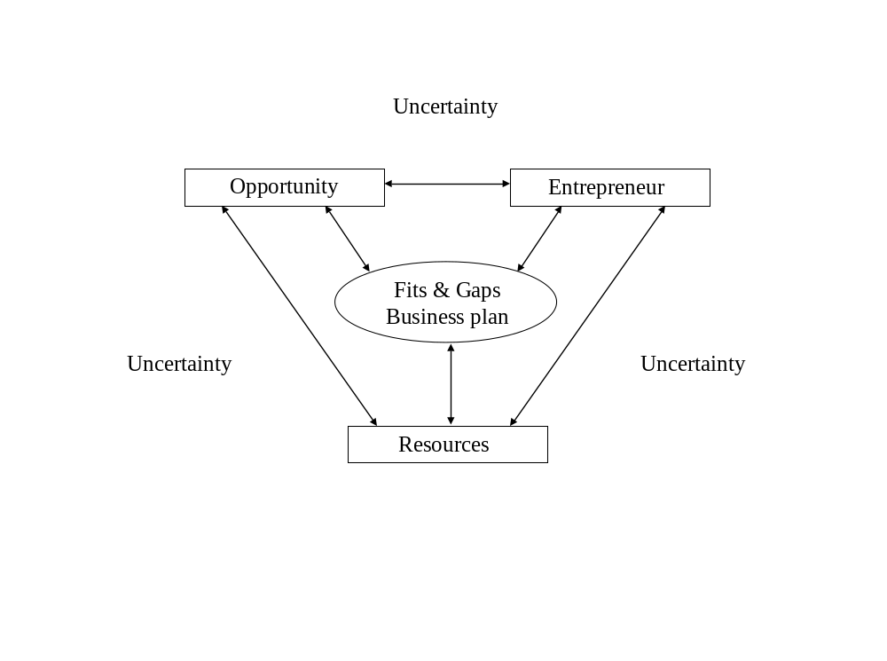
The Timmons Model

Slide 13


Tenets of the Timmons Model
The Opportunity
  Is there a clear customer need?
  Is the timing right: team ready, market ready?
  Combine these factors with the execution of the business plan to make an idea an opportunity
The Lead Entrepreneur and Management Team
  Experience within the proposed industry?
  Investors prefer to see a track record of driving growth and profits
  An ‘A’ team with a ‘B’ idea is almost always better than the opposite
The Resources
  Capital, technology, equipment, and most importantly – people
  Low overhead, high productivity, and controlling, but not owning resources
  Find ways to get things done faster, cheaper or better!

Slide 14

Ten D’s of Entrepreneurship
Dream
Decisiveness
Doers
Determination
Dedication

Slide 15
Ten D’s of Entrepreneurship
Devotion
Details
Destiny
Dollars
Distribute

Slide 16

Nine F’s of a Successful Company
Founders
Focused
Fast
Flexible

Slide 17
Nine F’s of a Successful Company
Forever-innovating
Flat
Frugal
Friendly
Fun

Slide 18

Lecture Review
Role of Entrepreneurs in Economic Development
The Entrepreneurial Process
Carol Moore’s Model of Entrepreneurial Process
The Timmon’s Model of Entrepreneurial Process
10 D’s of Entrepreneurship
9 F’s of a successful Firm

