Slide 1
ENTREPRENEURSHIP
Lecture No: 30
Resource Person:
Malik Jawad Saboor
Assistant Professor
Department of Management Sciences
COMSATS Institute of Information Technology
Islamabad.

Slide 2

Previous Lecture Review
Influencing and Negotiation
TOWS ANALYSIS

Slide 3

OBJECTIVES
Explain why “going global” has become an
integral part of many small companies' strategies.
Describe the principal strategies small businesses have for going global.
Explain how to build a thriving export program.
Discuss the major barriers to international trade and their impact on the global community.

Slide 4

Why “Go Global”?
Offset sales declines in the domestic market
Increase sales and profits
Extend products’ life cycles
Lower manufacturing costs
Lower product cost
Improve competitive position
Raise quality levels
Become more customer-oriented

Slide 5

Strategies for Going Global
Creating a Web site
Importing and
outsourcing
Relying on trade intermediaries
Creating joint ventures
Exporting
Foreign licensing
Establishing
international
locations
International franchising

Slide 6

The Web’s Global Reach
Available 24 hours a day to anyone anywhere in the world.
1.02 billion Web users worldwide

Slide 7

Trade Intermediaries
Domestic agencies that serve as distributors in foreign countries for companies of all sizes.
Several types:
  Export merchants
  Resident buying offices
  Foreign distributors

Slide 8

Joint Ventures
Domestic joint venture – two or more U.S. companies form an alliance for the purpose of exporting their goods and services abroad.
Foreign joint venture – a domestic firm forms an alliance with a company in the target nation.
  Most important ingredient: choosing the right partner
  Use the joint venture as a learning process

Slide 9
International Franchising
To expand internationally, franchisers should:
  Identify the country or countries that are best suited to the franchiser’s business concept.
  Generate leads for potential franchisees.
  Select quality candidates.
  Structure the franchise deal.
    Direct franchising
    Area development
    Master franchising

Slide 10

Exporting
Small companies account for 97 percent of all companies involved in exporting, but they generate just 29 percent of the dollar value of the nation’s exports.
Only 12 percent of all of exporting small companies actively market their products and services regularly in foreign markets.

Slide 11

Steps to Successful Exporting
1. Recognize that even the tiniest companies and least experienced entrepreneurs have the potential to export.
2. Analyze your product or service.
3. Analyze your commitment to developing export markets.
4. Research potential markets and pick your target.

Slide 12

Steps to Successful Exporting
(Continued)
5. Develop a distribution strategy.
6. Find your customer.
  U.S. Department of Commerce
  International Trade Administration
7. Find financing for export sales.
8. Ship your goods.
9. Collect your money.

Slide 13




How a Letter of Credit Works.
Seller
Buyer
Foreign buyer agrees to buy products;
seller agrees to ship goods if buyer
arranges a letter of credit.
Seller ships goods to buyer according to letter of credit’s terms and submits shipping documents to bank issuing
letter of credit.
Seller’s Bank
Buyer's Bank
$
$
$
Letter
of Credit
$
Buyer requests that his bank grant a
letter of credit, which assures exporter
payment if she presents documents
proving goods were actually shipped.
Bank makes out letter of credit to seller
and sends it to seller’s bank (called the
confirming bank).
Buyer’s bank makes payment to seller’s (confirming) bank. Confirming bank then pays seller amount specified in letter of credit.

Slide 14
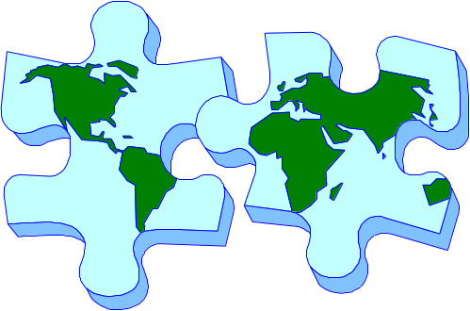
Strategies for “Going Global”
Establish international locations

Slide 15

Steps to Successful Importing or Outsourcing
Make sure that importing or outsourcing is right for your business.
Establish a target cost for your product.
Do your research before you leave home.
Be sensitive to cultural differences.
Do your groundwork.

Slide 16
Steps to Successful Importing or Outsourcing
Protect your company’s intellectual property.
Select a manufacturer.
Provide an exact model of the product you want manufactured.
Stay in constant contact with the manufacturer and try to build a long-term relationship.

Slide 17

Barriers to International Trade
Domestic Barriers:
Attitude: “My company is too small to export.”
Lack of information about how to get started.
Lack of export financing.

Slide 18

Barriers to International Trade
International Barriers:
Tariffs - Taxes a government imposes on goods and services imported into that country.
Quotas - Limits on the amount of a product imported into a country.
Embargoes - Total bans on imports of certain products.

Slide 19
Barriers to International Trade
International Barriers:
Dumping - Selling large quantities of a product in a foreign country below cost to gain market share.
Political barriers - rules, regulations, and risks.
Cultural barriers - Differing languages, philosophies, traditions, and accepted business practices.

Slide 20

Lecture Review
Explain why “going global” has become an
integral part of many small companies' strategies.
Describe the principal strategies small businesses have for going global.
Explain how to build a thriving export program.
Discuss the major barriers to international trade and their impact on the global community.
Reference: Essentials of Entrepreneurship & Small Business Management, Zimmer, Scarborough &Wilson, 5th Edition

