Slide 1
ENTREPRENEURSHIP
Lecture No: 29
Resource Person:
Malik Jawad Saboor
Assistant Professor
Department of Management Sciences
COMSATS Institute of Information Technology
Islamabad.

Slide 2

Previous Lecture Review
Focusing on Customers
Importance of Customer Satisfaction & Loyalty
Creating Satisfied Customers
Gathering Customer Information
Production and Service Delivery
CRM

Slide 3

OBJECTIVES
Influencing and Negotiation
TOWS ANALYSIS

Slide 4

Influencing and Negotiation

Slide 5
Influencing
Management is about getting things done, meeting objectives set in line with those of organisation, to get the things done management is influencing or imposing their will upon others, people may or may not be willing but they need to work towards a common goal, there cud be two extremes ‘ carrot or stick’ but there are many options in between, lets have a look on some influencing strategies

Slide 6
Influencing Strategies
Reason
Friendship
Coalition
Higher Authority
Sanctions

Slide 7
Negotiations
‘Negotiation is a process in which individual or groups seek to reach a goal by making agreements with others’
‘Negotiation is a dialogue intended to resolve disputes, to produce an agreement upon courses of action to bargain for individual and collective advantage’

Slide 8
Negotiation is the trading of value
Common Ground
The value to you and your organisation
The value to the other and their organisation
What is it that I have to offer them?
What is it that I want from them?
What is it that they need from me?
What is it that they have to offer me?

Slide 9

Negotiation Strategies
Hard Bargaining
Soft Bargaining
Principled Bargaining

Slide 10
Hard Bargaining
Gives away nothing.
See participant as adversaries
Hard sell and take-it-or-leave-it.
Distrust others
Play sneaky games to get negotiating advantage
May use physical presence/threats
Two hard bargainers may end up both loosing

Slide 11
Soft Bargaining
Agreeable & Flexible.
Treating the participant as friends
Seeking agreement at any cost
Honest about their bottom line
Leaves them to vulnerable to hard bargainers

Slide 12
Principled Bargaining
Separate the people from the problem
Focus on interests, not positions.
Generate options for mutual gain.

Slide 13

Types of negotiation
Distributive (win-lose)
Integrative (win-win)

Slide 14

Planning to negotiate
Establish your objectives
Establish other party’s objectives
Frame negotiation as a joint search for a solution
Identify areas of agreement
Trouble shoot disagreements: bargain & seek alternative solutions, introduce trade offs
Agreement and close: summarise and ensure acceptance

Slide 15

Team Roles in Negotiating Team
Lead Negotiator
Number Cruncher
Note Taker
Time Keeper

Slide 16

Factors for success
  Legitimacy of your case
  Confidence in presenting it
  Courtesy to the other party
  Adaptation to the other party’s style
  Rapport
  Incentives and trade offs
  Research the bigger picture

Slide 17
Tips on Negotiation
Aim high to begin with – easier to lose ground than gain
Give concessions ‘reluctantly’
Break down complex deals
Language:
  Make proposals with open questions such as:
    “what would happen if we…?”
    “suppose we were to…”
    “what would be the result of?”
  Dealing with stone-walls: “what would need to happen for you to be willing to negotiate over this?”
Always get agreement in writing

Slide 18
TOWS MATRIX

Slide 19
TOWS Matrix
SO Strategies
Strategies that enable competitive advantage, external opportunities match well with internal strengths, allows for competitive advantage to be built and maintained.

Slide 20
TOWS Matrix
ST Strategies
Mitigation Strategies, firm possesses internal strengths that facilitates neutralization of external threats, may lead to temporary advantage if competitors are impacted by environmental threats.

Slide 21
TOWS Matrix
WO Strategies
Acquisition/Development Strategies, situation where strategies are formulated to acquire or develop new resources/capabilities to take advantage of external opportunities.

Slide 22
TOWS Matrix
WT Strategies
Consolidation/Exit Strategies, if firms can’t find ways to convert weaknesses to strengths via acquisition/development, exit from market is recommended.

Slide 23
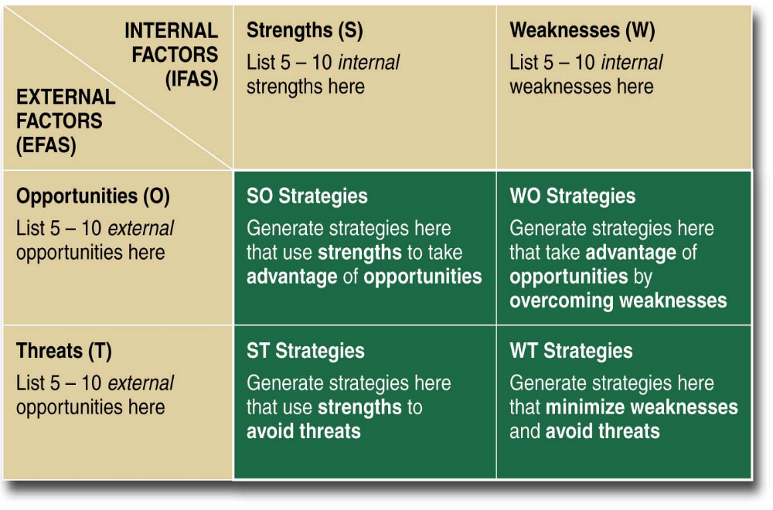
TOWS Matrix

Slide 24
SWOT ANALYSIS of South Asian Business Approach
Strengths Finance availability from informal resources Advice from social networks High level of trust and mutual dependency Motivation and enthusiasm towards self employment | Weaknesses Under utilization of business services Local scope Role of women in business Lack of interest in technology Language barrier Lack of understanding of macro factors and stereo typicality Lack of professionalism and business education
Opportunities Government policies concerning small businesses Usage of technology Institutional services serving South Asian needs Increasing demand and expansion of businesses to white majority area | Threats Government regulations / free trade and internationalization Intense competition between small enterprises Failure to continually improve competitiveness Non-cooperative attitudes of banks

Slide 25

TOWS ANALYSIS
Strengths-Opportunities (SO) Interaction of technology users with non users Take advantage of the incentives offered by government Business expansion opportunities for South Asian Muslims | Weaknesses- Opportunities (WO) South Asian women should take advantage of government initiatives South Asian entrepreneurs can adopt technology Short courses on business and management Diversify/ expand to tap market potential
Strengths- Threats (ST) Investment in technology to improve efficiency Differentiation to minimize competition | Weaknesses- threats (WT) Minimize the effects of unfavorable government policies by taking help of business support agencies Developing positive relations with banks Overcoming language barriers

Slide 26

Lecture Review
Influencing and Negotiation
TOWS ANALYSIS
www.mindtools.com

