Slide 1
ENTREPRENEURSHIP
Lecture No: 26
Resource Person:
Malik Jawad Saboor
Assistant Professor
Department of Management Sciences
COMSATS Institute of Information Technology
Islamabad.

Slide 2

Previous Lecture Review
One-to-One Marketing
Customer Sensitivity
Guerilla Marketing
Competitive Advantage Development through Customer Focus, Quality, Convenience, Innovation, Service & Speed
Benefits of Selling on Web

Slide 3

OBJECTIVES
Stakeholder’s Management

Slide 4

Stakeholder in Lexical Terms

Slide 5
What are Stakeholders?
Individuals and groups with a multitude of interests, expectations, and demands as to what business should provide to society

Slide 6
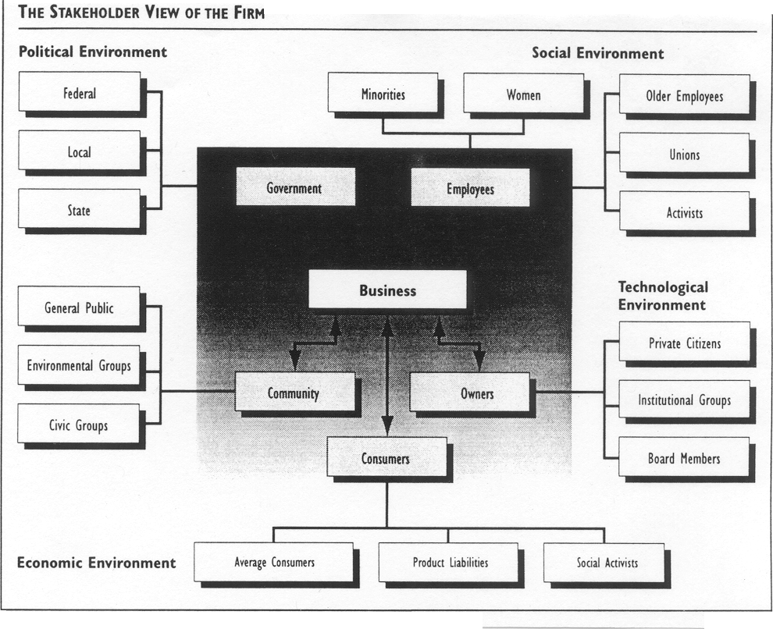
Who Are Business Stakeholders?

Slide 7
Types of Stake
Stakeholder/Responsibility Matrix
Stakeholders | Economic | Legal | Ethical | Philanthropic
Owners
Customers
Employees
Community
Public at large
Social Activists
Other

Slide 8

Power/Interest Grid
Two-by-two matrix with power on one axis and interest on the other
Each stakeholder is placed on the Grid based on its power and interest

Slide 9
Power/Interest Grid
Stakeholders Potential Threat to the Organisation
LOW
HIGH
HIGH
SUBJECTS
PLAYERS
Interest in the
Organisation
and its Activities
LOW
CROWD
CONTEXT SETTERS
Adapted from Eden & Ackerman, 1998
Notes:
If you are doing this as part of a strategy implementation, then first should show where people are at the moment relative to the firm and then show how this would be expected to change as a result of the change.

Slide 10
Strategies to tackle groups
Stakeholders Potential Threat to the Organisation
LOW
HIGH
SUBJECTS
Keep Satisfied
PLAYERS
Manage Closely
HIGH
Interest in the
Organisation
and its Activities
CROWD
Monitor (Minimum Effort)
CONTEXT SETTERS
Keep informed
LOW
Adapted from Eden & Ackerman, 1998
Notes:
If you are doing this as part of a strategy implementation, then first should show where people are at the moment relative to the firm and then show how this would be expected to change as a result of the change.

Slide 11

Lecture Review
Stakeholder’s Analysis
Reference: MindTools.com & Eden & Ackerman, 1998

