Slide 1
ENTREPRENEURSHIP
Lecture No: 16
Resource Person:
Malik Jawad Saboor
Assistant Professor
Department of Management Sciences
COMSATS Institute of Information Technology
Islamabad.

Slide 2

Previous Lecture Review
Why Develop a Business Plan?
The Elements of a Business Plan
What Lenders and Investors Look for in a Business Plan
Making the Business Plan Presentation Concluding remarks
Business Plan Format

Slide 3

Objectives
Identify the key attributes of a Social Enterprise
Characteristics of Social Enterprise
Understand how social enterprise differ from other organisations
Entrepreneurs in Action- Video on Google Boys

Slide 4
What is a Social Enterprise?
According to the Social Enterprise Coalition, Social Enterprises are…
“…businesses trading for social and environmental purposes. Social enterprises are distinctive because their social and/or environmental purpose is absolutely central to what they do - their profits are reinvested to sustain and further their mission for positive change.”
Notes:
Essentially, Social Enterprises are commercial businesses, designed to make profit. The difference occurs with the profit, which is reinvested to meet the social aims of the business.
There are many descriptions of Social Enterprises.
It is important to understand that a Social Enterprise is not a legal structure

Slide 5
What is a Social Enterprise?
“We have described and keep on describing organisations motivated by social objectives as non-profit organisations. We need to have another
description: ‘non-loss ’organisations, because we don’t want to lose money and our objective is to address a particular problem. So we are non-loss businesses with social objectives.”
Muhammad Yunus. Founder of the Grameen Bank, Bangladesh

Slide 6
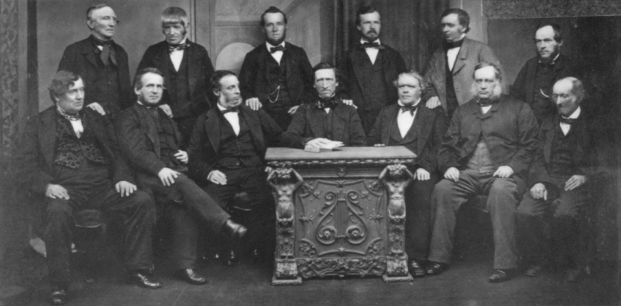
Example of Social Enterprise
The Social Enterprise movement first emerged 1840s. In Rochdale, a workers' co-operative was set up to provide high quality affordable food in response to factory conditions that were considered to be exploitative.
The Rochdale Society of Equitable Pioneers est 1844
Notes:
It is a misconception that Social Enterprise is a relatively new idea. Many long-established organisations qualify as Social Enterprises.
Social Enterprise has been frequently found in the financial sector, including Mutuals and Friendly Societies.
The Cooperative movement can be considered to be a major player in the field of Social Enterprise after providing benefits to members for many years.

Slide 7
The Process of Social Entrepreneurship
Find an opportunity
Develop a business concept
Figure out what success means and how to measure it
Acquire the right resources
Launch and grow
Attain goals

Slide 8
Characteristics
Social Enterprises:-
Operate as commercially run businesses
Aim to make profits
Generate the bulk of their income through sales of goods or
services
Use good business practices and principles
Use the majority of their profits to further social or
environmental goals
May hold the Social Enterprise Mark
Notes:
In February 2010 the Social Enterprise Mark was launched as the brand for social enterprises. It requires a business to meet six defined criteria in order to qualify to receive the Mark.
Many commercial businesses would consider themselves to have social objectives. Whether these objectives are central to the organisation determines whether they are indeed a social enterprise or a business with Social Aims

Slide 9
Key Differences
Explicit Social Aims (Triple Bottom Line) | Private sector business primarily focus is on trading; social enterprises too have a commercial focus but will also have an explicit social and/or environmental purpose.
Funding | Social enterprises often have a complex composition of sales income, commercial contracts, service level agreements and grant support.
Risk | Social enterprises are usually governed by a Board of volunteers, which may mean that they are more risk averse in terms of pursuing business ventures.
Scale | Start up costs may be much higher because social enterprise usually has to operate on a scale that is large enough to sustain its social commitment from the beginning
Notes:
There are a number of significant differences between social enterprises and private enterprises, in both the way that they are developed and the way in which they continue to develop

Slide 10
Key Differences
Investment | Social enterprises may have difficulty gaining access to traditional forms of investment such as loan finance.
Leadership / Entrepreneurship | Leaders of social enterprises are usually driven by the social potential of the venture and will need to find support for the other areas of the enterprise
Stakeholders | Social Enterprises usually have a wide range of stakeholders involved in their development, which can mean that there is a wide influence on the development process.
Sweat Equity | “sweat equity” is invested to grow and build the enterprise ,but the purpose is not financial gain but social

Slide 11
Myths about Social Entrepreneurship
Social entrepreneurs are anti-business
The difference between commercial and social entrepreneurship is greed
Social entrepreneurs are nonprofit managers
Social entrepreneurs are born, not made
Social entrepreneurs are misfits
Social enterprises usually fail
Social entrepreneurs love risk

Slide 12
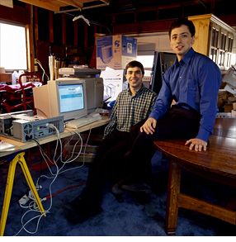
- The two founders -
Sergey Brin
CTO
Larry Page
CEO/CMO

Slide 13

History
Started as a research project (Stanford)
In 1998 founded in a garage (first named „BackRub“)

Slide 14
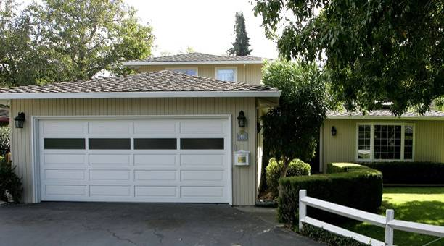
The Google garage

Slide 15
HISTORY
1st successful test version in the same year
In September 1999 google ended the test project
In 2000 google became the dominant search engine (indexed more than a billion pages)

Slide 16
Services
search/pictures
maps (street view)
mail
translator
Google+
calendar
books
video
YouTube
Google Play
Docs
news
Google Earth
wallet
Picasa
and even more

Slide 17


Lecture Review
Identify the key attributes of a Social Enterprise
Characteristics of Social Enterprise
Understand how social enterprise differ from other organisations
Entrepreneurs in Action- Video on Google Boys

