Slide 1
ENTREPRENEURSHIP
Lecture No: 14
Resource Person:
Malik Jawad Saboor
Assistant Professor
Department of Management Sciences
COMSATS Institute of Information Technology
Islamabad.

Slide 2

Previous Lecture Review
PESTEL Analysis
Key Success Factors
Analyzing Competitors
Create Company Goals and Objectives
Formulate Strategy
Translate Strategies into Action Plan
Establishing Control

Slide 3

Objectives
Conducting a Feasibility Analysis
The Feasibility Study
Five Forces Model
Product or Service Feasibility Analysis
Financial Feasibility Analysis

Slide 4
Feasibility Analysis
Entrepreneurs do not lack creative ideas,
but…
Is a particular idea a viable foundation for creating a successful business?
Feasibility study addresses the question: “Should we proceed with this business idea?”

Slide 5

Feasibility Study
Not the same as a business plan.
Serves as a filter, screening out ideas that lack the potential for building a successful business before an entrepreneur commits the necessary resources to building a business plan.
An investigative tool.

Slide 6
Elements of a Feasibility Analysis
Industry and
Market Feasibility
Product or Service
Feasibility
Financial
Feasibility

Slide 7
Elements of a Feasibility Analysis
Industry and
Market Feasibility
Product or Service
Feasibility
Financial
Feasibility

Slide 8
Industry and Market Feasibility Analysis
Two areas of focus:
Determining how attractive an industry is overall as a “home” for a new business.
Identifying possible niches a small business can occupy profitably.

Slide 9
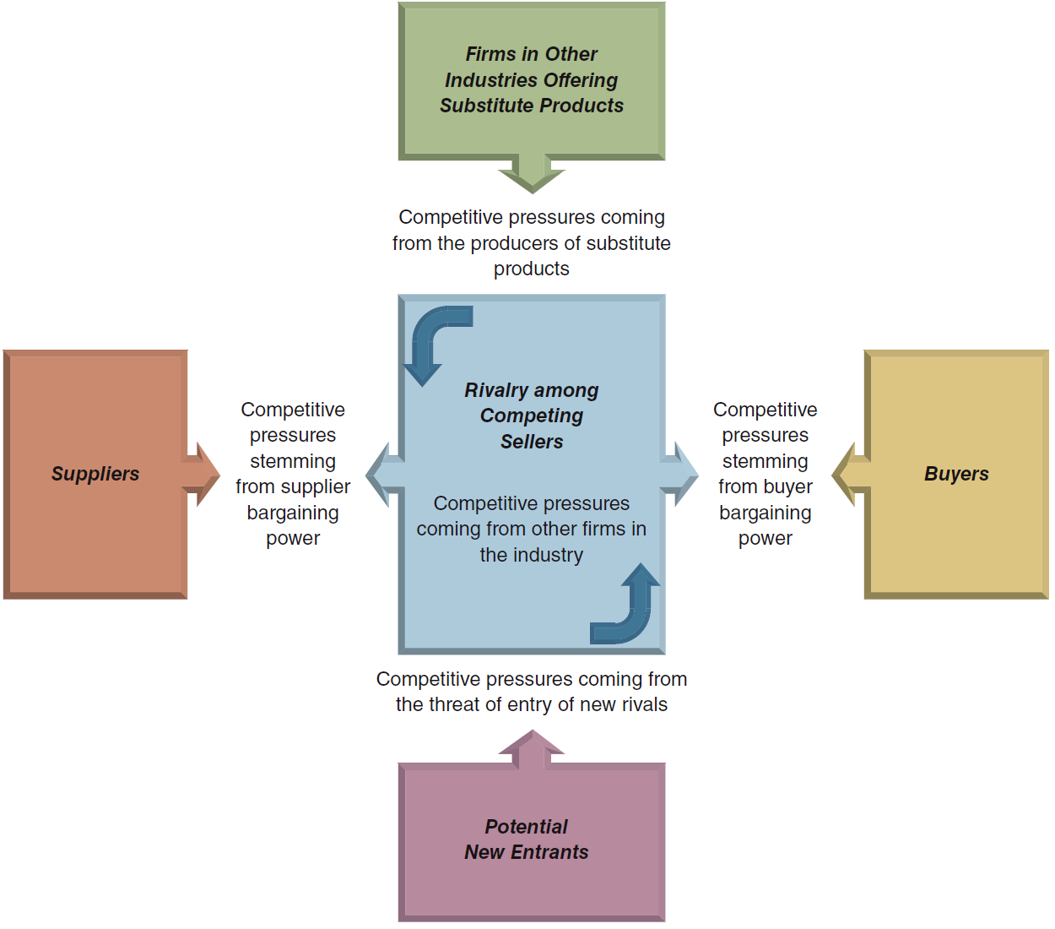
The Five-Forces Model of Competition: A Key Analytical Tool

Slide 10
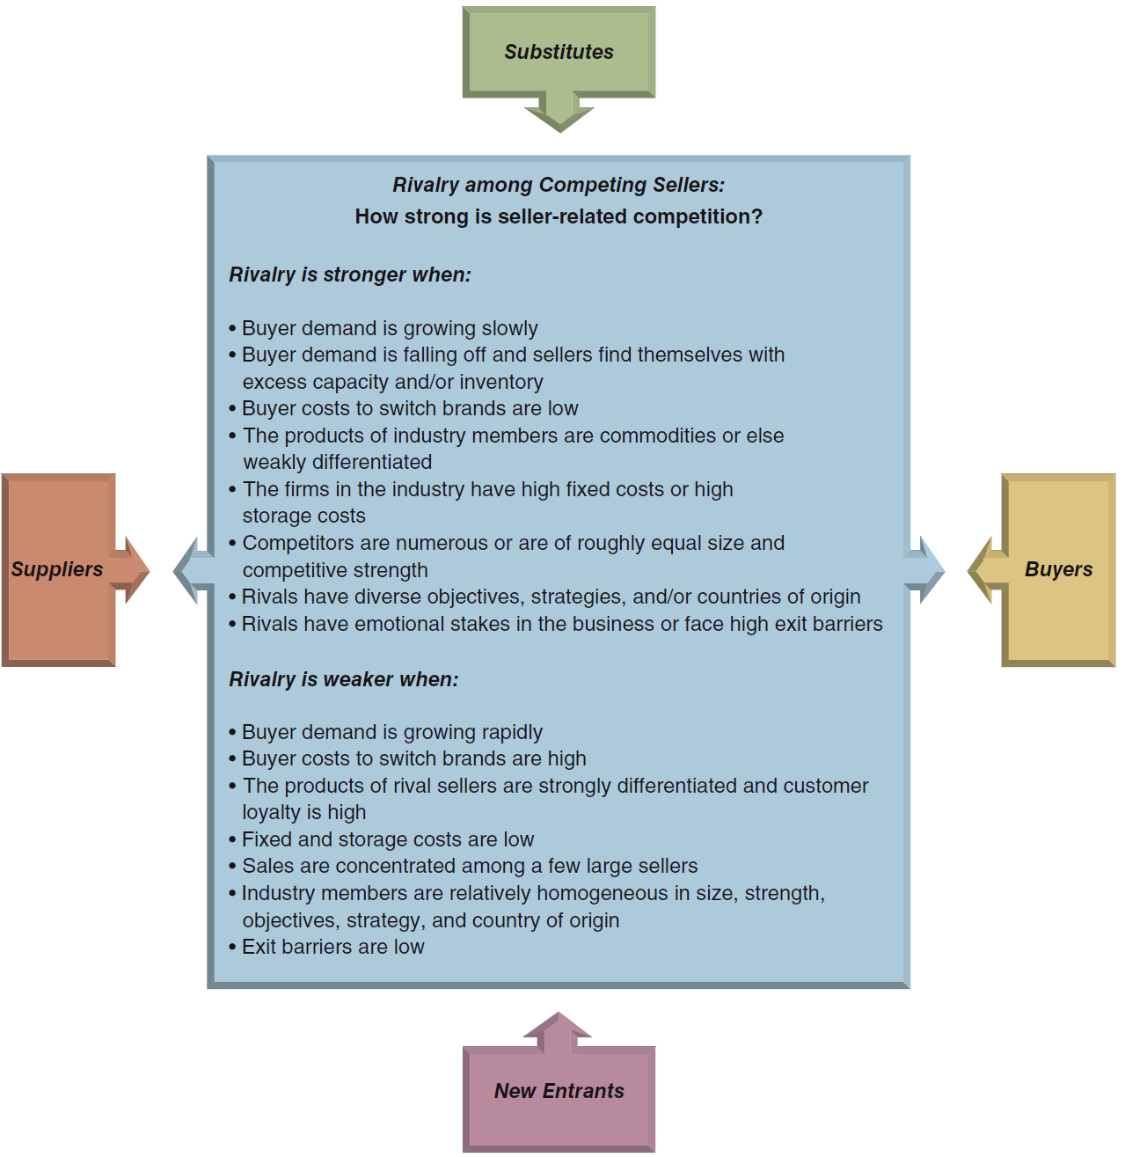
Factors Affecting the Strength of Rivalry

Slide 11
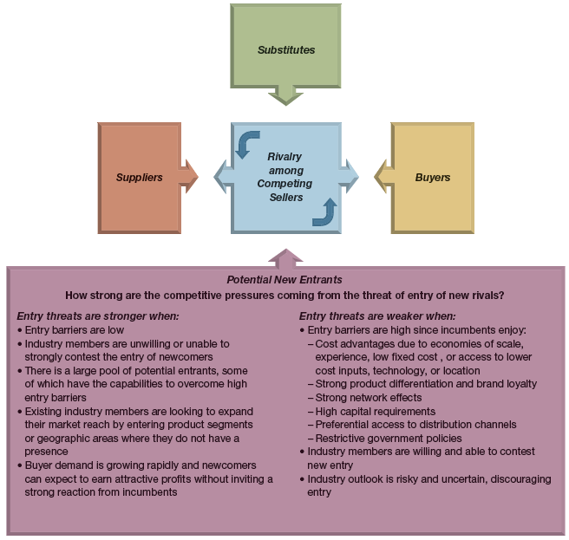
Factors Affecting the Threat of Entry

Slide 12
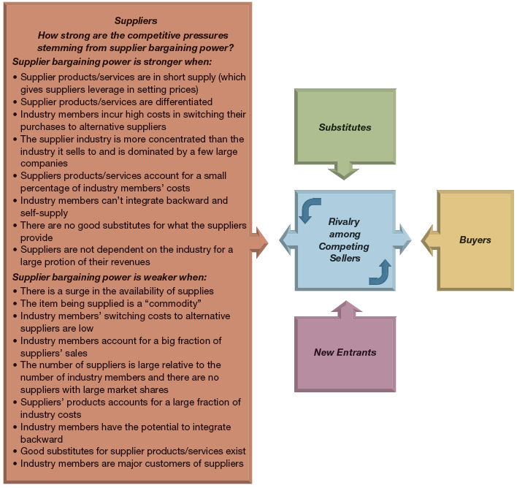
Factors Affecting the Bargaining Power of Suppliers

Slide 13
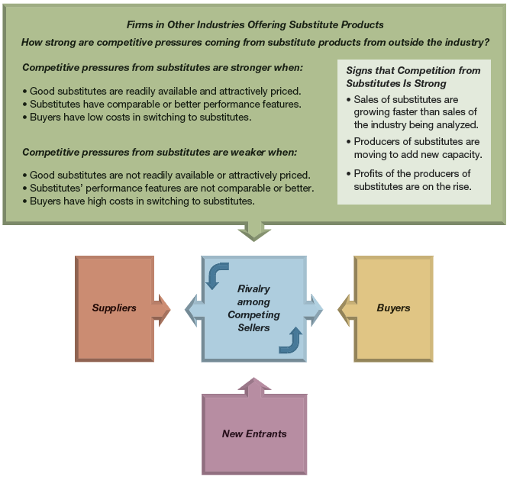
Factors Affecting Competition from Substitute Products

Slide 14
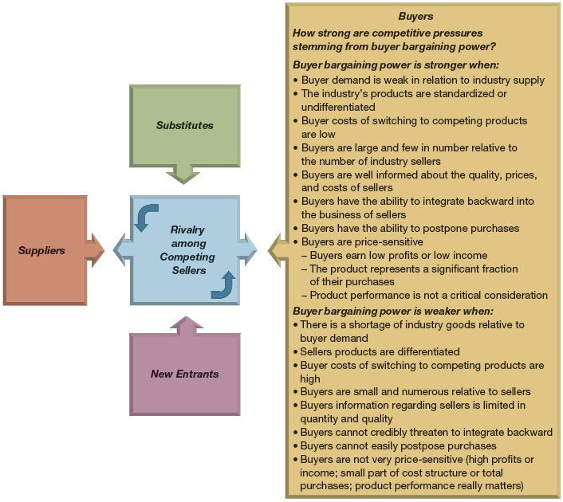
Factors Affecting the Bargaining Power of Buyers

Slide 15

Business Prototyping
Entrepreneurs test their business models on a small scale before committing serious resources to launch a business that might not work.
Recognizes that a business idea is a hypothesis that needs to be tested before taking it full scale.

Slide 16
Elements of a Feasibility Analysis
Industry and
Market Feasibility
Product or Service
Feasibility
Financial
Feasibility

Slide 17

Product or Service Feasibility Analysis
Determines the degree to which a product or service idea appeals to potential customers and identifies the resources necessary to produce it.
Two questions:
  Are customers willing to purchase our good or service?
  Can we provide the product or service to customers at a profit?

Slide 18
Product or Service Feasibility Analysis
Primary research – collect data firsthand and analyze it.
  Customer surveys and questionnaires
  Focus groups
Secondary research – gather data that already has been compiled and analyze it.
Prototypes
In-home trials

Slide 19
Elements of a Feasibility Analysis
Industry and
Market Feasibility
Product or Service
Feasibility
Financial
Feasibility

Slide 20

Financial Feasibility Analysis
Capital requirements – must have an estimate of how much start-up capital is required to launch the business.
Estimated earnings – forecasted income statements.
Return on investment – combining the previous two estimates to determine how much investors can expect their investments to return.

Slide 21




You Be The Consultant..
CASE STUDY

Slide 22


YOU BE THE CONSULTANT
Dick Bardow, a well-educated and experienced inventor and researcher in the medical equipment industry is seeking outside venture capital for his patent pending product. He is frustrated by the reaction to a presentation that he made to a Ms. Guinn and her staff of investors and analysts. Bardow spent considerable time describing the power and potential of his new technology, while the group only seemed interested in hearing about market strategies and returns on investment.
Questions:
Identify the possible problems with Dick Bardow’s presentation of his business plan.
Should potential lenders and investors evaluate new ventures that are based on cutting edge technology differently from other business ventures? Explain.
List at least five suggestions you would make to Dick Bardow to improve his business plan and his presentation of it.

Slide 23
You Be The Consultant..
CASE STUDY

Slide 24
YOU BE THE CONSULTANT
There is an unlimited amount of useful knowledge and information to gain from any company in any industry. The Crowley family has proved that many times over by borrowing techniques used in their bottling plant (Polar Beverages), applying those to their ski area (Wachusett Mountain), and vice versa.
A key factor for the success of both operations is filling unused capacity. An hour of unused or inefficient production time in the bottling plant has the same effect as an hour of unused or inefficient time on the ski slopes. The ski area was able to fill its idle capacity by targeting a number of diversified markets that use the slopes at different times of the day and week. The bottling plant was able to fill its idle capacity by reshaping the size of its bottles to better pack trucks.
On the surface, companies in different industries may appear to have little in common. The entrepreneur recognizes the opportunities of technology transfer--applying the lessons learned in one business and applying those same principles to assorted others.
Q1. Explain the core competencies that Wachusett Mountain has built. What is the source of its core competencies?
Q2.Explain how Wachusett Mountain uses knowledge management to
build a competitive advantage. What other steps would you suggest the
company take in this area?

Slide 25

Lecture Review
Conducting a Feasibility Analysis
The Feasibility Study
Five Forces Model
Product or Service Feasibility Analysis
Financial Feasibility Analysis

