Slide 1
ENTREPRENEURSHIP
Lecture No: 13
Resource Person:
Malik Jawad Saboor
Assistant Professor
Department of Management Sciences
COMSATS Institute of Information Technology
Islamabad.

Slide 2

Previous Lecture Review
PESTEL Analysis
Key Success Factors

Slide 3

Objectives
Analyzing Competitors
Create Company Goals and Objectives
Formulate Strategy
Translate Strategies into Action Plan
Establishing Control

Slide 4

Step 5: Analyze Competitors
NFIB study: Small business owners believe they operate in a highly competitive environment and the level of competition is increasing.
Yet, 97 percent of all U.S. businesses do not systematically track the progress of their key competitors.

Slide 5

Step 5: Analyze Competitors
Analyzing key competitors allows an entrepreneur to:
  Avoid surprises from existing competitors’ new strategies and tactics.
  Identify potential new competitors and the threats they pose.
  Improve reaction time to competitors’ actions.
  Anticipate rivals’ next strategic moves.

Slide 6

Step 5: Analyze Competitors
Techniques do not require unethical behavior:
  Monitor industry and trade publications.
  Talk to customers and suppliers.
  Regularly debrief employees, especially sales representatives and purchasing agents.
  Attend trade shows and conferences and study competitors’ sales literature.

Slide 7

Step 5: Analyze Competitors
Techniques do not require unethical behavior:
  Watch for employment ads from competitors to get an idea about their plans for the future.
  Conduct patent searches for patents competitors have filed.
  Learn about the kinds of equipment and raw materials competitors are importing.
  Buy competitors’ products and “benchmark”
  them.

Slide 8
Step 5: Analyze Competitors
Techniques do not require unethical behavior:
  Get competitors’ credit reports.
  Check out the reports publicly held competitors must file with the SEC.
  Use the World Wide Web to learn more about competitors.
  Visit competing businesses to observe their operations.

Slide 9
Knowledge Management
The practice of gathering, organizing, and disseminating the collective wisdom and experience of a company’s employees for the purpose of strengthening its competitive position.
Knowledge management involves:
  Taking inventory of the special knowledge the people in the company possess.
  Organizing that knowledge and disseminating it to those who need it.

Slide 10

Step 6: Create Company Goals and Objectives
Goals - broad, long-range attributes to be accomplished.
Objectives - more detailed, specific targets of performance that are S.M.A.R.T.
  Specific
  Measurable
  Attainable
  Realistic (yet challenging)
  Timely

Slide 11
Step 6: Create Company Goals and Objectives
SMART GOAL EXAMPLE
Broad Goal: I want to grow my business.
Specific: I will acquire twenty new clients for my consulting business.
Measurable: I will measure my progress by how many new clients I bring on, while maintaining my current client base.
Attainable: I will ask current clients for referrals, launch a social media marketing campaign and network with local businesses.
Relevant: Adding additional clients to my business will allow me to grow my business and increase my revenue.
Time-Based: I will have twenty new clients within six months.

Slide 12

Step 7: Formulate Strategies
Strategy - a road map of the actions an entrepreneur draws up to achieve a company’s mission, goals, and objectives. It is the company’s game plan for gaining a competitive advantage.
Three basic strategies:
Cost leadership
Differentiation
Strategy?
Focus

Slide 13
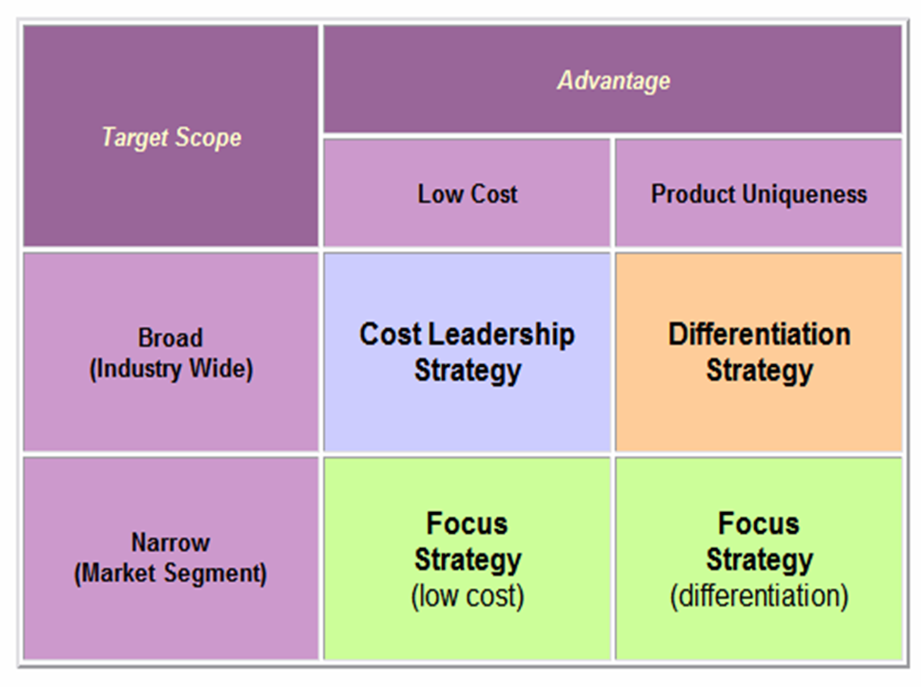
Three Generic Strategy Options

Slide 14
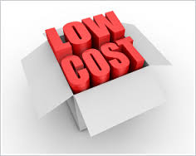

Cost Leadership
Goal: to be the low-cost producer in the industry (or market segment).
Low-cost leaders have an advantage in reaching buyers who buy on the basis of price, and they have the power to set the industry’s price floor.
Works well when:
  Buyers are sensitive to price changes.
  Competing firms sell the same commodity products.
  A company can benefit from economies of scale.
Example: JetBlue Airlines

Slide 15

Cost Leadership
WHEN A LOW-COST PROVIDER STRATEGY WORKS BEST
Price competition among rival sellers is vigorous.
Identical products are available from many sellers.
There are few ways to differentiate industry products.
Most buyers use the product in the same ways.
Buyers incur low costs in switching among sellers.
The majority of industry sales are made to a few, large volume buyers.
New entrants can use introductory low prices to attract buyers and build a customer base.

Slide 16
Cost Leadership
Securing a Cost Advantage:
  Use lower-cost inputs and hold minimal assets
  Offer only “essential” product features or services
  Offer only limited product lines
  Use low-cost distribution channels
  Use the most economical delivery methods
Cost Driver
  Is a factor with a strong influence on a firm’s costs.
  Can be asset- or activity-based.

Slide 17
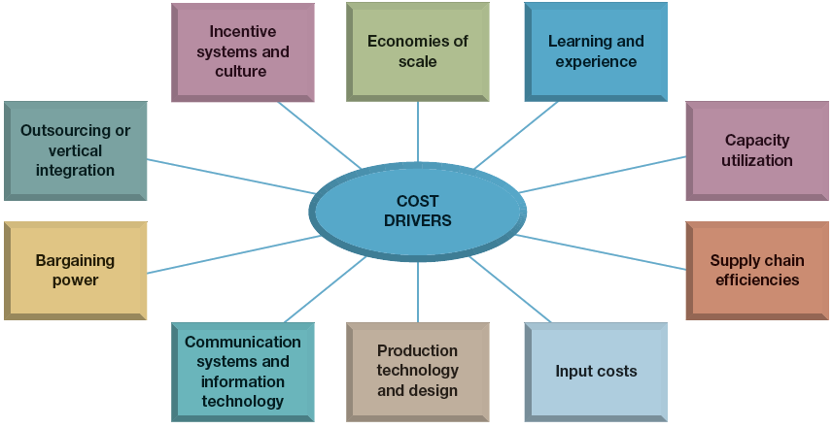
Cost Leadership
Drivers of Cost Leadership

Slide 18

Differentiation
Company seeks to build customer loyalty by positioning its goods or services in a unique or different fashion.
Idea is to be special at something customers value.
Key: Build basis for differentiation on a distinctive competence, something that the small company is uniquely good at doing in comparison to its competitors.
Examples: Outfitters and the Ice Hotel

Slide 19

Differentiation
BROAD DIFFERENTIATION STRATEGIES
Effective Differentiation Approaches:
  Carefully study buyer needs and behaviors, values and willingness to pay for a unique product or service.
  Incorporate features that both appeal to buyers and create a sustainably distinctive product offering.
  Use higher prices to recoup differentiation costs.
Advantages of Differentiation:
  Command premium prices for the firm’s products
  Increased unit sales due to attractive differentiation
  Brand loyalty that bonds buyers to the firm’s products

Slide 20
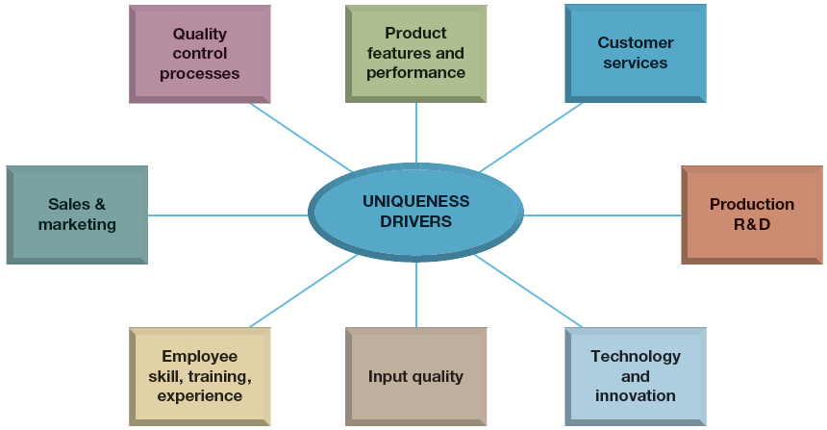
Differentiation
Keys To Create Differentiation Advantage

Slide 21
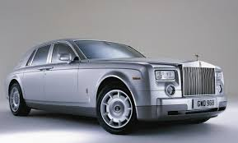

Focus
Company selects one or more customer segments in a market; identifies customers’ special needs, wants, or interests; and then targets them with a product or service designed specifically for them.
Strategy builds on differences among market segments.
Rather than try to serve the total market, the company focuses on serving a niche (or several niches) within that market.
Examples: Rolls Royce

Slide 22
Focus
WHEN A FOCUSED STRATEGY IS ATTRACTIVE
The target market niche is big enough to be profitable and offers good growth potential.
Industry leaders chose not to compete in the niche—focusers avoid competing against strong competitors
It is costly or difficult for multi-segment competitors to meet the specialized needs of niche buyers.
The industry has many different niches and segments.
Rivals have little or no interest in the target segment.

Slide 23

Step 8: Translate Strategies into Action Plans
Survey of senior executives: Companies achieved only 63 percent of the results in their strategic plans.
Create projects by defining:
  Purpose
  Scope
  Contribution
  Resource requirements
  Timing

Slide 24


Step 9: Establish Accurate Controls
Plan establishes the standards against which actual performance is measured.
Entrepreneur must:
  identify and track key performance indicators.
  take corrective action.

Slide 25

Lecture Review
Analyzing Competitors
Create Company Goals and Objectives
Formulate Strategy
Translate Strategies into Action Plan
Establishing Control

