Slide 1
Formulating the Research Design
Faisal Abbas, PhD
Lecture 8th

Slide 2
Process of Research Design
Research question will subsequently inform your;
choice of research strategy, and choices of
collection techniques,
analysis,
procedures, and
time horizon.
Research Strategy is a “general plan of how you will go about answering the research questions you have set (Saunders et al., 2007)”.
Have a look at “Research Onion” we studied before.

Slide 3
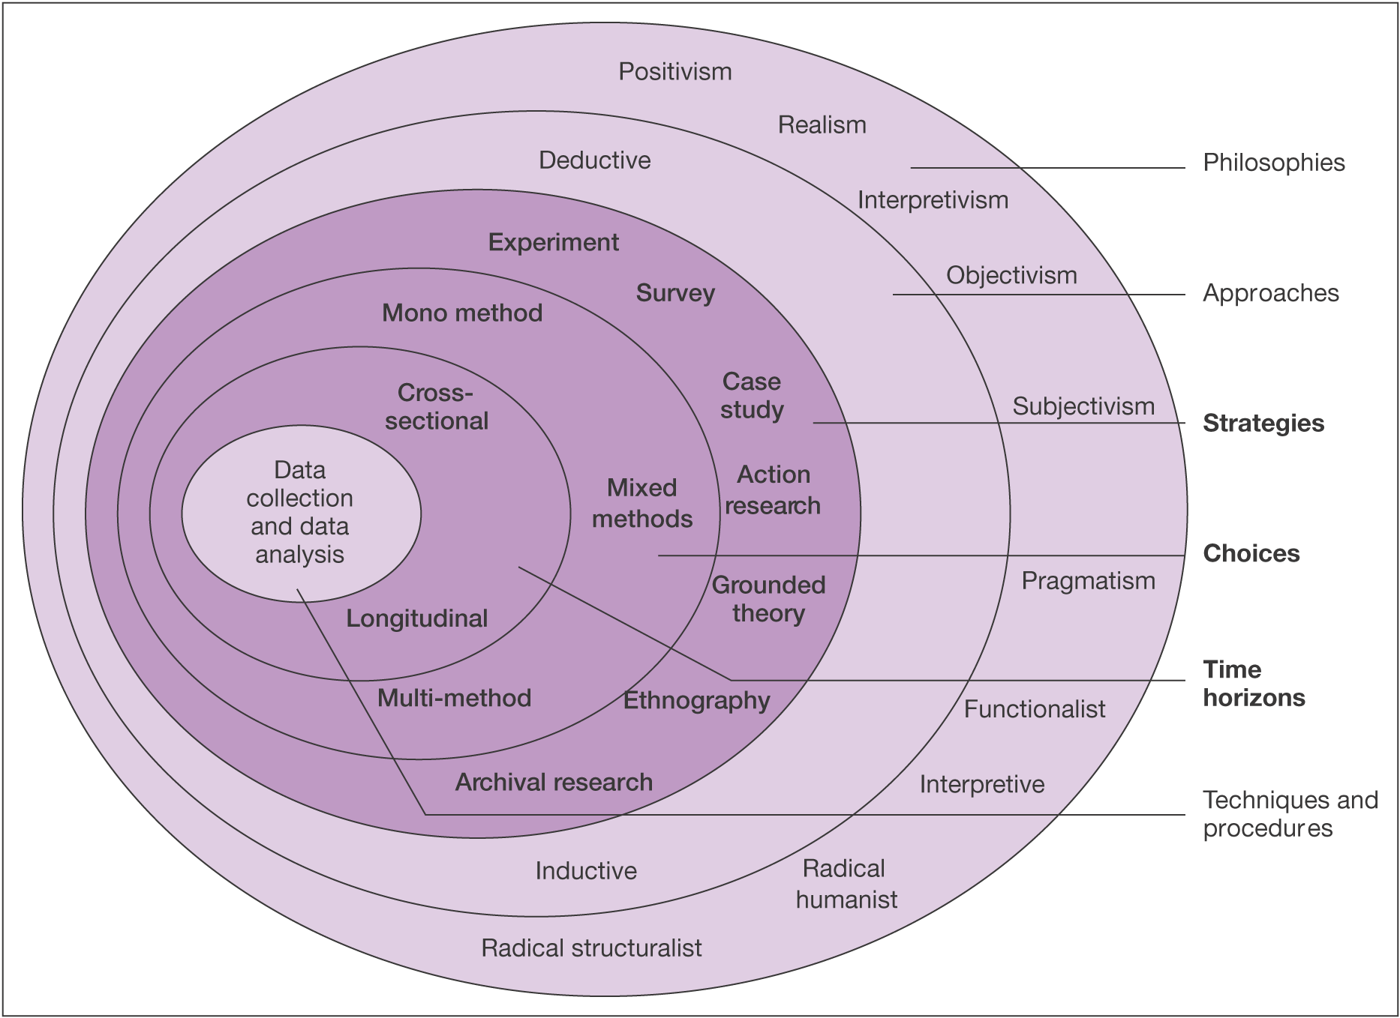
Figure : The research ‘onion’. Source: Mark Saunders, Philip Lewis and Adrian Thorn hill, 2006.

Slide 4
Contd……
What a Research Design Need ?
Objectives: Must be concise and Clear
Data Sources: Specific Sources of data and availability
Ethical Issues and Constraints: What ethical issues can hinder or come upfront of the research you are conducting as well as what type of constraints as researcher you can face.
Valid Reasons: Reasons for your choice of design for your research.

Slide 5
Research Purpose: Classifications
Exploratory Research
Valuable way of assessing phenomena in a new light; to ask questions’.
It is particularly useful to clarify understanding of a problem, if unsure of precise nature of the problem.

Slide 6
Contd……
Explanatory Research
Studies that establish causal relationships between variables may be termed explanatory research.
The emphasis is on studying a situation or a problem in order to explain the relationship between variables.
Three (3) ways of conducting explanatory research
Search of Literature
Interviewing Experts
Focus group interviews or discussions

Slide 7
Contd……
Descriptive Studies
The object of descriptive research is depicting an
accurate profile of persons, events and/or situations.
This may be an extension of, or a forerunner to a piece of exploratory research or, more often, a piece of explanatory research.
It is necessary to have a clear picture of the phenomena on which you wish to collect data prior to collection of data.

Slide 8
Research Strategies
Experiment
Survey
Action
Ethnographic
Grounded Theory
Case Study
Archival Research

Slide 9
Experimental Research
Measuring the effects of manipulating one variable on another variable.
What an Experiment involve??
Definition of a hypothesis (theoretical)
Samples from known populations
Randomness of samples
Introducing planned intervention
Measurement on a small number of dependent variables
Control of all other variables

Slide 10
Survey Research
Collection of information in standardized format from a groups of people.
Features of Survey Research
Popular in business/management research
Perceived as authoritative. For example; HOW and WHY
Allows collection of quantitative data
Data can be analysed quantitatively
Samples need to be representative
Gives the researcher independence
Structured observation and interviews can be used

Slide 11
Case Study Research
Development of detailed, intensive knowledge about a single ‘case’, or more number of related ‘cases’.
Key Features
Provides a rich understanding of a real life context
Uses and triangulates multiple sources of data
A case study can be categorised into;
single case; multiple case; holistic case and embedded case

Slide 12
Single and Multiple Case Studies
Single | Multiple
Represents a critical case or, an extreme or unique case. It may be typical provides an opportunity to observe and analyze a phenomenon that few have considered before. Inevitably, an important aspect of using a single case is defining the actual case. | Involves multiple or more than one cases. The rationale is to establish whether the findings of the first case occur in other cases and, as a consequence, the need to generalize from these findings. For this reason, Multiple case studies may be preferable to a single case study Yin (2003).

Slide 13
Holistic and Embedded Case Studies
Holistic | Embedded
Refers to the unit of analysis. For example, you may well have chosen to use an organization by which you have been employed or are currently employed as your case. If your research is concerned only with the organization as a whole then you are treating the organization as a holistic case study. | If one want to examine number of logical sub-units within the organization, perhaps departments or work groups, then your case will inevitably involve more than one unit of analysis. Regardless of the way you choose your observable units, this would be called an embedded case study

