Slide 1
Conducting and Literature Search
Lecture 7th

Slide 2
Conducting a literature search
Approaches can include
Searching tertiary literature sources
Obtaining relevant literature
Scanning and browsing secondary literature
Searching using the Internet

Slide 3
Conducting a literature search
Searching using tertiary literature
Ensure key words match controlled index language
Search appropriate printed and database sources
Note precise details used – including search strings
Note the FULL reference of each search found

Slide 4
Conducting a literature search
Printed sources
Databases – use of Boolean logic and free text searching
Scanning and browsing
Searching the Internet
Saunders et al. (2009)

Slide 5
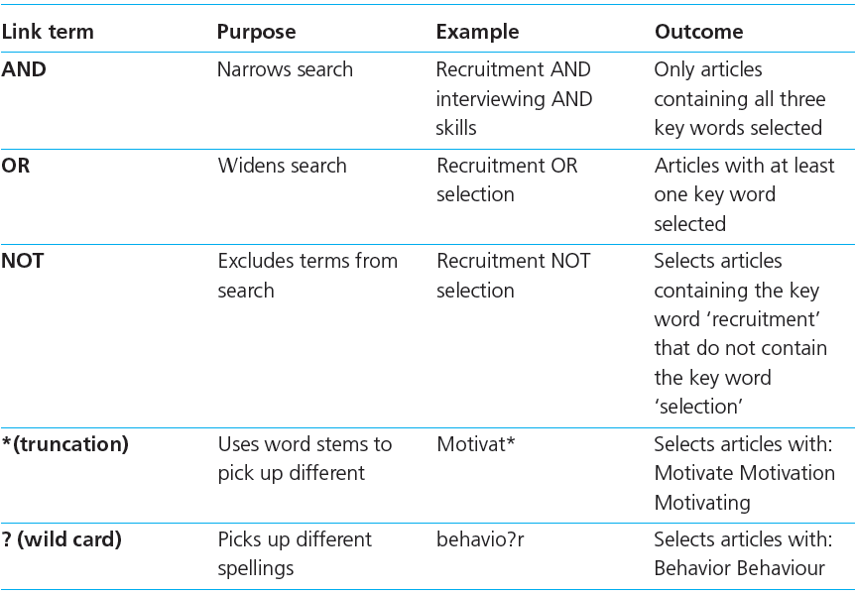
Bolean Logic: Common link terms

Slide 6
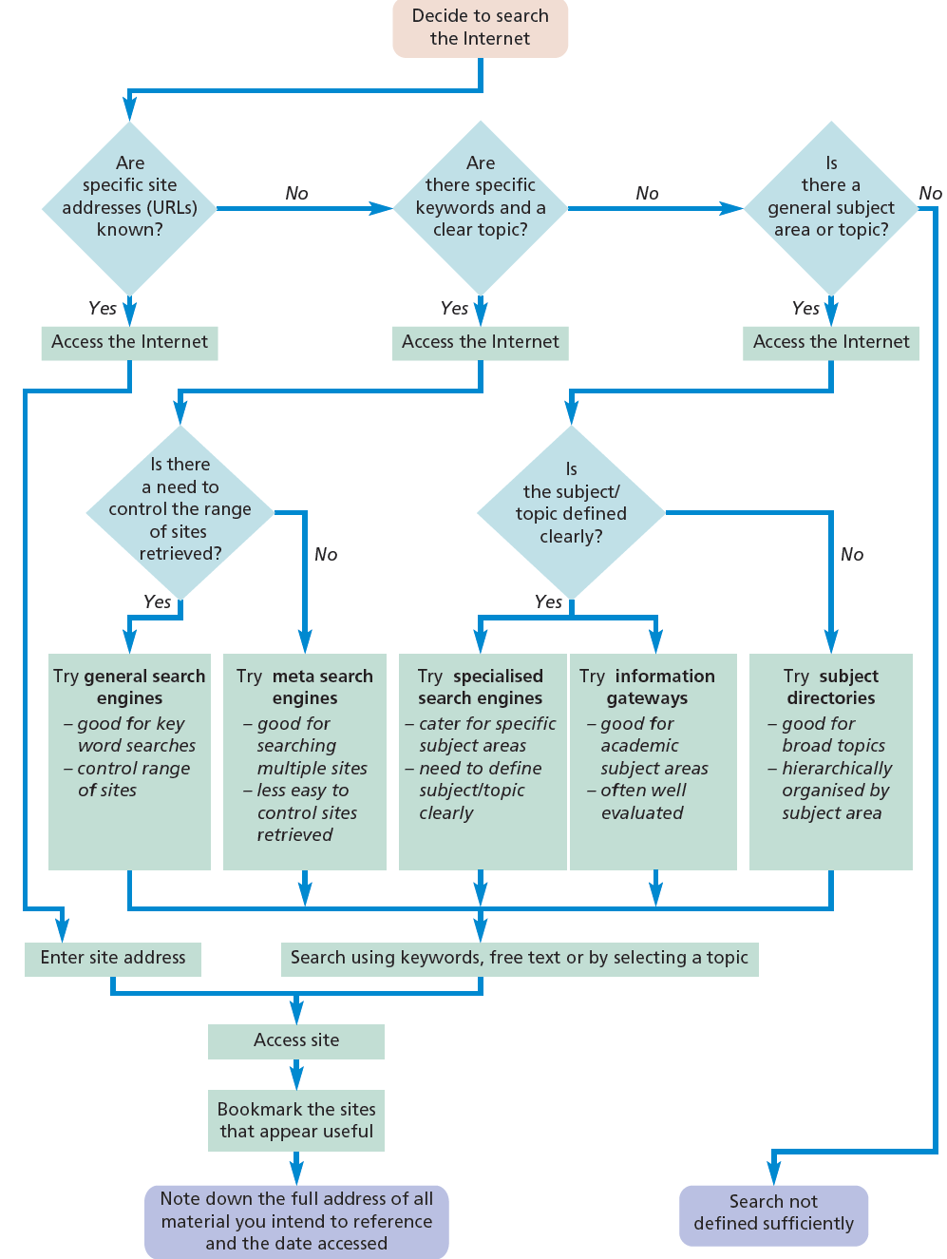

Slide 7
Evaluating the literature
Define the scope of your review
Assess relevance and value
Assess sufficiency

Slide 8
Recording the literature
Make notes for each item you read
Record –
Biographic details
Brief summary of content
Supplementary information
Sharp et al. (2002)

Slide 9
Recording the literature
Bibliographic details
Brief summary
Supplementary information
Saunders et al. (2009)

Slide 10
Summary
The critical literature review
Sets the research in context
Leads the reader into later sections of the report
Begins at a general level and narrows to specific topics

Slide 11
Summary
A literature search requires
Three main categories of sources
Clearly defined research questions and objectives
Defined parameters
Use of techniques – ( brainstorming and relevance trees)

