Slide 1
Sources of Literature
Faisal Abbas, PhD
Lecture 6th

Slide 2
Sources of Literature
Primary
Reports, Theses, Emails, Conference Proceedings, Government Publication, Unpublished manuscripts.
Secondary
Journals, books, newspapers.
Tertiary
Abstracts, Catalogues, Encyclopedia, Dictionaries, bibliographies

Slide 3
Journals: Refereed and Academic
Journals are also known as ‘periodical’ ‘serials’ and ‘magazines’ and are published on a regular basis.
Journals are a vital literature source for any research.
They are well covered by secondary literature, and good selection can be accessed from HEC digital Library for that matter (online library of HEC).

Slide 4
Journals: Refereed and Academic
Articles in refereed academic journals (e.g., The Journal of Finance) are evaluated by peers academic prior to publication, to assess their quality and suitability, they are usually written by experts in the field.
Usually contain detailed footnotes, an extensive bibliography, rigorous attention to detail and verification of information.
Written for a more narrow audience with a particular interest in the field.
The language used may be technical or highly specialized.

Slide 5
Books
Books and monographs are written for specific audiences.
Have theoretical and/or practical focus.
Book material is more ordered and accessible than in journals.
practically useful as introductory sources to help clarify your research question(s) and objectives or research methods you intend to use.

Slide 6
Why Search Strategy Planning needed ?
Because;
1). Literature search is a time consuming process
2). Beware of information over loading …..
3). Clearly defined objectives, research question(s) that are necessary to have focus.

Slide 7
Strategy of Literature Search
Note down the following;
1). Parameters
2). Keywords and search terms
3). Databases and search engines
4). Criteria of selection of relevant article
5). Discuss with your peer/ tutor and /or Supervisors !!

Slide 8
Parameters of Search Strategy
One need to be clear about;
1). Language for example English or Spanish!
2). Subject Area (Finance/Marketing/HRM)
3). Sector or particular focus (Stock exchange, Banking and/or Services etc.)
Geographical Focus (Regional, national, urban, rural, etc)
4). Literature Type (refereed journals or books )
5). Publication Period (10 years latest or 20 years etc…)

Slide 9
Keywords
Important at early stage to read both articles by key authors and recent review articles in area of your research.
This will help to define appropriate key words.
Also contain references to other work that is applicable to your research question(s) and objectives.
If you are unsure about review articles, ask your tutor/Supervisor.
Dissertations and theses in your university's library can be a potential source of references.

Slide 10
Keywords
You now need to define precisely what is relevant to your research in terms of key words.
The identification of keywords or ‘search 'terms is the most important part of planning your search for relevant literature (Bell 2005).
Key words are the basic terms that describe your research questions(s) and objectives.

Slide 11
How to minimize problems with Keywords
Spelling incorrect
use of incorrect terminology
Using recognised acronyms and abbreviations?
For example, UK for United Kingdom.
Avoiding jargon and using accepted terminology?

Slide 12
Point to Ponder
Discussion with yourself
Discussion with your tutor/supervisor
Discussion with the peers, friends and academic people

Slide 13
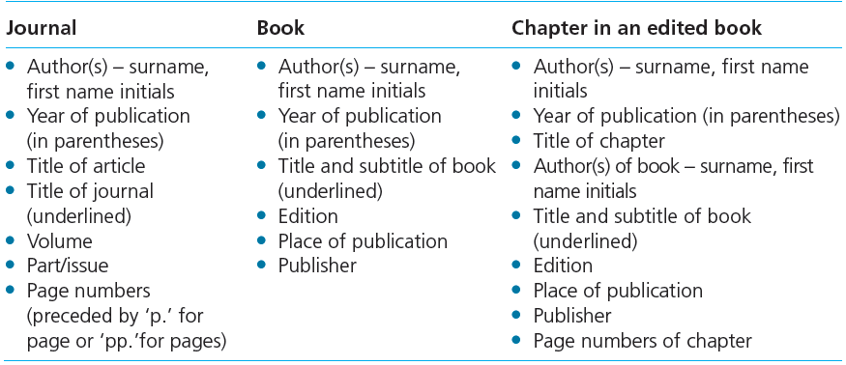
Bibliographic details

Slide 14
Plagiarism
Plagiarism can be of the following nature;
1). Stealing material from other sources
2). Submitting material not written by you
3). Copying material without quoting
4). Paraphrasing material without documentation

