Slide 1
Literature Review: Critically
Faisal Abbas, PhD
Lecture 4th

Slide 2
Why Review Literature?
To conduct a ‘preliminary’ search of existing material
To organise valuable ideas and findings
To identify other research that may be in progress
To generate research ideas
To develop a critical perspective

Slide 3
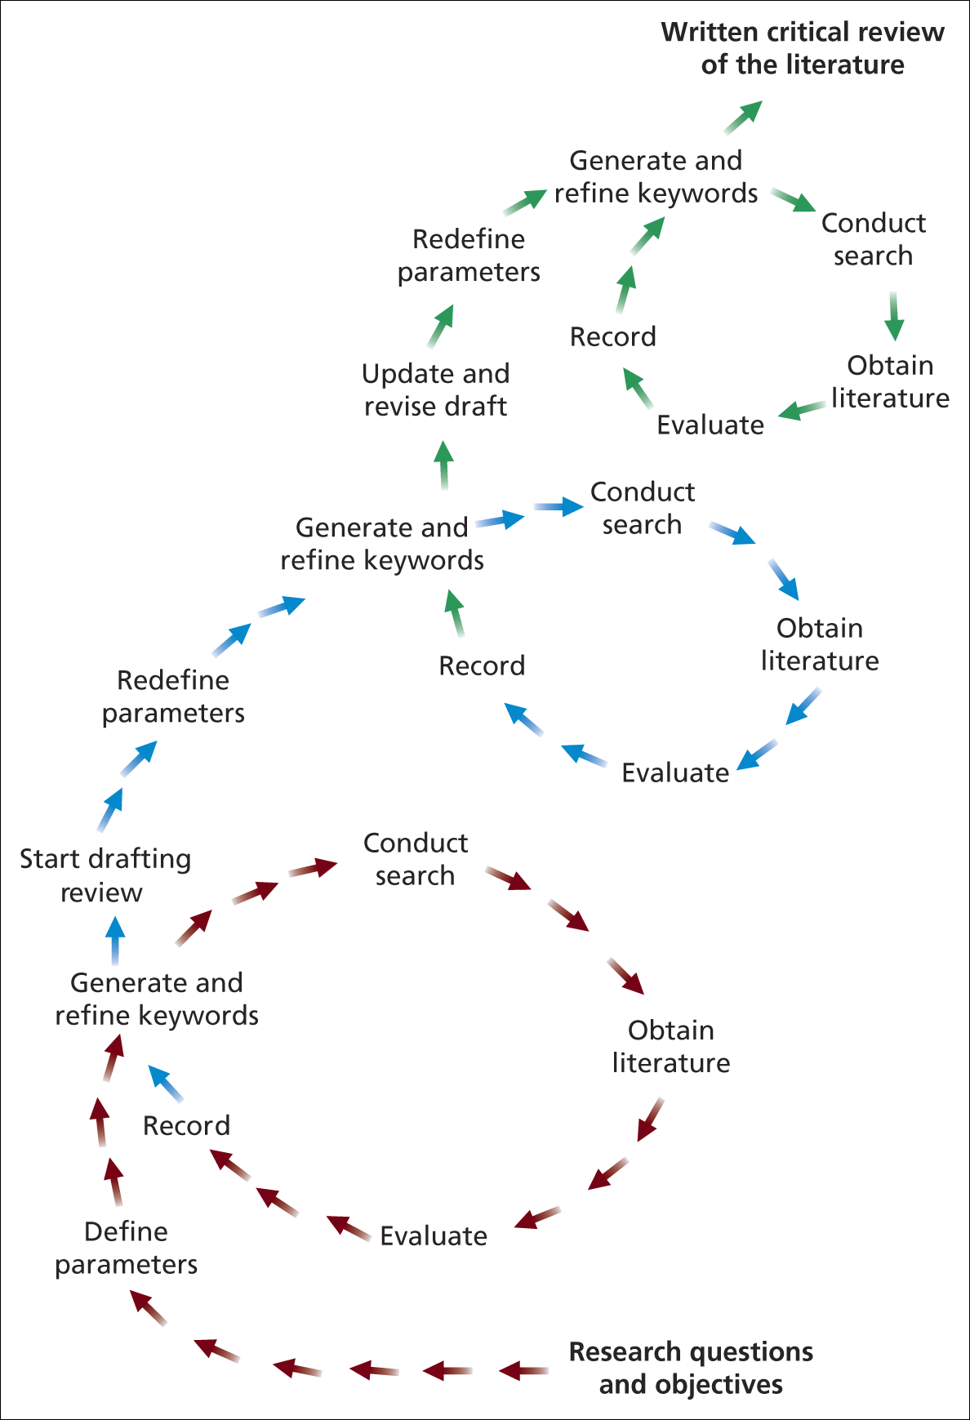
Process of Literature Review

Slide 4
Approaches
The following approaches can be used these are Deductive and Inductive.
Deductive
Develops a conceptual framework from the literature which is then tested using the data.
Inductive
Explores the data to develop theories which are then tested against the literature

Slide 5
Key Purposes of Review
To further refine research questions and objectives
To discover recommendations for further research
To avoid repeating work already undertaken
To provide insights into strategies and techniques appropriate to your research objectives

Slide 6
How to read effectively ?
Previewing
Looking around the text before you start reading in order to establish;
Its purpose and
how it may inform you about literature search
Annotating
Conducting a dialogue with yourself,
the author;
the issues and
the ideas at stake

Slide 7
How to read effectively ?
Summarising
Own words:
The best way to determine that you’ve really got the point is to be able to state it in your words.
Outlining:
the argument of text is a version of annotating, and can be done quite informally in the margins of the text
Comparing and contrasting
Ask your self how your thinking has been altered by this reading and/or
how has it affected your response to the issue and themes of your research

Slide 8
Asking Yourself?
Why am I reading this?
What the author is trying to do in writing this?
How convincing is this?
What use can I make of this reading?
Adapted from Wallace and Wray (2006)

Slide 9
Content of Critical Review
You need to include;
key academic theories
Demonstrate current knowledge of the area
Use clear referencing for the reader to find the original cited publications
Ensure that the literature have clear relation with your research question and objectives?
Acknowledge the research of others

Slide 10
Content Evaluation of Critical Literature Review
Theoretical Basis:
Covering the most relevant and significant theories in the area?
Updated coverage:
Have you included up-to-date literature?
Proper Referencing:
Have you referenced all the literature used in the format prescribed in the assessment criteria?

Slide 12
Critical Literature Review
Faisal Abbas
Lecture 4
04-03-2013

Slide 13
Writing Literature Review
It can be a single separate chapter
A series of Chapters
It can be included in the paper/dissertation / report throughout.

Slide 14
Sources of Literature
Primary
Reports, Theses, Emails, Conference Proceedings, Government Publication, Unpublished manuscripts.
Secondary
Journals, books, newspapers.
Tertiary
Abstracts, Catalogues, Encyclopedia, Dictionaries, bibliographies

Slide 15
Journals: Refereed and Academic
Journals are also known as ‘periodical’ ‘serials’ and ‘magazines’ and are published on a regular basis.
Journals are a vital literature source for any research. They are well covered by tertiary literature, and good selection can be accessed from COMSATS Library for that matter (online and Printed ) ……..

Slide 16
Contd……
Articles in refereed academic journals (such as The Journal of Finance)are evaluated by peers academic prior to publication, to assess their quality and suitability, they are usually written by experts in the field.
Usually detailed footnotes, an extensive bibliography , rigorous attention to detail and verification of information.
Written for a more narrow audience with a particular interest in the field. The language used may be technical or highly specialized.

Slide 17
Books
Books and monographs are written for specific audiences.
Have theoretical and/or practical focus.
Book material is more ordered and accessible manner than in journals,
practically useful as introductory sources to help clarify your research question(s) and objectives or research methods you intend to use.

Slide 18
Why Search Strategy Planning needed ?
Because;
1). Literature search is a time consuming process
2). Beware of information over loading …..
3). Clearly defined objectives, research question(s) that are necessary to have focus.

Slide 19
Strategy of Literature Search
Note Down the following;
1). Parameters
2). Keywords and search terms
3). Databases and search engines
4). Criteria of selection of relevant article
5). Discuss with your peer/ tutor and /or Supervisors !!

Slide 20
Parameters of Search Strategy
One need to be clear about;
1). Language for example English or Spanish!
2). Subject Area (Finance)
3). Sector or particular focus (Stock exchange, Services etc.)
Geographical Focus Regional, national, urban, rural, etc …
4). Literature Type (refereed journals or books )
5). Publication Period (10 years latest or 20 years etc…)

Slide 21
Keywords
Important at early stage to read both articles by key authors and recent review articles in area of your research .
This will help to define appropriate key words. Also contain references to other work that is applicable to your research question(s) and objectives.
If you are unsure about review articles ,Ask your tutor/Supervisor.
Dissertations and theses in your university's library can be a potential source of references.

Slide 22
Contd……
You now need to define precisely what is relevant to your research in terms of key words.
The identification of keywords or ‘research 'terms is the most important part of planning your search for relevant literature (Bell 2005).
Key words are the basic terms that describe your research questions(s) and objectives.

Slide 23
How to minimize problems with Keywords
spelling incorrect
use of incorrect terminology
Using recognised acronyms and abbreviations?
For example, UK for United Kingdom. ISI ??
Avoiding jargon and using accepted terminology?

Slide 24
Point to Ponder
Discussion with yourself
Discussion with your tutor/supervisor
Discussion with the peers, friends and academic people

Slide 25
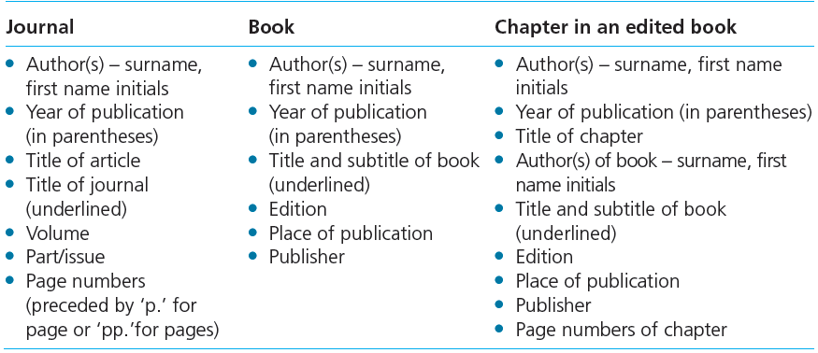
Bibliographic details

Slide 26
Plagiarism
Can be of the following nature;
1). Stealing material from other sources
2). Submitting material not written by you
3). Copying material without quoting
4). Paraphrasing material without documentation

