Slide 1
Research Methodology
Faisal Abbas, PhD

Slide 2
What is ‘Not’ Research?
Just collecting facts or information with no clear purpose;
Reassembling and reordering facts or information without interpretation
As a term to get your product or idea noticed and respected.
What is Research ?
‘that people (scientists) undertake in order to find things out in a systematic way, thereby increasing their knowledge (Saunders et al., 2009).’
“systematic” suggests that research is based on logical relationships and not just beliefs. Rainfall and election win !!
“to find out things” suggests multiplicity of possible purposes of research e.g. describing, explaining, understanding, criticizing, and analyzing.

Slide 3
The Process of Research
Stages of the research process
Formulating and clarifying a topic
Reviewing the literature
Designing the research
Collecting data
Analysing data
Writing up (Proposal, Paper or Dissertation)

Slide 4
Attributes of a Good Research Topic
Attributes of a good research topic includes;
1). Capability i.e., Is it feasible ?
Time Availability ! Can you complete the research in available time?
Will the research be current when you finish?
Financial and other resources !
Access to data ! Whether you be able to access the data?
Research Skills researcher possess! Do you have the necessary research skills?

Slide 5
2). Appropriateness
Meeting Institutional Standards! Will the examining institute's standards be met?
Theoretical Linkages! Does the topic contain issues with clear links to theory?
Clarity of Research Question(s) and Objective(s)! Are the research questions and objectives clearly stated?
Innovativeness and/or Contribution! Will the proposed research provide fresh insights into the topic?
Findings must be coherent with the analysis! Are the findings likely to be symmetrical?

Slide 6
Refining Research Idea: Delphi Technique
This involves using a group of people who are either involved or interested in the research idea to generate and choose a more specific research idea. To use this technique you need:
To brief the members of the group about the research idea;
Encourage group members to seek clarification and information;
Ask each member of the group about the justification of idea
Collect the research ideas in unedited and non-attributable form;
A second cycle of the process in which comment on the research ideas and revise them;
Subsequent cycles of the process until a consensus is reached .

Slide 7
Objective(s)
What is SMART?
Specific: What precisely do you hope to achieve from undertaking the research?
Measurable: What measures will you use to determine whether you have achieved your objectives?
Achievable: Are the targets you have set for yourself achievable given all the possible constraints?
Realistic: Given all other demands upon your time, will you have the time and energy to complete the research on time?
Timely: Will you have time to accomplish all your objectives?

Slide 8
Why reviewing Existing Literature ?
To conduct a ‘preliminary’ search of existing material
To organise valuable ideas and findings
To identify other research that may be in progress
To generate research ideas
To further refine research questions and objectives
To develop a critical perspective
To avoid repeating work already undertaken

Slide 9
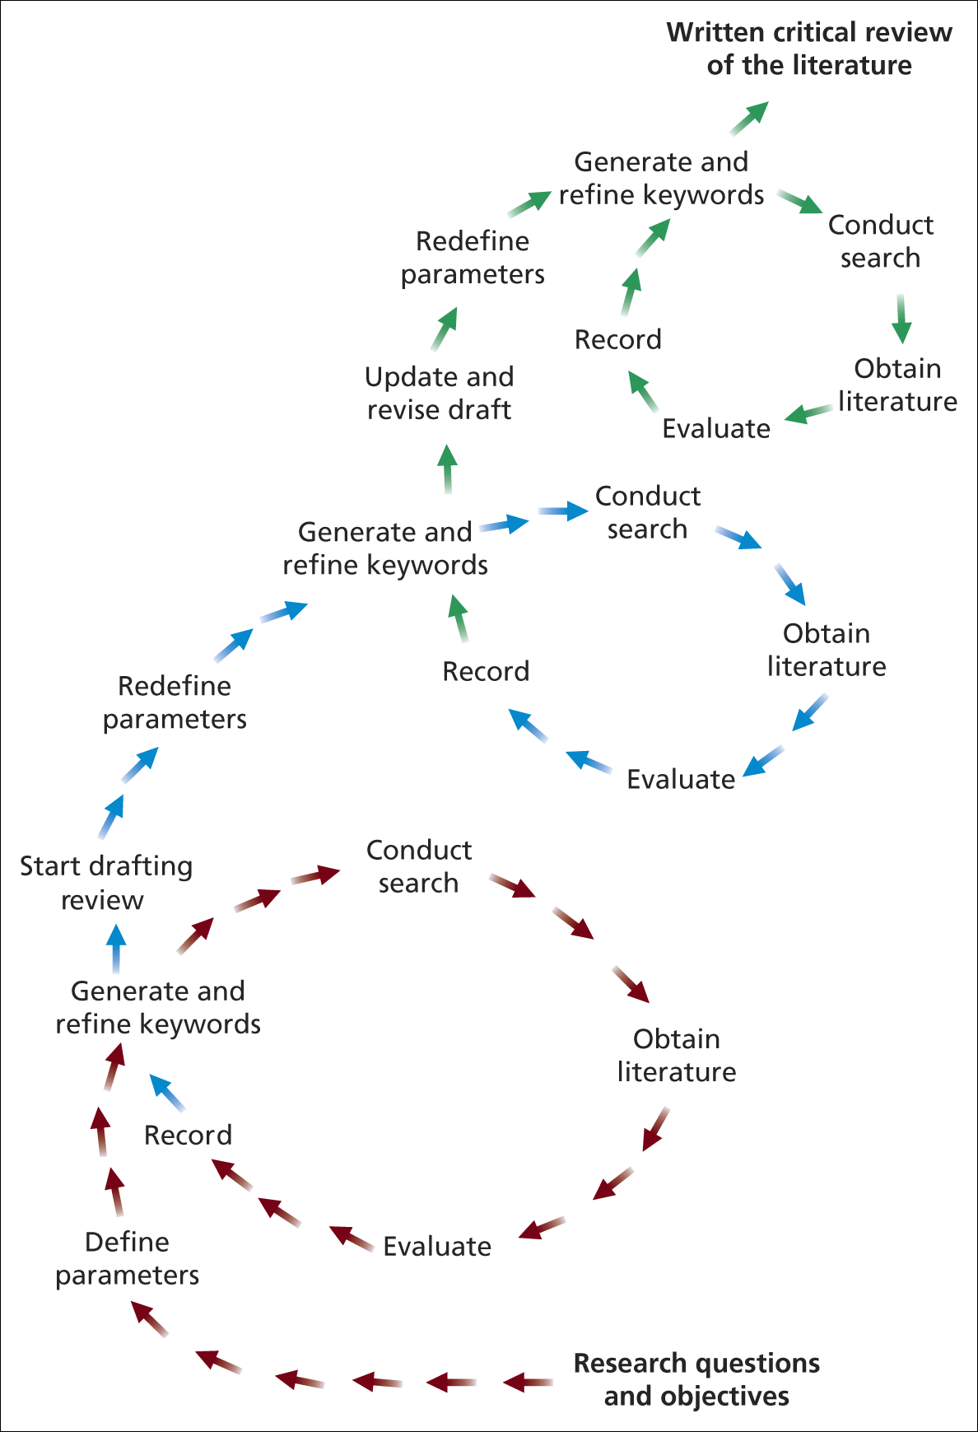
Process of Literature Review

Slide 10
How to read effectively ?
Previewing
Looking around the text before you start reading in order to establish precisely its purpose and how it may inform you literature search
Annotating
Conducting a dialogue with yourself, the author and the issues and the ideas at stake
Summarising
To determine that you’ve really got the point is to be able to state it in your words. Outlining the argument of text is a version of annotating, and can be done quite informally in the margins of the text
Comparing and contrasting
Ask your self how your thinking has been altered by this reading or how has it affected your response to the issue and themes your research

Slide 11
Sources of Literature
Primary
Reports, Theses, Emails, Conference Proceedings, Government Publication, Unpublished manuscripts.
Secondary
Journals, books, newspapers.
Tertiary
Abstracts, Catalogues, Encyclopedia, Dictionaries, bibliographies

Slide 12
Why Search Strategy Planning needed ?
Because;
1). Literature search is a time consuming process
2). Beware of information over loading …..
3). Clearly defined objectives, research question(s) that are necessary to have focus.

Slide 13
Parameters of Search Strategy
One need to be clear about;
1). Language for example English or Spanish!
2). Subject Area (Governance)
3). Sector or particular focus (Public Auditing/Cyber Crime)
4). Geographical Focus Regional, national, urban, rural, etc …
5). Literature Type (refereed journals or books )
6). Publication Period (10 years latest or 20 years etc…)

Slide 14
Plagiarism
Can be of the following nature;
1). Stealing material from other sources
2). Submitting material not written by you
3). Copying material without quoting
4). Paraphrasing material without documentation

Slide 15
Contd……
What a Research Design Need ?
Objectives: Must be concise and Clear
Data Sources: Specific Sources of data and availability
Ethical Issues and Constraints: What ethical issues can hinder or come upfront of the research you are conducting as well as what type of constraints as researcher you can face.
Valid Reasons: Reasons for your choice of design for your research.

Slide 16
Research Purpose: Classifications
Exploratory Research
Valuable way of assessing phenomena in a new light; to ask questions’.
It is particularly useful to clarify understanding of a problem, if unsure of precise nature of the problem.
Explanatory Research
Studies that establish causal relationships between variables may be termed explanatory research.
The emphasis her is on studying a situation or a problem in order to explain the relationship between variables.
Like; Inflation leads to corruption or vice versa?
Descriptive Studies
The object of descriptive research is depicting an accurate profile of persons, events &/or situations.
This may be an extension of, or a forerunner to a piece of exploratory research or, more often, a piece of explanatory research

Slide 17
Research Strategies
Experiment
Measuring the effects of manipulating one variable on another variable.
Survey
Collection of information in standardized format from a groups of people.
Ethnographic
The social world the research subject inhabits and the way they interpret it.
Grounded Theory
Theory is created from data made by a series of observations.
Case Study
Development of detailed, intensive knowledge of a single or more related ‘cases’.
Archival Research
Searching for historical records.

Slide 18
Hallmarks of Scientific Research
Purposiveness (Design)
Rigour (Validity)
Testability (method for trying or assessing)
Replicability
Accuracy
Objectivity
Generalisability
Parsimony (Cost Cutting)

Slide 19
Theoretical Framework Hypothesis Development
Observation
broad area
Preliminary
data gathering
Problem
definition
Theoretical
framework
Data collection
Analysis and
interpretation
Scientific
research design
Generation
Of hypothesis
Report
presentation
Managerial
decision
making
Deduction
hypothesis
Report
writing

Slide 20
Theoretical Framework: What and Why?
Basis of entire research.
Helps in building and identifying logical sense of the relationship among the several factors that are important to the problem.
Integrating logical beliefs with published research.

Slide 21
Theoretical Framework: What and Why?
It helps in developing a scientific basis for investigating the research problem.
Helps in testing certain relationships to improve our understanding of the situation.
Testable hypothesis can be developed

Slide 22
Theoretical Framework: What and Why?
First identify the problem and then, identify the variables that contribute to it.
Literature survey provides a solid foundation for developing a theoretical/conceptual framework.
The theoretical framework elaborates the relationships among the variables, explain the theory underlying these relations and describes the nature and direction of the relationships.

Slide 23
Theoretical Framework: What and Why?
Clarity, identification and labeling (relevance) the variables of study
The important relationships among the variables must be defined.
Give clear explanation of the existing relationships of different variables.

Slide 24
Variables
There are changeable values of any thing. (e.g. exam score)
Types of variables:
Dependent
Independent
Moderate
Intervening

Slide 25
Independent variable
It is that variable which influences the dependent variable.
Moderating Variable
It is that variables which modifies the original relationship between the independent and the dependent variables.

Slide 26
Intervening variable
It is the impact on the dependent variable caused by the independent variables influence the same.

Slide 27
Research proposal
Purpose
  Determine what the researcher wants to do?
  Why the research is important, convincing, and worth undertaking?
  How the researcher wish to undertake it?
  What benefit will result from the effort or attempt?

Slide 28
Research proposal
Elements of Research Paper/Proposal
  Introduction to area and questions
  Study objectives
  Proposed research design
  The setting of the study
  Instruments planned to be used
  A sample design and a sample size
  Outline the proposed chapters for the dissertation
  Study's problems, limitations and future areas of research
  A proposed time frame

Slide 29
What is Research Philosophy?
The development of knowledge and the nature of that knowledge (Saunders et al, 2009).

Slide 30
Aspects of Research Philosophy
There are following aspects of philosophy;
1). Positivism
This is the stance of natural scientist like Biology; Botany etc…..
2). Realism
It relates to scientific inquiry and can be
Direct and Critical Realism
3). Interpretivism
Researchers as social actors
4). Axiology
Studies judgment about values

Slide 31
Characteristics of Deduction
Deduction approach helps in;
Explaining causal relationships between variables
Establishing controls for testing hypotheses
Independence of the researcher
Concepts operationalised for quantitative measurement
Generalisation

Slide 32
Induction
It is the process of building theory by;
1). Understanding the way human build their world
2). Permitting alternative explanations of what’s going on
3). Being concerned with the context of events
4). Using more qualitative data
5). Using a variety of data collection methods

Slide 33
Deductive and Inductive Research Approaches: A Comparison
Deductive Approach
Emphasizes on scientific principles
Moving from theory to data
Explain causal relationships between variables
Collection of quantitative data
Structured approach
Independence of researcher of what is being researched

Slide 34
Inductive Approach
Understanding and gaining the meanings humans attach to events.
A close understanding of the research context
Collection of qualitative data
More flexible structure to permit changes of research emphasizes during the research process
Less concerned with the need to generalize
Realization that researcher is part of the research process

Slide 35
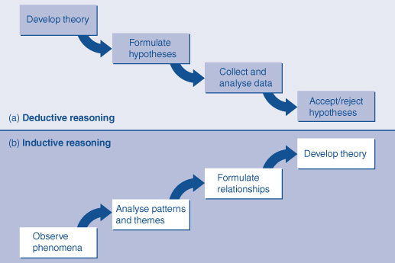
Deduction and Induction in Business Research

Slide 36
choice of Research approach
Choice of research approach helps in (Easterby-Smith et al., 2008);
Making more informed decision about the research design
Thinking which strategies will work for research topic
Adapting the research design to cater for any constraints

Slide 37
Why to do sampling?
What is Census?
What is sampling?
Sampling is a valid to a census because;
Entire population survey might be impracticable.
Budget and time constraints restrict data collection.
Need results from data collection quickly.

Slide 38
What is sampling frame ?
The sampling frame for any probability sample is a complete list of all the cases in the population from which your sample will be drawn.

Slide 39
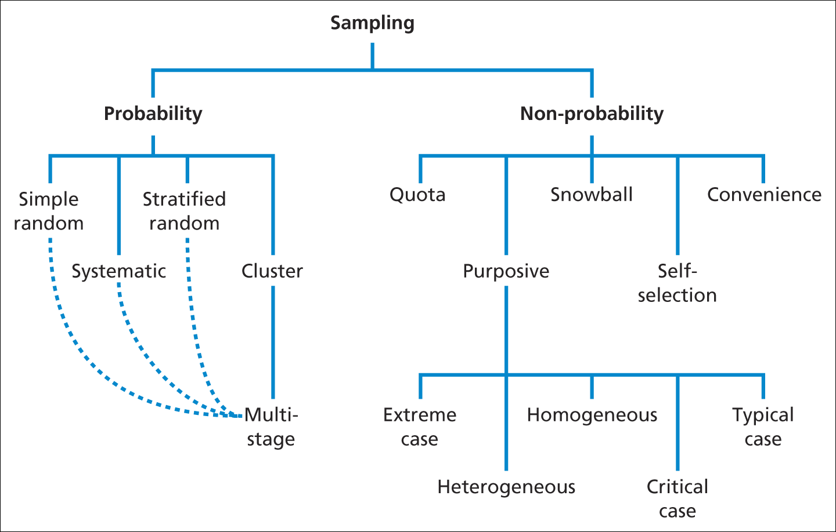
Sampling Techniques: An overview
Source: Saunders et al. (2009)

Slide 40
Probability Sampling
With probability samples the chance , or probability, of each case being selected from the population is known and usually equal to all cases.
This means that it is possible to answer research questions and to achieve objectives that require you to estimate statistically the characteristics of the population from the sample.
Consequently, probability sampling is often associated with survey and experimental research strategies.

Slide 41
Probability sampling
The probability sampling is four stage process
Identify sampling frame from research objectives
Decide on a suitable sample size
Select the appropriate technique and the sample
Check whether the sample is representative!

Slide 42
Non probability samples
The probability of each case being selected from the total population is not known.
It is impossible to answer research questions or to address research objectives that require you to make statistical inferences about the characteristics of the population.
You may still be able to generalize from non probability samples about the population, but not on statistical grounds.

Slide 43
Non Probability Sampling: Techniques
Quota sampling (larger populations)
Purposive sampling
Snowball sampling
Self-selection sampling
Convenience sampling

Slide 44
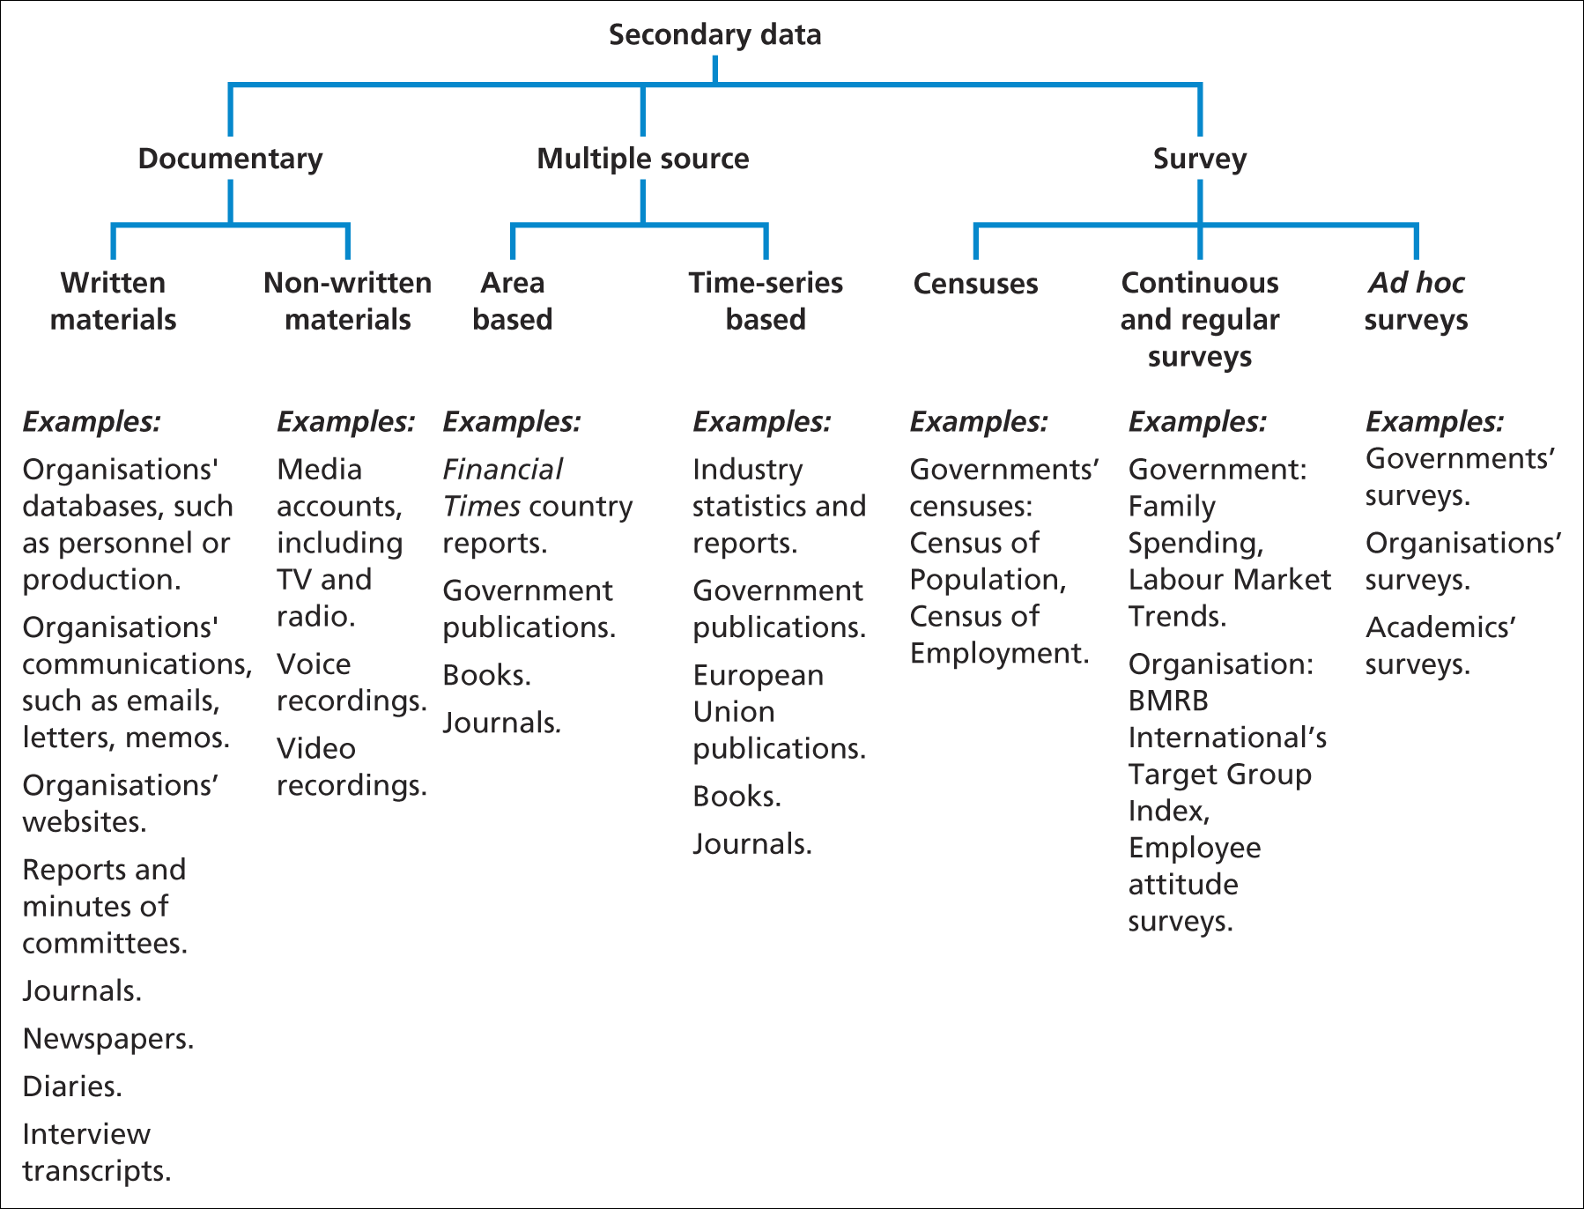
Secondary Data
Source: Saunders et al. (2006)

Slide 45
Observation: A data collection method
‘Observation involves the systematic observation, recording, description analysis and interpretation of people’s behaviour’.
Saunders et al. (2009)

Slide 46
Types of observation
There are two main types of observations;
1). Participant observation –
Emphasises the discovery of meaning attached to actions (qualitative)
2). Structured observation –
It is concerned with frequency of actions (quantitative)

Slide 47
Research Interviews
‘An interview is a purposeful discussion between two or more people’
Kahn and Cannell (1957)
Types of interview used in research are;
1). Semi-structured
2). Structured
3). In-depth
4). Group
Saunders et al. (2009)

Slide 48
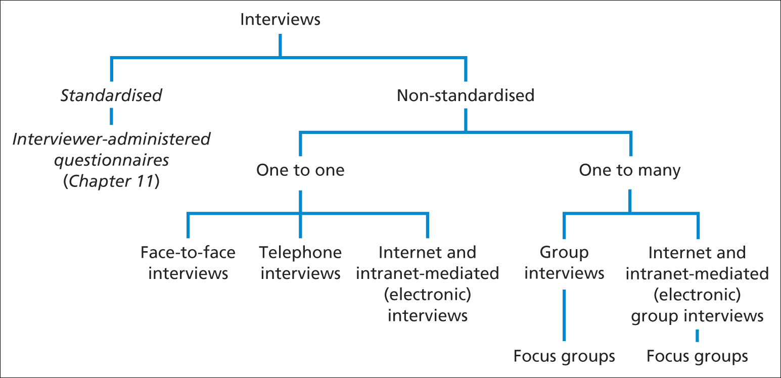
Research purpose and strategy
Forms of interview
Saunders et al. (2009)
Figure 10.1 Forms of interview

Slide 49
Types of interview
Structured interviews:
use questionnaire based on a predetermined and ‘standardized’ or identical set of questions and we refer to them as interviewer administered questionnaires.
Semi-structure interviews:
the researcher will have a list of themes and questions to be covered, although these may vary from interview to interview.
This means that you may omit some questions in particular interviews, given a specific organizational context that is encountered in relation to the research topic.
The order of questions also be varied depending on the flow of conversation.
On the other hand, additional questions may be required to explore your research question and objectives given the nature of events within particular organizations.

Slide 50
Types of interview
Unstructured interviews:
Unstructured interviews are informal.
You would use these to explore in-depth a general area in which you are interested .
We therefore, refer to these as in-depth interviews.
There is no predetermined list of questions to work through in this situation, although you need to have a clear idea about the aspect or aspects that you want to explore.
The interviewee is given the opportunity to talk freely about events behavior and beliefs in relation to topic area.

