Slide 1
Formulating and Clarifying the Research Topic
Faisal Abbas, PhD
Lecture 3rd

Slide 2
What we have already discussed?
Important steps of for formulating the topic include;
1). Attributes
Includes Capability and appropriateness meaning that whether it is feasible to conduct research and is it worthwhile to conduct research.
2). Generating Ideas
Rational and Creative thinking
Literature search and Scanning the media
Brainstorming and discussion
Exploring past projects
Keeping an “Ideas Notebook”

Slide 3
Refining Idea: Delphi Technique
To refine the research ideas we discussed about the Delphi technique.
Which is actually;
Involving a group of people who are either involved or interested in the research idea to generate and choose a more specific research idea.

Slide 4
Research questions
Write research questions that are:
Consistent with expected standards
Able to produce clear conclusions
Not too difficult: at the right level
Not too descriptive
Use the ‘Goldilocks Test’

Slide 5
What is Goldilocks Test?
Clough and Nutbrown use what they call the Goldilocks test.
Goldilocks test helps in deciding if research questions are either;
too big,
two small,
too hot
or just right.
Why it is needed to think ? Because;
a). Too big need significant funding
b). Too small are likely to be insufficient substance
c).

Slide 6
What is Goldilocks Test?
c). Too hot maybe so due to sensitivities that may be involved. This may be because of the timing of the research or that may upset key people who have a role to play.
d). Just right are those for investigation at this time by this research in this setting.

Slide 7
Turning Idea into Research
Idea: Exchange Rate Markets and Its determinants
Focus: What are the macroeconomic variables that influence exchange rate of Pakistan for a period of 1975 to 2012?
Idea: Capital Structure and Stock Return
Focus: What is the relationship of capital structure and stock return and how to analyze the determinants of capital structure and stock return of nonfinancial firms listed in KSE for the period of 2000-2012.
Idea: Carbon Emission and Financial Development
Focus: How financial market development in developing countries affect the carbon emission over a period of 50 years.

Slide 8
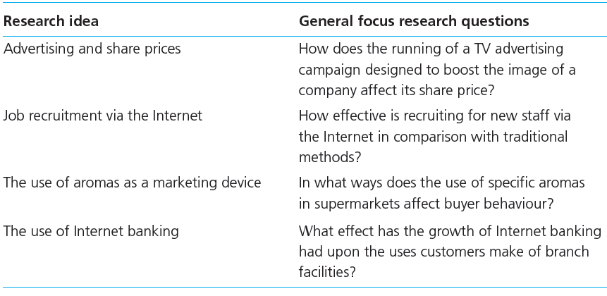
Turning Idea into Research Questions

Slide 9
Turning Idea into Research Questions
Start with a general focus question
Discuss areas of interest with your tutor/supervisor.
Writing clear research objectives
Check your examining body’s preferences for stated objectives
Use a general focus question to achieve precise objectives

Slide 10
SMART Objectives
What is SMART?
Specific: What precisely do you hope to achieve from undertaking the research?
Measurable: What measures will you use to determine whether you have achieved your objectives?
Achievable: Are the targets you have set for yourself achievable given all the possible constraints?
Realistic: Given all other demands upon your time, will you have the time and energy to complete the research on time?
Timely: Will you have time to accomplish all your objectives?

Slide 11
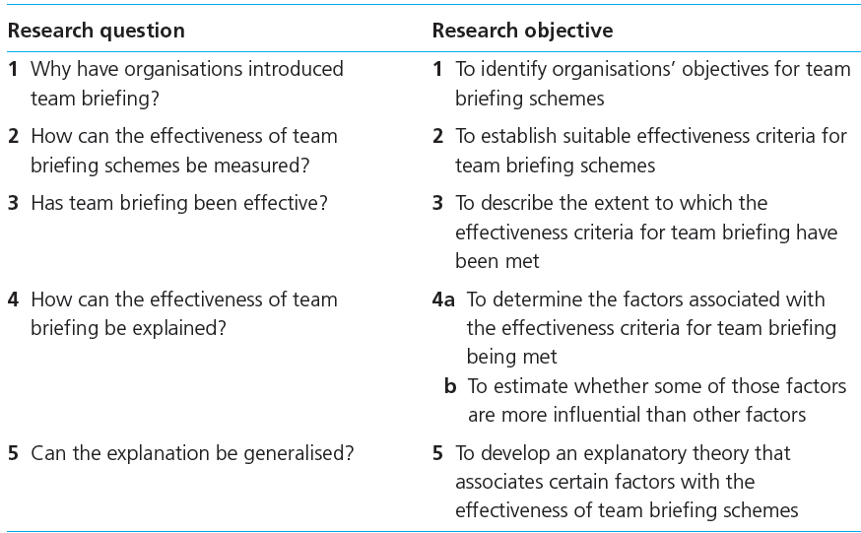
From Research Question to Objectives

Slide 12
Theory and its importance
Asking for opinions and gathering facts – 'what' questions (descriptive research)
Using questions that go beyond description and require analysis – 'why' questions.
In order to:
Explain phenomena
2) Analyse relationships
Predict outcomes
4) Compare and generalise

Slide 13
Theory and its importance
“ A formulation regarding the cause and effect relationship between two or more variables, which may or may not have been tested”

Slide 14
Typology of Theories
Grand theories:
Usually thought to be province of natural scientists . (that will lead to a whole new way of thinking about management)
Middle range theories:
which lack the capacity to change the way in which we think about the world but are nonetheless of significance. (some of the theories of human motivation well known to manager would be in this category.
Substantive theories :
that are restricted to a particular time, research setting, group or population or problem

Slide 15
Deductive and Inductive Approach
Deductive Approach
This discussion of theory dose assume that a clear theoretical position is developed prior to the collection of data.
Inductive approach
This will not always be the case. It may be that your study is based on the principle of developing theory after data have been collected

Slide 16
Writing your research proposal
Purposes
To organise your ideas
To convince your audience
To contract with your client (your tutor/supervisor)
To meet ethical requirements

Slide 17
Content of research proposal
Title - likely to change during the process
Background - context within the literature
Research questions and objectives - what you seek to achieve

Slide 18
Content of research proposal
Method - can be in two parts: research design and data collection
Timescale and Resources - (finance, data access, equipment)
References - include some key literature sources

Slide 19
Summary
Formulate and clarify the topic
Meet the requirements of the examining body
Use a variety of techniques when generating research ideas
Are focused on clear questions based on relevant literature

Slide 20
Summary
Topics of research are theory dependent
Have a proposal containing organised ideas
Must convey and tell the reader:
What will be done and why
How it will be achieved

